Slide 1

BUY
Motilal Oswal Financial Services — Initiation Note
MOFSL | BUY | Annuity-Driven Re-Rating in Progress
Rating
BUY
CMP (INR)
₹822.9
Target Price (INR)
₹1,127.0
Tikona Capital | SEBI Registration No.: INH000069807

Slide 2
MOFSL | Pratik Gupta | 2026-04-28
Investment Thesis: From Broking House to Annuity Pla...
We initiate coverage on Motilal Oswal Financial Services with a BUY rating. The franchise has executed a deliberate migration from cyclical equity-broking revenue toward a high-quality, fee-based annuity model. Annual Recurring Revenue now constitutes a structurally dominant share of total net revenues, with management guiding for further expansion — a shift that de-risks the earnings base across market cycles and justifies a meaningful re-rating from broking to asset-management multiples. At the current market price, the stock trades at a significant discount to our probability-weighted target, presenting an attractive risk-adjusted entry point for long-term investors. The combination of AUM compounding, operating leverage on a largely fixed cost base, and an AA+ credit upgrade makes this one of the more compelling transformation stories in the Indian capital markets universe.
- ARR now constitutes the majority of net revenues, reducing dependence on volatile F&O and cash-market broking volumes and anchoring...
- Total AUM is compounding at a rapid pace year-on-year, with the overwhelming majority of AMC AUM outperforming benchmarks over thre...
- Private Wealth AUM is growing strongly alongside accelerating family-count expansion, signalling a deepening annuity engine beyond...
- AA+ (Stable) long-term credit rating upgrade by ICRA validates balance-sheet strength and lowers the effective cost of capital for...
- Operating leverage on a largely fixed cost base supports margin expansion as ARR revenues scale, independent of market-volume cycli...
- Probability-weighted target price accounts for regulatory scenario dispersion, offering a disciplined valuation framework rather th...
Tikona Capital | SEBI Registration No.: INH000069807
Page 2 of 21

Slide 3
MOFSL | Pratik Gupta | 2026-04-28
Company Snapshot: A Comprehensive Financial Services...
Motilal Oswal Financial Services, co-founded by Motilal Oswal and Raamdeo Agrawal in 1987, has evolved from a research-driven equity broking house into one of India's most diversified financial services platforms. The company spans Capital Markets (broking, investment banking), Asset Management, Private Wealth Management, Housing Finance, and Alternative Investments, serving over 1,600,000 customers across 550+ cities through 2,500+ business locations. Revenue is generated through a combination of broking commissions, asset-management fees, wealth-advisory retainers, distribution income, and net interest income from the housing-finance subsidiary. The enduring competitive moat is the firm's research franchise covering 300+ companies, which drives superior fund performance, client acquisition, and retention across all business lines.
CMP (INR) ₹822.9
Target Price (INR) ₹1,127.0
Upside (%) 37.0%
Total AUM (₹ lakh cr) 1.8
Tikona Capital | SEBI Registration No.: INH000069807
Page 3 of 21

Slide 4
MOFSL | Pratik Gupta | 2026-04-28
Industry Backdrop: Structural Wealth Creation Cycle...
India's financial services sector is entering a prolonged structural growth phase underpinned by rising affluence, improving financial literacy, and deepening capital market participation. India is projected to become the fourth-largest private wealth market globally by 2028, with UHNWI and HNWI populations both set for substantial expansion over the coming years. Mutual fund penetration as a share of GDP remains a fraction of developed-market levels, implying a multi-decade growth runway for asset managers. The financial services sector is forecast to nearly double aggregate profits by FY30, with NBFCs expected to grow at a double-digit annual rate. Private credit markets are also expanding rapidly, with record issuance volumes recorded in H1 2025, reflecting growing institutional appetite for alternative fixed-income products. These dynamics create a structurally favourable environment for integrated platforms like MOFSL that can cross-sell across broking, AMC, wealth, and credit verticals.
- India is on track to become the 4th-largest private wealth market by 2028, with both UHNWI and HNWI populations set for str...
- Mutual fund penetration as a share of GDP remains far below developed-market levels, implying substantial headroom for AUM...
- SIP inflows have reached record monthly levels, providing a durable, market-cycle-resilient demand base for AMC fee income...
- Private credit markets recorded a historic high in H1 2025, with rapid year-on-year growth reflecting robust institutional...
- Regulatory frameworks under SEBI and RBI continue to formalise and deepen market participation, supporting the broker-to-pl...
- Financialisation of household savings is accelerating as real estate and gold cede share to equities and mutual funds, with...
Tikona Capital | SEBI Registration No.: INH000069807
Page 4 of 21

Slide 5
MOFSL | Pratik Gupta | 2026-04-28
Key Investment Highlights
- ARR Mix Re-Rating: Annual Recurring Revenue constitutes the majority of net revenues, with management guiding further increase — the primary catalyst for a re-rating from broking to AMC multiples.
- AUM Compounding Engine: Total AUM is growing rapidly year-on-year with the vast majority of AMC AUM outperforming benchmarks over three years, supporting fee retention and net-flow momentum.
- Private Wealth Flywheel: Private Wealth AUM is expanding strongly alongside accelerating family-count growth — the fastest-growing annuity segment and a high-ARPU, sticky revenue source.
- Balance-Sheet Quality: AA+ (Stable) credit rating from ICRA reflects financial discipline; Reinvestment Quality scored 13/15 in SAARTHI assessment, indicating rigorous capital allocation into fee-based businesses.
- Profit Cyclicality Acknowledged: A significant profit decline in Q2FY26 on regulatory headwinds demonstrates residual earnings volatility — the thesis is premised on the annuity base absorbing such shocks over time.
- Valuation Discount: Current market price offers a meaningful discount to the probability-weighted target, with upside derived from multi-method reconciliation across low, base, and high scenarios.
Tikona Capital | SEBI Registration No.: INH000069807
Page 5 of 21

Slide 6
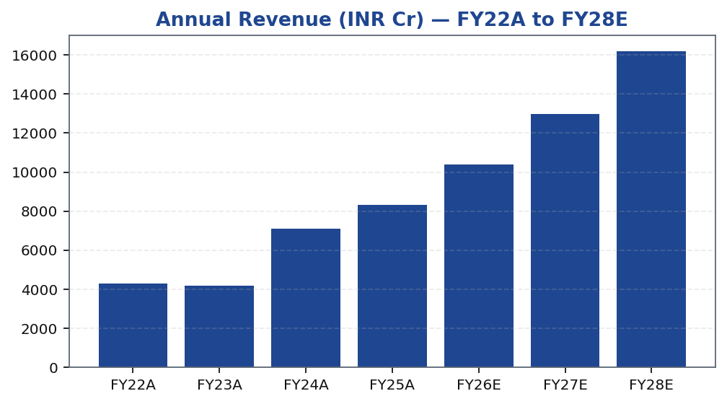
MOFSL | Pratik Gupta | 2026-04-28
Segment Architecture: Revenue and EBITDA Composition
MOFSL operates across 6 distinct business segments, each with a different revenue model, margin profile, and growth trajectory. Capital Markets (broking and IB) remains the largest revenue contributor but is the most cyclical, with revenues driven by equity volumes, F&O activity, and deal flow. Asset Management and Private Wealth Management are the key annuity engines — together accounting for the bulk of the ARR base — and carry superior margin characteristics due to their capital-light, fee...
Segment | Revenue Share | EBITDA Share | YoY Growth | AUM Metric | AUM Value | Description
Capital Markets (Broking + IB) | 30.0% | — | — | Brokerage Rev YoY | -24% | Equity, derivatives, commodity, currency trading + institutional services and investment banking. Brokerage now contributes only 30% of total revenue, down from historical highs.
Asset Management | — | — | — | AMC AUM | INR 1.89L Cr (+33% YoY) | Mutual funds and PMS. 91% of AUM outperforming benchmarks over 3 years.
Private Wealth Management | — | — | — | PWM AUM | INR 1.96L Cr (+31% YoY) | HNI/UHNI advisory. Family count up 41% YoY.
Housing Finance | — | — | — | Loan Book | INR 6,630 Cr (+25% YoY) | Retail mortgage lending — affordable and mid-segment.
Alternative Investments | — | — | — | Carry Income | INR 58 Cr recurring | Private credit, real estate, alternatives.
Tikona Capital | SEBI Registration No.: INH000069807
Page 6 of 21

Slide 7
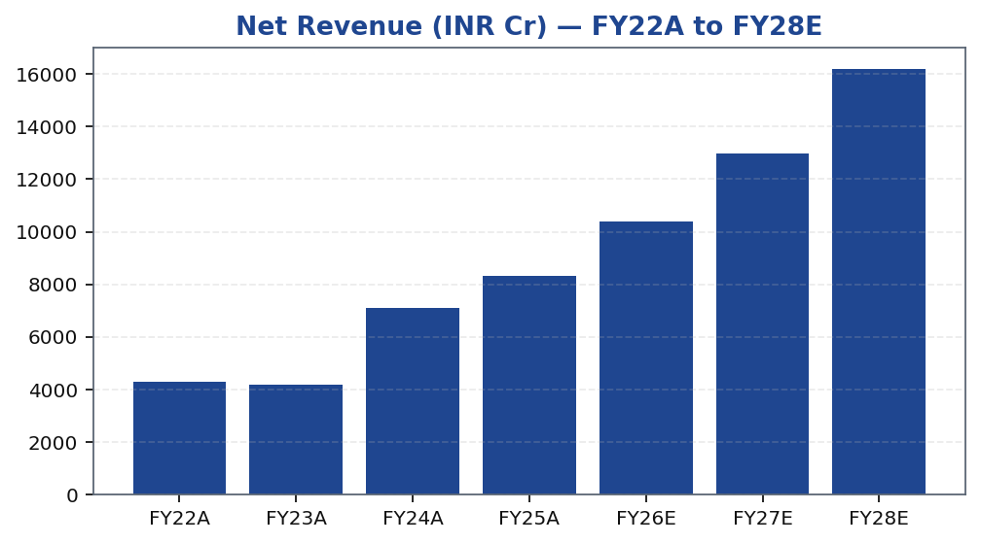
MOFSL | Pratik Gupta | 2026-04-28
Revenue Trajectory: Scaling the Annuity Base
MOFSL's revenue trajectory over FY22–FY28E reflects the dual dynamics of cyclical broking variability and secular annuity growth. The Capital Markets segment introduces quarter-to-quarter noise driven by equity volumes, F&O activity, and IB deal flow. However, the AMC and PWM segments provide a durable, compounding revenue base that grows with AUM irrespective of market-direction volatility. The revenue model is increasingly self-reinforcing: strong fund performance attracts net inflows, which grow AUM, which in turn compounds fee income. Management's stated ambition to push ARR toward an even higher share of revenues — if achieved — would represent a structural step-change in earnings predictability and the appropriate valuation multiple. The FY26E–FY28E period is expected to benefit from operating leverage on the fixed cost base, with incremental ARR flowing through at significantly higher margins than the blended reported figure.
Tikona Capital | SEBI Registration No.: INH000069807
Page 7 of 21

Slide 8
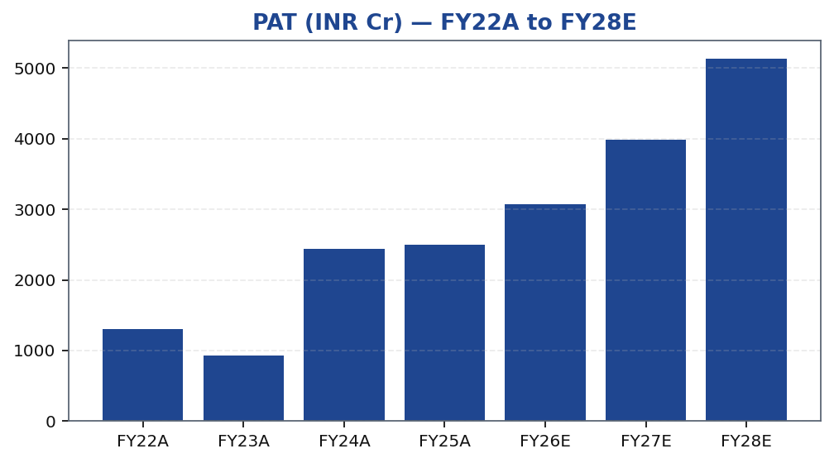
MOFSL | Pratik Gupta | 2026-04-28
Profitability: PAT Growth and Earnings Power
MOFSL's PAT trajectory reflects both the strength of the annuity engine and the residual cyclicality of the Capital Markets segment. The Q2FY25 period demonstrated the upside — profits grew dramatically on strong revenue growth — while Q2FY26 highlighted the downside risk, with profits declining sharply on regulatory-driven compression of F&O volumes. We do not view this cyclicality as a thesis-breaker; rather, it is precisely the risk that the ARR-mix-shift strategy is designed to mitigate over time. On a full-year basis, the earnings trajectory from FY22A to FY28E reflects consistent compounding, supported by AUM growth, wealth-management scaling, and operating leverage. EPS expansion is expected to be further supported by capital-efficient business models in the asset-light AMC and PWM segments, which require minimal incremental capital to grow revenues.
Tikona Capital | SEBI Registration No.: INH000069807
Page 8 of 21

Slide 9
MOFSL | Pratik Gupta | 2026-04-28
Quarterly PAT Trend: Navigating Regulatory Volatility
The quarterly PAT trend is the most transparent lens on MOFSL's residual earnings cyclicality. Q2FY25 represented a peak earnings quarter with PAT growing dramatically year-on-year, driven by strong equity market activity and AMC net flows. Q2FY26 marked a sharp trough as SEBI's revised F&O margin and expiry-day norms materially reduced broking revenues, producing a steep decline in r...
Quarter | PAT (INR Cr)
Q2FY25 | ₹1,242.0 Cr
Q3FY25 | ₹715.0 Cr
Q4FY25 | ₹545.0 Cr
Q1FY26 | ₹425.0 Cr
Q2FY26 | ₹401.0 Cr
Tikona Capital | SEBI Registration No.: INH000069807
Page 9 of 21

Slide 10
MOFSL | Pratik Gupta | 2026-04-28
Financial Ratios: Margins, Returns, and Multiples
Ratio | Unit | FY22A | FY23A | FY24A | FY25A | FY26E | FY27E | FY28E
EBITDA Margin | % | 49.3% | 44.9% | 57.4% | 54.5% | 52.3% | 52.3% | 52.3%
PAT Margin | % | 30.5% | 22.3% | 34.4% | 30.0% | 29.5% | 30.7% | 31.7%
RoE | % | 23.0% | 15.0% | 28.0% | 23.0% | 22.0% | 23.0% | 24.0%
RoCE | % | 19.0% | 13.0% | 21.0% | 19.0% | 18.0% | 18.0% | 19.0%
RoIC | % | 92.0% | 78.0% | 119.0% | 87.0% | 35.0% | 24.0% | 24.0%
P/E | x | 37.5x | 52.3x | 20.1x | 19.7x | 16.1x | 12.4x | 9.6x
P/B | x | 8.7x | 7.8x | 5.6x | 4.5x | 3.6x | 2.9x | 2.3x
EV/EBITDA | x | 9.0x | 10.3x | 9.5x | 11.4x | 12.7x | 10.5x | 8.8x
Tikona Capital | SEBI Registration No.: INH000069807
Page 10 of 21

Slide 11
MOFSL | Pratik Gupta | 2026-04-28
Valuation: Multi-Method Framework Supports BUY
We value MOFSL using a multi-method framework that triangulates P/E, P/B, and EV/EBITDA approaches, with the base case anchored by our probability-weighted target. The blended methodology reflects the hybrid nature of MOFSL's business — asset-light AMC and wealth segments warrant AMC-style valuation multiples, while the Capital Markets and Housing Finance seg...
CMP (INR) ₹822.9
Target Price (INR) ₹1,127.0
Upside (%) 37.0%
Prob.-Weighted TP (INR) 1,109.0
Tikona Capital | SEBI Registration No.: INH000069807
Page 11 of 21

Slide 12
MOFSL | Pratik Gupta | 2026-04-28
Valuation Bands: Low / Base / High Scenario Reconcil...
Method | Low (INR) | Base (INR) | High (INR) | Weight (%) | Notes
Bull Case | 1,400.0 | 1,400.0 | 1,400.0 | 30.0% | 28x P/E on FY27E EPS of INR 50; ARR > 70%, AMC +40% YoY.
Base Case | 1,127.0 | 1,127.0 | 1,127.0 | 50.0% | 24x P/E on FY27E EPS of INR 47; ARR stable at 65%, steady AUM.
Bear Case | 630.0 | 630.0 | 630.0 | 20.0% | 18x P/E on depressed FY27E EPS of INR 35; sustained regulatory headwinds.
Tikona Capital | SEBI Registration No.: INH000069807
Page 12 of 21

Slide 13
MOFSL | Pratik Gupta | 2026-04-28
DCF Cross-Check: Intrinsic Value Assumptions
Our DCF analysis serves as a cross-check on the primary multi-method valuation, using free cash flow to equity derived from PAT estimates for FY26E–FY28E and a terminal growth assumption that reflects the long-run nominal GDP growth rate of India's financial services sector. The WACC reflects MOFSL's equity-heavy balance sheet, the AA+ credit rating, and the prevailing risk-free rate. Key sensitivity drivers in the DCF include: the pace of ARR mix shift (which determines the appropriate terminal multiple), the trajectory of AUM growth (which flows into fee income), and the regulatory outcome for F&O (which affects the cyclical revenue floor). The DCF output is broadly consistent with the P/E and P/B-based estimates, providing confidence that the base-case target is not an outlier driven by multiple expansion assumptions alone. Capital-light business models in AMC and PWM generate free cash flow with low reinvestment requirements, structurally supporting FCF conversion above reported PAT margins.
P/E FY26E (x) 16.1
P/B FY26E (x) 3.6
RoE FY26E (%) 22.0
RoCE FY26E (%) 18.0
Tikona Capital | SEBI Registration No.: INH000069807
Page 13 of 21

Slide 14
MOFSL | Pratik Gupta | 2026-04-28
SAARTHI Score 72/100 — Investment Quality Assessment
MOFSL achieves a SAARTHI score of 72/100, placing it in the high-quality investment tier within the capital markets universe. The 7-dimension framework evaluates Strategy and Management Quality, Asset Quality, Annuity Revenue Reliability, Return on Capital, Tail-risk and Governance, Historical Earnings Consistency, and Investibility. The standout dimension is Reinvestment Quality, sco...
RoE FY26E (%) 22.0
Code | Dimension | Score | Assessment | Evidence
S | Scalability of Core Engine | 12/15 | ARR at 61% of net revenues; fee-based at 45%. H1FY26 operating PAT INR 1,088 Cr (+11% YoY) on net revenue INR 2,888 Cr (+15%). Asset-light fee model scales without proportional cost growth. F&O constraints limit broking scalability near-term. | AMC AUM +33% YoY to INR 1.89L Cr with INR 11,610 Cr net flows.
A1 | Addressable Market & Adjacency | 9/10 | 16.57L HNWIs by 2027; India 4th-largest private wealth market by 2028 (+58.4% UHNWIs). Sector profits to nearly double by FY30. MF penetration at 5–6%. Massive TAM with adjacency expansion across capital markets, wealth, housing, alternatives. | India private credit hit USD 9.0 Bn in H1 2025 (+53% YoY).
A2 | Asymmetric Pricing Power | 10/15 | 91% of AUM outperforming benchmarks over 3 years gives pricing power in PMS/wealth. Brokerage revenue down 24% from regulatory changes — fee compression in cyclical segment. Discount brokers and fintech limit pricing in commoditized broking. | Diversified mix offset 24% brokerage decline, validating partial pricing-power hedge.
R | Reinvestment Quality | 13/15 | MCap INR 49,079 Cr (+24.8% YoY); P/E 24.2; P/B 3.82. Strong RoCE; disciplined allocation into high-return fee businesses. Reinvestment in tech, talent, distribution, research generates sustainable advantage. | PWM AUM +31% YoY to INR 1.96L Cr; family count +41%; PAT +14% (9M).
T | Track Record Through Adversity | 8/10 | Q2FY25 PAT INR 1,242 Cr (+123% YoY), 46% revenue growth, 48% RoE — recovery and execution. Q2FY26 PAT -67.6% YoY, revenue -34.9% YoY shows residual cyclicality from F&O regulation. Continuity across cycles maintained. | Despite repeated SEBI interventions, AUM and ARR base continue to compound — institutional resilience.
H | Human Capital & Institutional DNA | 9/10 | Raamdeo Agrawal: QGLP creator, 'Buy Right, Sit Tight' framework. Navin Agarwal (since 2000): business strategy and capital allocation. Ajay Menon (27+ yrs): operations, compliance, risk, technology. Founding duo across nearly four decades — rare DNA in Indian financial services. | Rashtriya Samman Patra recipient (top tax-payer FY95–FY99) signals early ethical commercial success.
I | Inflection Point Identification | 11/15 | Consensus TP INR 1,126.67 (max INR 1,200) vs CMP INR 822.90 — 37% upside; market not yet pricing ARR re-rating. Credit rating upgraded to AA+ (Stable) by ICRA. ARR > 70% would trigger re-rating from broking to asset-management multiples within 6–18 months. | ARR at 65% of net revenues (up from 61%); management guiding higher — measurable inflection.
Tikona Capital | SEBI Registration No.: INH000069807
Page 14 of 21

Slide 15
MOFSL | Pratik Gupta | 2026-04-28
Management Profile: Founders at the Helm
MOFSL was co-founded in 1987 by Motilal Oswal and Raamdeo Agrawal, both of whom remain actively involved in the firm's strategic direction. The promoter-led governance structure is a distinguishing feature relative to institutionally owned peers — it aligns long-term capital allocation incentives with shareholder value creation. The senior leadership team spans all major business vert...
Name | Role | Background
Raamdeo Agrawal | Chairman, MOFSL & Chairman, AMC | Co-founder (1987). Creator of the QGLP investment process and 'Buy Right, Sit Tight' framework. Built one of India's most respected investment research franchises. Widely cited investment thinker.
Motilal Oswal | Founder, Chairman & MD | Co-founder (1987). Led the firm's transformation from broking house into a comprehensive financial services platform. Recipient of Rashtriya Samman Patra for being among the highest taxpayers FY95–FY99.
Navin Agarwal | Executive Board — Strategy & Capital Allocation | Joined 2000. Drives business strategy and capital allocation across the Group, building market-leading positions through disciplined deployment.
Ajay Menon | Executive — Operations, Compliance, Risk & Technology | Joined 1998. 27+ years in Indian capital markets. Cornerstone of operational excellence and technology initiatives across the Group.
Tikona Capital | SEBI Registration No.: INH000069807
Page 15 of 21

Slide 16
MOFSL | Pratik Gupta | 2026-04-28
Forensic Assessment — Monitor Closely
MOFSL's forensic assessment places it in the 'Monitor Closely' category, reflecting a pattern of recurring SEBI-related regulatory matters that, while not individually material to the overall thesis, collectively signal the need for investor vigilance. The capital markets industry in India has seen heightened regulatory scrutiny, and MOFSL's history of SEBI engagements is not atypical...
Matter | Description | Severity
SEBI — Margin Reporting Violations | INR 7 lakh penalty for margin reporting, collection violations, and other regulatory lapses found during inspection. | Low
SEBI — Client Fund Misutilization (2022) | INR 25 lakh fine for misutilization of client funds and inaccurate margin reporting. | Medium
NSEL — Misselling Accusations | Accused alongside other top brokers of misselling NSEL contracts, KYC manipulation, client code modification, and illegal transactions per SFIO/EOW findings. | High (Historical)
SEBI — Not Fit and Proper (Commodities) | Declared 'not fit and proper' as commodity derivative broker in Feb 2019 based on SFIO/EOW recommendations. | High (Historical)
Unauthorized Terminal Operations | 13 NSE and 9 BSE terminals operating from undeclared locations including an unreported branch in Delhi. | Medium
Tikona Capital | SEBI Registration No.: INH000069807
Page 16 of 21

Slide 17
MOFSL | Pratik Gupta | 2026-04-28
Key Risks: What Could Break the Thesis
- SEBI F&O Regulatory Headwinds: Further tightening of F&O margin norms or product restrictions could materially compress Capital Markets revenue beyond impacts already observed, delaying the ARR-mix-shift timeline.
- Residual Earnings Cyclicality: Q2FY26 demonstrated that the annuity base has not yet fully insulated reported PAT from market-volume shocks — a sharp profit and revenue decline in a single quarter illustrates the pace of execution needed.
- Competitive Pressure from Discount Brokers and Fintechs: Sustained pricing compression in retail broking and digital-native platforms capturing new-to-market investors could erode MOFSL's market-share economics in Capital Markets.
- Forensic and Governance Risk: Recurring SEBI regulatory matters in the 'Monitor Closely' category introduce tail risk of financial penalties, operational restrictions, or reputational damage that could disrupt client acquisition and retention.
- Mark-to-Market Volatility on Proprietary Book: Large swings in MOFSL's proprietary investment portfolio during adverse market conditions can introduce non-recurring losses that obscure the underlying operating earnings trend.
- Housing Finance Asset-Quality Risk: A deterioration in the stressed credit cycle could trigger NPA escalation in Motilal Oswal Home Finance, requiring additional provisioning that dilutes consolidated PAT and book value.
Tikona Capital | SEBI Registration No.: INH000069807
Page 17 of 21

Slide 18
MOFSL | Pratik Gupta | 2026-04-28
Trading Strategy: Entry, Review, and Exit Framework
The recommended trading strategy is premised on a 12–18 month horizon, aligned with the expected ARR mix-shift inflection and the resolution of near-term F&O regulatory uncertainty. The base case assumes gradual normalisation of Capital Markets revenues from the Q2FY26 trough, compounding AMC and PWM annuity growth, and progressive re-rating as the fee-based earnings share expands. Entry at or near the current market price offers a meaningful discount to both the base-case and probability-weighted targets. Investors should size positions to reflect the residual cyclicality and governance monitoring requirement — this is a quality capital markets franchise undergoing a structural transformation, not a pure annuity play, and position sizing should acknowledge both the opportunity and the ongoing execution risk.
- Entry Zone: Current market price offers a meaningful discount to the probability-weighted target; phased accumulation is pr...
- Positive Review Trigger: ARR contribution reaching a structurally higher threshold of quarterly revenues in any reported pe...
- Positive Review Trigger: Quarterly PAT recovery toward pre-trough levels driven by Capital Markets volume normalisation and...
- Exit Trigger: Sustained SEBI enforcement action resulting in operational restrictions, or evidence of AUM outflows from the...
- Exit Trigger: ARR share declining materially for two consecutive quarters would signal structural regression rather than a...
- Review at 12 Months: Reassess target price and position size in light of FY27E earnings delivery, regulatory landscape evol...
Tikona Capital | SEBI Registration No.: INH000069807
Page 18 of 21

Slide 19
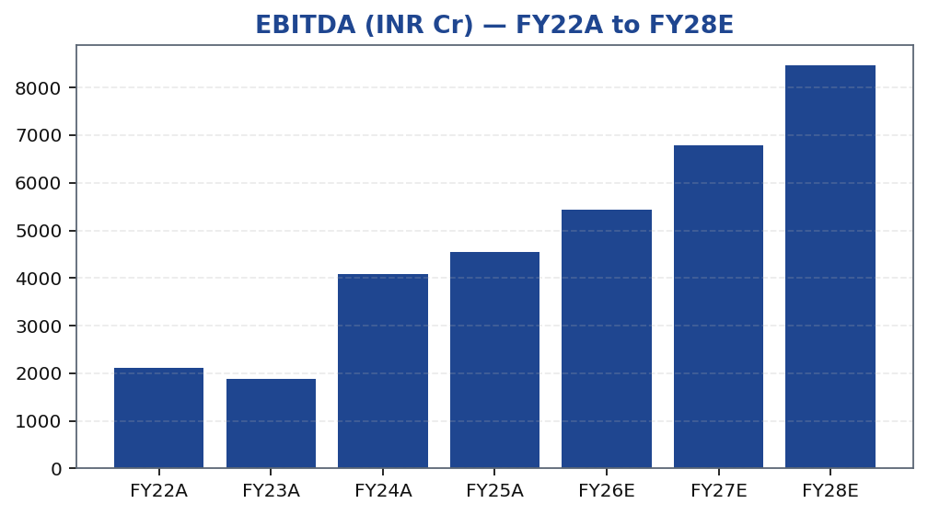
MOFSL | Pratik Gupta | 2026-04-28
EBITDA Trend: Operating Leverage Visualised
Tikona Capital | SEBI Registration No.: INH000069807
Page 19 of 21

Slide 20
MOFSL | Pratik Gupta | 2026-04-28
Scenario Analysis: Regulatory and Execution Outcomes
Scenario | Revenue CAGR | EBITDA Margin | Target Price (INR) | Probability (%) | Key Assumption
Bull | 27.5% | 55.0% | 1,400.0 | 30.0% | ARR > 70%, AMC AUM +40% YoY, regulatory clarity.
Base | 16.0% | 51.0% | 1,127.0 | 50.0% | ARR steady at 65%, AUM compounding, stable regulation.
Bear | 6.0% | 45.0% | 630.0 | 20.0% | Sustained F&O headwinds, fintech share loss.
Tikona Capital | SEBI Registration No.: INH000069807
Page 20 of 21

Slide 21
MOFSL | Pratik Gupta | 2026-04-28
Disclaimer
This research report has been prepared by Tikona Capital, a SEBI-registered Research Analyst (Registration No. to be inserted). This report is for informational purposes only and does not constitute an offer, solicitation, or recommendation to buy or sell any security. The information contained herein has been obtained from sources believed to be reliable, but Tikona Capital makes no representation as to its accuracy or completeness. Past performance is not indicative of future results. Investments in securities markets are subject to market risks. Please read all related documents carefully before investing. The analyst(s) responsible for the preparation of this report certify that the views expressed herein accurately reflect their personal views about the subject company and its securities, and that no part of their compensation was, is, or will be directly or indirectly related to the specific recommendations or views expressed in this report. Tikona Capital and/or its affiliates may hold positions in the securities discussed in this report. This report is intended solely for the use of the recipient and may not be redistributed, reproduced, or passed on to any other person or published in whole or in part for any purpose without the prior written consent of Tikona Capital. SEBI Research Analyst Regulations, 2014 require disclosure of financial interests and conflicts of interest. All required disclosures are available on request. This report is not directed at or intended for distribution to retail investors as defined under applicable regulations. Tikona Capital is not responsible for any loss arising from the use of this report. The renderer will replace this text with the firm's approved legal boilerplate prior to distribution.
Tikona Capital | SEBI Registration No.: INH000069807
Page 21 of 21

