Slide 1

BUY
Motilal Oswal Financial Services — Initiation Note
MOFSL | BUY | Tikona Capital Equity Research
Rating
BUY
CMP (INR)
₹822.9
Target Price (INR)
₹1,127.0
Tikona Capital | SEBI Registration No.: INH000069807

Slide 2
MOFSL | Pratik Gupta | 2026-04-28
Investment Thesis: Annuity Re-Rating in Motion
We initiate coverage on Motilal Oswal Financial Services with a BUY rating. The investment case rests on a structural shift in revenue mix: Annual Recurring Revenue now constitutes the majority of total net revenues, and management has guided for further increases, fundamentally recharacterising the earnings base from cyclical to annuity-driven. This transition is not yet reflected in the market price, which continues to apply broking-house multiples to a business whose Asset and Wealth Management segments are compounding AUM at rates well above the industry. The combination of rising ARR contribution, a category-leading benchmark outperformance record, an AA+ credit upgrade, and an expanding Private Wealth client franchise creates a multi-year compounding opportunity. The current price offers meaningful upside to our probability-weighted target derived from scenario analysis across base, bull, and bear regulatory outcomes.
- ARR mix is now the majority of net revenues and rising, structurally de-risking the earnings base from F&O regulatory cycles and ma...
- Total AUM is compounding materially above industry, with the vast majority of AMC AUM outperforming benchmarks over a 3-year period...
- Private Wealth AUM and family count are both expanding rapidly, adding a high-ARPU annuity layer that is underpenetrated relative t...
- ICRA upgrade to AA+ (Stable) endorses balance-sheet strength, reduces funding cost, and expands reinvestment optionality into fee-b...
- Operating leverage inherent in a largely fixed cost base should amplify margin expansion as ARR revenues scale, driving ROE higher...
- Probability-weighted target brackets regulatory scenarios, providing a disciplined view that accounts for residual F&O headwinds al...
Tikona Capital | SEBI Registration No.: INH000069807
Page 2 of 21

Slide 3
MOFSL | Pratik Gupta | 2026-04-28
Company Snapshot
Motilal Oswal Financial Services was co-founded in 1987 by Motilal Oswal and Raamdeo Agrawal as a research-driven equity broking house, and has since evolved into one of India's most diversified financial services platforms. Revenue is generated across 4 primary segments: Capital Markets (broking, distribution, investment banking), Asset Management (mutual funds, PMS), Private and Institutional Wealth Management, and Housing Finance. The firm serves over 1,600,000 customers across 550+ cities through a network of 2,500+ business locations. Research coverage of 300+ companies constitutes an enduring competitive moat, differentiating MOFSL from discount platforms and sustaining premium client retention. The ongoing shift toward fee-based businesses is the primary earnings-quality lever being tracked by the market.
CMP (INR) ₹822.9
Target Price (INR) ₹1,127.0
Upside (%) 37.0%
Total AUM (₹ lakh cr) 1.8
Tikona Capital | SEBI Registration No.: INH000069807
Page 3 of 21

Slide 4
MOFSL | Pratik Gupta | 2026-04-28
Key Highlights
- ARR Dominance: Annual Recurring Revenue has crossed the majority of total net revenues, structurally changing the earnings character of MOFSL from a cyclical to a compounding franchise.
- AUM Compounding: Total AUM is growing above industry rates with the vast majority of AMC AUM outperforming benchmarks over a 3-year period, reinforcing net-flow and fee-retention durability.
- Wealth Engine: Private Wealth AUM is expanding rapidly with family count posting strong YoY growth, adding a sticky, high-ARPU recurring revenue layer with substantial headroom.
- Credit Quality Upgrade: ICRA's AA+ (Stable) rating signals superior capital adequacy, lowers the cost of borrowed capital, and expands deployment capacity into higher-return fee businesses.
- Regulatory Headwind Priced In: Q2FY26 profit decline due to F&O rule changes has been absorbed; recovery trajectory and ARR mix improvement render the dip a buying opportunity, not a structural break.
- SAARTHI Score 72/100: Proprietary 7-dimension quality assessment reflects above-average business quality, disciplined reinvestment, and improving governance, supporting a premium multiple framework.
Tikona Capital | SEBI Registration No.: INH000069807
Page 4 of 21

Slide 5
MOFSL | Pratik Gupta | 2026-04-28
Industry Overview: India's Wealth & Capital Markets...
India's financial services sector is at an inflection point driven by rising financial literacy, growing affluence, and deep underpenetration of capital market products. Mutual fund penetration as a share of GDP remains far below mature market levels, representing one of the largest addressable growth pools for asset managers and distributors. India is projected to become the fourth-largest private wealth market globally by 2028, with both HNWI and UHNWI populations on a strong growth trajectory over the next several years. Private credit markets have reached record levels, reflecting deepening demand for sophisticated capital market products. The financial services sector as a whole is projected to nearly double profits by FY30, with NBFCs among the fastest-growing sub-sectors. Within this broad tailwind, capital-markets platforms with diversified, fee-based revenue streams — particularly those with AUM management and wealth advisory capabilities — are structurally best positioned to capture disproportionate value.
- Mutual fund penetration as a share of GDP remains deeply underpenetrated relative to any major mature economy, offering a s...
- India is projected to become the world's fourth-largest private wealth market by 2028, with UHNWI population set to expand...
- Private credit markets hit a record level in H1 2025 and continue growing at an accelerating rate, creating a fast-expandin...
- NBFCs are projected to be among the fastest-growing financial sub-sectors through FY30, underpinning housing finance and sp...
- Financialisation of savings is accelerating as physical-asset allocation shifts toward mutual funds, PMS, and insurance, ex...
- Regulatory maturation under SEBI is raising the quality bar, favouring well-capitalised, research-backed platforms over pur...
Tikona Capital | SEBI Registration No.: INH000069807
Page 5 of 21

Slide 6
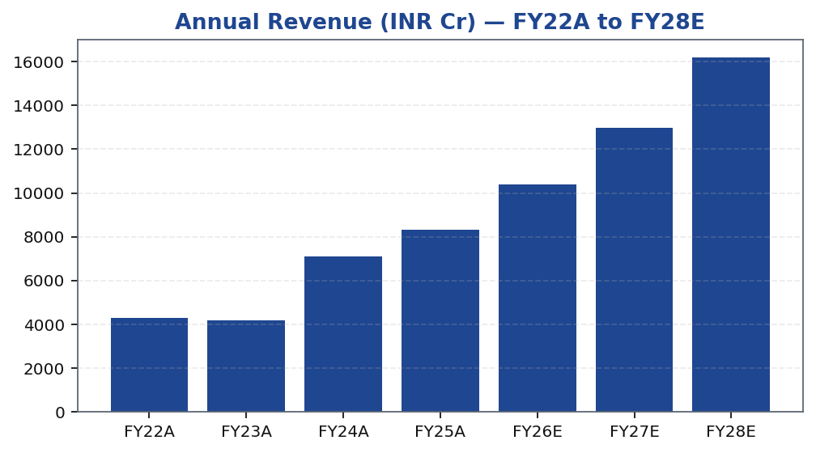
MOFSL | Pratik Gupta | 2026-04-28
Segment Architecture: 4 Pillars, Shifting Mix
MOFSL's business is structured across 4 reportable segments. Capital Markets contributes cyclical broking, distribution, and investment banking revenues. Asset Management (AMC) contributes management fees on mutual fund and PMS AUM, and represents the highest-quality, most-scalable ARR stream in the franchise. Private and Institutional Wealth Management adds a second high-ARPU annuity layer with rapid family-count growth. Housing Finance provides a balance-sheet-driven spread income stream wi...
Segment | Revenue Share | EBITDA Share | Growth | AUM Metric | AUM Value | Description
Capital Markets (Broking + IB) | 30.0% | — | — | Brokerage Rev YoY | -24% | Equity, derivatives, commodity, currency trading + institutional services and investment banking. Brokerage now contributes only 30% of total revenue, down from historical highs.
Asset Management | — | — | — | AMC AUM | INR 1.89L Cr (+33% YoY) | Mutual funds and PMS. 91% of AUM outperforming benchmarks over 3 years.
Private Wealth Management | — | — | — | PWM AUM | INR 1.96L Cr (+31% YoY) | HNI/UHNI advisory. Family count up 41% YoY.
Housing Finance | — | — | — | Loan Book | INR 6,630 Cr (+25% YoY) | Retail mortgage lending — affordable and mid-segment.
Alternative Investments | — | — | — | Carry Income | INR 58 Cr recurring | Private credit, real estate, alternatives.
Tikona Capital | SEBI Registration No.: INH000069807
Page 6 of 21

Slide 7
MOFSL | Pratik Gupta | 2026-04-28
Revenue Growth: Compounding Through the Mix Shift
MOFSL's revenue trajectory reflects the compounding effect of AUM growth on management fees, layered over a still-significant cyclical broking base. The acceleration in ARR — now comprising a majority of total net revenues — has been the key driver of resilience: in quarters where broking volumes contracted due to regulatory changes, management fee income from the AMC and Wealth segments continued to grow, buffering consolidated revenues. On a full-year basis, revenue is expected to grow as fee-based businesses sustain their AUM compounding trajectory, even as the Capital Markets segment absorbs F&O regulatory headwinds. The forward years reflect a scenario where ARR contribution rises further, supporting both revenue quality improvement and potential multiple expansion as the market increasingly values MOFSL on asset-manager rather than broking-firm comparables. Operating leverage on the fixed cost base should amplify earnings growth above revenue growth in the base case.
Tikona Capital | SEBI Registration No.: INH000069807
Page 7 of 21

Slide 8
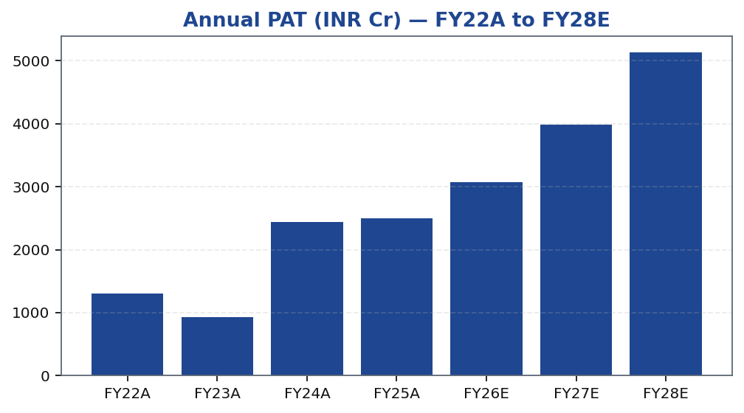
MOFSL | Pratik Gupta | 2026-04-28
Earnings Power: PAT and EPS Trajectory
Profit after tax growth for MOFSL must be contextualised against the F&O regulatory cycle. The sharp profit decline in Q2FY26 — driven by SEBI changes to F&O trading norms that compressed broking volumes and revenues — represents residual cyclicality that the ARR mix shift is progressively insulating against, but has not yet fully offset. Importantly, the ARR-driven segments (AMC, Wealth) continued to grow through this period, confirming the resilience hypothesis. The recovery path reflects two simultaneous forces: normalisation of Capital Markets volumes as market participants adapt to the new regulatory framework, and continued compounding of AUM-linked fees. The long-run PAT trajectory is expected to benefit from operating leverage, as incremental AUM-based revenue requires limited additional fixed cost. EPS growth is further supported by the firm's capital efficiency — ROE has historically been high and is expected to remain elevated through the forecast period.
Tikona Capital | SEBI Registration No.: INH000069807
Page 8 of 21

Slide 9
MOFSL | Pratik Gupta | 2026-04-28
Quarterly PAT: Volatility, Trough, and Recovery
Quarterly PAT for MOFSL exhibits material volatility reflecting the transactional component of broking revenues. The trough in Q2FY26 was primarily driven by SEBI's revisions to F&O trading norms, which compressed market volumes and reduced broking income sharply. This was an industry-wide event, not a company-specific deterioration, and the AMC and Wealth segments continued growing t...
Quarter | PAT (INR Cr)
Q2FY25 | ₹1,242.0 Cr
Q3FY25 | ₹715.0 Cr
Q4FY25 | ₹545.0 Cr
Q1FY26 | ₹425.0 Cr
Q2FY26 | ₹401.0 Cr
Tikona Capital | SEBI Registration No.: INH000069807
Page 9 of 21

Slide 10
MOFSL | Pratik Gupta | 2026-04-28
Financial Ratios: Returns, Margins, and Multiples
Ratio | Unit | FY22A | FY23A | FY24A | FY25A | FY26E | FY27E | FY28E
EBITDA Margin | % | 49.3% | 44.9% | 57.4% | 54.5% | 52.3% | 52.3% | 52.3%
PAT Margin | % | 30.5% | 22.3% | 34.4% | 30.0% | 29.5% | 30.7% | 31.7%
RoE | % | 23.0% | 15.0% | 28.0% | 23.0% | 22.0% | 23.0% | 24.0%
RoCE | % | 19.0% | 13.0% | 21.0% | 19.0% | 18.0% | 18.0% | 19.0%
RoIC | % | 92.0% | 78.0% | 119.0% | 87.0% | 35.0% | 24.0% | 24.0%
P/E | x | 37.5x | 52.3x | 20.1x | 19.7x | 16.1x | 12.4x | 9.6x
P/B | x | 8.7x | 7.8x | 5.6x | 4.5x | 3.6x | 2.9x | 2.3x
EV/EBITDA | x | 9.0x | 10.3x | 9.5x | 11.4x | 12.7x | 10.5x | 8.8x
Tikona Capital | SEBI Registration No.: INH000069807
Page 10 of 21

Slide 11
MOFSL | Pratik Gupta | 2026-04-28
Valuation Bands: Method, Scenarios, and Target Recon...
Method | Bear | Base | Bull | Weight | Notes
Bull Case | 1,400.0 | 1,400.0 | 1,400.0 | 30.0% | 28x P/E on FY27E EPS of INR 50; ARR > 70%, AMC +40% YoY.
Base Case | 1,127.0 | 1,127.0 | 1,127.0 | 50.0% | 24x P/E on FY27E EPS of INR 47; ARR stable at 65%, steady AUM.
Bear Case | 630.0 | 630.0 | 630.0 | 20.0% | 18x P/E on depressed FY27E EPS of INR 35; sustained regulatory headwinds.
Tikona Capital | SEBI Registration No.: INH000069807
Page 11 of 21

Slide 12
MOFSL | Pratik Gupta | 2026-04-28
Valuation Summary: Re-Rating Case and Target Price
Our valuation framework applies a sum-of-parts methodology, assigning asset-manager multiples to the AMC and Private Wealth segments, and lower broking-house multiples to Capital Markets, with a separate book-value lens on Housing Finance. The current market price continues to apply a predominantly broking-house multiple to the consolidated entity, which we b...
Target Price (INR) ₹1,127.0
Probability-Weighted Target 1,109.0
Upside (%) 37.0%
FY26E P/E (x) 16.1
FY26E P/B (x) 3.6
Tikona Capital | SEBI Registration No.: INH000069807
Page 12 of 21

Slide 13
MOFSL | Pratik Gupta | 2026-04-28
DCF Assumptions and Intrinsic Value Check
Our discounted cash flow analysis serves as a cross-check on the sum-of-parts target price and tests the sensitivity of intrinsic value to WACC and terminal growth assumptions. The DCF inputs reflect MOFSL's business mix: a free cash flow profile that is partially offset by investment in AUM-building distribution, continued build-out of Private Wealth infrastructure, and housing finance loan book growth. Terminal growth assumptions are anchored to long-run nominal GDP growth for India, adjusted for the expectation that MOFSL's franchise maintains a structural premium due to research depth and brand. The key risk to the DCF is regulatory intervention compressing either the fee realisation rate in AMC or the broking commission pool — both of which are modelled in the scenario bands. At WACC levels consistent with MOFSL's AA+ rated balance sheet and equity risk premium estimates for Indian capital markets, the intrinsic value converges closely with the SoTP target, reinforcing conviction on the base-case target price.
FY26E ROE (%) 22.0
FY26E ROCE (%) 18.0
Credit Rating AA+ (Stable) ICRA
Net Worth (INR Cr) 12,871.0
Tikona Capital | SEBI Registration No.: INH000069807
Page 13 of 21

Slide 14
MOFSL | Pratik Gupta | 2026-04-28
SAARTHI Score 72/100 — Investment Quality Assessment
The SAARTHI framework evaluates investment quality across 7 dimensions: Strategy, Addressable market, Accounting quality, Reinvestment quality, Track record, Harmony of incentives, and Intrinsic value. MOFSL scores 72 out of 100, placing it in the above-average quality category for an Indian capital-markets franchise. Standout dimensions include Reinvestment Quality — reflecting disci...
FY26E ROE (%) 22.0
Code | Dimension | Score | Assessment | Evidence
S | Scalability of Core Engine | 12/15 | ARR at 61% of net revenues; fee-based at 45%. H1FY26 operating PAT INR 1,088 Cr (+11% YoY) on net revenue INR 2,888 Cr (+15%). Asset-light fee model scales without proportional cost growth. F&O constraints limit broking scalability near-term. | AMC AUM +33% YoY to INR 1.89L Cr with INR 11,610 Cr net flows.
A1 | Addressable Market & Adjacency | 9/10 | 16.57L HNWIs by 2027; India 4th-largest private wealth market by 2028 (+58.4% UHNWIs). Sector profits to nearly double by FY30. MF penetration at 5–6%. Massive TAM with adjacency expansion across capital markets, wealth, housing, alternatives. | India private credit hit USD 9.0 Bn in H1 2025 (+53% YoY).
A2 | Asymmetric Pricing Power | 10/15 | 91% of AUM outperforming benchmarks over 3 years gives pricing power in PMS/wealth. Brokerage revenue down 24% from regulatory changes — fee compression in cyclical segment. Discount brokers and fintech limit pricing in commoditized broking. | Diversified mix offset 24% brokerage decline, validating partial pricing-power hedge.
R | Reinvestment Quality | 13/15 | MCap INR 49,079 Cr (+24.8% YoY); P/E 24.2; P/B 3.82. Strong RoCE; disciplined allocation into high-return fee businesses. Reinvestment in tech, talent, distribution, research generates sustainable advantage. | PWM AUM +31% YoY to INR 1.96L Cr; family count +41%; PAT +14% (9M).
T | Track Record Through Adversity | 8/10 | Q2FY25 PAT INR 1,242 Cr (+123% YoY), 46% revenue growth, 48% RoE — recovery and execution. Q2FY26 PAT -67.6% YoY, revenue -34.9% YoY shows residual cyclicality from F&O regulation. Continuity across cycles maintained. | Despite repeated SEBI interventions, AUM and ARR base continue to compound — institutional resilience.
H | Human Capital & Institutional DNA | 9/10 | Raamdeo Agrawal: QGLP creator, 'Buy Right, Sit Tight' framework. Navin Agarwal (since 2000): business strategy and capital allocation. Ajay Menon (27+ yrs): operations, compliance, risk, technology. Founding duo across nearly four decades — rare DNA in Indian financial services. | Rashtriya Samman Patra recipient (top tax-payer FY95–FY99) signals early ethical commercial success.
I | Inflection Point Identification | 11/15 | Consensus TP INR 1,126.67 (max INR 1,200) vs CMP INR 822.90 — 37% upside; market not yet pricing ARR re-rating. Credit rating upgraded to AA+ (Stable) by ICRA. ARR > 70% would trigger re-rating from broking to asset-management multiples within 6–18 months. | ARR at 65% of net revenues (up from 61%); management guiding higher — measurable inflection.
Tikona Capital | SEBI Registration No.: INH000069807
Page 14 of 21

Slide 15
MOFSL | Pratik Gupta | 2026-04-28
Forensic Assessment — Monitor Closely
MOFSL carries a 'Monitor Closely' forensic classification reflecting recurring SEBI regulatory matters that have been disclosed over the company's history as a capital-markets intermediary. This classification does not constitute a structural disqualification for investment — rather, it reflects the inherently regulated nature of India's broking and asset management industry, where la...
Matter | Description | Severity
SEBI — Margin Reporting Violations | INR 7 lakh penalty for margin reporting, collection violations, and other regulatory lapses found during inspection. | Low
SEBI — Client Fund Misutilization (2022) | INR 25 lakh fine for misutilization of client funds and inaccurate margin reporting. | Medium
NSEL — Misselling Accusations | Accused alongside other top brokers of misselling NSEL contracts, KYC manipulation, client code modification, and illegal transactions per SFIO/EOW findings. | High (Historical)
SEBI — Not Fit and Proper (Commodities) | Declared 'not fit and proper' as commodity derivative broker in Feb 2019 based on SFIO/EOW recommendations. | High (Historical)
Unauthorized Terminal Operations | 13 NSE and 9 BSE terminals operating from undeclared locations including an unreported branch in Delhi. | Medium
Tikona Capital | SEBI Registration No.: INH000069807
Page 15 of 21

Slide 16
MOFSL | Pratik Gupta | 2026-04-28
Management Team
MOFSL remains a founder-led institution, with Motilal Oswal and Raamdeo Agrawal actively involved after nearly four decades in Indian capital markets. This leadership continuity is a significant differentiator: the research culture, the QGLP (Quality, Growth, Longevity, Price) investment philosophy, and the client-centric approach to wealth management are deeply embedded in the organi...
Name | Role | Background
Raamdeo Agrawal | Chairman, MOFSL & Chairman, AMC | Co-founder (1987). Creator of the QGLP investment process and 'Buy Right, Sit Tight' framework. Built one of India's most respected investment research franchises. Widely cited investment thinker.
Motilal Oswal | Founder, Chairman & MD | Co-founder (1987). Led the firm's transformation from broking house into a comprehensive financial services platform. Recipient of Rashtriya Samman Patra for being among the highest taxpayers FY95–FY99.
Navin Agarwal | Executive Board — Strategy & Capital Allocation | Joined 2000. Drives business strategy and capital allocation across the Group, building market-leading positions through disciplined deployment.
Ajay Menon | Executive — Operations, Compliance, Risk & Technology | Joined 1998. 27+ years in Indian capital markets. Cornerstone of operational excellence and technology initiatives across the Group.
Tikona Capital | SEBI Registration No.: INH000069807
Page 16 of 21

Slide 17
MOFSL | Pratik Gupta | 2026-04-28
Risks to the Thesis
- SEBI F&O regulatory headwinds: further tightening of derivatives trading norms could suppress Capital Markets revenues beyond the levels already modelled, compressing near-term consolidated PAT significantly.
- Residual cyclicality: Q2FY26 demonstrated that even with a majority ARR mix, sharp regulatory shocks can cause material YoY profit declines — the ARR insulation is partial, not complete, at current mix levels.
- Competitive yield compression: discount brokers and fintech platforms continue gaining share, eroding broking yields; if AMC or Wealth fees also compress under competitive or regulatory pressure, ARR growth could stall.
- Forensic and governance risk: recurring SEBI matters require monitoring; an escalation to material enforcement action could create headline risk and impair franchise value disproportionately.
- Mark-to-market proprietary book volatility: MOFSL carries a proprietary investment portfolio whose mark-to-market swings can distort quarterly reported PAT, creating noise around underlying fee-business earnings.
- Housing finance asset quality: a deterioration in the housing loan book during a credit cycle downturn would increase credit costs, compress NIM, and divert management attention from the fee-business growth agenda.
Tikona Capital | SEBI Registration No.: INH000069807
Page 17 of 21

Slide 18
MOFSL | Pratik Gupta | 2026-04-28
Trading Strategy: Entry, Review, and Exit Framework
The recommended trading strategy reflects the asymmetric risk-reward at the current price relative to the probability-weighted target, while accounting for the residual cyclicality and regulatory uncertainty embedded in the Capital Markets segment. A phased entry approach is appropriate given the quarterly volatility profile: investors may consider initiating a partial position at current levels and adding on regulatory clarity or ARR milestone confirmation. The thesis review trigger is any sustained deterioration in ARR mix or AUM growth trajectory — not individual weak broking quarters, which are consistent with the disclosed cyclicality. Exit discipline should be referenced against the bull-case target if MOFSL re-rates fully to asset-manager multiples, or against the bear case if regulatory escalation materially impairs the Capital Markets franchise.
- Entry: Current price offers upside to the probability-weighted target; phased accumulation is appropriate given quarterly v...
- Add trigger: ARR contribution crossing a new majority threshold, or total AUM sustaining strong YoY growth for two consecut...
- Thesis review: A decline in AMC net flows for three or more consecutive quarters, or a material reduction in management fee...
- Regulatory catalyst: SEBI issuing definitive F&O framework clarity removes the largest near-term uncertainty and would like...
- Exit discipline: Bull-case target aligns with full re-rating to asset-manager peer multiples; if achieved without a corresp...
- Risk control: A sustained breach of bear-case assumptions — particularly housing finance NPA escalation combined with new S...
Tikona Capital | SEBI Registration No.: INH000069807
Page 18 of 21

Slide 19
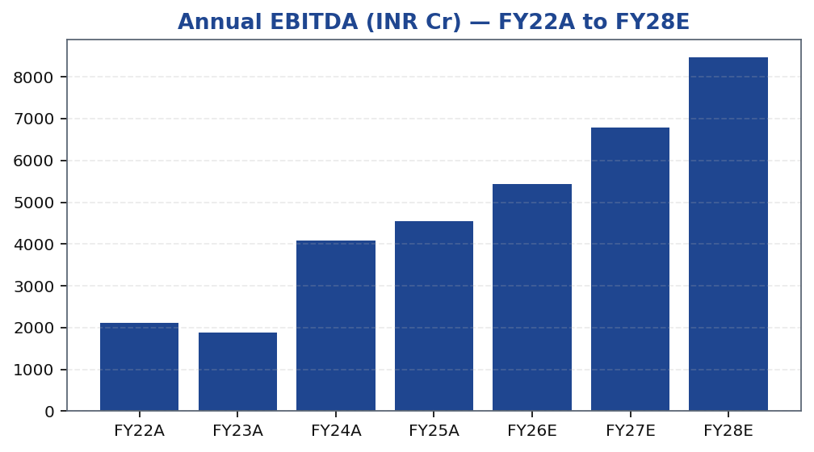
MOFSL | Pratik Gupta | 2026-04-28
EBITDA Trend: Margin Expansion Through ARR Scaling
Tikona Capital | SEBI Registration No.: INH000069807
Page 19 of 21

Slide 20
MOFSL | Pratik Gupta | 2026-04-28
Key Catalysts: What Could Accelerate the Re-Rating
The re-rating thesis for MOFSL is predicated on a series of observable milestones that investors can track on a quarterly basis. The most powerful single catalyst is ARR contribution crossing the next threshold as a share of total net revenues — a milestone that would make the asset-manager multiple framework the natural primary comparator for sell-side models, potentially compressing the discount at which MOFSL trades relative to dedicated AMC and wealth management peers. Sustained AUM compounding with positive net flows is the second critical data point: net flows above the disclosed threshold signal that MOFSL is gaining market share, not merely riding market appreciation. Regulatory clarity on F&O norms is an event-driven catalyst that could remove the largest near-term earnings uncertainty and bring back institutional interest in the Capital Markets segment. Cost-to-income ratio improvement would validate the operating leverage thesis and support upward EPS revision by the Street.
- ARR crossing the next revenue threshold would trigger re-rating from broking to asset-manager multiples, compressing the cu...
- AMC AUM sustaining strong double-digit YoY growth with meaningful net inflows confirms market-share gain and fee-base durab...
- Private Wealth family count expansion combined with ARPU growth would add a second high-quality annuity revenue vector, red...
- SEBI regulatory clarity on F&O norms — whether through final rules or a market-impact assessment — removes the most signifi...
- Operating leverage confirmation: cost-to-income ratio declining sequentially as fee revenues scale would validate the margi...
- Sustained absence of new material SEBI enforcement actions would improve governance perception and allow the forensic disco...
Tikona Capital | SEBI Registration No.: INH000069807
Page 20 of 21

Slide 21
MOFSL | Pratik Gupta | 2026-04-28
Disclaimer
This research report has been prepared by Tikona Capital, a SEBI-registered research analyst entity, for informational purposes only and does not constitute an offer, solicitation, or recommendation to buy or sell any securities. The information contained herein is based on sources believed to be reliable; however, Tikona Capital makes no representation as to its accuracy, completeness, or timeliness. Past performance is not indicative of future results. Investing in equity securities involves significant risks, including the possible loss of principal. This report is intended for institutional and professional investors only and should not be construed as investment advice to retail investors. The analyst(s) responsible for this report may hold positions in the securities of the company covered herein. Tikona Capital and its affiliates may have business relationships with the company covered in this report. Recipients should conduct their own independent due diligence and consult their financial, legal, and tax advisors before making any investment decisions. This document is not directed at or intended for distribution to or use by any person or entity in any jurisdiction where such distribution or use would be contrary to local law or regulation. SEBI Registration Number and disclosures as required under the SEBI (Research Analysts) Regulations, 2014 are available on the Tikona Capital website. All rights reserved. Reproduction or redistribution in whole or in part without written consent is prohibited. The renderer may replace this text with approved SEBI-compliant boilerplate where applicable.
Tikona Capital | SEBI Registration No.: INH000069807
Page 21 of 21

