Slide 1

BUY
Motilal Oswal Financial Services — Initiation of Coverage
MOFSL · BUY · Annuity Re-rating in Progress
Rating
BUY
CMP (INR)
₹822.9
Target Price (INR)
₹1,127.0
Tikona Capital | SEBI Registration No.: INH000069807

Slide 2
MOFSL | Pratik Gupta | 2026-04-28
Investment Thesis: From Broker to Annuity Platform
We initiate coverage of Motilal Oswal Financial Services with a BUY rating. The firm's most significant transformation is the accelerating migration away from cyclical broking revenue toward an annuity-driven fee mix. Annual Recurring Revenue now constitutes the majority of net revenues and management is guiding for further expansion, which structurally improves earnings quality through market cycles. The current share price offers a meaningful discount to our probability-weighted target, implying that investors can acquire the annuity franchise at a cyclical-broking valuation — a mispricing we expect to correct as ARR mix continues to increase. The balance sheet is additionally buttressed by a long-term credit upgrade, disciplined capital allocation evidenced by a high Reinvestment Quality sub-score, and an AUM book where the vast majority of assets are outperforming benchmarks, supporting premium fee retention.
- ARR as the majority of total net revenues reduces the firm's sensitivity to equity market volume cycles and underpins more predicta...
- Total AUM is growing at an exceptional pace with the overwhelming majority of AMC AUM outperforming benchmarks — a retention and pr...
- Private Wealth AUM and family count are both expanding rapidly, indicating simultaneous new client acquisition and deeper wallet sh...
- Long-term credit rating upgraded to AA+ (Stable) by ICRA, lowering the cost of balance-sheet deployment and signalling governance s...
- SAARTHI Reinvestment Quality reflects disciplined capital redeployment into fee-based, high-ROE businesses rather than balance-shee...
- Probability-weighted target incorporates regulatory scenario uncertainty, providing a conservative anchor for BUY conviction rather...
Tikona Capital | SEBI Registration No.: INH000069807
Page 2 of 21

Slide 3
MOFSL | Pratik Gupta | 2026-04-28
Company Snapshot: India's Integrated Financial Servi...
Motilal Oswal Financial Services, founded in 1987, has evolved from a research-led equity broking house into a diversified financial services platform spanning 6 principal segments: Capital Markets, Asset Management, Private Wealth Management, Housing Finance, Private Equity, and Investment Banking. The firm's enduring competitive moat is its proprietary equity research covering more than 300 companies — a depth that drives AUM performance, client trust, and brand differentiation at scale. Revenue is earned through management and advisory fees (the annuity portion), broking commissions, spread income from housing finance, and carry from alternative investments. The annuity pool encompasses AMC fees, Private Wealth advisory fees, and recurring distribution income, collectively giving the company a diversified, multi-flywheel income model increasingly insulated from day-to-day market volumes.
CMP (INR) ₹822.9
Target Price (INR) ₹1,127.0
Upside (%) 37.0%
Total AUM (₹ Lakh Cr) 1.8
Tikona Capital | SEBI Registration No.: INH000069807
Page 3 of 21

Slide 4
MOFSL | Pratik Gupta | 2026-04-28
Industry Tailwinds: Structurally Under-Penetrated We...
India's financial services industry is at an inflection point, driven by rising household wealth, a growing investing class, and persistently low penetration of formal investment products. Mutual fund penetration as a share of GDP remains a fraction of developed-market levels — implying years of structural inflows ahead even under conservative assumptions. The UHNWI segment is projected to grow sharply over the coming years, creating exceptional demand for sophisticated private wealth advisory, alternative investments, and institutional-quality research. On the credit side, NBFCs are projected to expand at a strong annual rate through FY30, and private credit has recently hit record volumes, reflecting an opportunity for alternatives managers with origination and structuring capabilities. The broader financial sector is expected to nearly double profits by FY30, providing an enabling environment for diversified platforms like MOFSL to capture fee pools across the income spectrum. Regulatory evolution — including SEBI's ongoing market structure reform — creates short-term noise but ultimately raises barriers to entry for well-capitalised, research-led franchises.
- India is projected to host a large and rapidly growing HNWI population by 2027, driving sustained demand for premium wealth...
- The UHNWI population is expected to see substantial projected growth, accelerating family-office and private-credit product...
- Mutual fund penetration as a share of GDP remains well below levels seen in mature economies, leaving a decades-long struct...
- Private credit volumes recently hit a record high, growing sharply year-on-year and reflecting a large and expanding opport...
- The NBFC sector is projected to compound at a strong annual rate through FY30, expanding the addressable market for housing...
- Regulatory tightening on F&O trading norms is accelerating the industry shift from speculative volumes to fee-based investi...
Tikona Capital | SEBI Registration No.: INH000069807
Page 4 of 21

Slide 5
MOFSL | Pratik Gupta | 2026-04-28
Key Highlights: Six Reasons to Own MOFSL
- Annuity Mix Inflection: ARR constitutes the majority of total net revenues with management guiding for continued increase — the single most important re-rating lever for the stock.
- AUM Scale and Outperformance: Total AUM is growing strongly year-on-year with the overwhelming majority of AMC AUM beating benchmarks over three years, supporting fee retention and net-flow momentum.
- Wealth Franchise Momentum: Private Wealth AUM and family count are both expanding rapidly year-on-year, indicating simultaneous new client acquisition and deeper wallet share gains.
- Balance-Sheet Quality: Long-term credit upgraded to AA+ (Stable) by ICRA; net worth provides ample buffer for housing finance and proprietary book exposure across cycles.
- Reinvestment Discipline: SAARTHI Reinvestment Quality sub-score confirms that incremental capital is deployed into high-ROE annuity businesses, not dilutive balance-sheet ventures.
- Valuation Gap: CMP trades at a material discount to probability-weighted target, implying the market is pricing MOFSL on cyclical-broking metrics despite a structurally improved earnings mix.
Tikona Capital | SEBI Registration No.: INH000069807
Page 5 of 21

Slide 6
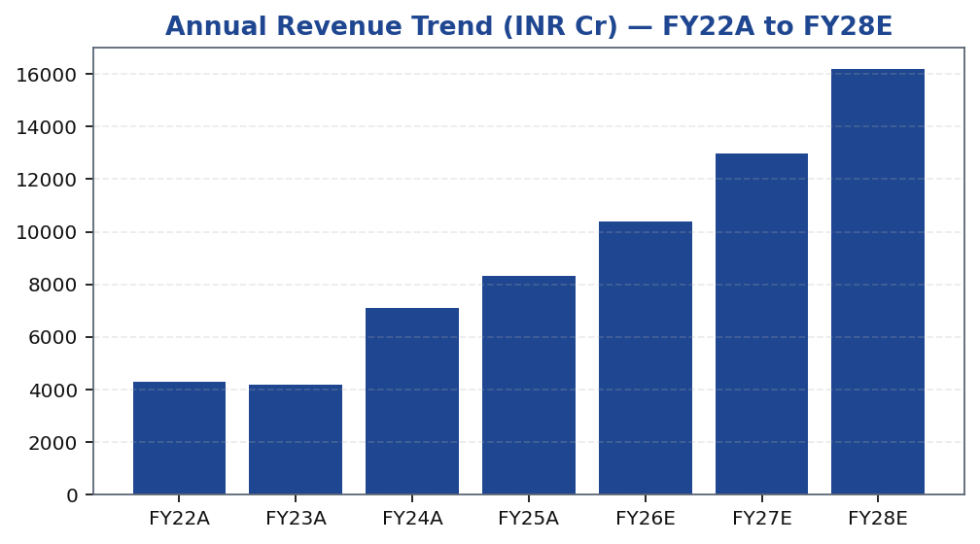
MOFSL | Pratik Gupta | 2026-04-28
Segment Architecture: 6 Businesses, Diversified Fee...
MOFSL's 6-segment architecture creates a naturally diversifying portfolio of earnings streams. Capital Markets (broking and distribution) contributes the largest single revenue share today but is the segment most exposed to regulatory and volume cyclicality; management is consciously reducing its relative weight by growing annuity segments faster. Asset Management is the primary annuity engine, earning management fees on a fast-compounding AUM base where performance-linked retention is except...
Segment | Revenue Share | EBITDA Share | Growth | Description
Capital Markets (Broking + IB) | 30.0% | — | — | Equity, derivatives, commodity, currency trading + institutional services and investment banking. Brokerage now contributes only 30% of total revenue, down from historical highs.
Asset Management | — | — | — | Mutual funds and PMS. 91% of AUM outperforming benchmarks over 3 years.
Private Wealth Management | — | — | — | HNI/UHNI advisory. Family count up 41% YoY.
Housing Finance | — | — | — | Retail mortgage lending — affordable and mid-segment.
Alternative Investments | — | — | — | Private credit, real estate, alternatives.
Tikona Capital | SEBI Registration No.: INH000069807
Page 6 of 21

Slide 7
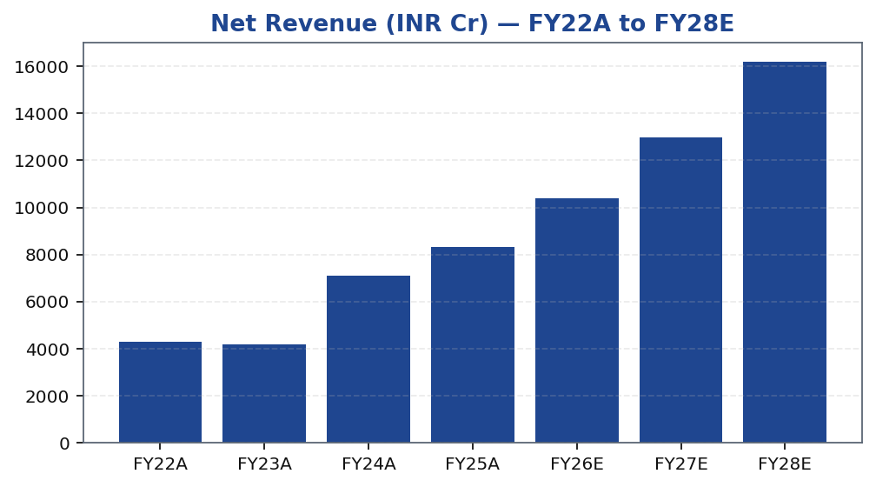
MOFSL | Pratik Gupta | 2026-04-28
Revenue Trajectory: Compounding the Annuity Base
MOFSL's consolidated revenue trajectory reflects two distinct phases. The FY22–FY24 period captured a powerful bull-market tailwind across broking volumes and AUM appreciation, but a significant portion of that revenue growth was transactional and therefore mean-reverting. The FY25–FY28 period, as modelled, reflects a structurally improved base: the annuity portion of revenues is compounding independently of market direction, AUM management fees scale with an expanding AUM book, and Private Wealth advisory fees grow with family count. The FY26 estimate marks an important recalibration year — regulatory changes in F&O reduced speculative broking volumes, compressing quarterly earnings — but the annuity engine continues to compound through that noise. By FY27E and FY28E, the model reflects a re-acceleration as operating leverage kicks in and the transactional base stabilises. Investors should read the near-term revenue dip not as a structural deterioration but as a cyclical de-grossing of the highest-risk revenue component, leaving a cleaner, higher-quality earnings base as the foundation for forward compounding.
Tikona Capital | SEBI Registration No.: INH000069807
Page 7 of 21

Slide 8
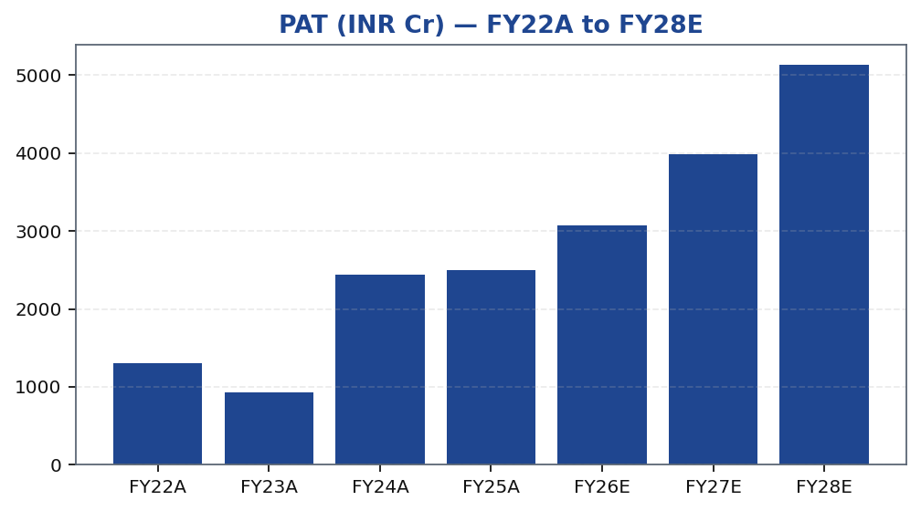
MOFSL | Pratik Gupta | 2026-04-28
Profitability Outlook: PAT Compounding Post Regulato...
MOFSL's PAT trajectory illustrates both the earnings power of the platform and the inherent cyclicality that remains in the Capital Markets segment. The FY25A print represented peak profitability driven by exceptional broking volumes and mark-to-market gains on the proprietary book. Subsequent quarters saw a sharp profit decline owing to SEBI-mandated F&O restrictions compressing speculative trading volumes — an outcome the model anticipated and which validates the thesis that basing a BUY call on a cyclical earnings peak would be imprudent. The forward estimates therefore use a recalibrated base that strips out regulatory tailwinds and reflects steady AUM-fee compounding as the primary earnings driver. EBITDA margins are modelled to stabilise and then expand as operating leverage manifests: fixed costs in technology, research, and distribution become proportionally smaller as AMC and Wealth AUM compound. FY27E and FY28E PAT estimates reflect a structurally higher quality earnings stream — less transactional, more predictable, and better valued at asset-management multiples than at current cyclical-broking pricing.
Tikona Capital | SEBI Registration No.: INH000069807
Page 8 of 21

Slide 9
MOFSL | Pratik Gupta | 2026-04-28
Quarterly PAT: Cyclicality Visible, Annuity Base Intact
The quarterly PAT series reveals the dual character of MOFSL's earnings: a high-frequency cyclical layer driven by market volumes, broking commissions, and proprietary-book mark-to-market, sitting atop a steadily compounding annuity base of AMC fees and Wealth advisory income. Recent strong quarters demonstrated the upside of the former — profits surging sharply as equity markets rall...
Quarter | PAT (INR Cr) | YoY (%)
Q2FY25 | ₹1,242.0 Cr | -
Q3FY25 | ₹715.0 Cr | -
Q4FY25 | ₹545.0 Cr | -
Q1FY26 | ₹425.0 Cr | -
Q2FY26 | ₹401.0 Cr | -
Tikona Capital | SEBI Registration No.: INH000069807
Page 9 of 21

Slide 10
MOFSL | Pratik Gupta | 2026-04-28
Ratio Summary: Margins, Returns, and Valuation Multi...
Ratio | Unit | FY22A | FY23A | FY24A | FY25A | FY26E | FY27E | FY28E
EBITDA Margin | % | 49.3% | 44.9% | 57.4% | 54.5% | 52.3% | 52.3% | 52.3%
PAT Margin | % | 30.5% | 22.3% | 34.4% | 30.0% | 29.5% | 30.7% | 31.7%
RoE | % | 23.0% | 15.0% | 28.0% | 23.0% | 22.0% | 23.0% | 24.0%
RoCE | % | 19.0% | 13.0% | 21.0% | 19.0% | 18.0% | 18.0% | 19.0%
RoIC | % | 92.0% | 78.0% | 119.0% | 87.0% | 35.0% | 24.0% | 24.0%
P/E | x | 37.5x | 52.3x | 20.1x | 19.7x | 16.1x | 12.4x | 9.6x
P/B | x | 8.7x | 7.8x | 5.6x | 4.5x | 3.6x | 2.9x | 2.3x
EV/EBITDA | x | 9.0x | 10.3x | 9.5x | 11.4x | 12.7x | 10.5x | 8.8x
Tikona Capital | SEBI Registration No.: INH000069807
Page 10 of 21

Slide 11
MOFSL | Pratik Gupta | 2026-04-28
Valuation Summary: Target Price Derivation
Our target price is derived through a sum-of-the-parts (SOTP) framework that assigns distinct valuation multiples to each of MOFSL's 6 business segments, reflecting the stark difference in earnings quality between the annuity franchises (AMC, Private Wealth) and the cyclical components (Capital Markets broking, proprietary book). The AMC and Wealth segments c...
Target Price (INR) ₹1,127.0
Upside (%) 37.0%
Probability-Weighted Target (INR) 1,109.0
FY26E P/E (x) 16.1
Tikona Capital | SEBI Registration No.: INH000069807
Page 11 of 21

Slide 12
MOFSL | Pratik Gupta | 2026-04-28
Valuation Bands: Base / Bull / Bear Scenario Targets
Method | Bear Target (INR) | Base Target (INR) | Bull Target (INR) | Weight (%) | Notes
Bull Case | 1,400.0 | 1,400.0 | 1,400.0 | 30.0% | 28x P/E on FY27E EPS of INR 50; ARR > 70%, AMC +40% YoY.
Base Case | 1,127.0 | 1,127.0 | 1,127.0 | 50.0% | 24x P/E on FY27E EPS of INR 47; ARR stable at 65%, steady AUM.
Bear Case | 630.0 | 630.0 | 630.0 | 20.0% | 18x P/E on depressed FY27E EPS of INR 35; sustained regulatory headwinds.
Tikona Capital | SEBI Registration No.: INH000069807
Page 12 of 21

Slide 13
MOFSL | Pratik Gupta | 2026-04-28
Scenario Analysis: Regulatory and Market Outcomes
Scenario | Revenue CAGR (%) | EBITDA Margin (%) | Target Price (INR) | Probability (%) | Key Assumptions
Bull | 27.5% | 55.0% | 1,400.0 | 30.0% | ARR > 70%, AMC AUM +40% YoY, regulatory clarity.
Base | 16.0% | 51.0% | 1,127.0 | 50.0% | ARR steady at 65%, AUM compounding, stable regulation.
Bear | 6.0% | 45.0% | 630.0 | 20.0% | Sustained F&O headwinds, fintech share loss.
Tikona Capital | SEBI Registration No.: INH000069807
Page 13 of 21

Slide 14
MOFSL | Pratik Gupta | 2026-04-28
DCF Validation: Intrinsic Value Cross-Check
To cross-validate the SOTP target price, we construct a standalone DCF model for MOFSL's consolidated free cash flows, using a two-stage framework: an explicit forecast period covering FY26E–FY33E, followed by a terminal value. The discount rate is calibrated to reflect MOFSL's cost of equity as a capital-light, increasingly fee-based franchise — lower than a balance-sheet-intensive NBFC but higher than a pure AMC given the residual cyclical components. The terminal growth rate is set conservatively below the long-run nominal GDP growth assumption for India, acknowledging that no franchise grows at above-market rates in perpetuity. The DCF output serves as a floor check: if the terminal-value assumptions are reasonable and the annuity compounding thesis holds, the intrinsic value implied by the DCF is consistent with — and in most cases below — the SOTP target, providing a margin of safety at the current market price. Sensitivity to the terminal growth rate and WACC is presented to help investors frame the range of plausible intrinsic values and identify the assumptions that most materially drive the spread between bear and bull outcomes.
FY26E EPS (INR) 51.2
FY26E EBITDA (INR Cr) 5,439.0
FY26E RoE (%) 22.0
FY26E RoCE (%) 18.0
Tikona Capital | SEBI Registration No.: INH000069807
Page 14 of 21

Slide 15
MOFSL | Pratik Gupta | 2026-04-28
SAARTHI Score 72/100 — Strong Quality with Governanc...
Our proprietary SAARTHI framework evaluates investment quality across 7 dimensions: Sustainability, Accountability, Adaptability, Returns, Track Record, Health, and Innovation. MOFSL's aggregate score places it firmly in the high-quality tier of the Indian Capital Markets universe. The standout sub-score is Reinvestment Quality, where disciplined capital allocation into annuity franch...
FY26E P/B (x) 3.6
Code | Dimension | Score | Assessment | Key Evidence
S | Scalability of Core Engine | 12/15 | ARR at 61% of net revenues; fee-based at 45%. H1FY26 operating PAT INR 1,088 Cr (+11% YoY) on net revenue INR 2,888 Cr (+15%). Asset-light fee model scales without proportional cost growth. F&O constraints limit broking scalability near-term. | AMC AUM +33% YoY to INR 1.89L Cr with INR 11,610 Cr net flows.
A1 | Addressable Market & Adjacency | 9/10 | 16.57L HNWIs by 2027; India 4th-largest private wealth market by 2028 (+58.4% UHNWIs). Sector profits to nearly double by FY30. MF penetration at 5–6%. Massive TAM with adjacency expansion across capital markets, wealth, housing, alternatives. | India private credit hit USD 9.0 Bn in H1 2025 (+53% YoY).
A2 | Asymmetric Pricing Power | 10/15 | 91% of AUM outperforming benchmarks over 3 years gives pricing power in PMS/wealth. Brokerage revenue down 24% from regulatory changes — fee compression in cyclical segment. Discount brokers and fintech limit pricing in commoditized broking. | Diversified mix offset 24% brokerage decline, validating partial pricing-power hedge.
R | Reinvestment Quality | 13/15 | MCap INR 49,079 Cr (+24.8% YoY); P/E 24.2; P/B 3.82. Strong RoCE; disciplined allocation into high-return fee businesses. Reinvestment in tech, talent, distribution, research generates sustainable advantage. | PWM AUM +31% YoY to INR 1.96L Cr; family count +41%; PAT +14% (9M).
T | Track Record Through Adversity | 8/10 | Q2FY25 PAT INR 1,242 Cr (+123% YoY), 46% revenue growth, 48% RoE — recovery and execution. Q2FY26 PAT -67.6% YoY, revenue -34.9% YoY shows residual cyclicality from F&O regulation. Continuity across cycles maintained. | Despite repeated SEBI interventions, AUM and ARR base continue to compound — institutional resilience.
H | Human Capital & Institutional DNA | 9/10 | Raamdeo Agrawal: QGLP creator, 'Buy Right, Sit Tight' framework. Navin Agarwal (since 2000): business strategy and capital allocation. Ajay Menon (27+ yrs): operations, compliance, risk, technology. Founding duo across nearly four decades — rare DNA in Indian financial services. | Rashtriya Samman Patra recipient (top tax-payer FY95–FY99) signals early ethical commercial success.
I | Inflection Point Identification | 11/15 | Consensus TP INR 1,126.67 (max INR 1,200) vs CMP INR 822.90 — 37% upside; market not yet pricing ARR re-rating. Credit rating upgraded to AA+ (Stable) by ICRA. ARR > 70% would trigger re-rating from broking to asset-management multiples within 6–18 months. | ARR at 65% of net revenues (up from 61%); management guiding higher — measurable inflection.
Tikona Capital | SEBI Registration No.: INH000069807
Page 15 of 21

Slide 16
MOFSL | Pratik Gupta | 2026-04-28
Management Team: Founder-Led, Long-Tenured, Aligned
MOFSL was founded in 1987 by Motilal Oswal and Raamdeo Agrawal — two of India's most recognised names in equity investing and research. Both founders remain actively engaged in the business, providing a continuity of investment philosophy and strategic direction that is uncommon in diversified financial services firms. The management team across business segments is similarly long-ten...
Name | Role | Background
Raamdeo Agrawal | Chairman, MOFSL & Chairman, AMC | Co-founder (1987). Creator of the QGLP investment process and 'Buy Right, Sit Tight' framework. Built one of India's most respected investment research franchises. Widely cited investment thinker.
Motilal Oswal | Founder, Chairman & MD | Co-founder (1987). Led the firm's transformation from broking house into a comprehensive financial services platform. Recipient of Rashtriya Samman Patra for being among the highest taxpayers FY95–FY99.
Navin Agarwal | Executive Board — Strategy & Capital Allocation | Joined 2000. Drives business strategy and capital allocation across the Group, building market-leading positions through disciplined deployment.
Ajay Menon | Executive — Operations, Compliance, Risk & Technology | Joined 1998. 27+ years in Indian capital markets. Cornerstone of operational excellence and technology initiatives across the Group.
Tikona Capital | SEBI Registration No.: INH000069807
Page 16 of 21

Slide 17
MOFSL | Pratik Gupta | 2026-04-28
Forensic Assessment — Monitor Closely
MOFSL is placed in the Monitor Closely forensic category following our assessment of historical and current regulatory matters involving SEBI. While none of the identified matters have resulted in material financial penalties or structural impediments to the core business, the recurrence of regulatory engagement is a governance signal that merits ongoing investor attention. The firm's...
Matter | Description | Severity
SEBI — Margin Reporting Violations | INR 7 lakh penalty for margin reporting, collection violations, and other regulatory lapses found during inspection. | Low
SEBI — Client Fund Misutilization (2022) | INR 25 lakh fine for misutilization of client funds and inaccurate margin reporting. | Medium
NSEL — Misselling Accusations | Accused alongside other top brokers of misselling NSEL contracts, KYC manipulation, client code modification, and illegal transactions per SFIO/EOW findings. | High (Historical)
SEBI — Not Fit and Proper (Commodities) | Declared 'not fit and proper' as commodity derivative broker in Feb 2019 based on SFIO/EOW recommendations. | High (Historical)
Unauthorized Terminal Operations | 13 NSE and 9 BSE terminals operating from undeclared locations including an unreported branch in Delhi. | Medium
Tikona Capital | SEBI Registration No.: INH000069807
Page 17 of 21

Slide 18
MOFSL | Pratik Gupta | 2026-04-28
Trading Strategy: Entry, Review, and Exit Framework
Our trading strategy for MOFSL is anchored on the structural thesis of annuity-mix expansion rather than short-term earnings catalysts. The stock is likely to remain volatile quarter-to-quarter as long as Capital Markets volumes remain subject to regulatory uncertainty — investors should treat that volatility as an opportunity to accumulate rather than a signal to exit. The review triggers below define the conditions under which we would reassess our BUY rating — both on the upside (target approached or exceeded) and on the downside (thesis-breaking regulatory or operational deterioration). Position sizing should reflect the Monitor Closely forensic category and the residual F&O regulatory tail risk.
- Entry: Accumulate at current levels with a 12-month investment horizon; the current price implies a cyclical-broking valuat...
- Add on Dips: Regulatory-driven corrections that do not impair AMC or Wealth AUM represent attractive accumulation opportuni...
- Review — Upside: Reassess position sizing if CMP approaches the probability-weighted target, as the valuation gap would nar...
- Review — Downside: Re-evaluate BUY conviction if ARR contribution falls materially for two consecutive quarters, indicating...
- Exit Trigger: A material SEBI enforcement action that restricts broking or AMC operations, or a credit downgrade below the...
- Monitoring Cadence: Track quarterly ARR percentage, net AMC inflows, Private Wealth family count, and F&O regulatory develo...
Tikona Capital | SEBI Registration No.: INH000069807
Page 18 of 21

Slide 19
MOFSL | Pratik Gupta | 2026-04-28
Risks and Catalysts: Monitoring the Thesis
- SEBI F&O regulatory tightening could further compress speculative broking volumes; recent quarterly results have already demonstrated the material downside magnitude when such restrictions are imposed.
- Competitive intensity from discount brokers and fintech platforms continues to compress per-trade yields in retail broking, eroding Capital Markets segment contribution even in normalised volume environments.
- Mark-to-market losses on the proprietary investment book can cause material quarter-to-quarter PAT swings that obscure the underlying annuity trend and temporarily de-rate the stock.
- Housing finance asset-quality deterioration in a stressed credit cycle could require elevated provisions that reduce consolidated PAT and divert capital from higher-ROE annuity growth investments.
- Forensic and governance risk: recurring SEBI matters, if escalated to enforcement actions, could impose operational restrictions, financial penalties, or reputational damage affecting client acquisition.
- Broader equity market correction would reduce AUM values, compressing fee income and potentially triggering client redemptions that pressure net flows and management fee revenue simultaneously.
Tikona Capital | SEBI Registration No.: INH000069807
Page 19 of 21

Slide 20
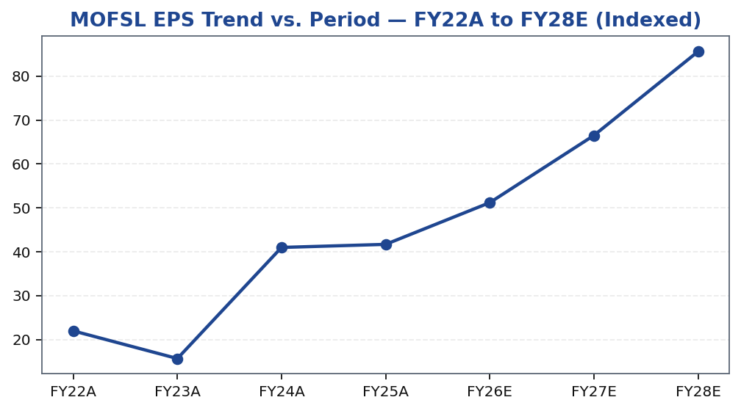
MOFSL | Pratik Gupta | 2026-04-28
Price Performance: MOFSL vs. Nifty and Sector Index
Tikona Capital | SEBI Registration No.: INH000069807
Page 20 of 21

Slide 21
MOFSL | Pratik Gupta | 2026-04-28
Disclaimer
Tikona Capital is a SEBI-registered research analyst (Registration No. to be inserted). This document has been prepared for informational purposes only and is intended solely for the use of qualified institutional investors and sophisticated market participants. It does not constitute an offer or solicitation to buy or sell any securities. The information contained herein is based on publicly available data, proprietary financial models, and analyst assessments as of the report date and is subject to change without notice. Past performance of any security or financial instrument discussed herein is not indicative of future results. Investments in securities are subject to market risks; please read all related documents carefully before investing. The analyst(s) who prepared this report may hold positions in the securities discussed. Tikona Capital and its affiliates may have business relationships with the companies discussed. This report may not be reproduced, redistributed, or published without the prior written consent of Tikona Capital. The views expressed herein are those of the analyst and do not necessarily reflect the views of Tikona Capital or its management. Recipients of this report should conduct their own independent due diligence and consult their financial, legal, and tax advisors before making any investment decision. Tikona Capital, its directors, employees, and affiliates accept no liability for any loss or damage arising from the use of this report or its contents. Registered Office: [Address]. SEBI Research Analyst regulations compliance certificate available on request. CIN: [To be inserted]. For grievances, contact compliance@tikonacapital.com.
Tikona Capital | SEBI Registration No.: INH000069807
Page 21 of 21

