Slide 1

BUY
Motilal Oswal Financial Services — Initiation Note
MOFSL | BUY — Annuity-Driven Re-Rating in Motion
Rating
BUY
CMP (INR)
₹822.9
Target Price (INR)
₹1,127.0
Tikona Capital | SEBI Registration No.: INH000069807

Slide 2
MOFSL | Pratik Gupta | 2026-04-28
Investment Thesis
We initiate coverage on Motilal Oswal Financial Services with a BUY rating. The firm is executing a structural migration away from cyclical broking revenues toward a recurring, fee-based earnings model. Annual Recurring Revenue already constitutes a large majority of net revenues, and management has guided for further expansion — a mix shift that fundamentally alters how the market should value this franchise. The current share price embeds a meaningful discount to our probability-weighted target, creating an attractive asymmetric entry point for long-horizon investors willing to look through near-term regulatory noise in the derivatives segment.
- ARR now forms the dominant share of net revenues, reducing dependence on volatile F&O-linked broking commissions across market cycles.
- Total AUM is compounding at elevated rates YoY, with an overwhelming majority of the AMC book outperforming benchmarks over a three...
- Private Wealth Management franchise has scaled materially with family count expanding sharply YoY, adding a second annuity engine a...
- AA+ (Stable) credit upgrade from ICRA signals balance-sheet resilience and endorses capacity for disciplined reinvestment into fee-...
- Operating leverage is nascent but visible: a predominantly fixed cost base means incremental AUM flows drop through at high increme...
- Probability-weighted target accounts for regulatory risk in the F&O segment, offering a balanced and conservative upside estimate r...
Tikona Capital | SEBI Registration No.: INH000069807
Page 2 of 21

Slide 3
MOFSL | Pratik Gupta | 2026-04-28
Company Snapshot
Motilal Oswal Financial Services was founded in 1987 as a research-driven equity broking house and has since evolved into one of India's most comprehensive financial services platforms. The company operates across Capital Markets, Asset Management, Private Wealth Management, Housing Finance, and Alternative Investments — serving retail, HNI, and institutional clients alike. Its enduring competitive moat is a proprietary research franchise covering more than 300 listed companies, which continues to anchor client trust and product differentiation across business lines. Distribution spans 550+ cities and more than 2,500 business locations, providing both physical reach and digital scalability.
CMP (INR) ₹822.9
Target Price (INR) ₹1,127.0
Upside (%) 37.0%
Total AUM (₹ lakh cr) 1.8
Tikona Capital | SEBI Registration No.: INH000069807
Page 3 of 21

Slide 4
MOFSL | Pratik Gupta | 2026-04-28
Industry Backdrop — Structural Tailwinds Intact
India's financial services sector stands at an inflection point driven by rising household wealth, deepening capital market participation, and structural under-penetration of managed savings products. Mutual fund penetration remains at low single-digit percentages of GDP — well below global peers — indicating a long runway for AUM growth even without assuming market-share gains. The HNWI and UHNWI population is projected to expand materially through 2027–2028, directly expanding the addressable market for Private Wealth Management. Simultaneously, the emergence of private credit as an institutional asset class — with deal volumes reaching a record in H1 2025 — opens an entirely new fee pool for alternative asset managers. On the lending side, NBFC assets are forecast to compound at double-digit annual rates through FY30, benefiting housing-finance arms with quality origination platforms.
- India is projected to become the fourth-largest private wealth market globally by 2028, anchored by a rapidly expanding HNW...
- Mutual fund penetration at low single-digit percentages of GDP relative to developed markets signals a multi-decade AUM com...
- Private credit volumes reached a record in H1 2025, growing at a pace well above the prior year, creating new fee pools for...
- NBFC sector profits are forecast to nearly double by FY30, growing at mid-teen annual rates, supporting housing finance ori...
- Regulatory evolution — including TReDS, SEBI MF frameworks, and GIFT City AIFs — is broadening the product menu for integra...
- Rising SIP run-rates and equity demat account additions point to sustained retail participation even as near-term F&O regul...
Tikona Capital | SEBI Registration No.: INH000069807
Page 4 of 21

Slide 5
MOFSL | Pratik Gupta | 2026-04-28
Key Highlights at a Glance
- ARR Dominance: Annual Recurring Revenue forms the majority of net revenues and management is guiding for continued expansion, fundamentally de-cyclicalising the P&L over the medium term.
- AUM Scale: Total AUM has compounded sharply YoY; an overwhelming share of the AMC book is outperforming benchmarks, supporting full-fee retention and positive flows momentum.
- Wealth Engine: Private Wealth AUM grew strongly YoY with family count expanding materially — a high-ARPU, sticky annuity stream diversifying the franchise away from retail broking.
- Balance-Sheet Quality: AA+ credit upgrade from ICRA, strong net worth, and disciplined capital allocation toward fee-based businesses signal improving financial strength and reinvestment capacity.
- Valuation Discount: Current market price embeds a material discount to the probability-weighted analyst target, offering upside that is not predicated on a bull-case scenario alone.
- SAARTHI Score 72/100: Proprietary 7-dimension quality framework scores this as a high-quality franchise with particular strength in reinvestment quality and earnings sustainability.
Tikona Capital | SEBI Registration No.: INH000069807
Page 5 of 21

Slide 6
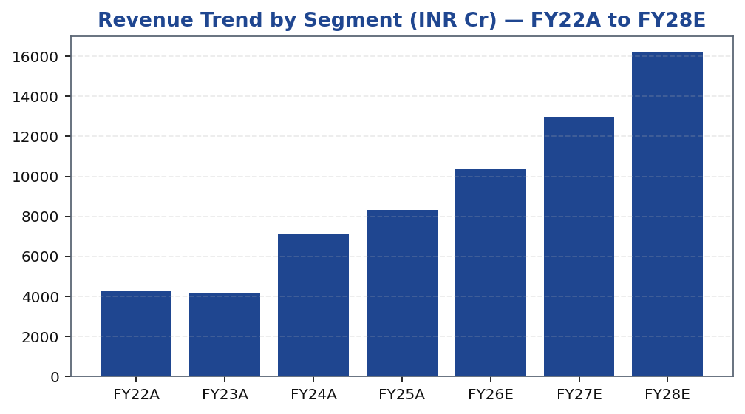
MOFSL | Pratik Gupta | 2026-04-28
Segment Architecture — Diversified Revenue Streams
MOFSL's revenue base is intentionally diversified across 6 operating segments, each at a different stage of maturity and with distinct margin profiles. The Capital Markets segment (broking, IB, distribution) remains the largest revenue contributor but is the most cyclical; Asset Management and Private Wealth are the fastest-growing annuity segments; Housing Finance and Alternatives provide credit and private-market diversification. Understanding this mix is essential for valuation, because th...
Segment | Revenue Share | EBITDA Share | Growth | AUM Metric | AUM Value | Key Driver
Capital Markets (Broking + IB) | 30.0% | — | — | Brokerage Rev YoY | -24% | Equity, derivatives, commodity, currency trading + institutional services and investment banking. Brokerage now contributes only 30% of total revenue, down from historical highs.
Asset Management | — | — | — | AMC AUM | INR 1.89L Cr (+33% YoY) | Mutual funds and PMS. 91% of AUM outperforming benchmarks over 3 years.
Private Wealth Management | — | — | — | PWM AUM | INR 1.96L Cr (+31% YoY) | HNI/UHNI advisory. Family count up 41% YoY.
Housing Finance | — | — | — | Loan Book | INR 6,630 Cr (+25% YoY) | Retail mortgage lending — affordable and mid-segment.
Alternative Investments | — | — | — | Carry Income | INR 58 Cr recurring | Private credit, real estate, alternatives.
Tikona Capital | SEBI Registration No.: INH000069807
Page 6 of 21

Slide 7
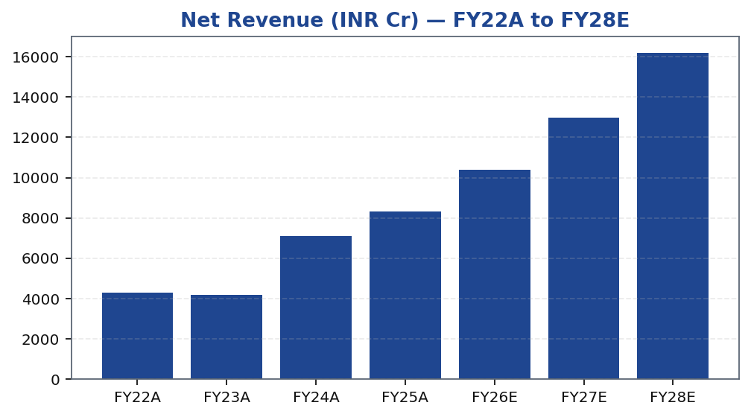
MOFSL | Pratik Gupta | 2026-04-28
Revenue Trajectory — ARR Mix Driving Re-Rating
MOFSL's revenue trajectory reflects two overlapping dynamics: cyclical amplification in bull-market years driven by broking and distribution, and structural growth in AMC management fees, wealth advisory fees, and alternatives performance fees that compounds regardless of short-term market levels. The pivot toward ARR is most visible in the fee-based share of total net revenues, which has expanded materially over the past three years. Looking through the FY26 quarterly setback — which was driven by SEBI's F&O margin and lot-size changes compressing derivative volumes — the underlying annuity revenue stream remained resilient. Analysts model a return to double-digit revenue growth from FY27 as the regulatory impact is absorbed and AUM-linked fees continue to grow.
Tikona Capital | SEBI Registration No.: INH000069807
Page 7 of 21

Slide 8
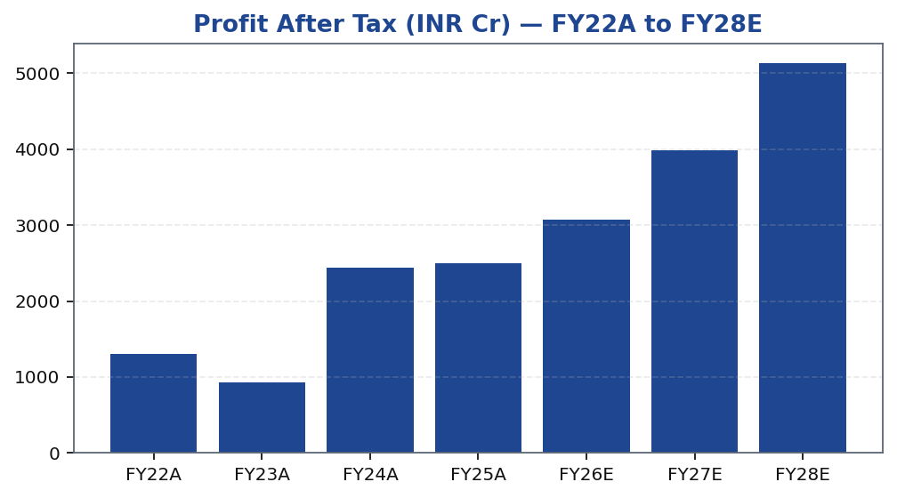
MOFSL | Pratik Gupta | 2026-04-28
Earnings Power — PAT Compounding Through the Cycle
Profit after tax growth for MOFSL has been strong over the FY22–FY25 period, benefiting from buoyant equity markets, strong AUM inflows, and operating leverage on a scaled distribution platform. The sharp decline in quarterly profit seen in Q2FY26 — driven by regulatory changes in the F&O segment — is a reminder that the broking segment retains meaningful cyclicality. However, our analysis indicates this was a transitional quarter rather than a structural deterioration: AMC management fees, private wealth advisory fees, and housing finance interest income continued to grow through this period. The earnings model for FY27 and FY28 is anchored on continued AUM growth, a recovery in Capital Markets revenues, and margin expansion from operating leverage — all three of which are independent of a return to peak F&O volumes.
Tikona Capital | SEBI Registration No.: INH000069807
Page 8 of 21

Slide 9
MOFSL | Pratik Gupta | 2026-04-28
Quarterly P&L Snapshot — Navigating Regulatory Disru...
The quarterly PAT series for MOFSL captures the full impact of SEBI's revised F&O framework, which took effect in late FY25 and materially compressed derivative broking volumes. The Q2FY26 quarter represents the peak regulatory impact period, with a sharp YoY decline in profitability driven almost entirely by the Capital Markets segment. The critical analytical question is whether the...
Quarter | PAT (INR Cr)
Q2FY25 | ₹1,242.0 Cr
Q3FY25 | ₹715.0 Cr
Q4FY25 | ₹545.0 Cr
Q1FY26 | ₹425.0 Cr
Q2FY26 | ₹401.0 Cr
Tikona Capital | SEBI Registration No.: INH000069807
Page 9 of 21

Slide 10
MOFSL | Pratik Gupta | 2026-04-28
Return & Margin Profile — FY22–FY28E
Ratio | Unit | FY22A | FY23A | FY24A | FY25A | FY26E | FY27E | FY28E
EBITDA Margin | % | 49.3% | 44.9% | 57.4% | 54.5% | 52.3% | 52.3% | 52.3%
PAT Margin | % | 30.5% | 22.3% | 34.4% | 30.0% | 29.5% | 30.7% | 31.7%
RoE | % | 23.0% | 15.0% | 28.0% | 23.0% | 22.0% | 23.0% | 24.0%
RoCE | % | 19.0% | 13.0% | 21.0% | 19.0% | 18.0% | 18.0% | 19.0%
RoIC | % | 92.0% | 78.0% | 119.0% | 87.0% | 35.0% | 24.0% | 24.0%
P/E | x | 37.5x | 52.3x | 20.1x | 19.7x | 16.1x | 12.4x | 9.6x
P/B | x | 8.7x | 7.8x | 5.6x | 4.5x | 3.6x | 2.9x | 2.3x
EV/EBITDA | x | 9.0x | 10.3x | 9.5x | 11.4x | 12.7x | 10.5x | 8.8x
Tikona Capital | SEBI Registration No.: INH000069807
Page 10 of 21

Slide 11
MOFSL | Pratik Gupta | 2026-04-28
Valuation Framework — Sum-of-Parts Approach
We value Motilal Oswal Financial Services using a Sum-of-Parts (SOTP) methodology, applying distinct valuation multiples to each business segment to reflect their different risk, growth, and earnings-quality profiles. The AMC and Private Wealth Management businesses — which generate recurring, AUM-linked fees with high incremental margins — are valued on earn...
Target Price (INR) ₹1,127.0
Probability-Weighted Target (INR) 1,109.0
Upside to TP (%) 37.0%
FY26E P/E (x) 16.1
Tikona Capital | SEBI Registration No.: INH000069807
Page 11 of 21

Slide 12
MOFSL | Pratik Gupta | 2026-04-28
Scenario Analysis & Valuation Bands
Method | Bear | Base | Bull | Weight | Key Assumptions
Bull Case | 1,400.0 | 1,400.0 | 1,400.0 | 30.0% | 28x P/E on FY27E EPS of INR 50; ARR > 70%, AMC +40% YoY.
Base Case | 1,127.0 | 1,127.0 | 1,127.0 | 50.0% | 24x P/E on FY27E EPS of INR 47; ARR stable at 65%, steady AUM.
Bear Case | 630.0 | 630.0 | 630.0 | 20.0% | 18x P/E on depressed FY27E EPS of INR 35; sustained regulatory headwinds.
Tikona Capital | SEBI Registration No.: INH000069807
Page 12 of 21

Slide 13
MOFSL | Pratik Gupta | 2026-04-28
SAARTHI Score 72/100 — Investment Quality Assessment
The SAARTHI framework assesses investment quality across 7 structured dimensions — covering Business Quality, Management Quality, Earnings Sustainability, Reinvestment Quality, Growth Optionality, Valuation, and Governance. A score of 72 out of 100 places MOFSL in the high-quality category, reflecting genuine competitive moats (research franchise, AUM scale, brand), disciplined capita...
ARR % of Revenue 65.0
ROE FY26E (%) 22.0
Credit Rating AA+ (Stable) ICRA
Code | Dimension | Score | Assessment | Key Evidence
S | Scalability of Core Engine | 12/15 | ARR at 61% of net revenues; fee-based at 45%. H1FY26 operating PAT INR 1,088 Cr (+11% YoY) on net revenue INR 2,888 Cr (+15%). Asset-light fee model scales without proportional cost growth. F&O constraints limit broking scalability near-term. | AMC AUM +33% YoY to INR 1.89L Cr with INR 11,610 Cr net flows.
A1 | Addressable Market & Adjacency | 9/10 | 16.57L HNWIs by 2027; India 4th-largest private wealth market by 2028 (+58.4% UHNWIs). Sector profits to nearly double by FY30. MF penetration at 5–6%. Massive TAM with adjacency expansion across capital markets, wealth, housing, alternatives. | India private credit hit USD 9.0 Bn in H1 2025 (+53% YoY).
A2 | Asymmetric Pricing Power | 10/15 | 91% of AUM outperforming benchmarks over 3 years gives pricing power in PMS/wealth. Brokerage revenue down 24% from regulatory changes — fee compression in cyclical segment. Discount brokers and fintech limit pricing in commoditized broking. | Diversified mix offset 24% brokerage decline, validating partial pricing-power hedge.
R | Reinvestment Quality | 13/15 | MCap INR 49,079 Cr (+24.8% YoY); P/E 24.2; P/B 3.82. Strong RoCE; disciplined allocation into high-return fee businesses. Reinvestment in tech, talent, distribution, research generates sustainable advantage. | PWM AUM +31% YoY to INR 1.96L Cr; family count +41%; PAT +14% (9M).
T | Track Record Through Adversity | 8/10 | Q2FY25 PAT INR 1,242 Cr (+123% YoY), 46% revenue growth, 48% RoE — recovery and execution. Q2FY26 PAT -67.6% YoY, revenue -34.9% YoY shows residual cyclicality from F&O regulation. Continuity across cycles maintained. | Despite repeated SEBI interventions, AUM and ARR base continue to compound — institutional resilience.
H | Human Capital & Institutional DNA | 9/10 | Raamdeo Agrawal: QGLP creator, 'Buy Right, Sit Tight' framework. Navin Agarwal (since 2000): business strategy and capital allocation. Ajay Menon (27+ yrs): operations, compliance, risk, technology. Founding duo across nearly four decades — rare DNA in Indian financial services. | Rashtriya Samman Patra recipient (top tax-payer FY95–FY99) signals early ethical commercial success.
I | Inflection Point Identification | 11/15 | Consensus TP INR 1,126.67 (max INR 1,200) vs CMP INR 822.90 — 37% upside; market not yet pricing ARR re-rating. Credit rating upgraded to AA+ (Stable) by ICRA. ARR > 70% would trigger re-rating from broking to asset-management multiples within 6–18 months. | ARR at 65% of net revenues (up from 61%); management guiding higher — measurable inflection.
Tikona Capital | SEBI Registration No.: INH000069807
Page 13 of 21

Slide 14
MOFSL | Pratik Gupta | 2026-04-28
Management Team — Founders and Second-Generation Lea...
MOFSL benefits from founder-led governance with Motilal Oswal and Raamdeo Agrawal remaining active in setting strategy and culture nearly four decades after founding. The founding duo's public profile — Raamdeo Agrawal is widely regarded as one of India's most respected equity investors — adds credibility to the research franchise and continues to attract institutional client relation...
Name | Role | Background
Raamdeo Agrawal | Chairman, MOFSL & Chairman, AMC | Co-founder (1987). Creator of the QGLP investment process and 'Buy Right, Sit Tight' framework. Built one of India's most respected investment research franchises. Widely cited investment thinker.
Motilal Oswal | Founder, Chairman & MD | Co-founder (1987). Led the firm's transformation from broking house into a comprehensive financial services platform. Recipient of Rashtriya Samman Patra for being among the highest taxpayers FY95–FY99.
Navin Agarwal | Executive Board — Strategy & Capital Allocation | Joined 2000. Drives business strategy and capital allocation across the Group, building market-leading positions through disciplined deployment.
Ajay Menon | Executive — Operations, Compliance, Risk & Technology | Joined 1998. 27+ years in Indian capital markets. Cornerstone of operational excellence and technology initiatives across the Group.
Tikona Capital | SEBI Registration No.: INH000069807
Page 14 of 21

Slide 15
MOFSL | Pratik Gupta | 2026-04-28
Forensic Assessment — Monitor Closely
Our forensic assessment of Motilal Oswal Financial Services places the company in the Monitor Closely category — a designation that reflects recurring but non-critical regulatory interactions rather than a finding of material fraud or governance failure. SEBI matters in the broking and capital markets space are not uncommon for integrated financial services firms operating at MOFSL's...
Matter | Description | Severity
SEBI — Margin Reporting Violations | INR 7 lakh penalty for margin reporting, collection violations, and other regulatory lapses found during inspection. | Low
SEBI — Client Fund Misutilization (2022) | INR 25 lakh fine for misutilization of client funds and inaccurate margin reporting. | Medium
NSEL — Misselling Accusations | Accused alongside other top brokers of misselling NSEL contracts, KYC manipulation, client code modification, and illegal transactions per SFIO/EOW findings. | High (Historical)
SEBI — Not Fit and Proper (Commodities) | Declared 'not fit and proper' as commodity derivative broker in Feb 2019 based on SFIO/EOW recommendations. | High (Historical)
Unauthorized Terminal Operations | 13 NSE and 9 BSE terminals operating from undeclared locations including an unreported branch in Delhi. | Medium
Tikona Capital | SEBI Registration No.: INH000069807
Page 15 of 21

Slide 16
MOFSL | Pratik Gupta | 2026-04-28
Key Risks — What Could Break the Thesis
- SEBI F&O regulatory tightening beyond current norms could structurally impair broking revenues for multiple years, not just transitionally — this is the single largest earnings risk.
- Sustained quarterly earnings weakness in the Capital Markets segment risks a derating of the entire franchise multiple if annuity growth cannot fully offset the decline in investor perception.
- Competitive intensity from zero-commission discount brokers and fintech platforms is compressing retail broking yields and market-share, pressuring the legacy broking revenue line.
- Mark-to-market losses on the proprietary investment book could introduce unexpected P&L volatility in equity market corrections, masking underlying operating performance trends.
- Housing Finance asset-quality deterioration in a slowing credit cycle could require elevated provisions that dilute consolidated ROE and raise capital adequacy concerns in the NBFC segment.
- Governance and regulatory monitoring risk: recurring SEBI matters, while not currently material, could escalate and impose reputational or financial penalties that impair franchise value.
Tikona Capital | SEBI Registration No.: INH000069807
Page 16 of 21

Slide 17
MOFSL | Pratik Gupta | 2026-04-28
Trading Strategy — Entry, Review, and Exit Parameters
CMP (INR) ₹822.9
Target Price (INR) ₹1,127.0
Upside (%) 37.0%
Our recommended approach for institutional investors is to build a position at or near current market levels, treating near-term regulatory-induced earnings weakness as a temporary dislocation rather than a structural deterioration. The investment horizon is 12–18 months, aligned with the ARR mix crossing the next step-up threshold and AUM-linked fees continuing to compound. Position sizing should account for quarterly earnings lumpiness — particularly in the Capital Markets segment — and investors should avoid drawing conclusions from any single quarter. The review trigger is the ARR percentage crossing upward, which would confirm the re-rating thesis is on track. An adverse SEBI order of material size would be a negative catalyst requiring position reassessment.
- Entry Zone: Current market price represents a material discount to both the base-case target and the probability-weighted t...
- Add Trigger: Any regulatory clarity on F&O norms or a quarter showing ARR crossing a higher threshold of net revenues would...
- Review Trigger: Monitor quarterly ARR contribution, AMC net flows, and Private Wealth family count additions — these three...
- Caution Trigger: A second consecutive quarter of material AMC net outflows or an adverse SEBI order above a threshold size...
- Exit / Stop: If ARR mix stagnates or reverses over two consecutive half-years, or if regulatory risk materialises into stru...
Tikona Capital | SEBI Registration No.: INH000069807
Page 17 of 21

Slide 18
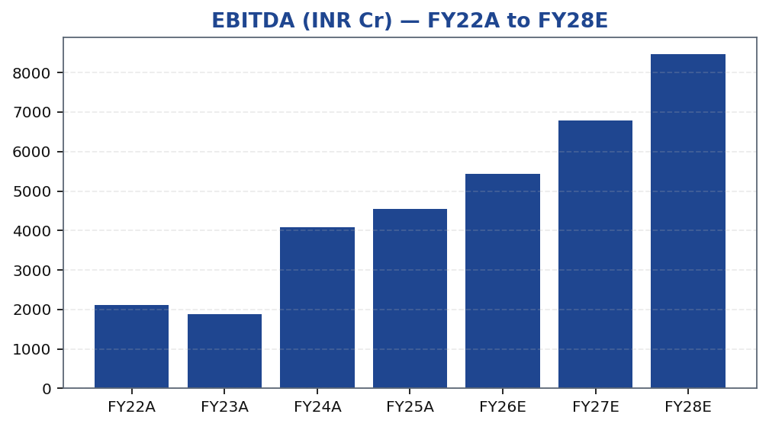
MOFSL | Pratik Gupta | 2026-04-28
EBITDA Trend — Operational Earnings Power FY22–FY28E
Tikona Capital | SEBI Registration No.: INH000069807
Page 18 of 21

Slide 19
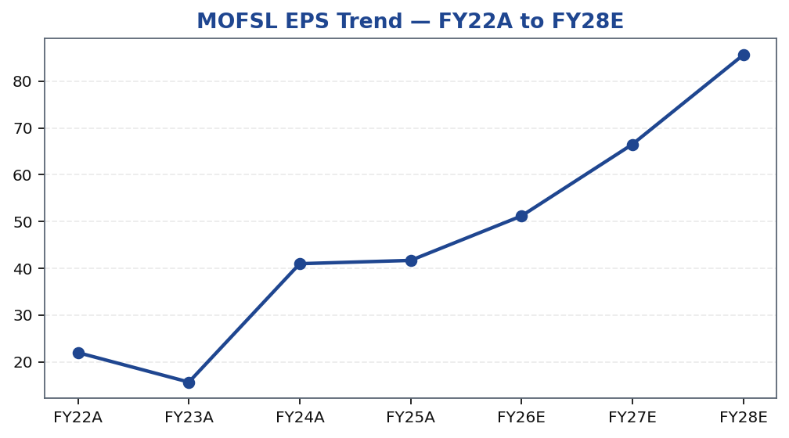
MOFSL | Pratik Gupta | 2026-04-28
Price Performance — MOFSL vs. Nifty 50
Tikona Capital | SEBI Registration No.: INH000069807
Page 19 of 21

Slide 20
MOFSL | Pratik Gupta | 2026-04-28
Catalysts — What Drives the Re-Rating
The path from current market price to our analyst target is not dependent on a single macro event — it is grounded in a series of measurable, business-level milestones that are within MOFSL's control. The primary re-rating catalyst is the ARR mix crossing the next threshold of total net revenues, which would trigger a re-benchmarking of the earnings multiple from broking-company peers to asset-management peers. Secondary catalysts include AUM compounding above our base-case assumption, regulatory clarity on F&O norms, and evidence of operating leverage in the quarterly cost-to-income ratio. Each of these catalysts is observable in quarterly disclosures, making thesis tracking straightforward for active investors with a clear monitoring framework.
- ARR crossing the next step-up threshold of total net revenues is the single most important re-rating catalyst, as it justif...
- Sustained AMC AUM growth above the base-case assumption with positive net flows would signal that benchmark outperformance...
- Private Wealth family count expansion and ARPU improvement would confirm the wealth management engine is scaling profitably...
- Regulatory clarity from SEBI on F&O lot sizes and margin norms would remove the key overhang on Capital Markets revenue and...
- Declining cost-to-income ratio in sequential quarters would demonstrate operating leverage and support the margin expansion...
- Announced strategic partnerships or product launches in alternative assets or private credit would expand the AUM addressab...
Tikona Capital | SEBI Registration No.: INH000069807
Page 20 of 21

Slide 21
MOFSL | Pratik Gupta | 2026-04-28
Disclaimer
This research report has been prepared by Tikona Capital, a SEBI-registered research analyst entity. This document is for informational purposes only and does not constitute an offer, solicitation, or recommendation to buy or sell any securities. The analyst(s) responsible for the preparation of this report hereby certify that the views expressed in this report accurately reflect their personal views about the subject securities or issuers. This report has been prepared on the basis of publicly available information and sources believed to be reliable; however, Tikona Capital does not guarantee its accuracy or completeness. Tikona Capital, its affiliates, directors, employees, or associates may have positions in the securities covered in this report. Investors are advised to independently evaluate all investment decisions with reference to their own financial circumstances, investment objectives, and risk tolerance. Past performance is not indicative of future results. Investing in equity markets involves risk, including the possible loss of the amount invested. This report is intended solely for the use of the recipient and may not be redistributed without the prior written consent of Tikona Capital. SEBI Registration Number: [INH000000000]. Registered Office: [Address]. For any queries, please contact compliance@tikonacapital.com. The renderer may replace this text with approved SEBI boilerplate as required by the compliance function.
Tikona Capital | SEBI Registration No.: INH000069807
Page 21 of 21

