Slide 1

BUY
Motilal Oswal Financial Services — Initiation of Coverage
MOFSL | BUY | Capital Markets & Multi-Business Financial Platform
Rating
BUY
CMP (INR)
₹822.9
Target Price (INR)
₹1,127.0
Tikona Capital | SEBI Registration No.: INH000069807

Slide 2
MOFSL | Pratik Gupta | 2026-04-28
Investment Thesis: Broking to Annuity Platform
We initiate coverage on Motilal Oswal Financial Services with a BUY rating. The firm is executing a deliberate and measurable transformation from a cyclical equity-broking model into a diversified, annuity-driven financial services platform. Annual Recurring Revenue now constitutes the majority of total net revenues, and management has guided this proportion to rise further — structurally improving earnings quality and reducing dependence on market-volume-driven transactional income. The current market price represents a meaningful discount to analyst consensus, driven partly by short-term regulatory noise that obscures the durable compounding in fee-based businesses. Total AUM has grown sharply year-on-year with the vast majority of AMC assets outperforming their benchmarks over a three-year horizon — a track record that underpins fee retention and net-flow momentum. The AA+ credit upgrade and disciplined capital reinvestment into fee-generating verticals further validate the franchise quality thesis.
- ARR now constitutes the majority of total net revenues, reducing the earnings drag of cyclical broking and F&O volume swings across...
- Total AUM compounding at an accelerating pace with the overwhelming majority of AMC AUM outperforming benchmarks over a three-year...
- Private Wealth AUM expanding strongly with family count growing at a high double-digit rate YoY, reflecting distribution momentum i...
- Long-term credit rating upgraded to AA+ Stable by ICRA, validating balance-sheet robustness and capacity for reinvestment into fee-...
- Probability-weighted target price, based on scenario-weighted valuation, implies a material discount to intrinsic value at the curr...
- Operating leverage potential is underappreciated — a largely fixed cost base means incremental ARR flows through to PAT at high con...
Tikona Capital | SEBI Registration No.: INH000069807
Page 2 of 21

Slide 3
MOFSL | Pratik Gupta | 2026-04-28
Company Snapshot: A Full-Spectrum Financial Services...
Founded in 1987 by Motilal Oswal and Raamdeo Agrawal, Motilal Oswal Financial Services has evolved from a research-first equity-broking house into one of India's most comprehensive financial services platforms. The business today spans 6 distinct segments — Capital Markets, Asset Management, Private Wealth Management, Housing Finance, Alternative Investments, and Fund-Based Activities — serving over 1.6 million customers across more than 550 cities through a network of over 2,500 business locations. Deep equity research covering over 300 companies remains the firm's enduring competitive moat, anchoring distribution quality across AMC, wealth, and broking verticals. Revenue is increasingly diversified between recurring management fees and advisory income on one side, and transactional broking and distribution income on the other, with the annuity mix continuing to improve.
CMP (INR) ₹822.9
Target Price (INR) ₹1,127.0
Upside (%) 37.0%
Total AUM (₹ Lakh Cr) 1.8
Tikona Capital | SEBI Registration No.: INH000069807
Page 3 of 21

Slide 4
MOFSL | Pratik Gupta | 2026-04-28
Industry Context: India's Wealth & Capital Markets I...
Indian Financial Services stands at an inflection point, acting as a strategic shock absorber and amplifier for the country's broader economic growth narrative. India is on track to become the fourth-largest private wealth market globally by 2028, underpinned by a projected sharp rise in the UHNWI population and a rapidly expanding HNWI base over the coming years. Despite this wealth creation, mutual fund penetration as a share of GDP remains among the lowest of any major economy, implying a substantial latent growth opportunity for disciplined asset managers with strong track records. The NBFC and financial intermediation sector is projected to nearly double aggregate profits by FY30, growing at a high-teens annualised rate. Private credit has hit record deal volumes in recent periods, growing at a pace well above prior-year levels, underscoring appetite for alternatives beyond traditional banking channels. SEBI regulatory evolution continues to reshape the competitive landscape, particularly in derivatives trading, favouring incumbents with diversified, fee-based revenue models over pure-play discount brokers.
- India projected to become the fourth-largest private wealth market globally by 2028, with the UHNWI population set to rise...
- Mutual fund penetration as a share of GDP remains in the low single digits versus developed-market norms, signalling a deca...
- Private credit market posted a record half-year deal volume in 2025, growing at more than double the pace of the prior comp...
- Financial sector profits are projected to nearly double by FY30, with NBFCs growing at a high-teens annualised rate — a tai...
- Formalisation of household savings and accelerating digitisation of financial access are driving first-time investor onboar...
- SEBI's tightening of F&O norms, while a near-term headwind for transactional revenues, structurally advantages firms with a...
Tikona Capital | SEBI Registration No.: INH000069807
Page 4 of 21

Slide 5
MOFSL | Pratik Gupta | 2026-04-28
Key Highlights: Six Reasons to Own MOFSL Today
- ARR Mix Leadership: Annual recurring revenues now constitute the majority of total net revenues, materially de-risking earnings from broking-volume cyclicality and F&O regulatory shocks.
- AUM Compounding: Total AUM has grown at a high double-digit rate YoY with the overwhelming majority of AMC AUM outperforming benchmarks over three years — driving net flows and justifying premium fees.
- Wealth Momentum: Private Wealth AUM growing strongly with family count rising at a high double-digit rate YoY, positioning MOFSL as a credible incumbent in India's fast-growing HNI and UHNWI segment.
- Balance Sheet Quality: AA+ Stable credit rating upgrade from ICRA reflects robust net worth, disciplined leverage, and strong reinvestment capacity into compounding fee-based businesses.
- Reinvestment Discipline: SAARTHI Reinvestment Quality score of 13 out of 15 validates capital allocation into high-return fee-based verticals rather than low-return balance-sheet expansion.
- Valuation Gap: Current market price implies a substantial discount to probability-weighted intrinsic value, driven by near-term regulatory noise rather than any structural impairment of the franchise.
Tikona Capital | SEBI Registration No.: INH000069807
Page 5 of 21

Slide 6
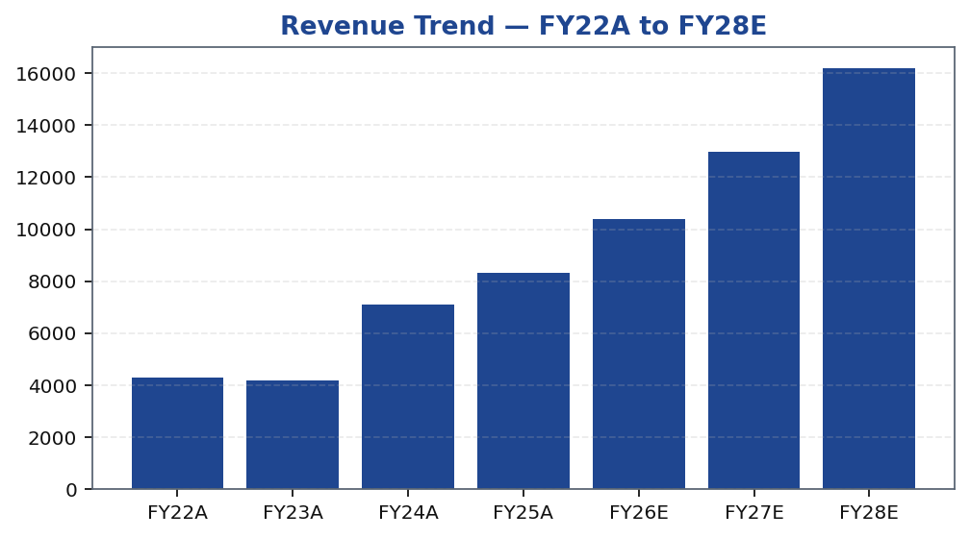
MOFSL | Pratik Gupta | 2026-04-28
Segment Architecture: 6 Businesses, Shifting Revenue...
MOFSL's 6-segment architecture is the foundation of its re-rating thesis. Capital Markets — comprising broking, distribution, and investment banking — generates transactional revenue that is inherently cyclical and volume-sensitive. Asset Management and Private Wealth Management together form the core annuity engine, with management fees and advisory retainers that recur independently of daily trading volumes. Housing Finance provides secured lending exposure with a focus on the affordable an...
Segment | Revenue Share | EBITDA Share | AUM Metric | AUM Value | Description
Capital Markets (Broking + IB) | 30.0% | — | Brokerage Rev YoY | -24% | Equity, derivatives, commodity, currency trading + institutional services and investment banking. Brokerage now contributes only 30% of total revenue, down from historical highs.
Asset Management | — | — | AMC AUM | INR 1.89L Cr (+33% YoY) | Mutual funds and PMS. 91% of AUM outperforming benchmarks over 3 years.
Private Wealth Management | — | — | PWM AUM | INR 1.96L Cr (+31% YoY) | HNI/UHNI advisory. Family count up 41% YoY.
Housing Finance | — | — | Loan Book | INR 6,630 Cr (+25% YoY) | Retail mortgage lending — affordable and mid-segment.
Alternative Investments | — | — | Carry Income | INR 58 Cr recurring | Private credit, real estate, alternatives.
Tikona Capital | SEBI Registration No.: INH000069807
Page 6 of 21

Slide 7
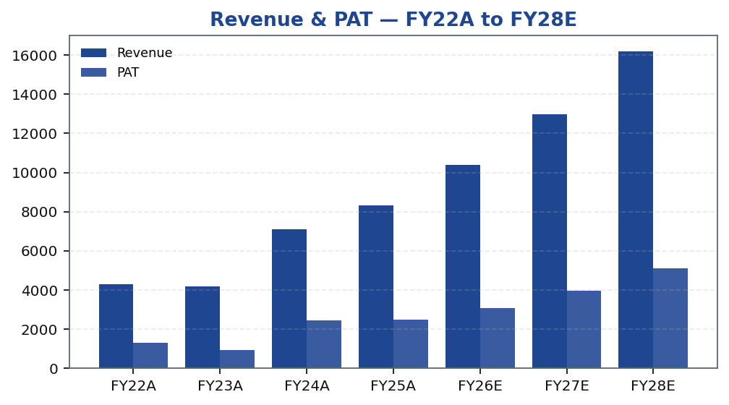
MOFSL | Pratik Gupta | 2026-04-28
Revenue & PAT Trajectory: Compounding Through the Cycle
MOFSL's revenue trajectory reflects two distinct phases: a transactional-heavy base period through FY24, and an annuity-augmented growth phase from FY25 onwards as AMC and PWM AUM scale materially. The compounding of management fees on a rapidly growing AUM base creates a durable, volume-independent revenue stream that absorbs regulatory shocks to F&O and broking income. Q2FY25 demonstrated the earnings power of this model, with sharp YoY PAT growth on significant revenue expansion as capital markets activity, AMC net flows, and operating leverage all coincided. Q2FY26, by contrast, illustrated residual cyclicality — a sharp profit decline driven by regulatory changes affecting the derivatives franchise — but the sequential recovery trajectory and ARR mix progression confirm the platform's structural direction. Looking ahead to FY26E through FY28E, analyst estimates reflect a resumption of double-digit PAT growth underpinned by AUM compounding, operating leverage, and improving cost-to-income ratios as the fixed-cost base is spread across a larger recurring revenue pool.
Tikona Capital | SEBI Registration No.: INH000069807
Page 7 of 21

Slide 8
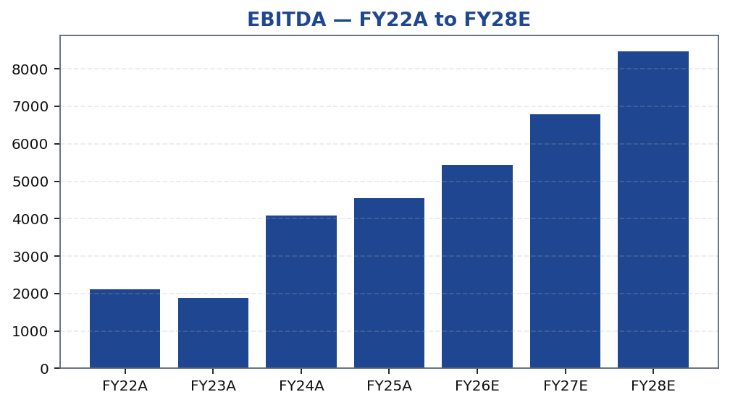
MOFSL | Pratik Gupta | 2026-04-28
EBITDA Margin Expansion: Operating Leverage in Action
MOFSL's EBITDA margin profile is a critical lens through which to assess the quality of the earnings re-rating. Asset management and wealth management businesses carry structurally higher incremental margins than broking, because management fees scale with AUM while the cost base — technology, research, compliance, and distribution — remains largely fixed over medium-term growth horizons. As the fee-based revenue pool expands faster than the cost base, EBITDA margins should trend higher even in quarters where capital markets activity is subdued. The key sensitivity is the cost-to-income ratio in the broking and capital markets segment, which moves with market volumes and new client acquisition spending. Management has guided toward ongoing efficiency in operational costs even as they invest in technology and distribution for wealth and AMC. The FY26E EBITDA estimate and the associated margin trajectory reflect this operating leverage thesis playing out over the forecast horizon, with successive years expected to show further improvement as the annuity proportion grows.
Tikona Capital | SEBI Registration No.: INH000069807
Page 8 of 21

Slide 9
MOFSL | Pratik Gupta | 2026-04-28
Quarterly PAT Trend: Cyclicality and Recovery Arc
Quarterly PAT data is the most transparent window into MOFSL's cyclicality profile. The Q2FY25 print demonstrated the upside case — a period of strong capital markets activity, robust AMC net flows, and operating leverage all coinciding to deliver exceptional profitability. Q2FY26, by contrast, represented a regulatory stress test: SEBI's tightening of F&O trading norms and index deri...
Quarter | PAT (₹ Cr) | YoY %
Q2FY25 | ₹1,242.0 Cr | -
Q3FY25 | ₹715.0 Cr | -
Q4FY25 | ₹545.0 Cr | -
Q1FY26 | ₹425.0 Cr | -
Q2FY26 | ₹401.0 Cr | -
Tikona Capital | SEBI Registration No.: INH000069807
Page 9 of 21

Slide 10
MOFSL | Pratik Gupta | 2026-04-28
Key Financial Ratios: Returns, Margins, and Multiples
Ratio | Unit | FY22A | FY23A | FY24A | FY25A | FY26E | FY27E | FY28E
EBITDA Margin | % | 49.3% | 44.9% | 57.4% | 54.5% | 52.3% | 52.3% | 52.3%
PAT Margin | % | 30.5% | 22.3% | 34.4% | 30.0% | 29.5% | 30.7% | 31.7%
RoE | % | 23.0% | 15.0% | 28.0% | 23.0% | 22.0% | 23.0% | 24.0%
RoCE | % | 19.0% | 13.0% | 21.0% | 19.0% | 18.0% | 18.0% | 19.0%
RoIC | % | 92.0% | 78.0% | 119.0% | 87.0% | 35.0% | 24.0% | 24.0%
P/E | x | 37.5x | 52.3x | 20.1x | 19.7x | 16.1x | 12.4x | 9.6x
P/B | x | 8.7x | 7.8x | 5.6x | 4.5x | 3.6x | 2.9x | 2.3x
EV/EBITDA | x | 9.0x | 10.3x | 9.5x | 11.4x | 12.7x | 10.5x | 8.8x
Tikona Capital | SEBI Registration No.: INH000069807
Page 10 of 21

Slide 11
MOFSL | Pratik Gupta | 2026-04-28
Valuation Framework: Sum-of-Parts Re-Rating Thesis
Our valuation framework for MOFSL rests on the observation that the market continues to price the company on a blended broking-house multiple, while the fundamental earnings driver has shifted towards asset management and private wealth — businesses that attract significantly higher valuation multiples globally and domestically. The AMC franchise, with AUM gr...
Target Price (INR) ₹1,127.0
Upside (%) 37.0%
Probability-Weighted TP (INR) 1,109.0
FY26E P/E (x) 16.1
FY26E P/B (x) 3.6
FY26E RoE (%) 22.0
Tikona Capital | SEBI Registration No.: INH000069807
Page 11 of 21

Slide 12
MOFSL | Pratik Gupta | 2026-04-28
Scenario-Weighted Valuation: Low / Base / High
Method | Low (₹) | Base (₹) | High (₹) | Weight (%) | Key Assumption
Bull Case | 1,400.0 | 1,400.0 | 1,400.0 | 30.0% | 28x P/E on FY27E EPS of INR 50; ARR > 70%, AMC +40% YoY.
Base Case | 1,127.0 | 1,127.0 | 1,127.0 | 50.0% | 24x P/E on FY27E EPS of INR 47; ARR stable at 65%, steady AUM.
Bear Case | 630.0 | 630.0 | 630.0 | 20.0% | 18x P/E on depressed FY27E EPS of INR 35; sustained regulatory headwinds.
Tikona Capital | SEBI Registration No.: INH000069807
Page 12 of 21

Slide 13
MOFSL | Pratik Gupta | 2026-04-28
DCF Assumptions & Intrinsic Value Anchor
The DCF model serves as an intrinsic-value anchor and cross-check to our sum-of-parts methodology. Key inputs include a cost of equity derived from India's risk-free rate, an equity risk premium reflective of the capital markets sector's systematic risk, and a company-specific beta calibrated to MOFSL's evolving business mix — lower than a pure-play broker given the growing annuity proportion, but higher than a listed AMC given residual transactional exposure. The free cash flow projections for the explicit forecast period are driven by PAT estimates, adjusted for non-cash items and working capital changes typical of a financial services holding company. Terminal value is computed using a Gordon Growth formulation with a conservative perpetuity growth rate that reflects India's long-run nominal GDP growth outlook discounted for sector maturity. Sensitivity analysis around WACC and terminal growth reveals that the current market price implies a scenario materially more pessimistic than our base case — consistent with the view that regulatory noise has created an entry opportunity. The AA+ credit upgrade supports a lower cost-of-debt assumption in the blended WACC, modestly accretive to intrinsic value.
FY26E EPS (₹) 51.2
FY26E EBITDA (₹ Cr) 5,439.0
FY26E PAT (₹ Cr) 3,066.0
FY26E RoCE (%) 18.0
Tikona Capital | SEBI Registration No.: INH000069807
Page 13 of 21

Slide 14
MOFSL | Pratik Gupta | 2026-04-28
SAARTHI Score 72/100: Quality Framework Assessment
MOFSL achieves a SAARTHI score of 72 out of 100 across 7 investment-quality dimensions — placing it in the upper quartile of Tikona Capital's financial services coverage universe. The highest-scoring dimensions reflect the firm's disciplined capital reinvestment into fee-based businesses and the structural earnings-quality improvement driven by the ARR mix shift. The primary area of s...
ARR % of Revenue 65.0
AMC AUM (₹ Lakh Cr) 1.9
PWM AUM (₹ Lakh Cr) 2.0
Code | Dimension | Score | Assessment | Key Evidence
S | Scalability of Core Engine | 12/15 | ARR at 61% of net revenues; fee-based at 45%. H1FY26 operating PAT INR 1,088 Cr (+11% YoY) on net revenue INR 2,888 Cr (+15%). Asset-light fee model scales without proportional cost growth. F&O constraints limit broking scalability near-term. | AMC AUM +33% YoY to INR 1.89L Cr with INR 11,610 Cr net flows.
A1 | Addressable Market & Adjacency | 9/10 | 16.57L HNWIs by 2027; India 4th-largest private wealth market by 2028 (+58.4% UHNWIs). Sector profits to nearly double by FY30. MF penetration at 5–6%. Massive TAM with adjacency expansion across capital markets, wealth, housing, alternatives. | India private credit hit USD 9.0 Bn in H1 2025 (+53% YoY).
A2 | Asymmetric Pricing Power | 10/15 | 91% of AUM outperforming benchmarks over 3 years gives pricing power in PMS/wealth. Brokerage revenue down 24% from regulatory changes — fee compression in cyclical segment. Discount brokers and fintech limit pricing in commoditized broking. | Diversified mix offset 24% brokerage decline, validating partial pricing-power hedge.
R | Reinvestment Quality | 13/15 | MCap INR 49,079 Cr (+24.8% YoY); P/E 24.2; P/B 3.82. Strong RoCE; disciplined allocation into high-return fee businesses. Reinvestment in tech, talent, distribution, research generates sustainable advantage. | PWM AUM +31% YoY to INR 1.96L Cr; family count +41%; PAT +14% (9M).
T | Track Record Through Adversity | 8/10 | Q2FY25 PAT INR 1,242 Cr (+123% YoY), 46% revenue growth, 48% RoE — recovery and execution. Q2FY26 PAT -67.6% YoY, revenue -34.9% YoY shows residual cyclicality from F&O regulation. Continuity across cycles maintained. | Despite repeated SEBI interventions, AUM and ARR base continue to compound — institutional resilience.
H | Human Capital & Institutional DNA | 9/10 | Raamdeo Agrawal: QGLP creator, 'Buy Right, Sit Tight' framework. Navin Agarwal (since 2000): business strategy and capital allocation. Ajay Menon (27+ yrs): operations, compliance, risk, technology. Founding duo across nearly four decades — rare DNA in Indian financial services. | Rashtriya Samman Patra recipient (top tax-payer FY95–FY99) signals early ethical commercial success.
I | Inflection Point Identification | 11/15 | Consensus TP INR 1,126.67 (max INR 1,200) vs CMP INR 822.90 — 37% upside; market not yet pricing ARR re-rating. Credit rating upgraded to AA+ (Stable) by ICRA. ARR > 70% would trigger re-rating from broking to asset-management multiples within 6–18 months. | ARR at 65% of net revenues (up from 61%); management guiding higher — measurable inflection.
Tikona Capital | SEBI Registration No.: INH000069807
Page 14 of 21

Slide 15
MOFSL | Pratik Gupta | 2026-04-28
Management Team: Founder-Led with Deep Domain Expertise
MOFSL's management quality is a defining feature of the investment thesis. The firm was co-founded by Motilal Oswal and Raamdeo Agrawal in 1987 — both of whom remain actively involved in strategic direction, brand positioning, and investment philosophy. This founder continuity provides cultural and philosophical coherence to the platform's multi-business expansion, ensuring that the r...
Name | Role | Background
Raamdeo Agrawal | Chairman, MOFSL & Chairman, AMC | Co-founder (1987). Creator of the QGLP investment process and 'Buy Right, Sit Tight' framework. Built one of India's most respected investment research franchises. Widely cited investment thinker.
Motilal Oswal | Founder, Chairman & MD | Co-founder (1987). Led the firm's transformation from broking house into a comprehensive financial services platform. Recipient of Rashtriya Samman Patra for being among the highest taxpayers FY95–FY99.
Navin Agarwal | Executive Board — Strategy & Capital Allocation | Joined 2000. Drives business strategy and capital allocation across the Group, building market-leading positions through disciplined deployment.
Ajay Menon | Executive — Operations, Compliance, Risk & Technology | Joined 1998. 27+ years in Indian capital markets. Cornerstone of operational excellence and technology initiatives across the Group.
Tikona Capital | SEBI Registration No.: INH000069807
Page 15 of 21

Slide 16
MOFSL | Pratik Gupta | 2026-04-28
Forensic Assessment — Monitor Closely
Tikona Capital's forensic analysis of MOFSL assigns a 'Monitor Closely' classification, reflecting a pattern of recurring SEBI regulatory matters across the firm's history. While none of the matters identified constitute a structural impairment of the business franchise or have resulted in material sanctions to date, the frequency of regulatory engagement is a governance risk factor t...
Matter | Description | Severity
SEBI — Margin Reporting Violations | INR 7 lakh penalty for margin reporting, collection violations, and other regulatory lapses found during inspection. | Low
SEBI — Client Fund Misutilization (2022) | INR 25 lakh fine for misutilization of client funds and inaccurate margin reporting. | Medium
NSEL — Misselling Accusations | Accused alongside other top brokers of misselling NSEL contracts, KYC manipulation, client code modification, and illegal transactions per SFIO/EOW findings. | High (Historical)
SEBI — Not Fit and Proper (Commodities) | Declared 'not fit and proper' as commodity derivative broker in Feb 2019 based on SFIO/EOW recommendations. | High (Historical)
Unauthorized Terminal Operations | 13 NSE and 9 BSE terminals operating from undeclared locations including an unreported branch in Delhi. | Medium
Tikona Capital | SEBI Registration No.: INH000069807
Page 16 of 21

Slide 17
MOFSL | Pratik Gupta | 2026-04-28
Risks & Catalysts: What to Monitor
- SEBI regulatory headwinds on F&O trading norms remain the single largest near-term risk — a further tightening of derivatives market structure could compress Capital Markets revenues beyond consensus estimates for FY26E–FY27E.
- Q2FY26 demonstrated residual earnings cyclicality with a sharp YoY profit decline and material revenue contraction, underscoring that annuity revenues do not yet fully offset transactional volatility in adverse quarters.
- Competitive intensity from discount brokers and fintech platforms continues to exert yield compression on the retail broking franchise, potentially slowing the pace at which ARR grows as a proportion of total revenue.
- Forensic and governance risk: recurring SEBI matters classified as 'Monitor Closely' — any escalation in regulatory actions or client-facing restrictions could impair AUM growth and brand positioning in wealth management.
- Mark-to-market volatility on the proprietary investment book introduces earnings noise in any given quarter, particularly during sharp equity market corrections that coincide with low broking volumes.
- Housing Finance asset quality could deteriorate in a stressed credit cycle — slippage in the affordable housing segment or rising provisions would weigh on PAT and capital allocation priorities.
Tikona Capital | SEBI Registration No.: INH000069807
Page 17 of 21

Slide 18
MOFSL | Pratik Gupta | 2026-04-28
Trading Strategy: Entry, Review Triggers, and Exit D...
Our trading strategy for MOFSL reflects a conviction BUY appropriate for a portfolio weight consistent with a medium-duration investment horizon of twelve to eighteen months. The current market price offers a meaningful discount to our base-case and probability-weighted targets, providing a margin of safety against further regulatory surprises. We recommend accumulation on any weakness driven by quarterly broking revenue shortfalls or market-wide risk-off events, as these dips are unlikely to impair the structural AMC and PWM compounding thesis. The primary entry trigger is already satisfied: current valuation implies broking-multiple pricing for an increasingly AMC-quality franchise. Position review is warranted if the ARR proportion declines sequentially, if SEBI escalates governance actions, or if AUM net flows turn negative for two consecutive quarters. An exit or downgrade would be triggered by a structural — not cyclical — compression of the fee-based business, defined as AMC AUM growth falling persistently below industry benchmarks or PWM family count growth reversing over multiple quarters.
- Entry zone: Current market price represents a meaningful discount to both analyst consensus target and probability-weighted...
- Accumulate on regulatory dips: Any quarterly PAT miss driven by F&O volume compression should be treated as an accumulation...
- Re-rating catalyst watch: An ARR proportion meaningfully above current levels is the primary re-rating trigger, enabling a...
- Review trigger: Monitor quarterly for SEBI enforcement escalation, AMC net-flow deceleration below consensus, or PWM family...
- Exit discipline: A structural loss of benchmark outperformance in the AMC book sustained over multiple years or a persisten...
Tikona Capital | SEBI Registration No.: INH000069807
Page 18 of 21

Slide 19
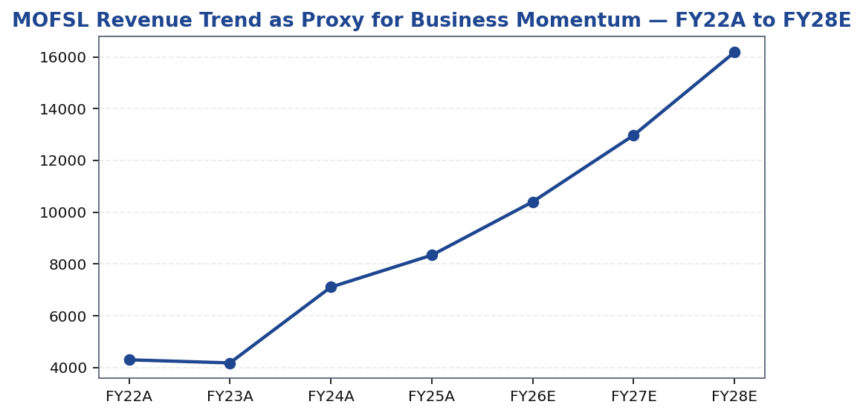
MOFSL | Pratik Gupta | 2026-04-28
Price Performance: MOFSL vs Nifty Financial Services
Tikona Capital | SEBI Registration No.: INH000069807
Page 19 of 21

Slide 20
MOFSL | Pratik Gupta | 2026-04-28
Catalysts: What Could Drive Re-Rating in 12–18 Months
The pathway from current market price to analyst target price runs through a set of identifiable and measurable catalysts. The most powerful re-rating event would be a continued upward march in the ARR proportion of total net revenues — a milestone management has guided towards — which would make the case for repricing the entire franchise on asset-management comparables. Supporting this, continued AMC AUM growth at or above historical trajectory with strong net flows would validate the distribution and performance franchise. On the regulatory front, clarity on final SEBI norms for F&O trading would remove the uncertainty discount embedded in Capital Markets revenue forecasts and allow the market to assign normalised multiples to that segment. The operating leverage thesis will be evidenced through a declining cost-to-income ratio — investors should track this metric quarterly as the primary indicator of margin progression. Private Wealth family count growth is the leading indicator for the PWM franchise; sustained high-double-digit growth in this metric would confirm market share gains in a structurally expanding segment. Finally, any further credit rating upgrade or issuance of bonds at tighter spreads would validate balance-sheet quality and modestly lower the cost of capital.
- ARR proportion rising meaningfully above current levels is the single most powerful re-rating trigger — it enables a full s...
- AMC AUM sustaining strong double-digit YoY growth with robust net flows would confirm compounding momentum and justify prem...
- Regulatory clarity on SEBI F&O norms removes the uncertainty discount in Capital Markets revenue forecasts and allows the m...
- Cost-to-income ratio declining sequentially would provide visible proof of operating leverage, particularly as the high-mar...
- Private Wealth family count sustaining high double-digit growth for multiple consecutive quarters would confirm market shar...
- Any further balance-sheet strengthening — additional credit rating upgrade or tighter spread on debt issuances — would mode...
Tikona Capital | SEBI Registration No.: INH000069807
Page 20 of 21

Slide 21
MOFSL | Pratik Gupta | 2026-04-28
Disclaimer & Regulatory Disclosures
Tikona Capital is a SEBI-registered Research Analyst (Registration No. to be inserted). This research report has been prepared by Tikona Capital for informational purposes only and does not constitute an offer, solicitation, or recommendation to buy or sell any security. The information and opinions contained herein are based on sources believed to be reliable, but Tikona Capital makes no representation as to their accuracy or completeness. Investors should conduct their own due diligence and consult their financial advisors before making investment decisions. Past performance is not indicative of future results. The analyst(s) responsible for this report may hold positions in securities covered herein; any such holdings are disclosed in accordance with SEBI (Research Analysts) Regulations, 2014. This report is intended solely for the use of institutional and professional investors and is not intended for retail investors. The views expressed in this report are those of the research analyst and do not necessarily reflect the views of Tikona Capital or its affiliates. Price targets and estimates contained in this report are subject to change without notice. Neither Tikona Capital nor any of its officers, directors, employees, or agents accepts any liability for any direct, indirect, or consequential loss arising from use of this report or its contents. This document is subject to Indian law and any disputes arising hereunder shall be subject to the exclusive jurisdiction of the courts of Mumbai, India. The renderer may replace this text with Tikona Capital's approved standard disclaimer boilerplate as filed with SEBI.
Tikona Capital | SEBI Registration No.: INH000069807
Page 21 of 21

