Slide 1

BUY
Motilal Oswal Financial Services — Initiation Note
MOFSL | BUY | Annuity Re-Rating in Progress
Rating
BUY
CMP
₹822.9
Target Price
₹1,127.0
Tikona Capital | SEBI Registration No.: INH000069807

Slide 2
MOFSL | Pratik Gupta | 2026-04-28
Investment Thesis: Broking House to Annuity Platform
We initiate coverage on Motilal Oswal Financial Services with a BUY rating. The firm is executing a deliberate and measurable migration from cyclical broking revenues toward a high-quality, annuity-driven financial services platform. Annual Recurring Revenue now constitutes a substantial majority of net revenues — with management guiding for further increases — fundamentally improving the quality and predictability of the earnings base. This structural shift has not yet been fully reflected in the market's valuation framework, which continues to apply broking-sector multiples to a business increasingly resembling an asset and wealth manager. The current market price therefore represents a meaningful discount to the analyst's probability-weighted target, creating an asymmetric risk-reward opportunity for long-horizon investors. The balance sheet has been reinforced by a long-term credit rating upgrade to AA+ (Stable) by ICRA, while total AUM has compounded sharply on a year-over-year basis across both the AMC and Private Wealth segments.
- ARR now forms the majority of net revenues, materially reducing dependence on cyclical broking and F&O transaction volumes across m...
- Total AUM has grown strongly year-on-year, with the vast majority of AMC AUM outperforming benchmarks over a 3-year horizon, suppor...
- Private Wealth AUM and family count are both compounding at high double-digit rates, signalling durable advisory revenue streams wi...
- Operating leverage on a largely fixed cost base positions MOFSL to deliver significant margin expansion as fee revenues scale beyon...
- AA+ (Stable) credit rating by ICRA endorses balance-sheet strength and validates the firm's capacity to fund reinvestment in fee-ba...
- Probability-weighted target accounts for regulatory scenario dispersion, providing a balanced view of risk-adjusted upside across b...
Tikona Capital | SEBI Registration No.: INH000069807
Page 2 of 21

Slide 3
MOFSL | Pratik Gupta | 2026-04-28
Company Snapshot: Integrated Financial Services Plat...
Motilal Oswal Financial Services, founded in 1987, has evolved from a research-driven equity broking house into one of India's most comprehensive financial services platforms. The company's revenue model spans 4 broad pillars — Capital Markets (broking, IB, distribution), Asset Management (equity mutual funds, PMS), Private Wealth Management, and Housing Finance — serving over 1.6 million customers across 550-plus cities through 2,500-plus business locations. Research coverage of 300-plus companies across market caps remains the firm's enduring competitive moat, differentiating it from pure-play discount brokers and underpinning the quality of its asset-management franchise. The shift toward fee-based recurring revenues across AMC and PWM is the primary re-rating lever for the stock.
CMP ₹822.9
Target Price ₹1,127.0
Upside 37.0%
Total AUM 1.8
Tikona Capital | SEBI Registration No.: INH000069807
Page 3 of 21

Slide 4
MOFSL | Pratik Gupta | 2026-04-28
Key Investment Highlights
- ARR Mix Transformation: Annual Recurring Revenue forms the majority of net revenues and is guided to rise further, structurally de-risking earnings from broking cycle volatility.
- AUM Compounding Engine: Total AUM has grown sharply year-on-year, with Private Wealth AUM and AMC AUM both outpacing broader market averages on flows and performance.
- Benchmark Outperformance: The vast majority of AMC AUM has outperformed its benchmark over a 3-year period, underpinning management fee durability and client retention.
- Credit Quality Upgrade: Long-term rating upgraded to AA+ (Stable) by ICRA, reflecting improved balance-sheet strength and reduced refinancing risk across the housing finance book.
- Reinvestment Discipline: Capital is being systematically redeployed into fee-based, higher-multiple businesses rather than into balance-sheet-intensive cyclical segments.
- Valuation Discount: The current market price represents a material discount to the probability-weighted analyst target, with upside underpinned by an ARR-driven re-rating thesis.
Tikona Capital | SEBI Registration No.: INH000069807
Page 4 of 21

Slide 5
MOFSL | Pratik Gupta | 2026-04-28
Industry Context: India's Wealth and Asset Managemen...
Indian Financial Services sits at the intersection of rising household wealth, low product penetration, and a rapidly formalising capital market ecosystem. Mutual fund penetration remains in the low single-digit percentage of GDP, reflecting a vast latent opportunity as retail and HNI savings migrate from physical assets into financial products. India's HNWI population is projected to grow significantly by 2027, with the country on track to become the fourth-largest private wealth market by 2028. The UHNWI segment is expected to see a particularly pronounced rise, driving demand for sophisticated wealth advisory and alternatives. The private credit market reached a record in the first half of 2025, growing substantially year-on-year, reflecting institutional appetite for yield-oriented products beyond conventional fixed income. Financial services sector profits are projected to nearly double by FY30, with non-bank lenders expanding at a high mid-teen annual rate — creating structural demand for integrated platforms like MOFSL that can originate, manage, and distribute across the capital spectrum.
- India is on track to become the fourth-largest private wealth market by 2028, underpinned by rapid UHNWI and HNWI populatio...
- Mutual fund penetration in the low single digits of GDP signals multi-decade headroom for SIP and lump-sum AUM accumulation...
- Private credit hit a record in H1 2025, growing well above prior-year levels, creating a durable alternative-investment dis...
- Financialisation of household savings is accelerating as physical asset allocation in gold and real estate gives way to cap...
- SEBI-led market structure reforms have deepened investor participation, expanding the addressable customer base for broking...
- Financial services sector earnings are projected to nearly double by FY30, with NBFCs contributing disproportionately to in...
Tikona Capital | SEBI Registration No.: INH000069807
Page 5 of 21

Slide 6
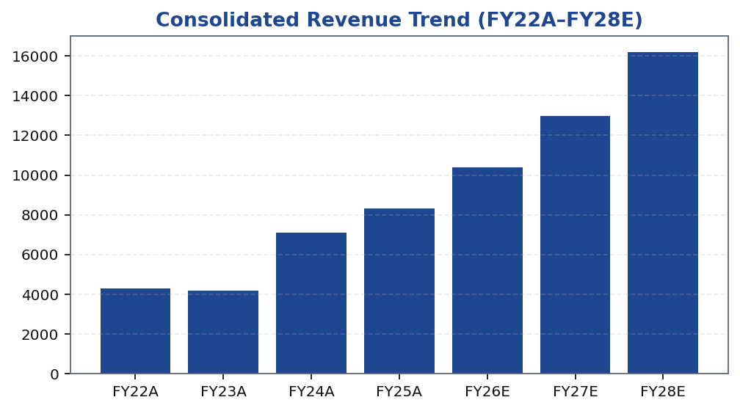
MOFSL | Pratik Gupta | 2026-04-28
Segment Architecture: 4-Pillar Revenue Model
MOFSL operates 4 distinct business segments, each with differentiated economics. Capital Markets contributes the largest share of revenues but carries the highest cyclicality; Asset Management and Private Wealth are the ARR engines that the market will increasingly reward with premium multiples. Housing Finance adds a balance-sheet-intensive leg with separate credit and margin dynamics. Understanding the inter-segment mix and its evolution is essential to tracking the re-rating catalyst — as...
Segment | Revenue Share | EBITDA Share | Growth | AUM Metric | AUM Value | Key Driver
Capital Markets (Broking + IB) | 30.0% | — | — | Brokerage Rev YoY | -24% | Equity, derivatives, commodity, currency trading + institutional services and investment banking. Brokerage now contributes only 30% of total revenue, down from historical highs.
Asset Management | — | — | — | AMC AUM | INR 1.89L Cr (+33% YoY) | Mutual funds and PMS. 91% of AUM outperforming benchmarks over 3 years.
Private Wealth Management | — | — | — | PWM AUM | INR 1.96L Cr (+31% YoY) | HNI/UHNI advisory. Family count up 41% YoY.
Housing Finance | — | — | — | Loan Book | INR 6,630 Cr (+25% YoY) | Retail mortgage lending — affordable and mid-segment.
Alternative Investments | — | — | — | Carry Income | INR 58 Cr recurring | Private credit, real estate, alternatives.
Tikona Capital | SEBI Registration No.: INH000069807
Page 6 of 21

Slide 7
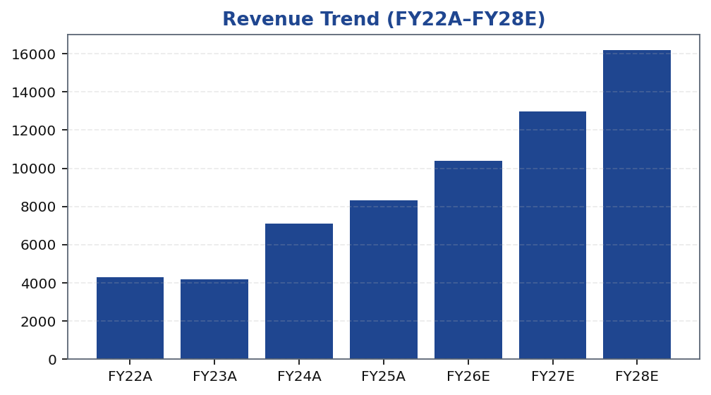
MOFSL | Pratik Gupta | 2026-04-28
Revenue Trajectory: From Cyclical to Compounding
MOFSL's consolidated revenue trajectory reflects the structural migration underway in the business mix. Capital Markets revenues remain subject to market volume and regulatory cycles — as evidenced by the sharp year-over-year decline in the most recent quarter — but AMC management fees and Private Wealth advisory retainers are growing at a pace that increasingly dominates the consolidated line. The FY26E and FY27E estimates embed a moderated Capital Markets contribution alongside continued high-teens-to-twenty-plus percent growth in recurring fee segments. EBITDA growth is expected to outpace revenue growth as operating leverage accrues from a largely fixed overhead base — technology, research, compliance — that was sized to support a larger transactional volume. Investors should focus on fee revenue CAGR and ARR share progression as the primary leading indicators for earnings quality improvement over the forecast period.
Tikona Capital | SEBI Registration No.: INH000069807
Page 7 of 21

Slide 8
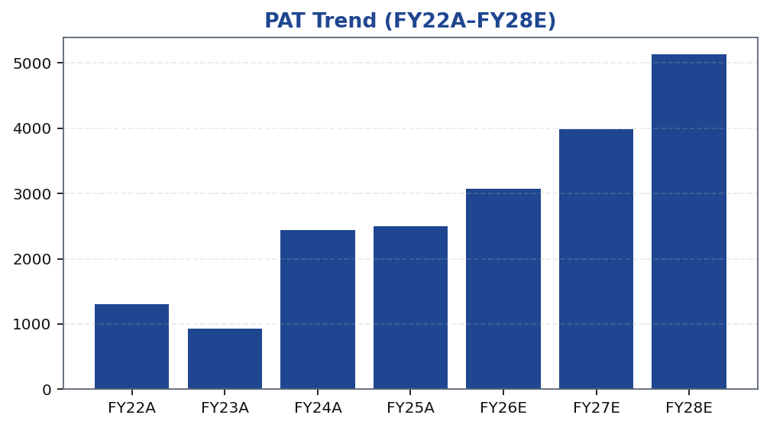
MOFSL | Pratik Gupta | 2026-04-28
Profitability: PAT Growth and Margin Expansion
MOFSL's profit-after-tax trajectory has been characterised by strong peaks driven by bull-market broking volumes and troughs driven by regulatory action or market slowdowns — a pattern that is expected to dampen as ARR grows as a share of revenues. The Q2FY25 performance demonstrated the platform's upside capture capacity: profit growth was exceptional year-on-year, driven by equity market buoyancy and strong AMC inflows. Conversely, Q2FY26 profit declined sharply year-on-year as SEBI's F&O rule changes compressed derivative transaction volumes, illustrating the residual cyclicality that remains in the Capital Markets segment. The forward earnings estimates reflect a normalised environment: AMC and PWM revenues compounding, broking revenues stabilising at a lower base, and housing finance growing steadily. EBITDA margins are projected to improve as the fixed cost base is absorbed across a larger recurring revenue pool, with ROE and ROCE both supported by disciplined capital allocation away from balance-sheet-intensive activities.
Tikona Capital | SEBI Registration No.: INH000069807
Page 8 of 21

Slide 9
MOFSL | Pratik Gupta | 2026-04-28
Quarterly Earnings: Volatility Profile and Trend
The quarterly earnings record is essential context for investors evaluating MOFSL's risk profile. Q2FY25 was a standout quarter — profits more than doubled year-on-year on the back of robust equity markets, strong AMC net inflows, and a buoyant broking environment. Q2FY26, however, saw profit fall sharply as SEBI's revised F&O trading norms took effect, compressing derivative volumes...
Quarter | PAT
Q2FY25 | ₹1,242.0 Cr
Q3FY25 | ₹715.0 Cr
Q4FY25 | ₹545.0 Cr
Q1FY26 | ₹425.0 Cr
Q2FY26 | ₹401.0 Cr
Tikona Capital | SEBI Registration No.: INH000069807
Page 9 of 21

Slide 10
MOFSL | Pratik Gupta | 2026-04-28
Key Ratios: Margins, Returns, and Valuation Multiples
Ratio | Unit | FY22A | FY23A | FY24A | FY25A | FY26E | FY27E | FY28E
EBITDA Margin | % | 49.3% | 44.9% | 57.4% | 54.5% | 52.3% | 52.3% | 52.3%
PAT Margin | % | 30.5% | 22.3% | 34.4% | 30.0% | 29.5% | 30.7% | 31.7%
RoE | % | 23.0% | 15.0% | 28.0% | 23.0% | 22.0% | 23.0% | 24.0%
RoCE | % | 19.0% | 13.0% | 21.0% | 19.0% | 18.0% | 18.0% | 19.0%
RoIC | % | 92.0% | 78.0% | 119.0% | 87.0% | 35.0% | 24.0% | 24.0%
P/E | x | 37.5x | 52.3x | 20.1x | 19.7x | 16.1x | 12.4x | 9.6x
P/B | x | 8.7x | 7.8x | 5.6x | 4.5x | 3.6x | 2.9x | 2.3x
EV/EBITDA | x | 9.0x | 10.3x | 9.5x | 11.4x | 12.7x | 10.5x | 8.8x
Tikona Capital | SEBI Registration No.: INH000069807
Page 10 of 21

Slide 11
MOFSL | Pratik Gupta | 2026-04-28
Valuation Summary: ARR Re-Rating Drives the Upside Case
Our valuation framework for MOFSL applies segment-level methodologies that reflect the distinct economic character of each business unit. The Asset Management and Private Wealth businesses are valued on earnings-per-share multiples consistent with asset-light, fee-driven comparables; Capital Markets is valued on a price-to-book basis reflecting its more cycli...
Target Price ₹1,127.0
Upside (%) 37.0%
Prob.-Weighted Target 1,109.0
P/E FY26E 16.1
Tikona Capital | SEBI Registration No.: INH000069807
Page 11 of 21

Slide 12
MOFSL | Pratik Gupta | 2026-04-28
Valuation Bands: Method, Scenario, and Target Reconc...
Valuation Method | Bear Case | Base Case | Bull Case | Weight | Notes
Bull Case | 1,400.0 | 1,400.0 | 1,400.0 | 30.0% | 28x P/E on FY27E EPS of INR 50; ARR > 70%, AMC +40% YoY.
Base Case | 1,127.0 | 1,127.0 | 1,127.0 | 50.0% | 24x P/E on FY27E EPS of INR 47; ARR stable at 65%, steady AUM.
Bear Case | 630.0 | 630.0 | 630.0 | 20.0% | 18x P/E on depressed FY27E EPS of INR 35; sustained regulatory headwinds.
Tikona Capital | SEBI Registration No.: INH000069807
Page 12 of 21

Slide 13
MOFSL | Pratik Gupta | 2026-04-28
Scenario Analysis: Regulatory and AUM Growth Sensiti...
Scenario | Revenue CAGR | EBITDA Margin | Target Price | Probability | Key Assumption
Bull | 27.5% | 55.0% | 1,400.0 | 30.0% | ARR > 70%, AMC AUM +40% YoY, regulatory clarity.
Base | 16.0% | 51.0% | 1,127.0 | 50.0% | ARR steady at 65%, AUM compounding, stable regulation.
Bear | 6.0% | 45.0% | 630.0 | 20.0% | Sustained F&O headwinds, fintech share loss.
Tikona Capital | SEBI Registration No.: INH000069807
Page 13 of 21

Slide 14
MOFSL | Pratik Gupta | 2026-04-28
SAARTHI Score 72/100 — Investment Quality Assessment
Our proprietary SAARTHI framework evaluates investment quality across 7 dimensions: Scalability, Advocacy moat, Annuity revenue, Return profile, Technology and compliance, Honesty of management, and Insider conviction. MOFSL scores well on the Annuity and Return dimensions, reflecting the ARR mix shift and strong ROE profile. The Reinvestment Quality sub-score is particularly high, co...
ARR as % of Revenue 65.0
RoE FY26E 22.0
RoCE FY26E 18.0
Code | Dimension | Score | Assessment | Evidence
S | Scalability of Core Engine | 12/15 | ARR at 61% of net revenues; fee-based at 45%. H1FY26 operating PAT INR 1,088 Cr (+11% YoY) on net revenue INR 2,888 Cr (+15%). Asset-light fee model scales without proportional cost growth. F&O constraints limit broking scalability near-term. | AMC AUM +33% YoY to INR 1.89L Cr with INR 11,610 Cr net flows.
A1 | Addressable Market & Adjacency | 9/10 | 16.57L HNWIs by 2027; India 4th-largest private wealth market by 2028 (+58.4% UHNWIs). Sector profits to nearly double by FY30. MF penetration at 5–6%. Massive TAM with adjacency expansion across capital markets, wealth, housing, alternatives. | India private credit hit USD 9.0 Bn in H1 2025 (+53% YoY).
A2 | Asymmetric Pricing Power | 10/15 | 91% of AUM outperforming benchmarks over 3 years gives pricing power in PMS/wealth. Brokerage revenue down 24% from regulatory changes — fee compression in cyclical segment. Discount brokers and fintech limit pricing in commoditized broking. | Diversified mix offset 24% brokerage decline, validating partial pricing-power hedge.
R | Reinvestment Quality | 13/15 | MCap INR 49,079 Cr (+24.8% YoY); P/E 24.2; P/B 3.82. Strong RoCE; disciplined allocation into high-return fee businesses. Reinvestment in tech, talent, distribution, research generates sustainable advantage. | PWM AUM +31% YoY to INR 1.96L Cr; family count +41%; PAT +14% (9M).
T | Track Record Through Adversity | 8/10 | Q2FY25 PAT INR 1,242 Cr (+123% YoY), 46% revenue growth, 48% RoE — recovery and execution. Q2FY26 PAT -67.6% YoY, revenue -34.9% YoY shows residual cyclicality from F&O regulation. Continuity across cycles maintained. | Despite repeated SEBI interventions, AUM and ARR base continue to compound — institutional resilience.
H | Human Capital & Institutional DNA | 9/10 | Raamdeo Agrawal: QGLP creator, 'Buy Right, Sit Tight' framework. Navin Agarwal (since 2000): business strategy and capital allocation. Ajay Menon (27+ yrs): operations, compliance, risk, technology. Founding duo across nearly four decades — rare DNA in Indian financial services. | Rashtriya Samman Patra recipient (top tax-payer FY95–FY99) signals early ethical commercial success.
I | Inflection Point Identification | 11/15 | Consensus TP INR 1,126.67 (max INR 1,200) vs CMP INR 822.90 — 37% upside; market not yet pricing ARR re-rating. Credit rating upgraded to AA+ (Stable) by ICRA. ARR > 70% would trigger re-rating from broking to asset-management multiples within 6–18 months. | ARR at 65% of net revenues (up from 61%); management guiding higher — measurable inflection.
Tikona Capital | SEBI Registration No.: INH000069807
Page 14 of 21

Slide 15
MOFSL | Pratik Gupta | 2026-04-28
Forensic Assessment — Monitor Closely
MOFSL has a history of recurring SEBI regulatory matters that institutional investors must monitor as part of ongoing due diligence. Our forensic review assigns the firm a 'Monitor Closely' classification — not a disqualifying flag, but a signal that governance quality and regulatory compliance should be tracked alongside financial performance. The matters identified are consistent wi...
Matter | Description | Severity
SEBI — Margin Reporting Violations | INR 7 lakh penalty for margin reporting, collection violations, and other regulatory lapses found during inspection. | Low
SEBI — Client Fund Misutilization (2022) | INR 25 lakh fine for misutilization of client funds and inaccurate margin reporting. | Medium
NSEL — Misselling Accusations | Accused alongside other top brokers of misselling NSEL contracts, KYC manipulation, client code modification, and illegal transactions per SFIO/EOW findings. | High (Historical)
SEBI — Not Fit and Proper (Commodities) | Declared 'not fit and proper' as commodity derivative broker in Feb 2019 based on SFIO/EOW recommendations. | High (Historical)
Unauthorized Terminal Operations | 13 NSE and 9 BSE terminals operating from undeclared locations including an unreported branch in Delhi. | Medium
Tikona Capital | SEBI Registration No.: INH000069807
Page 15 of 21

Slide 16
MOFSL | Pratik Gupta | 2026-04-28
Management Team: Founder-Led, Research-Rooted
MOFSL was co-founded in 1987 by Motilal Oswal and Raamdeo Agrawal, both of whom remain actively involved in strategic oversight. The firm's identity as a research-driven franchise is a direct extension of the founders' investment philosophy — value-oriented, conviction-heavy, and analytically rigorous. Leadership continuity at the top is a material positive for an asset and wealth man...
Name | Role | Background
Raamdeo Agrawal | Chairman, MOFSL & Chairman, AMC | Co-founder (1987). Creator of the QGLP investment process and 'Buy Right, Sit Tight' framework. Built one of India's most respected investment research franchises. Widely cited investment thinker.
Motilal Oswal | Founder, Chairman & MD | Co-founder (1987). Led the firm's transformation from broking house into a comprehensive financial services platform. Recipient of Rashtriya Samman Patra for being among the highest taxpayers FY95–FY99.
Navin Agarwal | Executive Board — Strategy & Capital Allocation | Joined 2000. Drives business strategy and capital allocation across the Group, building market-leading positions through disciplined deployment.
Ajay Menon | Executive — Operations, Compliance, Risk & Technology | Joined 1998. 27+ years in Indian capital markets. Cornerstone of operational excellence and technology initiatives across the Group.
Tikona Capital | SEBI Registration No.: INH000069807
Page 16 of 21

Slide 17
MOFSL | Pratik Gupta | 2026-04-28
Key Risks: What Could Break the Thesis
- SEBI F&O regulatory action remains the most material near-term risk; further restrictions on derivatives trading could structurally impair Capital Markets revenues beyond current estimates.
- Q2FY26 demonstrated residual earnings cyclicality — a sustained market downturn or prolonged low-volume regime would compress broking revenues and delay the ARR-share crossover.
- Competitive pressure from discount brokers and fintech platforms is compressing per-trade yields in equity cash and derivatives, threatening the revenue-per-customer trajectory.
- Housing Finance asset-quality slippage in a stressed credit cycle could generate elevated provisions and impair the segment's contribution to consolidated PAT.
- Mark-to-market losses on the proprietary investment book can create episodic earnings volatility that obscures the underlying franchise quality for external analysts.
- SEBI regulatory and forensic matters require ongoing monitoring; any escalation in enforcement action could have reputational and operational implications for the integrated platform.
Tikona Capital | SEBI Registration No.: INH000069807
Page 17 of 21

Slide 18
MOFSL | Pratik Gupta | 2026-04-28
Key Catalysts: What Could Accelerate the Re-Rating
- ARR share crossing a higher threshold of revenues would trigger a re-rating from broking-sector multiples to asset-management multiples, representing the single largest valuation catalyst.
- Sustained AMC AUM growth above trend with net flows exceeding a meaningful quarterly run-rate would validate the investment performance edge and fee retention capacity.
- Private Wealth AUM growth above prior-year rates alongside accelerating family count addition would confirm the advisory model is scaling without yield dilution.
- Regulatory clarity on F&O trading norms — particularly if revised rules are less restrictive than feared — would restore broking revenue visibility and remove a key overhang.
- Operating leverage materialisation through a declining cost-to-income ratio would demonstrate that the fixed-cost investment cycle is translating into margin expansion.
- Additional credit rating upgrades or improvement in housing finance asset quality metrics would reduce risk premium and support lower cost of funds across the NBFC subsidiary.
Tikona Capital | SEBI Registration No.: INH000069807
Page 18 of 21

Slide 19
MOFSL | Pratik Gupta | 2026-04-28
Trading Strategy: Entry, Monitoring, and Review Trig...
Our recommended approach is to initiate a position at or near current market levels, where the stock trades at a material discount to both the base-case and probability-weighted targets. The risk-reward profile is asymmetric: the bull case is driven by a re-rating catalyst (ARR crossing a higher share threshold) that is observable and time-bounded, while the bear case is bounded by the persistent cash-generation capacity of the AMC and PWM businesses. Position sizing should reflect the residual quarterly earnings volatility in Capital Markets — investors with a shorter time horizon should size more conservatively and use quarterly reporting events as review triggers. The target price and rating should be reviewed if ARR share falls below its current trajectory, if SEBI imposes materially more restrictive F&O regulations than currently enacted, or if Housing Finance NPA levels rise beyond a threshold consistent with base-case credit assumptions.
- Entry: Initiate at or near current market price; the discount to probability-weighted target provides a meaningful margin o...
- Add: Consider adding on dips driven by quarterly broking-revenue disappointment, as these do not impair the structural ARR...
- Review trigger — positive: ARR share inflection above a higher revenue threshold or AMC AUM net flows materially exceeding...
- Review trigger — negative: Further SEBI F&O restrictions beyond current rules, sustained decline in AMC benchmark outperfor...
- Exit: Revisit the thesis if ARR share trajectory reverses, management guidance on fee business growth decelerates materiall...
- Monitor quarterly: ARR as a percentage of net revenues, AMC AUM net flows, Private Wealth family count addition, and Capita...
- Monitor periodically: SEBI enforcement communications, housing finance NPA disclosures, proprietary book mark-to-market pos...
- Re-rating signal to watch: The first quarter in which AMC and PWM combined revenues clearly exceed Capital Markets revenues...
Tikona Capital | SEBI Registration No.: INH000069807
Page 19 of 21

Slide 20
MOFSL | Pratik Gupta | 2026-04-28
Investment Summary: BUY — Annuity Transformation at...
We initiate coverage on Motilal Oswal Financial Services with a BUY rating, grounded in the conviction that the market is applying an outdated, cyclical-broking valuation framework to a business that is structurally migrating toward asset and wealth management economics. ARR now constitutes the majority of net revenues and is growing faster than transactional revenues, driven by strong AUM compounding across both the AMC and Private Wealth segments. The vast majority of AMC AUM is outperforming benchmarks over a 3-year horizon, supporting fee retention and net-flow momentum. A long-term credit upgrade to AA+ (Stable) endorses balance-sheet strength. The current market price offers a material discount to our probability-weighted target, with the upside case anchored by an observable re-rating catalyst: ARR share crossing a higher threshold that justifies asset-management sector multiples. Risks are real — regulatory uncertainty around F&O norms, competitive yield pressure, housing finance credit cycles — but are assessed as more than reflected in the current discount. We recommend institutional investors initiate positions with a 12–18 month investment horizon and review at each quarterly earnings cycle.
- BUY rating based on ARR mix transformation driving a re-rating from broking to asset-management multiples — the primary val...
- Total AUM compounding strongly year-on-year across AMC and Private Wealth, with AMC benchmark outperformance providing a du...
- Probability-weighted target incorporates regulatory scenario dispersion; the current price represents a significant discoun...
- AA+ (Stable) credit rating by ICRA validates balance-sheet resilience and reduces cost-of-funds risk across the housing fin...
- SAARTHI score of 72/100 places MOFSL in the high-quality tier for the capital-markets sector, with Reinvestment Quality as...
- Key risk to monitor: SEBI F&O regulatory escalation; forensic matters are classified Monitor Closely and warrant ongoing at...
Tikona Capital | SEBI Registration No.: INH000069807
Page 20 of 21

Slide 21
MOFSL | Pratik Gupta | 2026-04-28
Disclaimer
This research report has been prepared by Tikona Capital, a SEBI-registered research analyst entity. The report is intended for informational purposes only and does not constitute an offer, solicitation, or recommendation to buy, sell, or hold any security. The information contained herein has been obtained from sources believed to be reliable, but Tikona Capital makes no representation or warranty, express or implied, as to its accuracy, completeness, or timeliness. Past performance of any security or financial instrument discussed herein is not a reliable indicator of future results. Investments in securities markets are subject to market risk; readers are advised to read all scheme-related documents and offering circulars carefully before investing. This report is not directed at, or intended for distribution to, any person or entity in any jurisdiction where such distribution would be contrary to applicable laws or regulations. Tikona Capital, its affiliates, directors, employees, and analysts may hold positions in the securities discussed in this report. Any opinions, estimates, or forecasts herein constitute the judgment of the analyst as of the date of this report and are subject to change without notice. Tikona Capital has no obligation to update, modify, or amend this report. SEBI Registration Number: [To be inserted by compliance]. CIN: [To be inserted by compliance]. The renderer may replace this block with approved compliance boilerplate as per firm policy.
Tikona Capital | SEBI Registration No.: INH000069807
Page 21 of 21

