Slide 1

BUY
ABC Ltd — Initiation of Coverage
ABC Ltd | BUY
Rating
BUY
CMP
₹420.0
Target Price
₹515.0
Tikona Capital | SEBI Registration No.: INH000069807

Slide 2
ABC | Jane Doe | 2026-04-28
Investment Thesis
We initiate coverage on ABC Ltd with a BUY rating, viewing the company as an emerging scaled specialty chemicals platform at an inflection point in both mix quality and export penetration. The business is transitioning away from lower-value commodity volumes toward higher-margin specialty formulations, a structural shift that we believe the market has not fully priced. Ongoing backward-integration investments are expected to underpin a sustained improvement in the gross margin profile, while management's demonstrated ability to execute across prior capex cycles provides confidence in earnings conversion over the medium term. The combination of expanding addressable markets, disciplined capital allocation, and a constructive demand environment across key end-use sectors supports our constructive view on the risk-reward balance at current levels.
- Export penetration is deepening as global customers diversify supply chains away from concentrated geographies, benefiting ABC's or...
- Product mix is shifting toward specialty formulations where realisation per tonne and margin profiles are structurally superior to...
- Backward integration into key intermediates is reducing raw material pass-through risk and supporting gross margin resilience acros...
- Management has delivered steady execution across prior capacity expansions, lending credibility to the current capex cycle and its...
- Demand visibility across core end markets remains healthy, supported by multi-year off-take arrangements and a diversified customer...
- Valuation upside is supported by a probability-weighted target price derived from earnings-based and free-cash-flow methods across...
Tikona Capital | SEBI Registration No.: INH000069807
Page 2 of 19

Slide 3
ABC | Jane Doe | 2026-04-28
Company Snapshot
ABC Ltd is a specialty chemicals manufacturer listed on the NSE, operating across multiple end-use segments including agrochemicals, pharmaceutical intermediates, and performance materials. The company generates revenue through a combination of domestic institutional supply agreements and export contracts, with the latter becoming an increasingly important growth vector. Its monetisation model is built on process chemistry expertise and capacity scale, with margin accretion driven by product mix enrichment and integration into upstream raw material steps. The business operates in a capital-intensive environment where utilisation rates and working capital efficiency are key levers for return-on-capital improvement, both of which management has been optimising through the current investment cycle.
CMP ₹420.0
Target Price ₹515.0
Upside 22.6%
Rating BUY
Tikona Capital | SEBI Registration No.: INH000069807
Page 3 of 19

Slide 4
ABC | Jane Doe | 2026-04-28
Industry Overview — Specialty Chemicals
The Indian specialty chemicals sector occupies a strategically significant position in the global supply chain, benefiting from a combination of process chemistry talent, cost-competitive manufacturing, and an improving regulatory environment that is attracting long-term offtake commitments from multinational customers. The sector spans agrochemicals, dyes and pigments, surfactants, performance polymers, and pharmaceutical intermediates — each sub-segment exhibiting distinct demand cycles but collectively underpinned by the broader shift toward supply-chain diversification away from China. Domestic demand is additionally supported by rising consumption in agriculture, personal care, and infrastructure chemicals. The competitive landscape is fragmenting as scale players invest in integration and application development, raising barriers to entry and supporting pricing power for established manufacturers. Capital intensity and regulatory compliance requirements are consolidating market share toward players with stronger process credentials and environmental management systems.
- China+1 supply chain restructuring is diverting long-term procurement volumes toward Indian manufacturers with scale, quali...
- Government production-linked incentive schemes are incentivising domestic capacity creation in key specialty intermediates,...
- Rising agrochemical consumption driven by farm mechanisation and crop protection adoption underpins steady base demand for...
- Pharmaceutical sector growth in domestic formulations and API exports is creating durable demand for high-purity intermedia...
- Environmental and ESG-linked procurement policies of global multinationals are progressively filtering out lower-compliance...
- Backward integration by domestic specialty players is reducing exposure to volatile global feedstock markets and improving...
Tikona Capital | SEBI Registration No.: INH000069807
Page 4 of 19

Slide 5
ABC | Jane Doe | 2026-04-28
Key Investment Highlights
- Mix Enrichment: Ongoing shift from commodity-grade volumes toward specialty formulations is the primary driver of EBITDA margin expansion in the forecast period.
- Export Penetration: International revenue is growing as a proportion of the total business, driven by multi-year supply agreements with global agro and pharma customers.
- Backward Integration: Captive intermediate production is reducing raw material cost volatility and supporting gross margin stability across input price cycles.
- Capex Discipline: Management has a demonstrated track record of capacity additions that convert to utilisation within planned timelines, protecting return-on-capital trajectories.
- Balance Sheet Health: Net debt-to-EBITDA remains within a manageable range even through the active investment phase, preserving financial flexibility for future expansion.
- Demand Visibility: Healthy order visibility across core end markets provides earnings predictability that justifies a premium multiple relative to commodity chemicals peers.
Tikona Capital | SEBI Registration No.: INH000069807
Page 5 of 19

Slide 6
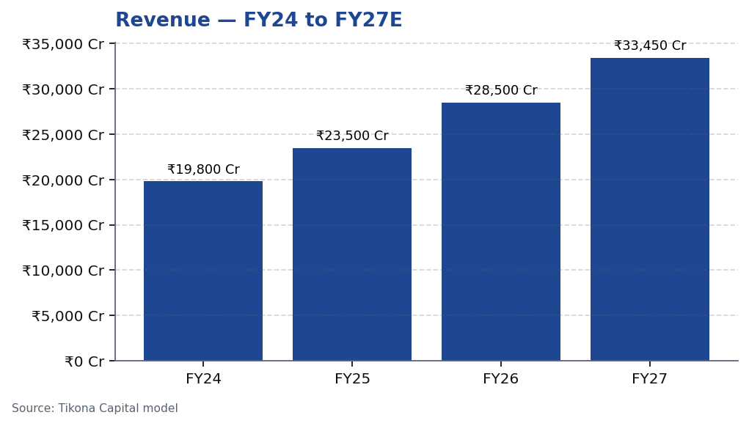
ABC | Jane Doe | 2026-04-28
Revenue Growth Trajectory
ABC Ltd's revenue trajectory reflects a deliberate combination of volume expansion from new capacity coming on-stream and mix improvement as the company progressively shifts product composition toward higher-value specialty grades. Growth in the near term is expected to be driven by export market penetration, where the company has secured incremental offtake commitments from existing and new customers, and by domestic demand recovery in key end-use sectors. The capacity additions undertaken in the prior investment cycle are maturing toward fuller utilisation, which should translate into operating leverage on the fixed cost base and accelerating EBITDA growth relative to revenue. Management's guidance has consistently emphasised quality of revenue growth over headline volume, a posture that is reflected in the improving margin profile observable across the forecast horizon. We expect the revenue trajectory to remain broadly on course barring meaningful disruption from external demand shocks or raw material availability constraints.
Tikona Capital | SEBI Registration No.: INH000069807
Page 6 of 19

Slide 7
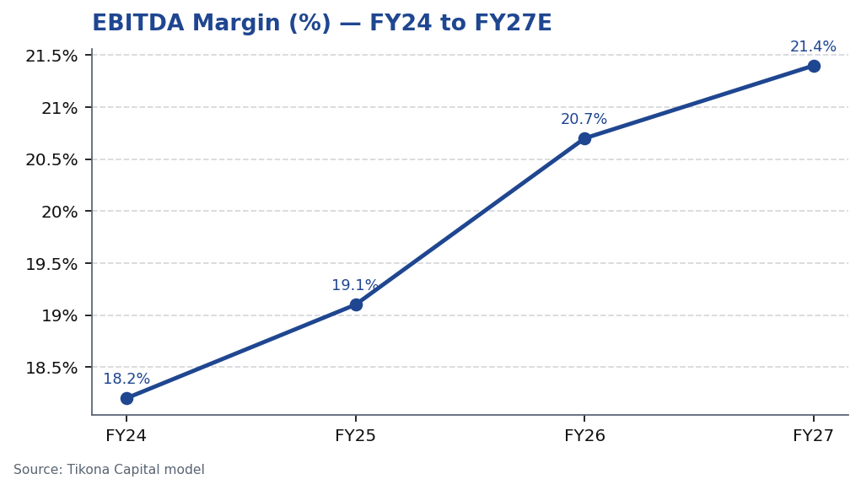
ABC | Jane Doe | 2026-04-28
EBITDA Margin Expansion
The EBITDA margin trajectory at ABC Ltd is the most direct expression of the mix-enrichment and backward-integration strategy. As the proportion of specialty-grade products in the revenue mix increases, blended realisations per tonne improve while the cost structure benefits from captive intermediate supply, producing a dual positive effect on margins. The integration investments, while depressing near-term free cash flow, are expected to deliver sustainable gross margin improvement by reducing the company's exposure to third-party feedstock pricing cycles. Fixed cost dilution through higher utilisation of existing assets provides an additional layer of operating leverage. Historically, management has demonstrated the ability to protect margins during raw material stress periods through a mix of pass-through clauses in customer contracts and inventory management. We project continued margin expansion through the forecast window, with the pace of improvement contingent on the utilisation ramp of recently commissioned capacities and the stability of export pricing environments.
Tikona Capital | SEBI Registration No.: INH000069807
Page 7 of 19

Slide 8
ABC | Jane Doe | 2026-04-28
Valuation Summary
Our target price for ABC Ltd is derived from a blended valuation framework that weights earnings-based multiples and discounted cash flow analysis, reflecting the company's current phase of transition from a growth-investment cycle toward normalised free cash generation. In the near term, the earnings-per-share trajectory is the primary valuation anchor, supp...
Target Price ₹515.0
Upside 22.6%
FY26E Revenue 28,500.0
FY26E EBITDA 5,900.0
Tikona Capital | SEBI Registration No.: INH000069807
Page 8 of 19

Slide 9
ABC | Jane Doe | 2026-04-28
DCF Framework
The discounted cash flow analysis underpinning our valuation assigns value to ABC Ltd's ability to convert EBITDA growth into free cash flow as the current capex cycle concludes and utilisation on newly commissioned assets rises toward designed capacity. The model assumes a multi-year explicit forecast window covering FY26 through FY30, during which we project progressive improvement in operating cash generation driven by margin expansion and working capital normalisation as the business scales. Beyond the explicit period, a terminal growth assumption reflects the company's estimated long-run nominal growth capacity in the specialty chemicals segment, consistent with sector precedents for integrated, export-oriented manufacturers. The discount rate is calibrated to reflect the cost of equity appropriate for a mid-cap specialty chemicals company listed on the NSE, accounting for sector-specific operating risk and balance sheet leverage at the current investment phase. Sensitivity analysis across the key assumptions — EBITDA margin trajectory, capex intensity, and terminal growth — suggests that the downside to intrinsic value is materially limited at the current market price, while upside scenarios where export ramp and integration benefits materialise ahead of schedule offer meaningful additional return.
FY26E PAT 3,450.0
Net Debt / EBITDA (FY26E) 0.8
Tikona Capital | SEBI Registration No.: INH000069807
Page 9 of 19

Slide 10
ABC | Jane Doe | 2026-04-28
Key Risks
- Raw material volatility: Key feedstock prices are subject to global commodity cycles; a sustained adverse move could compress gross margins materially and delay the integration benefit timeline.
- Utilisation ramp risk: Delays in reaching designed utilisation on newly commissioned capacities would push out earnings conversion, potentially extending the payback period on capital deployed.
- Export demand softness: A deceleration in global specialty chemicals demand, particularly from agrochemical or pharmaceutical end markets, could affect near-term revenue growth and export pricing.
- China competition: Renewed volume dumping or aggressive pricing from Chinese integrated manufacturers could pressure realisations for overlapping product categories in both domestic and export markets.
- Regulatory and environmental compliance: Tightening environmental norms domestically or in export destination markets could require incremental compliance capex and temporarily constrain production volumes.
- Execution risk on integration: Backward-integration projects are technically complex; cost overruns or operational issues during commissioning could delay the expected margin benefit and increase net debt levels.
Tikona Capital | SEBI Registration No.: INH000069807
Page 10 of 19

Slide 11
ABC | Jane Doe | 2026-04-28
Trading Strategy
Our trading strategy for ABC Ltd is premised on accumulating a position at or near current market levels, where we believe the risk-reward is asymmetrically positive relative to our base-case target price. The investment is best suited to investors with a medium-term horizon of twelve to twenty-four months, aligned with the expected timing of utilisation ramp-up on new capacities and the realisation of integration-led margin benefits. Near-term volatility is likely to be influenced by quarterly earnings progression versus expectations, raw material price movements, and macro-driven sector sentiment shifts — each of which could create tactical entry opportunities for patient investors. We recommend active monitoring of quarterly EBITDA margins, export revenue trends, and management commentary on capacity utilisation as the primary thesis-tracking metrics.
- Accumulate at current levels with a medium-term horizon, as the earnings inflection from utilisation ramp and margin expans...
- Add on dips triggered by sector-wide selloffs or raw material noise, provided fundamental thesis drivers — mix improvement...
- Review thesis if quarterly EBITDA margins fail to show sequential improvement for two consecutive periods or if management...
- Monitor export revenue contribution each quarter as the primary leading indicator of the international penetration thesis;...
- Exit or reduce position if net debt-to-EBITDA deteriorates meaningfully beyond current forecasts due to cost overruns on ca...
Tikona Capital | SEBI Registration No.: INH000069807
Page 11 of 19

Slide 12
ABC | Jane Doe | 2026-04-28
Financial Outlook — FY26 and FY27
The financial outlook for ABC Ltd over FY26 and FY27 is shaped by three converging drivers: the maturation of recently commissioned capacity toward higher utilisation, the progressive improvement in product mix toward specialty grades, and the cost benefit from backward-integration investments becoming operational. Together, these factors are expected to produce a meaningful acceleration in EBITDA and PAT growth relative to the topline, as operating leverage on the fixed cost base compounds with the margin-expansion effect of mix enrichment. Working capital intensity, which has historically been elevated during ramp-up phases, is expected to moderate as the business scales and customer payment terms normalise. Return on equity is forecast to improve as the earnings base grows without a commensurate increase in the capital base, a dynamic that should become increasingly visible in reported numbers through FY27. We note that the financial trajectory is sensitive to the pace of export offtake realisation, and a meaningful delay in international volume ramp could moderate the pace of PAT growth without altering the directional thesis.
- FY26E revenue growth is expected to be driven by a combination of new capacity contribution and export volume gains, with s...
- EBITDA margin improvement in FY26 and FY27 is underpinned by both gross margin gains from integration and fixed cost diluti...
- PAT growth is expected to outpace EBITDA growth in FY27 as the interest cost burden eases with debt repayment from operatin...
- Return on equity is forecast to improve meaningfully in FY27 as earnings compound faster than equity, reflecting the operat...
- Net debt-to-EBITDA is expected to trend downward through the forecast period as free cash generation improves and capital e...
Tikona Capital | SEBI Registration No.: INH000069807
Page 12 of 19

Slide 13
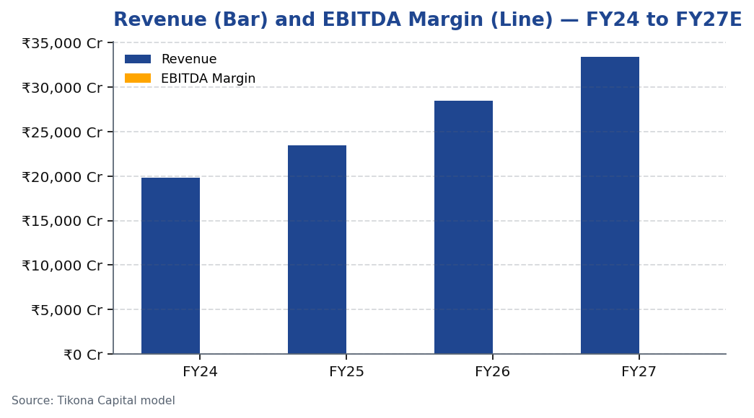
ABC | Jane Doe | 2026-04-28
Revenue and EBITDA Margin — Combined View
Tikona Capital | SEBI Registration No.: INH000069807
Page 13 of 19

Slide 14
ABC | Jane Doe | 2026-04-28
Competitive Positioning
ABC Ltd competes in a specialty chemicals landscape characterised by fragmentation at the lower end and meaningful scale advantages at the integrated manufacturer level. The company's competitive positioning rests on a combination of process chemistry depth, multi-product manufacturing capability, and a growing track record of reliable export delivery that is critical for retaining multinational customers operating under stringent supply chain quality requirements. The ongoing backward-integration investment differentiates ABC from pure conversion players by creating a cost-and-reliability advantage in key intermediates, while the export focus diversifies revenue away from domestic demand cycles. Management has consistently invested in R&D and process improvement, which supports gradual product portfolio upgrades and helps the company move up the value chain in its core end-use segments. Scale advantages in procurement and shared manufacturing infrastructure further support the competitive cost position versus smaller regional competitors.
- Process chemistry expertise across multiple synthesis routes provides a technical barrier to entry that cannot easily be re...
- Backward integration into key intermediates creates a structural cost advantage and reduces dependence on volatile third-pa...
- Export track record with multinational customers provides reputational credibility that is difficult for smaller or newer e...
- Multi-product manufacturing capability allows the company to optimise asset utilisation by flexing product mix in response...
- Domestic demand base provides a diversification buffer against export market volatility, reducing earnings cyclicality rela...
- Investment in environmental and quality compliance infrastructure positions the company favourably relative to lower-compli...
Tikona Capital | SEBI Registration No.: INH000069807
Page 14 of 19

Slide 15
ABC | Jane Doe | 2026-04-28
Raw Material and Working Capital Considerations
Raw material management is a critical operational discipline for ABC Ltd given that key feedstocks — primarily petrochemical derivatives and aromatic intermediates — exhibit meaningful price volatility linked to global crude oil markets and regional supply-demand dynamics. The company's backward-integration strategy directly addresses this exposure by internalising production of certain intermediates, thereby converting a variable external cost into a more manageable internal cost structure. However, residual exposure to third-party feedstock pricing remains and represents a risk to gross margin predictability in periods of rapid input price escalation. Working capital intensity is an inherent characteristic of specialty chemicals manufacturing, driven by inventory requirements at the raw material, work-in-progress, and finished goods stages, as well as debtor terms in customer contracts. Management has been focused on optimising working capital turns as the business scales, and we expect a gradual improvement in cash conversion as revenue grows and the proportion of contractual customers with structured payment terms increases. Monitoring debtor days and inventory days alongside reported EBITDA margins will be important for validating the cash generation thesis in coming quarters.
- Key raw material exposures include petrochemical derivatives and aromatic intermediates, both of which are subject to crude...
- Backward integration into select intermediates is partially hedging RM cost volatility, with the full benefit expected in g...
- Working capital intensity is characteristic of the specialty chemicals manufacturing model; management's focus on contractu...
- Inventory management practices have historically balanced adequate buffer stock against carrying cost efficiency; improveme...
- Customer contract structures for export volumes typically include partial raw material pass-through provisions, providing a...
- Net working capital as a proportion of revenue is a key metric to track alongside EBITDA margin; sustained improvement in t...
Tikona Capital | SEBI Registration No.: INH000069807
Page 15 of 19

Slide 16
ABC | Jane Doe | 2026-04-28
FY26E Financial Summary
Revenue (FY26E) | EBITDA (FY26E) | PAT (FY26E) | RoE (FY26E) | Net Debt / EBITDA (FY26E)
- | - | - | - | -
- | - | - | - | -
- | - | - | - | -
- | - | - | - | -
Tikona Capital | SEBI Registration No.: INH000069807
Page 16 of 19

Slide 17
ABC | Jane Doe | 2026-04-28
Catalysts to Watch
While our base case for ABC Ltd already incorporates a constructive margin and growth trajectory, several incremental catalysts could accelerate the investment thesis and support a faster re-rating than our base-case timeline assumes. These catalysts span operational milestones, market developments, and external policy changes — each capable of providing a positive surprise to consensus earnings estimates or to the multiple the market is willing to assign to the franchise. Investors monitoring the stock for tactical entry or sizing decisions should track these catalysts alongside the risk factors identified earlier in this report, as together they frame the range of outcomes around our base-case target price. The asymmetry between the upside catalysts and the downside risks, assessed on a probability-weighted basis, is a key input to our overall BUY recommendation.
- Faster-than-expected utilisation ramp on newly commissioned capacity would accelerate EBITDA growth and bring forward the f...
- New large export contract wins with multinational customers in pharmaceutical or agrochemical segments would validate the m...
- Sustained decline in key raw material input costs would expand gross margins above base-case assumptions, providing a posit...
- Favourable government policy announcements supporting domestic specialty chemicals manufacturing — such as extended PLI ben...
- Sector-wide re-rating driven by continued China+1 supply chain restructuring could lift peer multiples and carry ABC's valu...
- Successful commissioning of backward-integration assets ahead of schedule would de-risk the margin expansion timeline and p...
Tikona Capital | SEBI Registration No.: INH000069807
Page 17 of 19

Slide 18
ABC | Jane Doe | 2026-04-28
Initiation Summary — BUY
We initiate coverage on ABC Ltd with a BUY rating, premised on the company's credible transition toward a scaled specialty chemicals platform with improving mix quality, expanding export penetration, and a backward-integration strategy that supports structural gross margin improvement. The investment case is grounded in evidence of management execution across prior capex cycles, healthy demand visibility in core end markets, and a financial model that projects accelerating earnings conversion as utilisation on commissioned assets improves. The current valuation provides an entry point that does not fully price the medium-term earnings inflection, creating a risk-reward that we view as asymmetrically positive for investors with a twelve-to-twenty-four month horizon. Key monitoring metrics — EBITDA margin trajectory, export revenue growth, utilisation rates, and net debt evolution — provide clear thesis-tracking anchors for ongoing position management. We recommend investors accumulate at current levels and review the position as quarterly earnings data validate or challenge the assumed operational ramp trajectory.
- Specialty chemicals platform in transition: mix enrichment, export penetration, and integration are three concurrent driver...
- Management execution track record across prior capex cycles reduces execution risk discount and supports confidence in the...
- Valuation upside to target price is supported by both earnings-based and DCF methods, with the bull case offering meaningfu...
- Risk-reward is asymmetrically positive at current levels: the primary downside risks — RM volatility and utilisation delays...
- Key thesis-tracking metrics include quarterly EBITDA margin, export revenue contribution, utilisation guidance, and net deb...
- BUY recommendation is premised on a medium-term horizon; near-term earnings volatility from external factors should be view...
Tikona Capital | SEBI Registration No.: INH000069807
Page 18 of 19

Slide 19
ABC | Jane Doe | 2026-04-28
Disclaimer
This research report has been prepared by Tikona Capital, a SEBI-registered research analyst firm, for informational purposes only. The report is based on publicly available information and data sources believed to be reliable, but Tikona Capital does not warrant or guarantee the accuracy, completeness, or timeliness of the information contained herein. This report does not constitute investment advice, nor does it constitute an offer or solicitation to buy or sell any securities. The opinions, estimates, and forecasts expressed in this report reflect the analyst's judgment as of the date of publication and are subject to change without notice. Past performance of securities discussed herein is not indicative of future performance. Investing in equity securities involves significant risks, including the possible loss of the principal amount invested. Recipients of this report should conduct their own independent due diligence and consult with their financial advisors before making any investment decisions. Tikona Capital, its directors, employees, and affiliates may hold positions in the securities discussed in this report. This report is intended solely for the use of the recipient and may not be redistributed or reproduced in any form without the prior written consent of Tikona Capital. SEBI Registration: [Insert Registration Number]. This report is prepared in accordance with SEBI (Research Analysts) Regulations, 2014. The analyst certifies that the views expressed in this report accurately reflect personal views about the subject company and its securities, and that no part of the analyst's compensation was, is, or will be directly or indirectly related to the specific recommendations or views expressed herein. The renderer may replace this text with approved compliance boilerplate as required.
Tikona Capital | SEBI Registration No.: INH000069807
Page 19 of 19

