Slide 1

BUY
XYZ Finance Ltd — Update Note
XYZ Finance Ltd | BUY
Rating
BUY
CMP
₹178.0
Target Price
₹225.0
Tikona Capital | SEBI Registration No.: INH000069807

Slide 2
XYZ | Amit Rao | 2026-04-28
Company Snapshot
XYZ Finance Ltd is a diversified non-banking financial company with a growing secured retail loan franchise. The company generates income primarily through net interest spreads on a retail loan book that spans secured and semi-secured product categories. Its competitive positioning is anchored in branch-level distribution and a disciplined credit underwriting process that has supported improving return ratios over recent periods. Management has articulated a strategy of deepening penetration in existing geographies before expanding to new ones, which underpins the current phase of measured growth.
CMP ₹178.0
Target Price ₹225.0
Upside 26.4%
Tikona Capital | SEBI Registration No.: INH000069807
Page 2 of 10

Slide 3
XYZ | Amit Rao | 2026-04-28
Investment Thesis
We maintain a BUY rating on XYZ Finance. The company is executing a deliberate shift toward a secured loan mix, which structurally reduces credit-cost volatility and supports a more predictable earnings profile. Branch productivity improvements across newer cohorts indicate that the distribution buildout is translating into per-unit economics, while adequate funding access provides runway for the next leg of disbursement growth. The current market valuation does not fully reflect the improving return trajectory, presenting a risk-adjusted re-rating opportunity for patient investors.
- Secured mix expansion is the primary lever for credit-cost stability, reducing vulnerability to unsecured-cycle stress.
- Branch productivity across newer cohorts is inflecting upward, validating the distribution model and supporting operating leverage.
- Funding access remains adequate for planned disbursement growth, reducing refinancing risk over the near-to-medium term.
- Improving return ratios signal that the franchise is moving from investment mode toward a self-sustaining profitability phase.
- Disciplined balance-sheet management has preserved capital adequacy, providing headroom for continued loan-book expansion.
Tikona Capital | SEBI Registration No.: INH000069807
Page 3 of 10

Slide 4
XYZ | Amit Rao | 2026-04-28
Industry Overview — India NBFC Sector
India's NBFC sector plays a critical intermediation role in segments underserved by scheduled commercial banks, including small-ticket secured loans, vehicle finance, and affordable housing. Regulatory evolution under the RBI's scale-based framework has raised compliance requirements but simultaneously narrowed the competitive field, favouring well-capitalised and well-governed entities. Credit penetration in Tier-II and Tier-III geographies remains structurally low relative to formal income levels, creating a long runway for lenders with adequate distribution networks. Funding conditions have normalised materially from the tightness witnessed in prior credit cycles, supporting net interest margins for disciplined borrowers. The secured retail lending sub-segment, in particular, benefits from improving collateral frameworks and digital credit bureau coverage, both of which reduce adverse selection risk.
- Under-penetration in Tier-II/III markets provides a multi-year growth runway for branch-led NBFCs with local distribution m...
- RBI scale-based regulation is pruning weaker competitors, improving the risk-return environment for compliant, well-rated f...
- Normalised funding costs post the liquidity tightening episode support margin recovery for NBFCs with diversified borrowing...
- Digital credit bureau expansion is reducing credit-cost surprises, particularly in first-time borrower segments.
- Favourable demographic profile of India's working-age population sustains demand for secured consumption and asset-building...
Tikona Capital | SEBI Registration No.: INH000069807
Page 4 of 10

Slide 5
XYZ | Amit Rao | 2026-04-28
Key Highlights
- Secured Mix Shift: The portfolio mix is tilting toward secured products, structurally dampening credit-cost cyclicality versus prior years.
- Branch Productivity: Newer branch cohorts are demonstrating improving disbursement and collection metrics, validating the expansion model.
- Funding Stability: Diversified liability franchise with adequate committed lines provides visibility on near-term growth funding.
- Return Trajectory: NIM and PAT trends for FY26 reflect the operating leverage inherent in a scaling secured-loan book.
- Valuation Re-rating: The stock trades at a discount to the fundamental value implied by improving ROE, offering a risk-adjusted upside to our target price.
Tikona Capital | SEBI Registration No.: INH000069807
Page 5 of 10

Slide 6
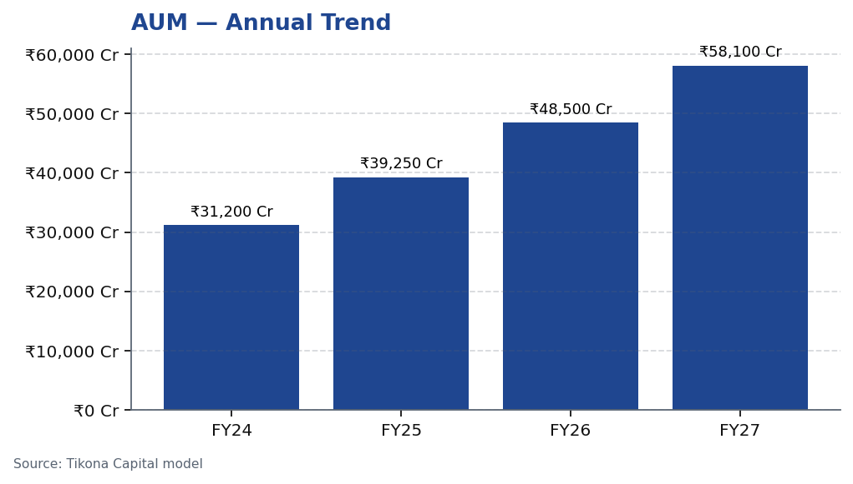
XYZ | Amit Rao | 2026-04-28
AUM Growth Trajectory
XYZ Finance's loan assets under management have grown consistently, driven by a deliberate push into secured retail products that carry lower risk weights and more stable credit costs than unsecured alternatives. The growth trajectory reflects both new-to-credit customer acquisition and deeper penetration within existing geographies. Importantly, the company has maintained disbursement momentum without compromising on underwriting standards, as evidenced by stable to improving portfolio quality metrics. The AUM build over FY24 through FY27 reflects the scaling of a branch network that has now passed initial productivity inflection points in most older cohorts.
Tikona Capital | SEBI Registration No.: INH000069807
Page 6 of 10

Slide 7
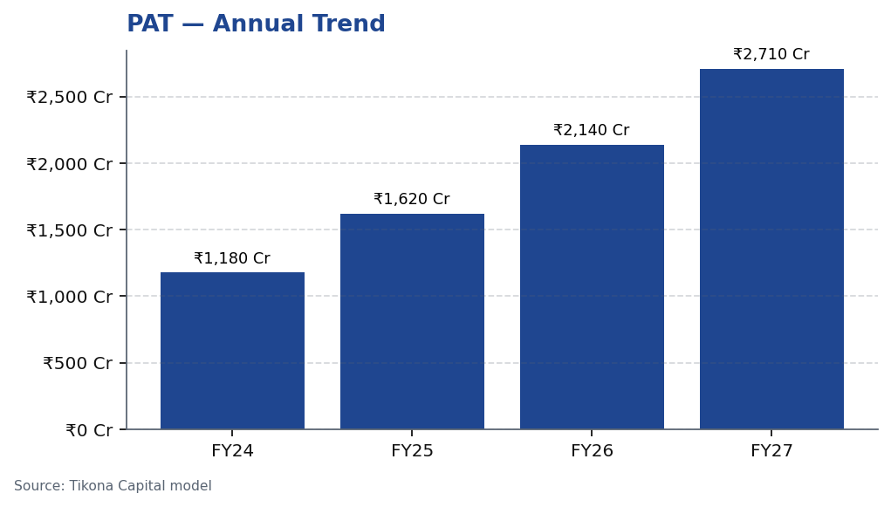
XYZ | Amit Rao | 2026-04-28
Profitability — PAT Growth
Profit after tax growth at XYZ Finance reflects a convergence of positive operating drivers: NIM resilience underpinned by the secured mix, operating leverage as branch costs amortise over a larger loan base, and contained credit costs stemming from disciplined collateral-backed underwriting. The cost-to-income ratio is on a gradual improvement path as revenue growth outpaces the incremental cost of branch and headcount additions. Going forward, the key earnings sensitivity lies in the trajectory of credit costs — any acceleration in the secured mix shift would support further PAT outperformance relative to estimates. FY26 and FY27 estimates embed conservative credit-cost assumptions to reflect macro uncertainty.
Tikona Capital | SEBI Registration No.: INH000069807
Page 7 of 10

Slide 8
XYZ | Amit Rao | 2026-04-28
Valuation Summary
Our target price for XYZ Finance is derived from a price-to-book approach calibrated to the company's improving return-on-equity trajectory. NBFCs in the secured lending segment command valuation multiples commensurate with the quality, consistency, and growth of their return ratios. As XYZ Finance's ROE converges toward peer medians through FY26 and FY27, a...
Target Price ₹225.0
CMP ₹178.0
Upside 26.4%
FY26E ROE 16.9
Tikona Capital | SEBI Registration No.: INH000069807
Page 8 of 10

Slide 9
XYZ | Amit Rao | 2026-04-28
Risks and Monitoring Points
- Competitive intensity from banks and fintech lenders could compress lending spreads, limiting the NIM expansion embedded in our estimates.
- Asset-quality normalisation may take longer than expected if macroeconomic conditions in target geographies deteriorate, elevating credit costs above our base-case assumption.
- Execution slippage in new geographies could slow disbursement momentum and delay the operating leverage that underpins our FY27 profitability estimate.
- Regulatory tightening — including RBI guidelines on NBFC risk weights or provisioning norms — could increase capital consumption and moderate ROE improvement.
- Funding market tightness, if it recurs, could widen borrowing costs and compress net interest margins for mid-tier NBFCs including XYZ Finance.
Tikona Capital | SEBI Registration No.: INH000069807
Page 9 of 10

Slide 10
XYZ | Amit Rao | 2026-04-28
Disclaimer
This research report has been prepared by Tikona Capital, a SEBI-registered research analyst entity. The information contained herein is based on sources believed to be reliable but is not guaranteed as to accuracy or completeness. This report is for informational purposes only and does not constitute an offer, solicitation, or recommendation to buy or sell any securities. Past performance is not indicative of future results. Investments in securities markets are subject to market risks; please read all related documents carefully before investing. The analyst(s) responsible for the preparation of this report certify that the views expressed herein accurately reflect their personal views about the subject securities and issuers. Tikona Capital and its affiliates may hold positions in the securities discussed. This report is not directed to, or intended for distribution to, any person in any jurisdiction where such distribution would be contrary to applicable laws or regulations. Readers should independently verify all investment decisions with their registered financial advisors. SEBI Registration details of Tikona Capital are available on the SEBI website. This document is confidential and intended solely for the use of the individual or entity to which it is addressed. The renderer may substitute this text with Tikona Capital's approved regulatory boilerplate in the final published version.
Tikona Capital | SEBI Registration No.: INH000069807
Page 10 of 10

