Slide 1

BUY
Motilal Oswal Financial Services — Initiation of Coverage
MOFSL | BUY | Capital Markets Franchise in Structural Transition
Rating
BUY
CMP
₹822.9
Target Price
₹1,127.0
Tikona Capital | SEBI Registration No.: INH000069807

Slide 2
MOFSL | Pratik Gupta | 2026-04-28
Investment Thesis: From Cyclical Broker to Annuity Platform
We initiate coverage on Motilal Oswal Financial Services with a BUY rating. The company is mid-way through a deliberate structural shift — from a high-quality but cyclical equity broking franchise into an annuity-driven, multi-product financial services platform. Annual Recurring Revenue now constitutes a majority of total net revenues, with management guiding further increases. This earnings-mix transformation is the single most important re-rating lever: as ARR crosses the next threshold, the market is likely to price MOFSL closer to asset-management comparables than broking peers. The franchise also benefits from a research moat covering more than 300 companies, a Private Wealth platform compounding at scale, and an AMC with a strong long-term performance track record that supports fee retention.
- ARR contribution now represents a dominant share of net revenues, structurally reducing sensitivity to F&O volumes and market-linke...
- Total AUM compounding at elevated YoY rates with the vast majority of AMC AUM outperforming benchmarks over 3 years, underpinning f...
- Private Wealth AUM growing strongly with family count up meaningfully YoY, deepening the annuity base and average revenue per family.
- AA+ (Stable) credit upgrade by ICRA reflects balance-sheet discipline and opens lower-cost funding for the housing-finance subsidiary.
- SAARTHI Score of 72/100 and high Reinvestment Quality indicate disciplined capital allocation toward fee-based, higher-multiple bus...
- CMP offers a meaningful discount to analyst consensus target, implying the market has not yet priced the structural earnings-mix re...
Tikona Capital | SEBI Registration No.: INH000069807
Page 2 of 20

Slide 3
MOFSL | Pratik Gupta | 2026-04-28
Company Snapshot: A Full-Spectrum Financial Services Platform
Motilal Oswal Financial Services was founded in 1987 by Motilal Oswal and Raamdeo Agrawal as a research-driven equity broking house and has since evolved into one of India's most comprehensive capital-markets franchises. The company today operates across 6 segments — Capital Markets, Asset Management, Private Wealth Management, Housing Finance, Alternative Investments, and Distribution — serving over 1,600,000 customers across 550+ cities through 2,500+ business locations. Revenue is generated through a combination of brokerage commissions, management and advisory fees, distribution income, net interest income from housing finance, and fund-performance fees. The enduring competitive moat is a research capability covering 300+ companies, which drives client acquisition and retention across both institutional and retail channels.
CMP ₹822.9
Target Price ₹1,127.0
Upside 37.0%
Total AUM 1.8
Tikona Capital | SEBI Registration No.: INH000069807
Page 3 of 20

Slide 4
MOFSL | Pratik Gupta | 2026-04-28
Industry Context: India's Wealth & Capital Markets Inflection
Indian financial services is entering a multi-decade structural expansion phase driven by rising household wealth, formalisation of savings, and deepening capital markets. India is on track to become the fourth-largest private wealth market globally by 2028, supported by a projected rise in UHNWIs and a rapidly expanding HNI population. Mutual fund penetration remains among the lowest in Asia relative to GDP, underscoring the size of the latent opportunity compared to developed-market peers. The financial services sector as a whole is projected to nearly double profits by FY30, with NBFCs growing at double-digit rates annually. The private credit market reached a record high in H1 2025, signalling appetite for alternative fixed-income products that diversified platforms like MOFSL are well-placed to capture.
- India's HNWI population is projected to expand significantly by 2027, fuelling sustained demand for discretionary wealth ma...
- The UHNWI segment is expected to grow at a high rate over the next several years, deepening the addressable market for priv...
- Mutual fund penetration as a share of GDP remains far below developed-market levels — a structural multi-decade AUM compoun...
- The private credit market reached a record high in H1 2025, growing at a rapid YoY pace, directly benefiting alternative in...
- NBFCs are projected to grow at a strong annual pace through FY30, supporting housing-finance subsidiary expansion at above-...
- Capital market deepening — rising SIP flows, new demat account additions, and equity culture penetration — structurally sup...
Tikona Capital | SEBI Registration No.: INH000069807
Page 4 of 20

Slide 5
MOFSL | Pratik Gupta | 2026-04-28
Key Highlights: Six Reasons to Own MOFSL
- ARR Mix Transformation: Annual Recurring Revenue now constitutes a dominant share of net revenues and is rising, re-rating earnings quality from broking toward asset-management comparables.
- AUM Compounding Engine: Total AUM growing at strong double-digit YoY rates; the vast majority of AMC AUM outperforms benchmarks over 3 years, supporting flow momentum and fee retention.
- Private Wealth Scaling: PWM family count growing meaningfully YoY with AUM compounding at an elevated annual rate, continuously expanding the annuity revenue base.
- Balance Sheet Discipline: AA+ (Stable) ICRA upgrade and high Reinvestment Quality score confirm disciplined capital allocation toward fee-based, higher-multiple businesses.
- Regulatory Resilience: Diversified revenue streams across AMC, PWM, housing finance, and alternatives cushion F&O regulatory headwinds in the broking segment.
- Valuation Discount: CMP offers a material discount to analyst consensus target, implying the market has not yet priced the structural earnings-mix upgrade.
Tikona Capital | SEBI Registration No.: INH000069807
Page 5 of 20

Slide 6
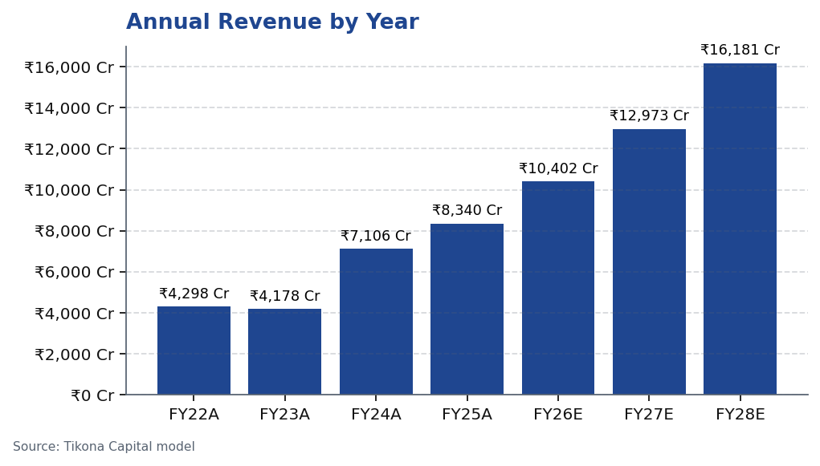
MOFSL | Pratik Gupta | 2026-04-28
Segment Architecture: Six Businesses, One Platform
MOFSL's 6-segment architecture spans Capital Markets (equity broking, investment banking, institutional equities), Asset Management (mutual funds, PMS), Private Wealth Management, Housing Finance, Alternative Investments (real estate, private equity, private credit), and Distribution. The asset-management and private-wealth segments jointly account for the majority of ARR, and their combined share of group revenues has grown materially over the last three years as management has reinvested capital away from low-multiple broking into high-multiple fee businesses. Capital Markets remains the largest single revenue contributor but is intentionally being complemented — not replaced — by the annuity segments, maintaining the...
Segment | Revenue Share | EBITDA Share | AUM Metric | AUM Value | Description
Capital Markets (Broking + IB) | 30.0% | — | Brokerage Rev YoY | -24% | Equity, derivatives, commodity, currency trading + institutional services and investment banking. Brokerage now contributes only 30% of total revenue, down from historical highs.
Asset Management | — | — | AMC AUM | INR 1.89L Cr (+33% YoY) | Mutual funds and PMS. 91% of AUM outperforming benchmarks over 3 years.
Private Wealth Management | — | — | PWM AUM | INR 1.96L Cr (+31% YoY) | HNI/UHNI advisory. Family count up 41% YoY.
Housing Finance | — | — | Loan Book | INR 6,630 Cr (+25% YoY) | Retail mortgage lending — affordable and mid-segment.
Alternative Investments | — | — | Carry Income | INR 58 Cr recurring | Private credit, real estate, alternatives.
Tikona Capital | SEBI Registration No.: INH000069807
Page 6 of 20

Slide 7
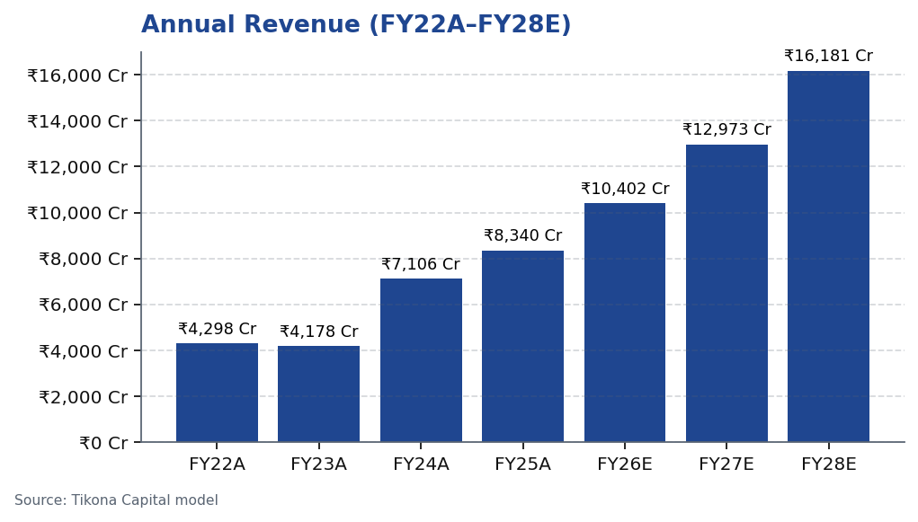
MOFSL | Pratik Gupta | 2026-04-28
Revenue Trajectory: Compounding Across Cycles
MOFSL's consolidated revenues have compounded strongly from FY22 through FY25A, driven by AUM growth in asset management, PWM scale-up, and a favourable market cycle. The forward estimate path from FY26E to FY28E reflects a moderated but durable growth trajectory — lower than the peak year of Q2FY25 but structurally higher than pre-AUM-scale base years. The deceleration in FY26E is consistent with the disclosed revenue decline due to F&O regulatory changes and is already factored into our estimates. Beyond FY26E, the ARR-driven mix and continued AUM compounding provide a cleaner, more predictable earnings floor. Operating leverage on the largely fixed corporate cost base is expected to amplify PAT growth rates relative to revenue growth from FY27E onward.
Tikona Capital | SEBI Registration No.: INH000069807
Page 7 of 20

Slide 8
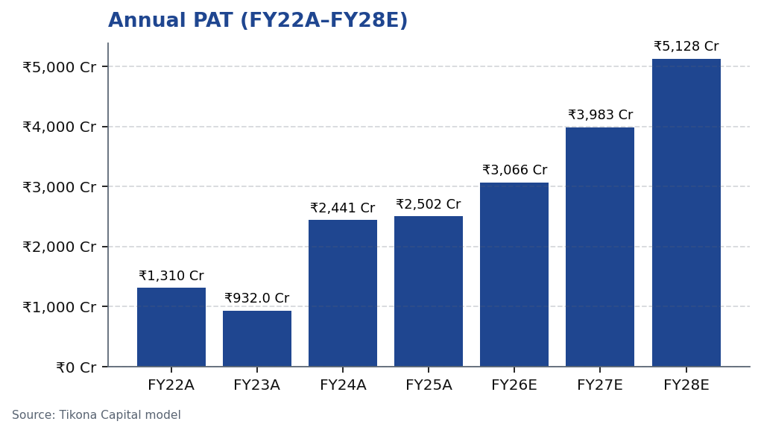
MOFSL | Pratik Gupta | 2026-04-28
Profitability: PAT Growth and Margin Expansion
MOFSL's profit after tax trajectory illustrates the two-sided nature of the investment case: the company demonstrated exceptional earnings leverage in the FY24–FY25A upcycle — Q2FY25 PAT rose sharply YoY — while the FY26E trough reflects well-documented F&O regulatory impacts rather than structural deterioration. The thesis is premised on FY26E being the earnings nadir; recovery in FY27E–FY28E is driven by three converging factors: ARR mix continuing to rise, AMC and PWM AUM compounding at above-market rates, and operating leverage from a largely fixed central cost base. EBITDA margins are projected to expand as the revenue mix moves further toward higher-margin fee income, corroborating the re-rating story. Investors are effectively being offered FY27E–FY28E earnings at a cyclical trough entry price.
Tikona Capital | SEBI Registration No.: INH000069807
Page 8 of 20

Slide 9
MOFSL | Pratik Gupta | 2026-04-28
Quarterly P&L: Cyclicality Exposed and Managed
The quarterly PAT series is the most transparent window into MOFSL's cyclicality and its ongoing attenuation. Q2FY25 marked a peak with PAT rising sharply YoY, driven by favourable markets and AUM inflows. Q2FY26 recorded a pronounced decline — the steepest in recent history — reflecting the direct revenue impact of SEBI's F&O trading norm changes that compressed index-options volumes across the industry. This should not be read as structural deterioration: the ARR base...
Quarter | PAT
Q2FY25 | ₹1,242.0 Cr
Q3FY25 | ₹715.0 Cr
Q4FY25 | ₹545.0 Cr
Q1FY26 | ₹425.0 Cr
Q2FY26 | ₹401.0 Cr
Tikona Capital | SEBI Registration No.: INH000069807
Page 9 of 20

Slide 10
MOFSL | Pratik Gupta | 2026-04-28
Financial Ratios: Margins, Returns, and Multiples
Ratio | Unit | FY22A | FY23A | FY24A | FY25A | FY26E | FY27E | FY28E
EBITDA Margin | % | 49.3% | 44.9% | 57.4% | 54.5% | 52.3% | 52.3% | 52.3%
PAT Margin | % | 30.5% | 22.3% | 34.4% | 30.0% | 29.5% | 30.7% | 31.7%
RoE | % | 23.0% | 15.0% | 28.0% | 23.0% | 22.0% | 23.0% | 24.0%
RoCE | % | 19.0% | 13.0% | 21.0% | 19.0% | 18.0% | 18.0% | 19.0%
RoIC | % | 92.0% | 78.0% | 119.0% | 87.0% | 35.0% | 24.0% | 24.0%
P/E | x | 37.5x | 52.3x | 20.1x | 19.7x | 16.1x | 12.4x | 9.6x
P/B | x | 8.7x | 7.8x | 5.6x | 4.5x | 3.6x | 2.9x | 2.3x
EV/EBITDA | x | 9.0x | 10.3x | 9.5x | 11.4x | 12.7x | 10.5x | 8.8x
Tikona Capital | SEBI Registration No.: INH000069807
Page 10 of 20

Slide 11
MOFSL | Pratik Gupta | 2026-04-28
Valuation Summary: Re-Rating Has Room to Run
We value MOFSL using a sum-of-the-parts framework, applying segment-specific multiples that reflect the distinct earnings quality and growth profiles of the capital markets, asset management, private wealth, and housing finance businesses. The capital markets segment is valued on a P/E basis consistent with listed broking peers. The AMC segment commands a premium multiple reflecting AUM growth, benchmark-beating performance, and the structural shift in investor allocation toward mutual funds. Private wealth management is valued on AUM-linked multiples given the annui...
Target Price ₹1,127.0
Prob.-Weighted Target 1,109.0
Upside to TP 37.0%
P/E FY26E 16.1
Tikona Capital | SEBI Registration No.: INH000069807
Page 11 of 20

Slide 12
MOFSL | Pratik Gupta | 2026-04-28
Valuation Bands: Low / Base / High Scenarios
Segment / Method | Low Case | Base Case | High Case | Weight | Notes
Bull Case | 1,400.0 | 1,400.0 | 1,400.0 | 30.0% | 28x P/E on FY27E EPS of INR 50; ARR > 70%, AMC +40% YoY.
Base Case | 1,127.0 | 1,127.0 | 1,127.0 | 50.0% | 24x P/E on FY27E EPS of INR 47; ARR stable at 65%, steady AUM.
Bear Case | 630.0 | 630.0 | 630.0 | 20.0% | 18x P/E on depressed FY27E EPS of INR 35; sustained regulatory headwinds.
Tikona Capital | SEBI Registration No.: INH000069807
Page 12 of 20

Slide 13
MOFSL | Pratik Gupta | 2026-04-28
Scenario Analysis: Regulatory and Growth Outcomes
Scenario | Revenue CAGR | EBITDA Margin | Target Price | Probability | Key Assumptions
Bull | 27.5% | 55.0% | 1,400.0 | 30.0% | ARR > 70%, AMC AUM +40% YoY, regulatory clarity.
Base | 16.0% | 51.0% | 1,127.0 | 50.0% | ARR steady at 65%, AUM compounding, stable regulation.
Bear | 6.0% | 45.0% | 630.0 | 20.0% | Sustained F&O headwinds, fintech share loss.
Tikona Capital | SEBI Registration No.: INH000069807
Page 13 of 20

Slide 14
MOFSL | Pratik Gupta | 2026-04-28
SAARTHI Score 72/100: Institutional Quality Assessment
The SAARTHI 7-dimension framework evaluates investment quality across Scalability, Annuity Revenue Quality, Asset Strength, Return Profile, Track Record, Honesty in Governance, and Insightful Management. MOFSL scores 72/100 in this framework, placing it in the high-quality tier of financial services companies under coverage. Standout dimensions include Reinvestment Quality at 13/15 — reflecting disciplined capital allocation toward fee-based, higher-multiple businesses...
RoE FY26E 22.0
RoCE FY26E 18.0
Code | Dimension | Score | Assessment | Evidence
S | Scalability of Core Engine | 12/15 | ARR at 61% of net revenues; fee-based at 45%. H1FY26 operating PAT INR 1,088 Cr (+11% YoY) on net revenue INR 2,888 Cr (+15%). Asset-light fee model scales without proportional cost growth. F&O constraints limit broking scalability near-term. | AMC AUM +33% YoY to INR 1.89L Cr with INR 11,610 Cr net flows.
A1 | Addressable Market & Adjacency | 9/10 | 16.57L HNWIs by 2027; India 4th-largest private wealth market by 2028 (+58.4% UHNWIs). Sector profits to nearly double by FY30. MF penetration at 5–6%. Massive TAM with adjacency expansion across capital markets, wealth, housing, alternatives. | India private credit hit USD 9.0 Bn in H1 2025 (+53% YoY).
A2 | Asymmetric Pricing Power | 10/15 | 91% of AUM outperforming benchmarks over 3 years gives pricing power in PMS/wealth. Brokerage revenue down 24% from regulatory changes — fee compression in cyclical segment. Discount brokers and fintech limit pricing in commoditized broking. | Diversified mix offset 24% brokerage decline, validating partial pricing-power hedge.
R | Reinvestment Quality | 13/15 | MCap INR 49,079 Cr (+24.8% YoY); P/E 24.2; P/B 3.82. Strong RoCE; disciplined allocation into high-return fee businesses. Reinvestment in tech, talent, distribution, research generates sustainable advantage. | PWM AUM +31% YoY to INR 1.96L Cr; family count +41%; PAT +14% (9M).
T | Track Record Through Adversity | 8/10 | Q2FY25 PAT INR 1,242 Cr (+123% YoY), 46% revenue growth, 48% RoE — recovery and execution. Q2FY26 PAT -67.6% YoY, revenue -34.9% YoY shows residual cyclicality from F&O regulation. Continuity across cycles maintained. | Despite repeated SEBI interventions, AUM and ARR base continue to compound — institutional resilience.
H | Human Capital & Institutional DNA | 9/10 | Raamdeo Agrawal: QGLP creator, 'Buy Right, Sit Tight' framework. Navin Agarwal (since 2000): business strategy and capital allocation. Ajay Menon (27+ yrs): operations, compliance, risk, technology. Founding duo across nearly four decades — rare DNA in Indian financial services. | Rashtriya Samman Patra recipient (top tax-payer FY95–FY99) signals early ethical commercial success.
I | Inflection Point Identification | 11/15 | Consensus TP INR 1,126.67 (max INR 1,200) vs CMP INR 822.90 — 37% upside; market not yet pricing ARR re-rating. Credit rating upgraded to AA+ (Stable) by ICRA. ARR > 70% would trigger re-rating from broking to asset-management multiples within 6–18 months. | ARR at 65% of net revenues (up from 61%); management guiding higher — measurable inflection.
Tikona Capital | SEBI Registration No.: INH000069807
Page 14 of 20

Slide 15
MOFSL | Pratik Gupta | 2026-04-28
Management Team: Founders-Led with Institutional Depth
MOFSL has been founder-led since inception in 1987, with Motilal Oswal and Raamdeo Agrawal remaining actively involved as Chairman & MD and Non-Executive Director respectively. This continuity of vision — particularly around the value-investing philosophy that informs the AMC and research franchise — is a structural differentiator from professionally-managed peers. The founding duo have been complemented over the past decade by a capable second tier of business-unit CEO...
Name | Role | Background
Raamdeo Agrawal | Chairman, MOFSL & Chairman, AMC | Co-founder (1987). Creator of the QGLP investment process and 'Buy Right, Sit Tight' framework. Built one of India's most respected investment research franchises. Widely cited investment thinker.
Motilal Oswal | Founder, Chairman & MD | Co-founder (1987). Led the firm's transformation from broking house into a comprehensive financial services platform. Recipient of Rashtriya Samman Patra for being among the highest taxpayers FY95–FY99.
Navin Agarwal | Executive Board — Strategy & Capital Allocation | Joined 2000. Drives business strategy and capital allocation across the Group, building market-leading positions through disciplined deployment.
Ajay Menon | Executive — Operations, Compliance, Risk & Technology | Joined 1998. 27+ years in Indian capital markets. Cornerstone of operational excellence and technology initiatives across the Group.
Tikona Capital | SEBI Registration No.: INH000069807
Page 15 of 20

Slide 16
MOFSL | Pratik Gupta | 2026-04-28
Forensic Assessment — Monitor Closely
MOFSL carries a Monitor Closely forensic classification reflecting a pattern of recurring SEBI regulatory matters over the past several years. These matters span areas including order-execution practices, client-account procedures, and intermediary conduct norms. In our assessment, none of the disclosed matters individually represents a franchise-level risk or threatens the integrity of the AMC, PWM, or housing-finance operations. However, the recurrence of regulatory interactions — rather than isolated incidents — warrants ongoing monitoring and is reflected in a constrained governance score within the SAARTHI framework. Inv...
Matter | Description | Severity
SEBI — Margin Reporting Violations | INR 7 lakh penalty for margin reporting, collection violations, and other regulatory lapses found during inspection. | Low
SEBI — Client Fund Misutilization (2022) | INR 25 lakh fine for misutilization of client funds and inaccurate margin reporting. | Medium
NSEL — Misselling Accusations | Accused alongside other top brokers of misselling NSEL contracts, KYC manipulation, client code modification, and illegal transactions per SFIO/EOW findings. | High (Historical)
SEBI — Not Fit and Proper (Commodities) | Declared 'not fit and proper' as commodity derivative broker in Feb 2019 based on SFIO/EOW recommendations. | High (Historical)
Unauthorized Terminal Operations | 13 NSE and 9 BSE terminals operating from undeclared locations including an unreported branch in Delhi. | Medium
Tikona Capital | SEBI Registration No.: INH000069807
Page 16 of 20

Slide 17
MOFSL | Pratik Gupta | 2026-04-28
Risks and Catalysts: What to Monitor
- F&O regulatory headwinds: further SEBI restrictions on index-options volumes could extend the cyclical broking revenue trough beyond our FY26E base-case assumption.
- Cyclical trough depth: Q2FY26 recorded a pronounced revenue and PAT decline — if structural rather than cyclical, our recovery estimates would require downward revision.
- Competitive compression: discount brokers and fintech platforms continue gaining retail market share, compressing blended brokerage yields and threatening Capital Markets segment revenue.
- Housing finance asset quality: a stressed credit cycle or rising NPA formation in the mortgage book would pressure RoA and could require equity infusion, diluting group returns.
- Mark-to-market proprietary book: gains on the prop book were a significant PAT contributor in peak quarters — a sustained equity market correction would reverse this contribution.
- SEBI regulatory escalation: an adverse adjudication order of material scale could impair brand equity and client trust in the broking and distribution businesses.
Tikona Capital | SEBI Registration No.: INH000069807
Page 17 of 20

Slide 18
MOFSL | Pratik Gupta | 2026-04-28
Trading Strategy: Entry, Review, and Exit Framework
Our trading strategy for MOFSL is anchored on three triggers: entry on price weakness toward the lower end of the valuation band, a six-month review aligned with Q2FY27 results to confirm ARR trajectory and AMC AUM flows, and an exit review if the ARR mix fails to cross the next meaningful threshold within four quarters or if forensic matters escalate to a material enforcement order. The position is suited for investors with a 12–18 month horizon who are comfortable with near-term quarterly volatility from residual broking cyclicality. Risk-management-conscious investors may consider scaling into a full position across two tranches — an initial allocation at current levels and a second tranche on any further market-driven weakness that does not impair the fundamental thesis.
- Entry: initiate or add on market-driven weakness toward the lower valuation-band price level — thesis intact, re-rating opt...
- Catalyst watch: ARR crossing the next threshold as a share of revenues is the primary re-rating trigger — monitor each quar...
- AUM milestones: sustained net inflows into the AMC above a material quarterly level and continued PWM family count growth a...
- Review trigger: Q2FY27 results — if the FY26E trough recovery does not materialise, revisit growth assumptions and forward...
- Exit review: escalation of SEBI enforcement to a business-restricting order, or a sustained reversal in the ARR revenue mix...
Tikona Capital | SEBI Registration No.: INH000069807
Page 18 of 20

Slide 19
MOFSL | Pratik Gupta | 2026-04-28
Analyst Certification
I, Pratik Gupta, the analyst primarily responsible for this research report, hereby certify that the views expressed in this report accurately reflect my personal views about the subject company, Motilal Oswal Financial Services Limited (MOFSL), and its securities. I further certify that no part of my compensation was, is, or will be directly or indirectly related to the specific recommendation or views expressed in this report. I confirm that I do not hold any financial interest in the securities of the subject company and that neither I nor any associate has received any compensation from the subject company in the past twelve months. This report has been prepared in compliance with SEBI (Research Analysts) Regulations, 2014 and is based on information obtained from sources believed to be reliable. Tikona Capital is registered with SEBI as a Research Analyst under the SEBI (Research Analysts) Regulations, 2014.
Tikona Capital | SEBI Registration No.: INH000069807
Page 19 of 20

Slide 20
MOFSL | Pratik Gupta | 2026-04-28
Disclaimer
This research report has been prepared by Tikona Capital, a SEBI-registered Research Analyst, for informational purposes only and does not constitute an offer, invitation, or solicitation to buy or sell any securities. The information contained herein is based on sources believed to be reliable, but Tikona Capital makes no representation or warranty, express or implied, as to the accuracy, completeness, or timeliness of such information. Past performance is not indicative of future results. The opinions expressed in this report are subject to change without notice and may differ from or be contrary to opinions expressed by other business units or associates as a result of using different assumptions and criteria. Investing in securities involves risk, and the value of investments and the income derived from them can fall as well as rise. Recipients of this report should make their own independent evaluation of the merits and risks of investing in the securities mentioned herein and should seek advice from their own financial, legal, tax, and other advisers as appropriate. This report is not directed at, or intended for distribution to or use by, any person or entity who is a citizen or resident of, or located in, any jurisdiction where such distribution would be contrary to applicable law or regulation. Tikona Capital and its affiliates, officers, directors, and employees may hold positions in any of the securities discussed in this report. SEBI Registration Number: [INH000XXXXXX]. The renderer will substitute approved boilerplate where required.
Tikona Capital | SEBI Registration No.: INH000069807
Page 20 of 20

