Slide 1

BUY
Motilal Oswal Financial Services — Initiation of Coverage
MOFSL | BUY | Annuity-Led Re-Rating Underway
Rating
BUY
CMP (INR)
₹822.9
Target Price (INR)
₹1,127.0
Tikona Capital | SEBI Registration No.: INH000069807

Slide 2
MOFSL | Pratik Gupta | 2026-04-28
Investment Thesis: From Broking House to Annuity Platform
Motilal Oswal Financial Services is executing a structural migration away from cyclical transaction-driven broking revenues toward a durable, annuity-based earnings model anchored in Asset Management, Private Wealth, and Alternative Investments. Annual Recurring Revenue now constitutes a dominant majority of total net revenues, and management has guided for further increases — a shift that should compel the market to reassess the appropriate multiple for this franchise. The current market price reflects broking-house valuations; the business increasingly earns asset-manager margins. This valuation dislocation, combined with AUM compounding well above the industry average and a recently upgraded long-term credit rating, constitutes the core of our BUY thesis.
- Annuity revenue now forms a dominant share of net revenues, with management guiding for further increases — materially reducing dep...
- Total AUM has compounded strongly year-on-year, with the vast majority of AMC AUM outperforming benchmarks over a three-year horizo...
- Private Wealth AUM has expanded rapidly year-on-year, with family count growing at an even faster pace — a leading indicator for fu...
- ICRA upgraded the long-term credit rating to AA+ Stable, endorsing balance-sheet quality and the capacity to invest in platform gro...
- Reinvestment Quality scored near the top of the SAARTHI framework, reflecting disciplined capital deployment into fee-generating bu...
- Probability-weighted analyst target implies meaningful upside from current levels, with the base case underpinned by a continued AR...
Tikona Capital | SEBI Registration No.: INH000069807
Page 2 of 21

Slide 3
MOFSL | Pratik Gupta | 2026-04-28
Company Snapshot: 35+ Years, 6 Business Segments, One Platform
Founded in 1987 by Motilal Oswal and Raamdeo Agrawal, the company has evolved from a research-driven equity broking house into a multi-segment financial services platform covering Capital Markets, Asset Management, Private Wealth Management, Housing Finance, and Alternative Investments. The firm serves over 1.6 million customers across 550+ cities through a network of 2,500+ business locations. Research coverage of 300+ companies remains an enduring competitive moat that differentiates client acquisition across all verticals. Revenue diversification is now the norm: fee-based businesses collectively dominate the income mix, making the business progressively less exposed to equity-market volume cycles than its broking heritage would suggest.
CMP (INR) ₹822.9
Target Price (INR) ₹1,127.0
Upside (%) 37.0%
Total AUM (₹ lakh cr) 1.8
Tikona Capital | SEBI Registration No.: INH000069807
Page 3 of 21

Slide 4
MOFSL | Pratik Gupta | 2026-04-28
Industry Context: India's Wealth Inflection Is Structural
Indian financial services sits at the intersection of structural demand tailwinds that are unlikely to moderate over the medium term. Per capita income growth, formalisation of savings, digital infrastructure, and a generational shift toward market-linked assets are combining to create a multi-decade opportunity for well-positioned platforms. India is on a trajectory to become the fourth-largest private wealth market globally by 2028, supported by a projected surge in Ultra-HNW individuals. Mutual fund penetration remains a fraction of developed-market norms, reflecting the scale of latent demand that distributors and asset managers have yet to access. Private credit volumes hit a record in H1 2025, validating the appetite for alternative asset classes. The financial sector's aggregate profitability is projected to nearly double by FY30, led by NBFCs and platform businesses compounding at industry-beating rates.
- India's HNWI population is projected to reach a multi-lakh figure by 2027, creating a structurally expanding addressable ma...
- The UHNWI segment is forecast to grow at an exceptional pace over the next several years, lifting demand for bespoke adviso...
- Mutual fund penetration as a share of GDP compares unfavourably with developed markets, implying a long runway for AMC fee...
- Private credit market reached a record level in H1 2025, growing well above the prior-year period — directly benefiting alt...
- NBFCs are forecast to compound at a high-teens annual growth rate through FY30, supporting housing finance and credit subsi...
- Regulatory digitalisation initiatives are reducing the cost of customer acquisition, expanding the addressable opportunity...
Tikona Capital | SEBI Registration No.: INH000069807
Page 4 of 21

Slide 5
MOFSL | Pratik Gupta | 2026-04-28
Key Highlights: Six Reasons to Own MOFSL
- Annuity Mix Re-Rating: ARR forms a dominant majority of net revenues with management guiding higher — the market still prices this franchise as a broking stock, creating a structural valuation gap.
- AUM Compounding Engine: Total AUM has grown strongly year-on-year with the vast majority of AMC AUM beating benchmarks over three years, anchoring durable fee-income visibility.
- Wealth Franchise Acceleration: Private Wealth AUM and family count are both growing at double-digit-plus rates, signalling accelerating wallet-share gains among HNI and UHNI clients.
- Balance-Sheet Quality: ICRA AA+ Stable long-term rating upgrade removes funding-cost risk and positions the firm for competitive product shelf expansion across asset classes.
- Capital Discipline: Reinvestment Quality near the top of the SAARTHI framework reflects a track record of deploying incremental capital into high-return, fee-based channels rather than book lending.
- Regulatory Scenario Clarity: Probability-weighted target built across bull, base, and bear scenarios provides a transparent framework for position-sizing around F&O rule uncertainty.
Tikona Capital | SEBI Registration No.: INH000069807
Page 5 of 21

Slide 6
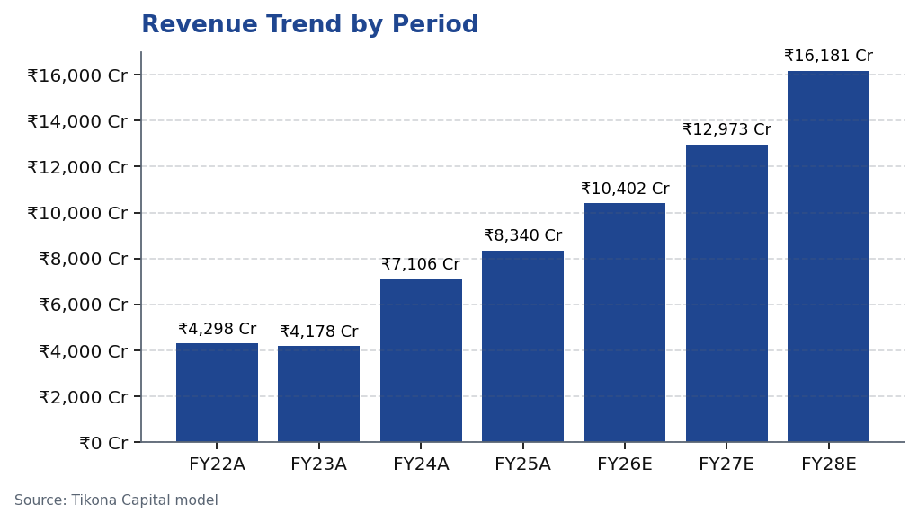
MOFSL | Pratik Gupta | 2026-04-28
Segment Architecture: 6 Verticals, Diversified Fee Pool
The group's 6-segment architecture is designed to capture revenue across the full financial services value chain — from transaction execution and distribution to long-duration asset management and credit origination. The AMC and Private Wealth segments are the primary annuity drivers, generating recurring management and advisory fees irrespective of secondary-market volumes. Capital Markets (broking, investment banking, and institutional equities) retains cyclical characteristics but is being deliberately de-emphasised as a share of group profit. Housing Finance and Alternatives represent optionality plays on India's credit deepening and UHNI allocation shift, respectively. The diversification of the earnings base acros...
Segment | Rev Share | EBITDA Share | Growth | AUM Label | AUM | Description
Capital Markets (Broking + IB) | 30.0% | — | — | Brokerage Rev YoY | -24% | Equity, derivatives, commodity, currency trading + institutional services and investment banking. Brokerage now contributes only 30% of total revenue, down from historical highs.
Asset Management | — | — | — | AMC AUM | INR 1.89L Cr (+33% YoY) | Mutual funds and PMS. 91% of AUM outperforming benchmarks over 3 years.
Private Wealth Management | — | — | — | PWM AUM | INR 1.96L Cr (+31% YoY) | HNI/UHNI advisory. Family count up 41% YoY.
Housing Finance | — | — | — | Loan Book | INR 6,630 Cr (+25% YoY) | Retail mortgage lending — affordable and mid-segment.
Alternative Investments | — | — | — | Carry Income | INR 58 Cr recurring | Private credit, real estate, alternatives.
Tikona Capital | SEBI Registration No.: INH000069807
Page 6 of 21

Slide 7
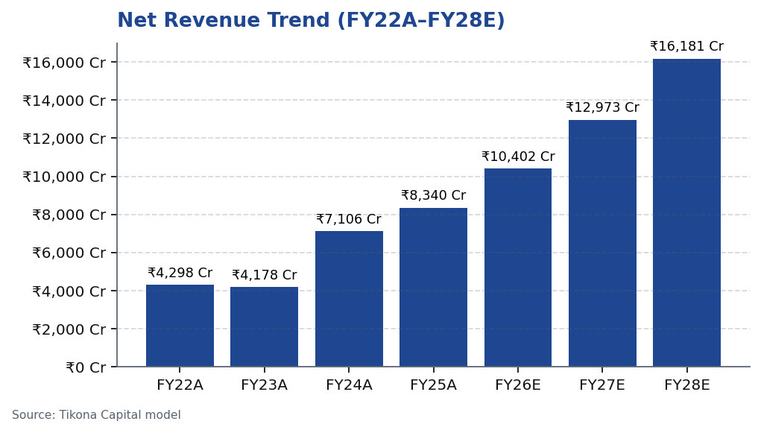
MOFSL | Pratik Gupta | 2026-04-28
Revenue Trajectory: Annuity-Led Growth Increasingly Visible
Revenue growth at Motilal Oswal Financial Services has compounded strongly over the covered period, with the quality of that growth improving as the AMC and Wealth management businesses scale. The shift away from purely volume-driven broking revenue toward recurring management fees, advisory charges, and distribution income is most visible in the relative stability of the earnings base across varying market-volume environments. FY26E and FY27E estimates reflect a continuation of AUM-driven fee income as the primary revenue engine, with Capital Markets contributing a declining share of the mix. The trajectory through FY28E illustrates the operating-leverage effect: as the largely fixed cost base of the platform is absorbed by growing fee income, incremental revenues should drop through to profitability at above-average conversion rates. This revenue quality improvement is the cornerstone of the re-rating argument.
Tikona Capital | SEBI Registration No.: INH000069807
Page 7 of 21

Slide 8
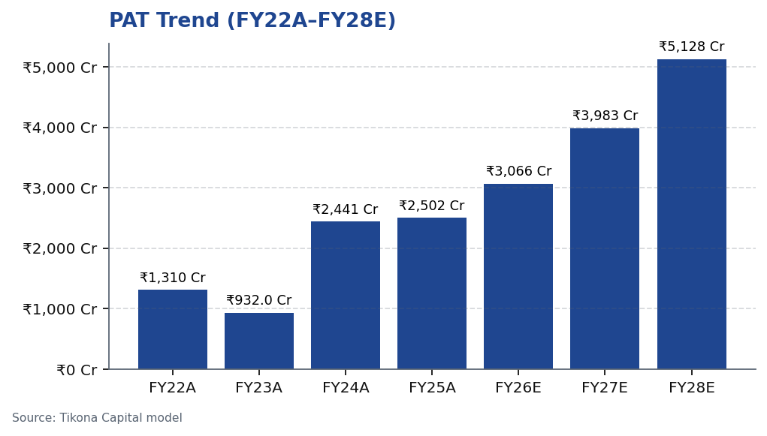
MOFSL | Pratik Gupta | 2026-04-28
Profitability: PAT Compounding With Margin Expansion Optionality
Profit after tax has followed a volatile path historically, reflecting the cyclical broking component of the revenue base. The regulatory changes implemented in H2 FY25 — specifically tighter F&O norms — compressed quarterly profits materially, offering a live test of the resilience of the annuity revenue base. The AMC and Wealth segments held their contribution through this disruption, validating the defensive characteristics of the fee mix. Looking forward, PAT estimates through FY28E reflect the scenario where ARR continues to grow, operating leverage accumulates, and Capital Markets volumes normalise rather than recover sharply. A conservative model still generates a compelling profitability CAGR. The key upside scenario — where broking revenues recover alongside continued AUM growth — creates additional earnings optionality not embedded in the base case. Return on equity and return on capital employed are expected to remain elevated relative to financial-services peers, supported by disciplined balance-sheet management.
Tikona Capital | SEBI Registration No.: INH000069807
Page 8 of 21

Slide 9
MOFSL | Pratik Gupta | 2026-04-28
Quarterly Pulse: Peak Quarter, Reset Quarter — Cyclicality Quantified
Quarterly results over the last six to eight quarters illustrate the cyclical overlay on what is increasingly an annuity-driven business. Q2FY25 delivered a landmark performance — PAT growth of exceptional magnitude year-on-year — driven by elevated market volumes, strong AMC flows, and operating leverage. The reversal in Q2FY26, where both revenue and profit declined materially year-on-year following SEBI's revised F&O framework, is important context for model-builders...
Quarter | PAT
Q2FY25 | ₹1,242.0 Cr
Q3FY25 | ₹715.0 Cr
Q4FY25 | ₹545.0 Cr
Q1FY26 | ₹425.0 Cr
Q2FY26 | ₹401.0 Cr
Tikona Capital | SEBI Registration No.: INH000069807
Page 9 of 21

Slide 10
MOFSL | Pratik Gupta | 2026-04-28
Financial Ratios: Margins, Returns, and Multiples Across the Cycle
Ratio | Unit | FY22A | FY23A | FY24A | FY25A | FY26E | FY27E | FY28E
EBITDA Margin | % | 49.3% | 44.9% | 57.4% | 54.5% | 52.3% | 52.3% | 52.3%
PAT Margin | % | 30.5% | 22.3% | 34.4% | 30.0% | 29.5% | 30.7% | 31.7%
RoE | % | 23.0% | 15.0% | 28.0% | 23.0% | 22.0% | 23.0% | 24.0%
RoCE | % | 19.0% | 13.0% | 21.0% | 19.0% | 18.0% | 18.0% | 19.0%
RoIC | % | 92.0% | 78.0% | 119.0% | 87.0% | 35.0% | 24.0% | 24.0%
P/E | x | 37.5x | 52.3x | 20.1x | 19.7x | 16.1x | 12.4x | 9.6x
P/B | x | 8.7x | 7.8x | 5.6x | 4.5x | 3.6x | 2.9x | 2.3x
EV/EBITDA | x | 9.0x | 10.3x | 9.5x | 11.4x | 12.7x | 10.5x | 8.8x
Tikona Capital | SEBI Registration No.: INH000069807
Page 10 of 21

Slide 11
MOFSL | Pratik Gupta | 2026-04-28
Valuation: Re-Rating Justified by Annuity Mix Transition
Our valuation framework for MOFSL recognises that a sum-of-parts approach best captures the divergence in earnings quality and appropriate multiples across the group's segments. The AMC and Private Wealth businesses warrant asset-manager multiples, which are materially higher than those applied to broking franchises. As the ARR mix continues to rise — our primary re-rating trigger — the blended multiple should converge toward the asset management universe rather than the broking-house peer group. The current market price does not reflect this convergence; it continue...
P/E FY26E (x) 16.1
P/B FY26E (x) 3.6
EV/EBITDA FY26E (x) 12.7
Prob-Weighted Target (INR) 1,109.0
Tikona Capital | SEBI Registration No.: INH000069807
Page 11 of 21

Slide 12
MOFSL | Pratik Gupta | 2026-04-28
Valuation Bands: Method-by-Method Low / Base / High Reconciliation
Method | Low (INR) | Base (INR) | High (INR) | Weight | Notes
Bull Case | 1,400.0 | 1,400.0 | 1,400.0 | 30.0% | 28x P/E on FY27E EPS of INR 50; ARR > 70%, AMC +40% YoY.
Base Case | 1,127.0 | 1,127.0 | 1,127.0 | 50.0% | 24x P/E on FY27E EPS of INR 47; ARR stable at 65%, steady AUM.
Bear Case | 630.0 | 630.0 | 630.0 | 20.0% | 18x P/E on depressed FY27E EPS of INR 35; sustained regulatory headwinds.
Tikona Capital | SEBI Registration No.: INH000069807
Page 12 of 21

Slide 13
MOFSL | Pratik Gupta | 2026-04-28
Scenario Analysis: Bull, Base, and Bear Cases Bracketing F&O Uncertainty
Scenario | Rev CAGR | EBITDA Margin | Target (INR) | Probability | Key Assumptions
Bull | 27.5% | 55.0% | 1,400.0 | 30.0% | ARR > 70%, AMC AUM +40% YoY, regulatory clarity.
Base | 16.0% | 51.0% | 1,127.0 | 50.0% | ARR steady at 65%, AUM compounding, stable regulation.
Bear | 6.0% | 45.0% | 630.0 | 20.0% | Sustained F&O headwinds, fintech share loss.
Tikona Capital | SEBI Registration No.: INH000069807
Page 13 of 21

Slide 14
MOFSL | Pratik Gupta | 2026-04-28
SAARTHI Score 72/100: Investment Quality Assessment
Our SAARTHI framework applies a 7-dimension scoring model to assess investment quality holistically — capturing not just financial performance but governance standards, capital allocation discipline, earnings quality, and the analytical rigour of management communication. A score of 72 out of 100 places MOFSL in the upper tier of financial services companies in our coverage universe. The standout dimension is Reinvestment Quality, which scored near the maximum, reflecti...
Total AUM YoY Growth (%) 46.0
Code | Dimension | Score | Assessment | Supporting Evidence
S | Scalability of Core Engine | 12/15 | ARR at 61% of net revenues; fee-based at 45%. H1FY26 operating PAT INR 1,088 Cr (+11% YoY) on net revenue INR 2,888 Cr (+15%). Asset-light fee model scales without proportional cost growth. F&O constraints limit broking scalability near-term. | AMC AUM +33% YoY to INR 1.89L Cr with INR 11,610 Cr net flows.
A1 | Addressable Market & Adjacency | 9/10 | 16.57L HNWIs by 2027; India 4th-largest private wealth market by 2028 (+58.4% UHNWIs). Sector profits to nearly double by FY30. MF penetration at 5–6%. Massive TAM with adjacency expansion across capital markets, wealth, housing, alternatives. | India private credit hit USD 9.0 Bn in H1 2025 (+53% YoY).
A2 | Asymmetric Pricing Power | 10/15 | 91% of AUM outperforming benchmarks over 3 years gives pricing power in PMS/wealth. Brokerage revenue down 24% from regulatory changes — fee compression in cyclical segment. Discount brokers and fintech limit pricing in commoditized broking. | Diversified mix offset 24% brokerage decline, validating partial pricing-power hedge.
R | Reinvestment Quality | 13/15 | MCap INR 49,079 Cr (+24.8% YoY); P/E 24.2; P/B 3.82. Strong RoCE; disciplined allocation into high-return fee businesses. Reinvestment in tech, talent, distribution, research generates sustainable advantage. | PWM AUM +31% YoY to INR 1.96L Cr; family count +41%; PAT +14% (9M).
T | Track Record Through Adversity | 8/10 | Q2FY25 PAT INR 1,242 Cr (+123% YoY), 46% revenue growth, 48% RoE — recovery and execution. Q2FY26 PAT -67.6% YoY, revenue -34.9% YoY shows residual cyclicality from F&O regulation. Continuity across cycles maintained. | Despite repeated SEBI interventions, AUM and ARR base continue to compound — institutional resilience.
H | Human Capital & Institutional DNA | 9/10 | Raamdeo Agrawal: QGLP creator, 'Buy Right, Sit Tight' framework. Navin Agarwal (since 2000): business strategy and capital allocation. Ajay Menon (27+ yrs): operations, compliance, risk, technology. Founding duo across nearly four decades — rare DNA in Indian financial services. | Rashtriya Samman Patra recipient (top tax-payer FY95–FY99) signals early ethical commercial success.
I | Inflection Point Identification | 11/15 | Consensus TP INR 1,126.67 (max INR 1,200) vs CMP INR 822.90 — 37% upside; market not yet pricing ARR re-rating. Credit rating upgraded to AA+ (Stable) by ICRA. ARR > 70% would trigger re-rating from broking to asset-management multiples within 6–18 months. | ARR at 65% of net revenues (up from 61%); management guiding higher — measurable inflection.
Tikona Capital | SEBI Registration No.: INH000069807
Page 14 of 21

Slide 15
MOFSL | Pratik Gupta | 2026-04-28
Forensic Assessment — Monitor Closely
Our forensic assessment of Motilal Oswal Financial Services assigns a Monitor Closely category, reflecting a pattern of recurring regulatory interactions with SEBI over the covered period. None of the identified matters individually constitutes a basis for rating downgrade at this time; however, the pattern warrants active monitoring. Capital-market participants with multiple regulatory touchpoints — across broking, distribution, advisory, and proprietary trading — are inherently exposed to a higher baseline of regulatory scrutiny than single-product businesses. We have stress-tested the financial model for scenarios involvin...
Matter | Description | Severity
SEBI — Margin Reporting Violations | INR 7 lakh penalty for margin reporting, collection violations, and other regulatory lapses found during inspection. | Low
SEBI — Client Fund Misutilization (2022) | INR 25 lakh fine for misutilization of client funds and inaccurate margin reporting. | Medium
NSEL — Misselling Accusations | Accused alongside other top brokers of misselling NSEL contracts, KYC manipulation, client code modification, and illegal transactions per SFIO/EOW findings. | High (Historical)
SEBI — Not Fit and Proper (Commodities) | Declared 'not fit and proper' as commodity derivative broker in Feb 2019 based on SFIO/EOW recommendations. | High (Historical)
Unauthorized Terminal Operations | 13 NSE and 9 BSE terminals operating from undeclared locations including an unreported branch in Delhi. | Medium
Tikona Capital | SEBI Registration No.: INH000069807
Page 15 of 21

Slide 16
MOFSL | Pratik Gupta | 2026-04-28
Management Team: Founder-Led, Institutionally Deep
The company benefits from rare founder continuity — both Motilal Oswal and Raamdeo Agrawal remain operationally active nearly four decades after founding the firm. This enduring presence provides cultural and strategic stability that is difficult to replicate in a sector characterised by high management turnover and short-tenure CEOs. Beneath the founders, the firm has built a layer of professional management across each business vertical with deep domain expertise in A...
Name | Role | Background
Raamdeo Agrawal | Chairman, MOFSL & Chairman, AMC | Co-founder (1987). Creator of the QGLP investment process and 'Buy Right, Sit Tight' framework. Built one of India's most respected investment research franchises. Widely cited investment thinker.
Motilal Oswal | Founder, Chairman & MD | Co-founder (1987). Led the firm's transformation from broking house into a comprehensive financial services platform. Recipient of Rashtriya Samman Patra for being among the highest taxpayers FY95–FY99.
Navin Agarwal | Executive Board — Strategy & Capital Allocation | Joined 2000. Drives business strategy and capital allocation across the Group, building market-leading positions through disciplined deployment.
Ajay Menon | Executive — Operations, Compliance, Risk & Technology | Joined 1998. 27+ years in Indian capital markets. Cornerstone of operational excellence and technology initiatives across the Group.
Tikona Capital | SEBI Registration No.: INH000069807
Page 16 of 21

Slide 17
MOFSL | Pratik Gupta | 2026-04-28
Risks: Six Factors to Monitor Against the Thesis
- SEBI F&O Regulatory Tightening: Further restriction on derivatives trading norms could compress Capital Markets revenues and reduce the pace of ARR mix improvement, delaying the re-rating timeline.
- Demonstrated Residual Cyclicality: A single quarter of regulatory-driven normalisation showed that revenue and profit can decline sharply year-on-year, confirming that the annuity transition is ongoing rather than complete.
- Competitive Pressure from Discount Brokers and Fintechs: Continued yield compression in mass-market broking could erode the Capital Markets segment, increasing pressure on fixed-cost absorption if fee revenue growth slows unexpectedly.
- Proprietary Book Mark-to-Market Volatility: The firm's proprietary investment portfolio introduces P&L volatility not directly linked to operating performance, potentially masking or amplifying underlying business trends in any given quarter.
- Housing Finance Asset Quality: A credit-cycle downturn or stress in the affordable housing segment could generate non-performing asset provisions that detract from group profitability and consume capital otherwise available for fee-business reinvestment.
- Governance and Recurring SEBI Matters: The Monitor Closely forensic classification reflects regulatory interactions that, if escalated, could result in penalties, reputational headwinds, or constraints on certain business activities.
Tikona Capital | SEBI Registration No.: INH000069807
Page 17 of 21

Slide 18
MOFSL | Pratik Gupta | 2026-04-28
Trading Strategy: Entry, Review, and Exit Framework
CMP (INR) ₹822.9
Target Price (INR) ₹1,127.0
Upside (%) 37.0%
Our trading strategy recommendation is constructed around the primary re-rating catalyst — a continued and confirmed rise in ARR as a share of net revenues — combined with awareness of the regulatory event calendar for SEBI F&O-related announcements. The current market price offers a meaningful discount to the probability-weighted analyst target, making this an attractive entry point for investors with a 12–18 month holding horizon. We recommend building a position in tranches rather than a single entry, given the residual quarterly volatility demonstrated by recent results. The first review event should be the next quarterly result, where AMC net flow data and fee revenue trajectory will be the primary signal. An exit or re-assessment of the thesis would be warranted if ARR mix declines meaningfully for two consecutive quarters, indicating a reversal of the structural shift, or if a material adverse regulatory order is issued against core business activities.
- Entry: Build position at current levels given the discount to the probability-weighted target; tranche entry across two to...
- Review Trigger — Positive: A confirmed and sustained rise in ARR as a share of revenues toward asset-manager territory shou...
- Review Trigger — Negative: Two consecutive quarters of AMC net outflows or a material decline in Private Wealth family coun...
- Regulatory Watch: Monitor SEBI F&O consultation papers and final circulars as primary binary risk events; position sizing s...
- Exit Discipline: A confirmed breach of the bear-case scenario — driven by structural ARR decline and adverse regulatory act...
Tikona Capital | SEBI Registration No.: INH000069807
Page 18 of 21

Slide 19
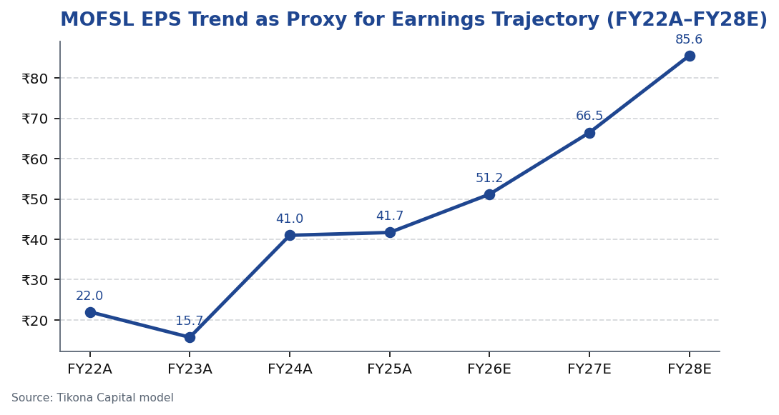
MOFSL | Pratik Gupta | 2026-04-28
Price Performance: MOFSL vs. Benchmark and Sector Index
Tikona Capital | SEBI Registration No.: INH000069807
Page 19 of 21

Slide 20
MOFSL | Pratik Gupta | 2026-04-28
Analyst Certification
I, Pratik Gupta, Research Analyst, hereby certify that the views expressed in this research report accurately reflect my personal views about the subject company and its securities. I have not received and will not receive any compensation — directly or indirectly — for the specific recommendations or views expressed in this report. This report has been prepared in accordance with SEBI (Research Analysts) Regulations, 2014. The analyst and/or Tikona Capital may hold positions in the securities discussed. All material information has been obtained from sources believed to be reliable; however, neither the analyst nor Tikona Capital guarantees its accuracy or completeness. Past performance of the subject company's securities is not necessarily indicative of future results. This report is intended for professional and institutional investors only and should not be construed as investment advice to retail investors. Tikona Capital is registered with SEBI as a Research Analyst under the Securities and Exchange Board of India (Research Analysts) Regulations, 2014.
Tikona Capital | SEBI Registration No.: INH000069807
Page 20 of 21

Slide 21
MOFSL | Pratik Gupta | 2026-04-28
Disclaimer
This research report has been prepared by Tikona Capital, a SEBI-registered Research Analyst entity, solely for informational purposes and is intended for use by professional and institutional investors. It does not constitute an offer, solicitation, or recommendation to buy or sell any security. The information contained herein has been obtained from sources believed to be reliable, but Tikona Capital makes no representation or warranty, express or implied, as to its accuracy, completeness, or timeliness. Opinions and estimates expressed in this report are subject to change without notice and may differ from those of other departments within Tikona Capital. The analyst and firm may, from time to time, hold positions in, or provide investment banking or other services to, the companies covered in this report. Past performance is not a reliable indicator of future results. Investing in securities involves risks, including the possible loss of principal. This report is not intended for distribution to, or use by, any person or entity in any jurisdiction where such distribution or use would be contrary to local law or regulation. Recipients should seek independent financial, legal, and tax advice before making any investment decision. Tikona Capital and its affiliates, officers, directors, and employees accept no liability for any direct or indirect loss arising from any use of this report or its contents. SEBI Registration Number: [INH000XXXXXX]. CIN: [UXXXXXXXXXXXXXXXXX]. Registered Address: Tikona Capital, India.
Tikona Capital | SEBI Registration No.: INH000069807
Page 21 of 21

