Slide 1

BUY
ABC Ltd Initiation Note
ABC Ltd | BUY
Rating
BUY
CMP
₹420.0
TP
₹515.0
Tikona Capital | SEBI Registration No.: INH000069807

Slide 2
ABC | Jane Doe | 2026-04-28
Investment Thesis
ABC Ltd is emerging as a scaled specialty chemicals platform with improving mix, stronger export penetration, and disciplined capacity expansion.
- ABC Ltd is emerging as a scaled specialty chemicals platform with improving mix, stronger export penetration, and disciplined capac...
- Demand visibility remains healthy across key end markets.
- Margin profile is improving due to mix and backward integration.
- Management execution has been steady across prior capex cycles.
- Raw material volatility could pressure gross margins.
- Delays in utilization ramp-up may push out earnings conversion.
Tikona Capital | SEBI Registration No.: INH000069807
Page 2 of 7

Slide 3
ABC | Jane Doe | 2026-04-28
ABC Ltd At A Glance
ABC Ltd is a specialty chemicals manufacturer focused on export-led growth and margin expansion.
CMP ₹420.0
TP ₹515.0
Upside 22.6%
Tikona Capital | SEBI Registration No.: INH000069807
Page 3 of 7

Slide 4
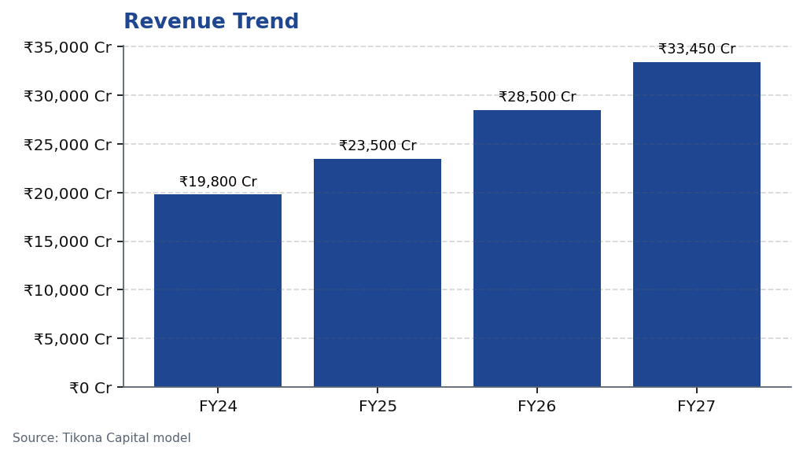
ABC | Jane Doe | 2026-04-28
Revenue Trend
Revenue trajectory across the forecast period reflects mix shift and AUM scale-up.
Tikona Capital | SEBI Registration No.: INH000069807
Page 4 of 7

Slide 5
ABC | Jane Doe | 2026-04-28
Annual Financial Summary
Period | Revenue
FY24 | ₹19,800.0 Cr
FY25 | ₹23,500.0 Cr
FY26 | ₹28,500.0 Cr
FY27 | ₹33,450.0 Cr
Tikona Capital | SEBI Registration No.: INH000069807
Page 5 of 7

Slide 6
ABC | Jane Doe | 2026-04-28
Key Risks
- Raw material volatility could pressure gross margins.
- Delays in utilization ramp-up may push out earnings conversion.
- Export demand softness could affect near-term growth.
Tikona Capital | SEBI Registration No.: INH000069807
Page 6 of 7

Slide 7
ABC | Jane Doe | 2026-04-28
Disclaimer
For internal research workflow validation only. Final legal disclaimer copy will be supplied from approved assets.
Tikona Capital | SEBI Registration No.: INH000069807
Page 7 of 7

