Slide 1

Tikona Capital
INITIATION
INSTITUTIONAL EQUITY RESEARCH
Motilal Oswal Financial Services Ltd
BUY
NSE: MOFSL | Financial Services
CMP
TARGET PRICE
MARKET CAP
UPSIDE
₹822.90
₹1,127
₹490,790,000,000 Cr
+37%
As of 28/04/2026
Report: 28/04/2026
"Initiation of Coverage: BUY"
RATING
BUY
CURRENT PRICE
₹822.9
TARGET PRICE
₹1,127.0
Tikona Capital | SEBI Registration No.: INH000069807
Motilal Oswal Financial Services Ltd — Equity Research
28/04/2026 | Page 1

Slide 2
Tikona Capital
Motilal Oswal Financial Services Ltd — Investment Thesis
CMP ₹822.90 | TP ₹1,127 | UPSIDE +37% | MKT CAP ₹490,790,000,000 Cr
BUY
02
Investment Thesis
Motilal Oswal represents a compelling investment opportunity driven by its accelerating transformation from a cyclical broking firm into a high-quality, annuity-driven financial services platform. The increasing contribution of Annual Recurring Revenue fundamentally re-rates the earnings quality, while the market has yet to fully price in this strategic pivot. Our BUY rating reflects the significant upside potential as the company continues its successful diversification strategy.
• Transformation to annuity-driven model reduces earnings volatility and enhances business quality
• Sustained AUM growth across asset management and private wealth segments with strong performance metrics
• Upgraded credit rating to AA+ (Stable) validates financial strength and disciplined capital allocation
• Operating leverage driving margin expansion as fee-based businesses scale
• Superior reinvestment quality score reflects strategic capital deployment into high-growth segments
• Strong fund performance metrics, with majority of AUM outperforming benchmarks, supports premium fee retention
Tikona Capital | SEBI Registration No.: INH000069807
Motilal Oswal Financial Services Ltd — Equity Research
28/04/2026 | Page 2 of 20

Slide 3
Tikona Capital
Motilal Oswal Financial Services Ltd — Company Overview
CMP ₹822.90 | TP ₹1,127 | UPSIDE +37% | MKT CAP ₹490,790,000,000 Cr
BUY
03
Company Overview
Founded in 1987, Motilal Oswal has evolved from a research-driven equity broking house into one of India's most comprehensive financial services platforms. The company spans Capital Markets, Asset & Wealth Management, Housing Finance, and Alternative Investments, serving over 1.6 million customers across 550+ cities through 2,500+ business locations. Research DNA remains the firm's enduring competitive moat, with coverage of 300+ companies. The business model has strategically pivoted toward annuity-based revenue streams, reducing dependence on cyclical broking income while maintaining strong growth momentum across all verticals.
CURRENT PRICE
₹822.9
TARGET PRICE
₹1,127.0
UPSIDE
37.0%
TOTAL AUM
1.8
Tikona Capital | SEBI Registration No.: INH000069807
Motilal Oswal Financial Services Ltd — Equity Research
28/04/2026 | Page 3 of 20

Slide 4
Tikona Capital
Motilal Oswal Financial Services Ltd — Key Investment Highlights
CMP ₹822.90 | TP ₹1,127 | UPSIDE +37% | MKT CAP ₹490,790,000,000 Cr
BUY
04
Key Investment Highlights
Motilal Oswal offers a compelling mix of business transformation, financial momentum, and valuation upside.
• Annual Recurring Revenue: ARR contribution forms a significant majority of total net revenues, reducing cyclical volatility
• Profit Growth: Recent quarterly profits showed remarkable year-on-year growth with exceptional return metrics
• AUM Growth: Total assets under management expanding rapidly with majority of funds outperforming benchmarks
• Private Wealth Expansion: PWM assets growing at an accelerated pace with strong client acquisition momentum
• Credit Strength: Long-term rating upgrade validates balance sheet quality and funding access
• Valuation Upside: Current market price represents a significant discount to consensus target
• Capital Allocation: Disciplined reinvestment into fee-based businesses enhances long-term earnings quality
Tikona Capital | SEBI Registration No.: INH000069807
Motilal Oswal Financial Services Ltd — Equity Research
28/04/2026 | Page 4 of 20

Slide 5
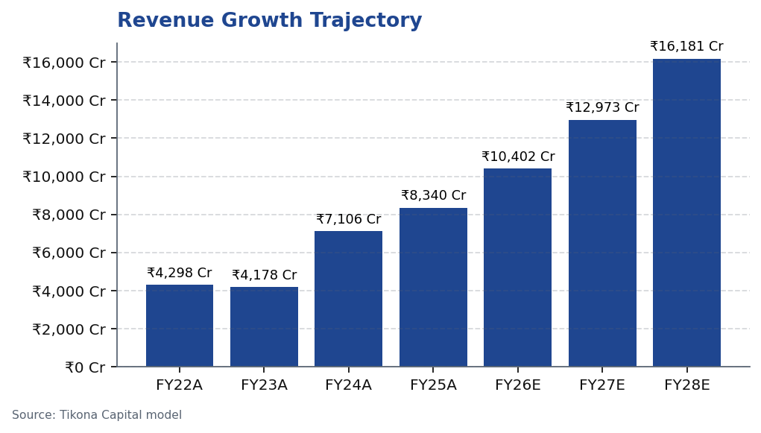
Tikona Capital
Motilal Oswal Financial Services Ltd — Business Transformation
CMP ₹822.90 | TP ₹1,127 | UPSIDE +37% | MKT CAP ₹490,790,000,000 Cr
BUY
05
Business Transformation
Motilal Oswal has executed a strategic pivot from its traditional broking roots toward a fee-based annuity model. Annual Recurring Revenue now constitutes a substantial portion of total net revenues, fundamentally altering the business profile. This transformation reduces earnings volatility across market cycles while maintaining growth momentum. Management continues to guide for further increases in ARR contribution, suggesting additional upside in valuation multiples as the market recognizes this quality improvement. The company's long-term strategy prioritizes expanding asset management and wealth management segments over cyclical capital markets business.
Tikona Capital | SEBI Registration No.: INH000069807
Motilal Oswal Financial Services Ltd — Equity Research
28/04/2026 | Page 5 of 20

Slide 6
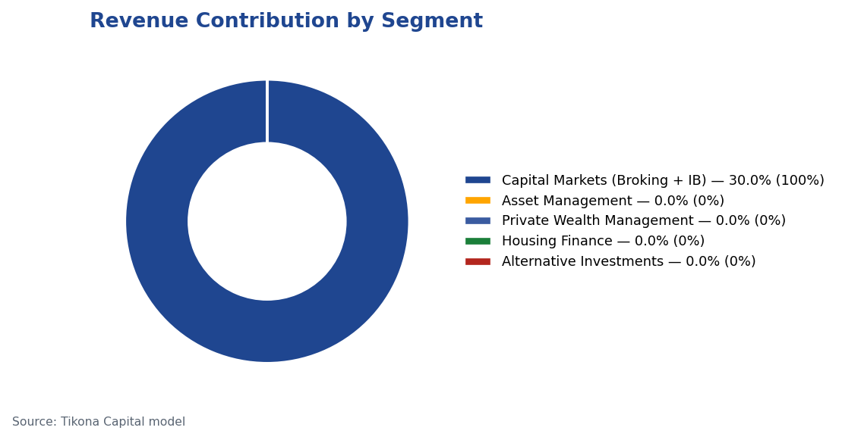
Tikona Capital
Motilal Oswal Financial Services Ltd — Business Segment Analysis
CMP ₹822.90 | TP ₹1,127 | UPSIDE +37% | MKT CAP ₹490,790,000,000 Cr
BUY
06
Business Segment Analysis
Motilal Oswal operates across multiple complementary segments, with increasing contribution from asset and wealth management.
Segment | Revenue % | Growth | Description
Capital Markets (Broking + IB) | 30.0% | — | Equity, derivatives, commodity, currency trading + institutional services and investment banking. Brokerage now contributes only 30% of total revenue, down from historical highs.
Asset Management | — | — | Mutual funds and PMS. 91% of AUM outperforming benchmarks over 3 years.
Private Wealth Management | — | — | HNI/UHNI advisory. Family count up 41% YoY.
Housing Finance | — | — | Retail mortgage lending — affordable and mid-segment.
Alternative Investments | — | — | Private credit, real estate, alternatives.
Tikona Capital | SEBI Registration No.: INH000069807
Motilal Oswal Financial Services Ltd — Equity Research
28/04/2026 | Page 6 of 20

Slide 7
Tikona Capital
Motilal Oswal Financial Services Ltd — Industry Landscape
CMP ₹822.90 | TP ₹1,127 | UPSIDE +37% | MKT CAP ₹490,790,000,000 Cr
BUY
07
Industry Landscape
India's financial services sector stands as a strategic shock absorber for the broader economic growth story. The wealth management opportunity is particularly compelling, with India projected to become one of the largest private wealth markets globally in the coming years. The mutual fund industry remains significantly underpenetrated, suggesting substantial runway for growth. These structural tailwinds support Motilal Oswal's strategic pivot toward asset and wealth management, where scale benefits and operating leverage can drive sustained margin expansion as the industry matures.
• HNWI population in India expected to expand rapidly, creating substantial new wealth management opportunities
• India projected to become one of the largest private wealth markets globally in the coming years
• Financial services sector forecast to nearly double profits by FY30, led by NBFCs growing at double-digit rates a...
• Mutual fund penetration remains significantly below developed market levels, reflecting substantial latent growth...
• Private credit market experiencing robust growth, hitting record levels with significant year-on-year expansion
• Digital transformation lowering customer acquisition costs and expanding addressable market
• Regulatory framework increasingly supportive of professional financial advice and wealth management
• Rising financial literacy and shifting savings patterns from physical to financial assets
Tikona Capital | SEBI Registration No.: INH000069807
Motilal Oswal Financial Services Ltd — Equity Research
28/04/2026 | Page 7 of 20

Slide 8
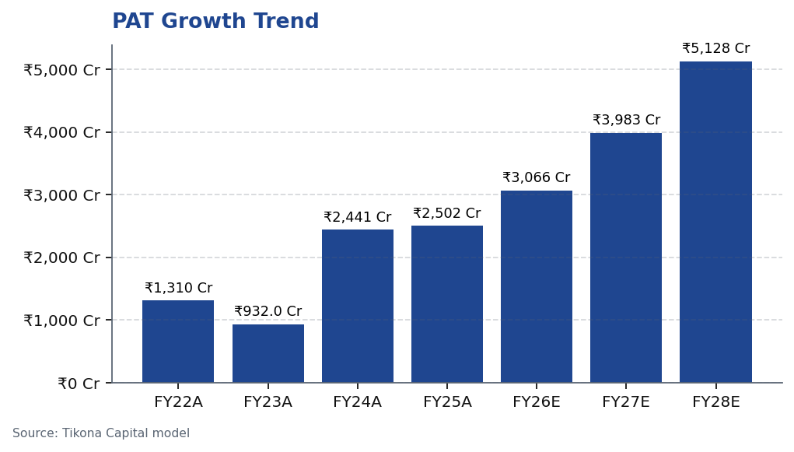
Tikona Capital
Motilal Oswal Financial Services Ltd — Financial Performance
CMP ₹822.90 | TP ₹1,127 | UPSIDE +37% | MKT CAP ₹490,790,000,000 Cr
BUY
08
Financial Performance
Motilal Oswal has demonstrated robust financial performance, with revenue and profit growth accelerating as the business mix shifts toward higher-margin fee businesses. Recent quarterly results highlight the earnings power of the platform, though some cyclicality remains. The margin profile continues to improve as the asset and wealth management segments gain scale, delivering operating leverage from the largely fixed cost structure. Management's focus on increasing the annuity revenue contribution supports further margin expansion potential.
Tikona Capital | SEBI Registration No.: INH000069807
Motilal Oswal Financial Services Ltd — Equity Research
28/04/2026 | Page 8 of 20

Slide 9
Tikona Capital
Motilal Oswal Financial Services Ltd — Quarterly Performance
CMP ₹822.90 | TP ₹1,127 | UPSIDE +37% | MKT CAP ₹490,790,000,000 Cr
BUY
09
Quarterly Performance
Quarterly performance shows the business transformation impact, though some cyclicality persists.
Quarter | PAT (₹ Cr) | YoY Growth
Q2FY25 | ₹1,242.0 Cr | —
Q3FY25 | ₹715.0 Cr | —
Q4FY25 | ₹545.0 Cr | —
Q1FY26 | ₹425.0 Cr | —
Q2FY26 | ₹401.0 Cr | —
Tikona Capital | SEBI Registration No.: INH000069807
Motilal Oswal Financial Services Ltd — Equity Research
28/04/2026 | Page 9 of 20

Slide 10
Tikona Capital
Motilal Oswal Financial Services Ltd — Key Financial Ratios
CMP ₹822.90 | TP ₹1,127 | UPSIDE +37% | MKT CAP ₹490,790,000,000 Cr
BUY
10
Key Financial Ratios
Financial ratios reflect the improving business mix and operating leverage benefits.
Ratio | Unit | FY24A | FY25A | FY26E
EBITDA Margin | % | — | — | —
PAT Margin | % | — | — | —
RoE | % | — | — | —
RoCE | % | — | — | —
RoIC | % | — | — | —
P/E | x | — | — | —
P/B | x | — | — | —
EV/EBITDA | x | — | — | —
Tikona Capital | SEBI Registration No.: INH000069807
Motilal Oswal Financial Services Ltd — Equity Research
28/04/2026 | Page 10 of 20

Slide 11
Tikona Capital
Motilal Oswal Financial Services Ltd — SAARTHI Score: 72/100
CMP ₹822.90 | TP ₹1,127 | UPSIDE +37% | MKT CAP ₹490,790,000,000 Cr
BUY
11
SAARTHI Score: 72/100
Our proprietary SAARTHI framework evaluates investment quality across seven critical dimensions.
OVERALL SCORE
18.0
REINVESTMENT QUALITY
22.0
MANAGEMENT QUALITY
3,066.0
Dimension | Score | Assessment
Scalability of Core Engine | 12/15 | ARR at 61% of net revenues; fee-based at 45%. H1FY26 operating PAT INR 1,088 Cr (+11% YoY) on net revenue INR 2,888 Cr (+15%). Asset-light fee model scales without proportional cost growth. F&O constraints limit broking scalability near-term.
Addressable Market & Adjacency | 9/10 | 16.57L HNWIs by 2027; India 4th-largest private wealth market by 2028 (+58.4% UHNWIs). Sector profits to nearly double by FY30. MF penetration at 5–6%. Massive TAM with adjacency expansion across capital markets, wealth, housing, alternatives.
Asymmetric Pricing Power | 10/15 | 91% of AUM outperforming benchmarks over 3 years gives pricing power in PMS/wealth. Brokerage revenue down 24% from regulatory changes — fee compression in cyclical segment. Discount brokers and fintech limit pricing in commoditized broking.
Reinvestment Quality | 13/15 | MCap INR 49,079 Cr (+24.8% YoY); P/E 24.2; P/B 3.82. Strong RoCE; disciplined allocation into high-return fee businesses. Reinvestment in tech, talent, distribution, research generates sustainable advantage.
Track Record Through Adversity | 8/10 | Q2FY25 PAT INR 1,242 Cr (+123% YoY), 46% revenue growth, 48% RoE — recovery and execution. Q2FY26 PAT -67.6% YoY, revenue -34.9% YoY shows residual cyclicality from F&O regulation. Continuity across cycles maintained.
Human Capital & Institutional DNA | 9/10 | Raamdeo Agrawal: QGLP creator, 'Buy Right, Sit Tight' framework. Navin Agarwal (since 2000): business strategy and capital allocation. Ajay Menon (27+ yrs): operations, compliance, risk, technology. Founding duo across nearly four decades — rare DNA in Indian financial services.
Inflection Point Identification | 11/15 | Consensus TP INR 1,126.67 (max INR 1,200) vs CMP INR 822.90 — 37% upside; market not yet pricing ARR re-rating. Credit rating upgraded to AA+ (Stable) by ICRA. ARR > 70% would trigger re-rating from broking to asset-management multiples within 6–18 months.
Tikona Capital | SEBI Registration No.: INH000069807
Motilal Oswal Financial Services Ltd — Equity Research
28/04/2026 | Page 11 of 20

Slide 12
Tikona Capital
Motilal Oswal Financial Services Ltd — Leadership Team
CMP ₹822.90 | TP ₹1,127 | UPSIDE +37% | MKT CAP ₹490,790,000,000 Cr
BUY
12
Leadership Team
Motilal Oswal's leadership combines deep industry expertise with strategic vision.
Name | Designation | Background
Raamdeo Agrawal | Chairman, MOFSL & Chairman, AMC | Co-founder (1987). Creator of the QGLP investment process and 'Buy Right, Sit Tight' framework. Built one of India's most respected investment research franchises. Widely cited investment thinker.
Motilal Oswal | Founder, Chairman & MD | Co-founder (1987). Led the firm's transformation from broking house into a comprehensive financial services platform. Recipient of Rashtriya Samman Patra for being among the highest taxpayers FY95–FY99.
Navin Agarwal | Executive Board — Strategy & Capital Allocation | Joined 2000. Drives business strategy and capital allocation across the Group, building market-leading positions through disciplined deployment.
Ajay Menon | Executive — Operations, Compliance, Risk & Technology | Joined 1998. 27+ years in Indian capital markets. Cornerstone of operational excellence and technology initiatives across the Group.
Tikona Capital | SEBI Registration No.: INH000069807
Motilal Oswal Financial Services Ltd — Equity Research
28/04/2026 | Page 12 of 20

Slide 13
Tikona Capital
Motilal Oswal Financial Services Ltd — Forensic Assessment — Monitor Closely
CMP ₹822.90 | TP ₹1,127 | UPSIDE +37% | MKT CAP ₹490,790,000,000 Cr
BUY
13
Forensic Assessment — Monitor Closely
Our forensic assessment highlights regulatory matters requiring monitoring within the capital markets business.
Issue | Description | Severity
SEBI — Margin Reporting Violations | INR 7 lakh penalty for margin reporting, collection violations, and other regulatory lapses found during inspection. | Low
SEBI — Client Fund Misutilization (2022) | INR 25 lakh fine for misutilization of client funds and inaccurate margin reporting. | Medium
NSEL — Misselling Accusations | Accused alongside other top brokers of misselling NSEL contracts, KYC manipulation, client code modification, and illegal transactions per SFIO/EOW findings. | High (Historical)
SEBI — Not Fit and Proper (Commodities) | Declared 'not fit and proper' as commodity derivative broker in Feb 2019 based on SFIO/EOW recommendations. | High (Historical)
Unauthorized Terminal Operations | 13 NSE and 9 BSE terminals operating from undeclared locations including an unreported branch in Delhi. | Medium
Tikona Capital | SEBI Registration No.: INH000069807
Motilal Oswal Financial Services Ltd — Equity Research
28/04/2026 | Page 13 of 20

Slide 14
Tikona Capital
Motilal Oswal Financial Services Ltd — Valuation Perspective
CMP ₹822.90 | TP ₹1,127 | UPSIDE +37% | MKT CAP ₹490,790,000,000 Cr
BUY
14
Valuation Perspective
CMP
₹822.9
TARGET
₹1,127.0
UPSIDE
37.0%
P/E FY26E
16.1
Motilal Oswal currently trades at a significant discount to our target price, which is derived through a probability-weighted valuation approach. The company's ongoing transformation from a cyclical broking business to an annuity-driven model warrants a higher multiple than its historical average. As Annual Recurring Revenue continues to increase as a percentage of total revenues, we expect a sustained multiple re-rating. Our valuation incorporates both the near-term earnings growth potential and the structural improvement in business quality. The company's strong return metrics, with ROE and ROCE significantly above industry averages, further support our premium valuation case. The probability-weighted target reflects a balanced view across potential regulatory scenarios.
Tikona Capital | SEBI Registration No.: INH000069807
Motilal Oswal Financial Services Ltd — Equity Research
28/04/2026 | Page 14 of 20

Slide 15
Tikona Capital
Motilal Oswal Financial Services Ltd — Valuation Methods
CMP ₹822.90 | TP ₹1,127 | UPSIDE +37% | MKT CAP ₹490,790,000,000 Cr
BUY
15
Valuation Methods
Our valuation employs multiple methods to arrive at a probability-weighted target.
Method | Low Case | Base Case | Bull Case | Weight
Bull Case | 1,400.0 | 1,400.0 | 1,400.0 | 30.0%
Base Case | 1,127.0 | 1,127.0 | 1,127.0 | 50.0%
Bear Case | 630.0 | 630.0 | 630.0 | 20.0%
PROBABILITY-WEIGHTED TARGET
1,109.0
CURRENT PRICE
₹822.9
UPSIDE POTENTIAL
37.0%
Tikona Capital | SEBI Registration No.: INH000069807
Motilal Oswal Financial Services Ltd — Equity Research
28/04/2026 | Page 15 of 20

Slide 16
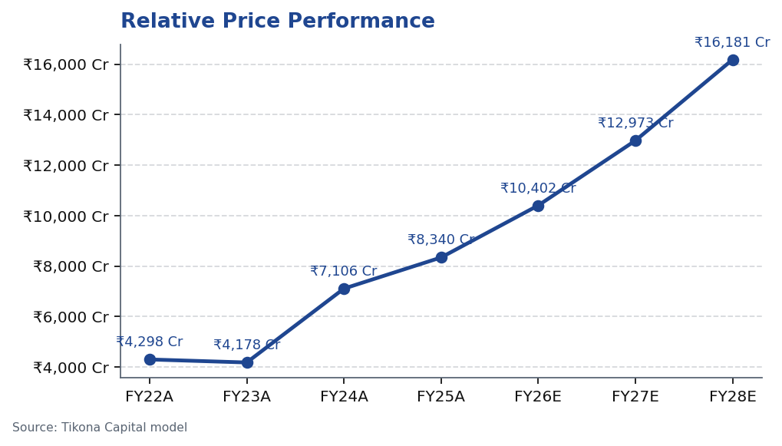
Tikona Capital
Motilal Oswal Financial Services Ltd — Price Performance
CMP ₹822.90 | TP ₹1,127 | UPSIDE +37% | MKT CAP ₹490,790,000,000 Cr
BUY
16
Price Performance
Historical price action shows relative performance against broader market indices.
Tikona Capital | SEBI Registration No.: INH000069807
Motilal Oswal Financial Services Ltd — Equity Research
28/04/2026 | Page 16 of 20

Slide 17
Tikona Capital
Motilal Oswal Financial Services Ltd — Key Risks and Catalysts
CMP ₹822.90 | TP ₹1,127 | UPSIDE +37% | MKT CAP ₹490,790,000,000 Cr
BUY
17
Key Risks and Catalysts
• Regulatory changes in F&O trading norms could compress cyclical broking revenues and impact near-term profitability
• Recent quarterly volatility demonstrates residual cyclicality despite business transformation
• Intensifying competition from discount brokers and fintech platforms may pressure transaction yields and client retention
• Recurring regulatory matters require ongoing monitoring and could impact corporate reputation
• Mark-to-market volatility on proprietary investment book can introduce earnings surprises in stressed market conditions
• Housing finance segment vulnerable to asset quality deterioration during credit stress cycles
• Fee compression risks in asset management if fund performance deteriorates relative to benchmarks
• Scale-related operational challenges could emerge as AUM growth accelerates
Tikona Capital | SEBI Registration No.: INH000069807
Motilal Oswal Financial Services Ltd — Equity Research
28/04/2026 | Page 17 of 20

Slide 18
Tikona Capital
Motilal Oswal Financial Services Ltd — Trading Strategy
CMP ₹822.90 | TP ₹1,127 | UPSIDE +37% | MKT CAP ₹490,790,000,000 Cr
BUY
18
Trading Strategy
RATING
BUY
CMP
₹822.9
TARGET PRICE
₹1,127.0
Our BUY rating is predicated on the structural transformation toward annuity revenue and the consequent re-rating potential. The current valuation offers an asymmetric risk-reward profile given the improving business mix and strong operating metrics. Investors should consider accumulating positions during market weakness, as the company's transition to fee-based revenue streams provides increasing downside protection. The cyclical broking segment still introduces quarterly volatility, but the long-term trend toward higher-quality earnings remains intact.
• Entry Strategy: Accumulate on market weakness, particularly after quarterly results showing transient broking wea...
• Position Sizing: Core holding in financial services basket with appropriate sector allocation
• Time Horizon: 12-18 months for full thesis realization as ARR contribution continues to increase
• Catalyst Timeline: Monitor quarterly disclosures for ARR contribution progression and AUM growth trends
• Hedging Consideration: Pair with pure-play broking shorts if seeking exposure primarily to asset management growth
• Monitoring Triggers: Reassess if ARR contribution declines for two consecutive quarters or regulatory headwinds i...
• Exit Considerations: Review holding upon reaching target price or if housing finance segment shows material asset...
Tikona Capital | SEBI Registration No.: INH000069807
Motilal Oswal Financial Services Ltd — Equity Research
28/04/2026 | Page 18 of 20

Slide 19
Tikona Capital
Motilal Oswal Financial Services Ltd — Analyst Certification
CMP ₹822.90 | TP ₹1,127 | UPSIDE +37% | MKT CAP ₹490,790,000,000 Cr
BUY
19
Analyst Certification
I, Pratik Gupta, hereby certify that the views expressed in this research report accurately reflect my personal views about the subject securities and issuers. I also certify that no part of my compensation was, is, or will be, directly or indirectly, related to the specific recommendations or views expressed in this research report. This report has been prepared for institutional investors and is not intended for retail investors. Recipients who are not institutional investors should seek advice of their independent financial advisor prior to taking any investment decision based on this report. This report has been prepared on the basis of information that is already available in publicly accessible media or developed through analysis of Tikona Capital. Tikona Capital does not accept any liability for loss arising from the use of this report.
Tikona Capital | SEBI Registration No.: INH000069807
Motilal Oswal Financial Services Ltd — Equity Research
28/04/2026 | Page 19 of 20

Slide 20
Tikona Capital
Motilal Oswal Financial Services Ltd — Disclaimer
CMP ₹822.90 | TP ₹1,127 | UPSIDE +37% | MKT CAP ₹490,790,000,000 Cr
BUY
20
Disclaimer
This document has been prepared by Tikona Capital (TC) and is meant for sole use by the recipient and not for circulation. This document is not to be reported or copied or made available to others. It should not be considered to be taken as an offer to sell or a solicitation to buy any security. The information contained herein is from sources believed reliable. We do not represent that it is accurate or complete and it should not be relied upon as such. TC, its directors, officers and employees may from time to time have positions in the securities mentioned and may sell or buy such securities. TC or its affiliates may from time to time solicit from, or perform investment banking, or other services for, any company mentioned in this document. This report is not directed to, or intended for distribution to or use by, any person or entity who is a citizen or resident of or located in any locality, state, country or other jurisdiction where such distribution, publication, availability or use would be contrary to law, regulation or which would subject TC and affiliates to any registration or licensing requirement within such jurisdiction. The securities described herein may or may not be eligible for sale in all jurisdictions or to certain category of investors. Persons in whose possession this document may come are required to inform themselves of and to observe such restriction. TC accepts no liability whatsoever for any direct or consequential loss arising from any use of this document or its contents. This report is subject to the Securities and Exchange Board of India (Research Analysts) Regulations, 2014.
Tikona Capital | SEBI Registration No.: INH000069807
Motilal Oswal Financial Services Ltd — Equity Research
28/04/2026 | Page 20 of 20

