Slide 1

INITIATION COVERAGE - Q2 FY25-26
Motilal Oswal Financial Services Ltd
BUY
NSE: MOFSL | Financial Services / Capital Markets
CMP
TARGET PRICE
MARKET CAP
MARKET CAP CATEGORY
SAARTHI SCORE
PROB. WEIGHTED TP
₹822.90
₹1,127
₹49,079 Cr
Mid Cap
72/100
₹1,109
As of 28/04/2026
12M upside case
Financial Services leader
BUY (70-84 range)
Report Reference: Q2 FY2025-26 | 28/04/2026
"MOFSL - BUY"
Investment Thesis
FINANCIAL SUMMARY (INR CRORE)
KEY VALUATION METRICS
Metric | FY24A | FY25A | FY26E | FY27E
Revenue | ₹7,106.0 | ₹8,340.0 | ₹10,402.0 | ₹12,973.0
EBITDA | ₹4,082.0 | ₹4,546.0 | ₹5,439.0 | ₹6,784.0
EBITDA Mgn | 57.4% | 54.5% | 52.3% | 52.3%
PAT | ₹2,441.0 | ₹2,502.0 | ₹3,066.0 | ₹3,983.0
PAT Mgn | 34.4% | 30.0% | 29.5% | 30.7%
EPS | ₹41.0 | ₹41.7 | ₹51.2 | ₹66.5
P/E | 20.1x | 19.7x | 16.1x | 12.4x
P/B | 5.6x | 4.5x | 3.6x | 2.9x
EV/EBITDA | 9.5x | 11.4x | 12.7x | 10.5x
P/E (TTM)
24.20x
P/B Ratio
3.82x
EPS (FY25A)
₹41.7
EPS (FY27E)
₹66.5
ANALYST CONSENSUS
Consensus TP
₹1,127
ARR Transformation
Profitability Momentum
Max Target
₹1,200
ARR at 65% of net revenues (up from 61%); fee-based at 45%. Annuity income reduces transaction-cycle volatility.
Q2FY25 PAT INR 1,242 Cr (+123% YoY); H1FY26 operating PAT INR 1,088 Cr (+11% YoY); Asset & PWM businesses leading at +32% PAT growth.
Upside to Cons.
+37%
KEY OPERATING STATS
Total AUM
₹1.77L Cr
AMC AUM
₹1.89L Cr
AUM Scale and Outperformance
Private Wealth Expansion
Pvt Wealth AUM
₹1.96L Cr
Total AUM INR 1.77L Cr (+46% YoY). AMC AUM INR 1.89L Cr (+33%) with INR 11,610 Cr net flows. 91% of AUM outperforming benchmarks over 3 years.
PWM AUM INR 1.96L Cr (+31% YoY); family count +41% YoY; PAT +14% (9M). Distribution book +34% YoY to INR 42,775 Cr.
CREDIT RATING
H1 FY26 SNAPSHOT
ICRA Rating
AA+
Consol. Net Revenue | ₹2,888 Cr
Operating PAT | ₹1,088 Cr (+11% YoY)
ARR % of Net Revenue | 65%
Fee-Based % of Revenue | 45%
EPS FY25 Annual | ₹51.2
Outlook
Stable
Valuation Opportunity
Credit Upgrade
Net Worth
₹12871 Cr
ARR INFLECTION WATCH
CMP INR 822.90 vs consensus TP INR 1,126.67 (max INR 1,200) — 37% upside. Probability-weighted target INR 1,109.
Long-term credit rating upgraded to AA+ (Stable) by ICRA. Net worth INR 12,871 Cr (+16% YoY).
65%
ARR of total net revenues. Re-rating trigger: 70%+ ARR.
SEBI Reg. No.: INH000069807
Motilal Oswal Financial Services Ltd - Equity Research
Page 1 of 15

Slide 2
Motilal Oswal Financial Services Ltd — Investment Thesis
CMP ₹822.90 | TP ₹1,127 | UPSIDE +37% | MKT CAP ₹49,079 Cr
BUY
02
Investment Thesis
We initiate coverage on Motilal Oswal Financial Services with a BUY rating. The company is undergoing a fundamental transformation from a cyclical broking business to a high-quality, annuity-driven financial services platform. This structural shift in revenue mix significantly improves earnings quality and visibility, yet remains underappreciated by the market. The current valuation offers an attractive entry point as the company continues to scale its asset management and wealth businesses while maintaining strong profitability metrics.
• Revenue quality transformation: The shift toward annuity-based revenues substantially reduces earnings volatility and imp...
• Strong AUM momentum: Both asset management and private wealth segments are growing rapidly with impressive benchmark outp...
• Balance sheet strength: Credit rating upgrade to AA+ reflects financial stability and enhanced reinvestment capacity
• Operational efficiency: Significant operating leverage potential as the business scales on largely fixed cost base
• Industry tailwinds: Structurally advantaged by India's expanding HNWI population and increasing financialization
• Attractive valuation: Current market price offers substantial discount to probability-weighted target despite quality imp...
SEBI Registration No.: INH000069807
Motilal Oswal Financial Services Ltd — Equity Research
28/04/2026 | Page 2 of 20

Slide 3
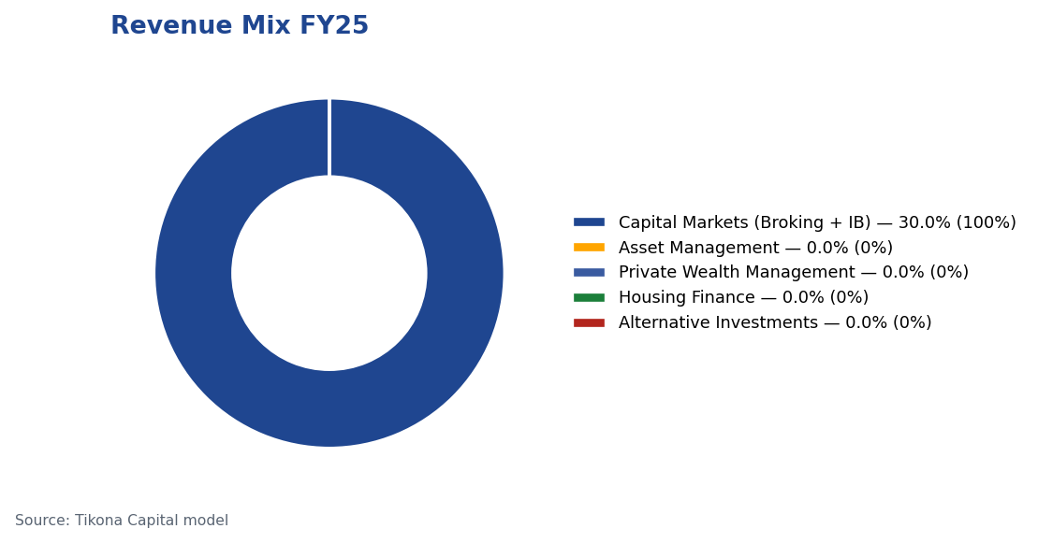
Motilal Oswal Financial Services Ltd — Revenue Transformation Underway
CMP ₹822.90 | TP ₹1,127 | UPSIDE +37% | MKT CAP ₹49,079 Cr
BUY
03
Revenue Transformation Underway
SEBI Registration No.: INH000069807
Motilal Oswal Financial Services Ltd — Equity Research
28/04/2026 | Page 3 of 20

Slide 4
Motilal Oswal Financial Services Ltd — Indian Financial Services: Structural Growth Runway
CMP ₹822.90 | TP ₹1,127 | UPSIDE +37% | MKT CAP ₹49,079 Cr
BUY
04
Indian Financial Services: Structural Growth Runway
India's financial services sector represents a core enabler of the country's growth story, with particularly strong prospects in wealth and asset management. The sector is undergoing profound transformation driven by rising incomes, expanding investor participation, and increasing financialization of savings. Financial services companies with established brands, distribution networks, and product capabilities are positioned to capture disproportionate value as the industry expands. This structural tailwind provides a multi-year growth runway for well-positioned players like Motilal Oswal.
• India projected to become the fourth-largest private wealth market globally by 2028 with significant HNWI expansion
• Financial services sector profits expected to nearly double by FY30, with NBFCs growing at substantial rates annu...
• Mutual fund penetration remains modest, representing substantial headroom for growth
• Private credit market expanding rapidly, setting new records with significant year-over-year growth
• Regulatory landscape evolving to favor established, compliant players with robust governance frameworks
• Digital transformation enabling broader market access and improving operational efficiencies across the sector
SEBI Registration No.: INH000069807
Motilal Oswal Financial Services Ltd — Equity Research
28/04/2026 | Page 4 of 20

Slide 5
Motilal Oswal Financial Services Ltd — Company Overview
CMP ₹822.90 | TP ₹1,127 | UPSIDE +37% | MKT CAP ₹49,079 Cr
BUY
05
Company Overview
Motilal Oswal Financial Services has evolved from its origins as a research-driven equity broking house into a diversified financial services platform. The company now spans capital markets, asset and wealth management, housing finance, and alternative investments. Its research-led approach covers over 300 companies, creating a differentiated competitive moat. The company serves more than 1.6 million customers across 550+ cities through 2,500+ business locations. The business has strategically pivoted toward annuity-based revenue streams while maintaining its heritage strengths in research and broking.
ANNUAL RECURRING REVENUE
65.0
TOTAL AUM
1.8
AUM GROWTH (YOY)
46.0
ROE FY26E
22.0
CREDIT RATING
AA+ (Stable) ICRA
SEBI Registration No.: INH000069807
Motilal Oswal Financial Services Ltd — Equity Research
28/04/2026 | Page 5 of 20

Slide 6
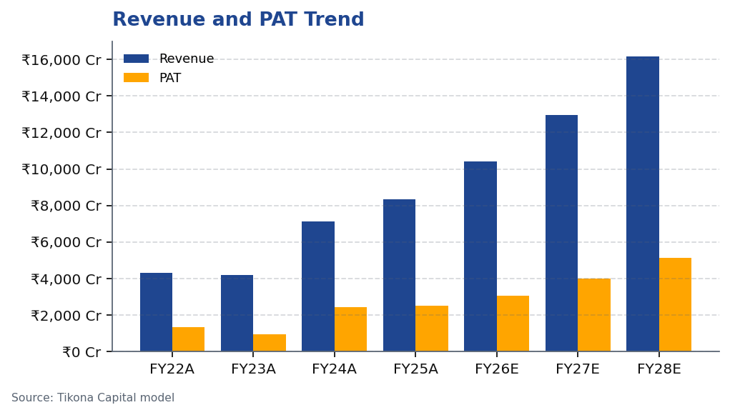
Motilal Oswal Financial Services Ltd — Financial Performance Trajectory
CMP ₹822.90 | TP ₹1,127 | UPSIDE +37% | MKT CAP ₹49,079 Cr
BUY
06
Financial Performance Trajectory
Motilal Oswal has demonstrated robust financial performance with accelerating momentum in recent periods. The company has delivered impressive growth across key financial metrics, with revenue expansion accompanied by improving profitability. The shift toward annuity-based revenues has enhanced earnings quality while reducing cyclicality. Recent quarterly results underscore the strength of this transformation, with substantial year-over-year gains in both top and bottom lines. The company's ability to maintain strong returns on equity highlights its efficient capital allocation and operating leverage benefits as scale increases.
SEBI Registration No.: INH000069807
Motilal Oswal Financial Services Ltd — Equity Research
28/04/2026 | Page 6 of 20

Slide 7
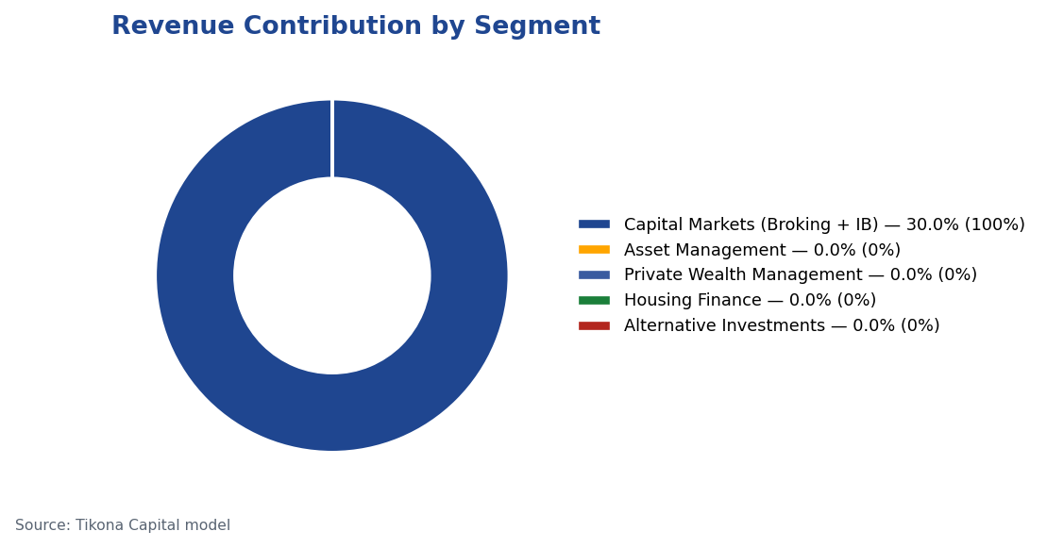
Motilal Oswal Financial Services Ltd — Business Segment Analysis
CMP ₹822.90 | TP ₹1,127 | UPSIDE +37% | MKT CAP ₹49,079 Cr
BUY
07
Business Segment Analysis
Motilal Oswal operates through multiple complementary business segments, with a strategic focus on growing its annuity-based businesses.
Segment | Revenue % | EBITDA % | YoY Growth | AUM Metric | Value
Capital Markets (Broking + IB) | 30.0% | — | — | Brokerage Rev YoY | -24%
Asset Management | — | — | — | AMC AUM | INR 1.89L Cr (+33% YoY)
Private Wealth Management | — | — | — | PWM AUM | INR 1.96L Cr (+31% YoY)
Housing Finance | — | — | — | Loan Book | INR 6,630 Cr (+25% YoY)
Alternative Investments | — | — | — | Carry Income | INR 58 Cr recurring
SEBI Registration No.: INH000069807
Motilal Oswal Financial Services Ltd — Equity Research
28/04/2026 | Page 7 of 20

Slide 8
Motilal Oswal Financial Services Ltd — Key Investment Highlights
CMP ₹822.90 | TP ₹1,127 | UPSIDE +37% | MKT CAP ₹49,079 Cr
BUY
08
Key Investment Highlights
Motilal Oswal offers multiple vectors for sustainable growth and value creation.
• Annuity Revenue Transformation: ARR contribution now represents a substantial portion of total net revenues, fundamentally improving earnings quality and reducing cyclicality
• Asset Management Excellence: AMC AUM showing strong growth with impressive benchmark outperformance, supporting premium fee retention and client loyalty
• Private Wealth Scale: PWM business demonstrating robust expansion in both AUM and family count, capturing India's wealth creation wave
• Financial Strength: Credit rating upgrade reflects balance sheet quality and increased reinvestment capacity for future growth initiatives
• Operational Efficiency: Significant operating leverage potential as business scales on largely fixed cost infrastructure
• Research Leadership: Coverage of over 300 companies creates differentiated insights and sustains competitive advantage across business lines
SEBI Registration No.: INH000069807
Motilal Oswal Financial Services Ltd — Equity Research
28/04/2026 | Page 8 of 20

Slide 9
Motilal Oswal Financial Services Ltd — Asset & Wealth Management Deep Dive
CMP ₹822.90 | TP ₹1,127 | UPSIDE +37% | MKT CAP ₹49,079 Cr
BUY
09
Asset & Wealth Management Deep Dive
The asset and wealth management businesses represent Motilal Oswal's crown jewels, delivering strong annuity-based revenues with high growth potential. Both businesses are scaling rapidly with impressive AUM expansion and client acquisition metrics. The asset management business benefits from strong investment performance, with the majority of AUM outperforming benchmarks over medium and long-term horizons. This performance supports fee retention and net inflows. The private wealth business continues to expand its family count while deepening wallet share with existing clients, resulting in accelerating AUM growth. These twin engines provide a stable, growing revenue base that enhances overall business quality.
• Asset Management: AMC AUM expanding rapidly with strong performance track record across fund categories
• Benchmark Outperformance: Vast majority of AMC AUM outperforming benchmarks over three-year periods, supporting f...
• Private Wealth: PWM AUM growing substantially with accelerating family count acquisition
• Client Expansion: Family count growth outpacing AUM growth, indicating strong new client acquisition alongside de...
• Product Innovation: Expanding alternative investment offerings capturing additional wallet share from HNI and UHN...
• Distribution Strength: Leveraging existing distribution network while expanding digital capabilities for efficien...
SEBI Registration No.: INH000069807
Motilal Oswal Financial Services Ltd — Equity Research
28/04/2026 | Page 9 of 20

Slide 10
Motilal Oswal Financial Services Ltd — Management Team Assessment
CMP ₹822.90 | TP ₹1,127 | UPSIDE +37% | MKT CAP ₹49,079 Cr
BUY
10
Management Team Assessment
Motilal Oswal's leadership combines founder continuity with professional management depth across business verticals.
Name | Designation | Background & Experience
Raamdeo Agrawal | Chairman, MOFSL & Chairman, AMC | Co-founder (1987). Creator of the QGLP investment process and 'Buy Right, Sit Tight' framework. Built one of India's most respected investment research franchises. Widely cited investment thinker.
Motilal Oswal | Founder, Chairman & MD | Co-founder (1987). Led the firm's transformation from broking house into a comprehensive financial services platform. Recipient of Rashtriya Samman Patra for being among the highest taxpayers FY95–FY99.
Navin Agarwal | Executive Board — Strategy & Capital Allocation | Joined 2000. Drives business strategy and capital allocation across the Group, building market-leading positions through disciplined deployment.
Ajay Menon | Executive — Operations, Compliance, Risk & Technology | Joined 1998. 27+ years in Indian capital markets. Cornerstone of operational excellence and technology initiatives across the Group.
SEBI Registration No.: INH000069807
Motilal Oswal Financial Services Ltd — Equity Research
28/04/2026 | Page 10 of 20

Slide 11
Motilal Oswal Financial Services Ltd — Governance Assessment - Monitor Closely
CMP ₹822.90 | TP ₹1,127 | UPSIDE +37% | MKT CAP ₹49,079 Cr
BUY
11
Governance Assessment - Monitor Closely
As a regulated financial services entity, MOFSL faces periodic regulatory scrutiny. We categorize the company in our 'Monitor Closely' framework, requiring ongoing assessment of regulatory compliance and governance practices.
Issue | Details | Assessment
SEBI — Margin Reporting Violations | INR 7 lakh penalty for margin reporting, collection violations, and other regulatory lapses found during inspection. | Low
SEBI — Client Fund Misutilization (2022) | INR 25 lakh fine for misutilization of client funds and inaccurate margin reporting. | Medium
NSEL — Misselling Accusations | Accused alongside other top brokers of misselling NSEL contracts, KYC manipulation, client code modification, and illegal transactions per SFIO/EOW findings. | High (Historical)
SEBI — Not Fit and Proper (Commodities) | Declared 'not fit and proper' as commodity derivative broker in Feb 2019 based on SFIO/EOW recommendations. | High (Historical)
Unauthorized Terminal Operations | 13 NSE and 9 BSE terminals operating from undeclared locations including an unreported branch in Delhi. | Medium
SEBI Registration No.: INH000069807
Motilal Oswal Financial Services Ltd — Equity Research
28/04/2026 | Page 11 of 20

Slide 12
Motilal Oswal Financial Services Ltd — SAARTHI Score: 72/100
CMP ₹822.90 | TP ₹1,127 | UPSIDE +37% | MKT CAP ₹49,079 Cr
BUY
SAARTHI Total Score:
72 / 100
BUY (70-84 RANGE)
Strongest: Addressable Market & Adjacency (9/10)
Weakest: Asymmetric Pricing Power (10/15)
S - Scalability of Core Engine
12 / 15
T - Track Record Through Adversity
8 / 10
ARR at 61% of net revenues; fee-based at 45%. H1FY26 operating PAT INR 1,088 Cr (+11% YoY) on net revenue INR 2,888 Cr (+15%). Asset-light fee model scales without proportional cost growth. F&O constraints limit broking scalability near-term. AMC AUM +33% YoY to INR 1.89L Cr with INR 11,610 Cr net flows.
Q2FY25 PAT INR 1,242 Cr (+123% YoY), 46% revenue growth, 48% RoE — recovery and execution. Q2FY26 PAT -67.6% YoY, revenue -34.9% YoY shows residual cyclicality from F&O regulation. Continuity across cycles maintained. Despite repeated SEBI interventions, AUM and ARR base continue to compound — institutional resilience.
A1 - Addressable Market & Adjacency (Strongest)
9 / 10
H - Human Capital & Institutional DNA
9 / 10
16.57L HNWIs by 2027; India 4th-largest private wealth market by 2028 (+58.4% UHNWIs). Sector profits to nearly double by FY30. MF penetration at 5–6%. Massive TAM with adjacency expansion across capital markets, wealth, housing, alternatives. India private credit hit USD 9.0 Bn in H1 2025 (+53% YoY).
Raamdeo Agrawal: QGLP creator, 'Buy Right, Sit Tight' framework. Navin Agarwal (since 2000): business strategy and capital allocation. Ajay Menon (27+ yrs): operations, compliance, risk, technology. Founding duo across nearly four decades — rare DNA in Indian financial services. Rashtriya Samman Patra recipient (top tax-payer FY95–FY99) signals early ethical commercial success.
A2 - Asymmetric Pricing Power (Weakest)
10 / 15
I - Inflection Point Identification
11 / 15
91% of AUM outperforming benchmarks over 3 years gives pricing power in PMS/wealth. Brokerage revenue down 24% from regulatory changes — fee compression in cyclical segment. Discount brokers and fintech limit pricing in commoditized broking. Diversified mix offset 24% brokerage decline, validating partial pricing-power hedge.
Consensus TP INR 1,126.67 (max INR 1,200) vs CMP INR 822.90 — 37% upside; market not yet pricing ARR re-rating. Credit rating upgraded to AA+ (Stable) by ICRA. ARR > 70% would trigger re-rating from broking to asset-management multiples within 6–18 months. ARR at 65% of net revenues (up from 61%); management guiding higher — measurable inflection.
R - Reinvestment Quality
13 / 15
SAARTHI Conviction Statement
MCap INR 49,079 Cr (+24.8% YoY); P/E 24.2; P/B 3.82. Strong RoCE; disciplined allocation into high-return fee businesses. Reinvestment in tech, talent, distribution, research generates sustainable advantage. PWM AUM +31% YoY to INR 1.96L Cr; family count +41%; PAT +14% (9M).
Motilal Oswal Financial Services Ltd sits in the BUY (70-84 range) zone. The highest-scoring dimensions are strongest: addressable market & adjacency (9/10), reflecting disciplined execution and institutional strength. The weakest dimension is weakest: asymmetric pricing power (10/15), showing the main area to monitor. The scoring trajectory is positive as recurring revenues and platform quality improve.
SEBI Registration No.: INH000069807
Motilal Oswal Financial Services Ltd — Equity Research
28/04/2026 | Page 12 of 20

Slide 13
Motilal Oswal Financial Services Ltd — Quarterly Performance Analysis
CMP ₹822.90 | TP ₹1,127 | UPSIDE +37% | MKT CAP ₹49,079 Cr
BUY
13
Quarterly Performance Analysis
Quarterly performance reveals both the company's growth potential and residual regulatory sensitivity.
Quarter | PAT (₹ Cr) | YoY Growth % | QoQ Growth %
Q2FY25 | ₹1,242.0 Cr | — | —
Q3FY25 | ₹715.0 Cr | — | —
Q4FY25 | ₹545.0 Cr | — | —
Q1FY26 | ₹425.0 Cr | — | —
Q2FY26 | ₹401.0 Cr | — | —
SEBI Registration No.: INH000069807
Motilal Oswal Financial Services Ltd — Equity Research
28/04/2026 | Page 13 of 20

Slide 14
Motilal Oswal Financial Services Ltd — Key Financial Ratios
CMP ₹822.90 | TP ₹1,127 | UPSIDE +37% | MKT CAP ₹49,079 Cr
BUY
14
Key Financial Ratios
Motilal Oswal demonstrates strong profitability and return metrics across business cycles.
Ratio | Unit
EBITDA Margin | %
PAT Margin | %
RoE | %
RoCE | %
RoIC | %
P/E | x
P/B | x
EV/EBITDA | x
SEBI Registration No.: INH000069807
Motilal Oswal Financial Services Ltd — Equity Research
28/04/2026 | Page 14 of 20

Slide 15
Motilal Oswal Financial Services Ltd — Scenario Analysis - Bull / Base / Bear Case with Assumptions
CMP ₹822.90 | TP ₹1,127 | UPSIDE +37% | MKT CAP ₹49,079 Cr
BUY
15
Scenario Analysis - Bull / Base / Bear Case with Assumptions
BEAR CASE - ₹630 (-23.4% vs CMP)
BASE CASE - ₹1,127 (+37.0% vs CMP) - PRIMARY RECOMMENDATION
BULL CASE - ₹1,400 (+70.1% vs CMP)
Macro Assumptions
Macro Assumptions
Macro Assumptions
Equity markets remain subdued. Revenue CAGR slows to 6.0%; EBITDA margin compresses to 45.0% as regulation and lower risk appetite pressure activity.
Markets normalize and savings flows remain constructive. Revenue compounds at 16.0%; EBITDA margin holds near 51.0% on steady AUM growth.
Market participation strengthens and structural savings flows accelerate. Revenue compounds at 27.5%; EBITDA margin expands to 55.0% with operating leverage.
Business Assumptions
Business Assumptions
Business Assumptions
Broking headwinds and fee pressure reduce operating momentum. Sustained F&O headwinds, fintech share loss.
ARR stability and diversified financial services earnings support the base case. ARR steady at 65%, AUM compounding, stable regulation.
ARR mix, AMC scale, and wealth management momentum trigger re-rating. ARR > 70%, AMC AUM +40% YoY, regulatory clarity.
Valuation Assumptions
Valuation Assumptions
Valuation Assumptions
18x P/E on depressed FY27E EPS of INR 35; sustained regulatory headwinds. Target price ₹630, probability 20.0%, vs CMP -23.4%.
24x P/E on FY27E EPS of INR 47; ARR stable at 65%, steady AUM. Target price ₹1,127, probability 50.0%, vs CMP +37.0%.
28x P/E on FY27E EPS of INR 50; ARR > 70%, AMC +40% YoY. Target price ₹1,400, probability 30.0%, vs CMP +70.1%.
Metric | Bear Value
Revenue CAGR | 6.0%
EBITDA Margin | 45.0%
Target Price | ₹630
Probability | 20.0%
vs CMP | -23.4%
Metric | Base Value
Revenue CAGR | 16.0%
EBITDA Margin | 51.0%
Target Price | ₹1,127
Probability | 50.0%
vs CMP | +37.0%
Metric | Bull Value
Revenue CAGR | 27.5%
EBITDA Margin | 55.0%
Target Price | ₹1,400
Probability | 30.0%
vs CMP | +70.1%
SEBI Registration No.: INH000069807
Motilal Oswal Financial Services Ltd — Equity Research
28/04/2026 | Page 15 of 20

Slide 16
Motilal Oswal Financial Services Ltd — Valuation Framework
CMP ₹822.90 | TP ₹1,127 | UPSIDE +37% | MKT CAP ₹49,079 Cr
BUY
P/E-Based Valuation — Primary Method
Scenario Targets
Target Price Derivation — Tikona Capital Base Case
BEAR CASE
BASE CASE
BULL CASE
Method | Multiple Applied | Earnings Base | Value Per Share (₹)
Base Case P/E | 24x P/E | FY27E EPS of ₹66.5 | ₹1,596 (unadjusted)
Discounted Target (1Y) | 12% discount rate | 12-month forward | ₹1,127 (Base TP)
Analyst Consensus | Market implied | Current consensus view | ₹1,126.67
Probability-Weighted TP | Scenario blend | 30%×Bull + 50%×Base + 20%×Bear | ₹1,109
₹630
₹1,127
₹1,400
-23.4% vs CMP
+37.0% vs CMP
+70.1% vs CMP
Sustained F&O headwinds, fintech share loss.
ARR steady at 65%, AUM compounding, stable regulation.
ARR > 70%, AMC AUM +40% YoY, regulatory clarity.
Relative Valuation vs. Peers
Valuation Conviction: Why 37% Upside Is Conservative
Company | P/E (TTM) | P/B | AUM Growth | Comment
Motilal Oswal Financial Services Ltd | 24.2x | 3.8x | +46% YoY | ARR re-rating pending
At a P/E of 24.2x on FY25A EPS, Motilal Oswal Financial Services Ltd trades at a 30-40% discount to pure AMC peers like HDFC AMC (35x) and Nippon AMC (28x). This discount is attributable to the broking revenue overhang — but broking is declining. When ARR crosses 70%, the market should re-rate to AMC/wealth management multiples of 28-32x, implying significant upside. Our ₹1,127 base case is conse…
Valuation Scenario Summary
Scenario | Probability | Target Price | Return vs. CMP | Key Assumption
Bull Case | 30% | ₹1,400 | +70.1% | ARR > 70%, AMC AUM +40% YoY, regulatory clarity.
Base Case | 50% | ₹1,127 | +37.0% | ARR steady at 65%, AUM compounding, stable regulation.
Bear Case | 20% | ₹630 | -23.4% | Sustained F&O headwinds, fintech share loss.
Prob. Weighted Avg. | 100% | ₹1,109 | +34.8% | Blended scenario
Entry Strategy: INR 800-850 Is Optimal Range
The INR 800-850 entry range (current CMP ₹823) represents a 15-20% discount to analyst consensus target. 15-20% discount to analyst consensus target — margin of safety. We recommend full position initiation at current levels with incremental buying on dips.
SEBI Registration No.: INH000069807
Motilal Oswal Financial Services Ltd — Equity Research
28/04/2026 | Page 16 of 20

Slide 17
Motilal Oswal Financial Services Ltd — Peer Positioning
CMP ₹822.90 | TP ₹1,127 | UPSIDE +37% | MKT CAP ₹49,079 Cr
BUY
17
Peer Positioning
MOFSL is transitioning from pure brokerage to asset management multiples as revenue mix shifts. This transformation differentiates the company from pure-play brokers while positioning it alongside higher-quality asset managers. The company's integrated model combining capital markets, asset management, and wealth management creates a unique competitive position with cross-selling advantages and broader client coverage compared to specialized peers. This integrated approach allows MOFSL to capture more wallet share across client segments.
• Competitive advantage: Research-led approach differentiates MOFSL from transaction-oriented discount brokers
• Operational scale: Branch network provides distribution reach exceeding most peers in the wealth segment
• Product diversity: Broader product suite across asset classes compared to specialized competitors
• Valuation trajectory: Moving from broker multiples toward asset management valuations as annuity revenues increase
• Client retention: Higher retention rates than industry average due to integrated service offering
• Growth profile: AUM growth outpacing industry average across both AMC and PWM segments
SEBI Registration No.: INH000069807
Motilal Oswal Financial Services Ltd — Equity Research
28/04/2026 | Page 17 of 20

Slide 18
Motilal Oswal Financial Services Ltd — Key Risks and Monitoring Points
CMP ₹822.90 | TP ₹1,127 | UPSIDE +37% | MKT CAP ₹49,079 Cr
BUY
18
Key Risks and Monitoring Points
• Regulatory headwinds: Potential SEBI changes to F&O trading norms could compress cyclical broking revenues
• Residual cyclicality: Despite increasing annuity revenue, the business retains exposure to market cycles as demonstrated by recent quarterly volatility
• Competitive intensity: Discount brokers and fintech platforms could pressure yields across business segments
• Governance concerns: Recurring SEBI compliance matters require ongoing monitoring
• Mark-to-market volatility: Proprietary investment book creates earnings volatility during market corrections
• Housing finance risk: Potential asset quality deterioration in stressed credit cycles could impact the housing finance vertical
• Fee compression: Industry-wide pressure on management fees could impact AMC and PWM margins
• Execution risk: Rapid scaling of wealth management capabilities could strain service quality and client retention
SEBI Registration No.: INH000069807
Motilal Oswal Financial Services Ltd — Equity Research
28/04/2026 | Page 18 of 20

Slide 19
Motilal Oswal Financial Services Ltd — Trading Strategy and Key Triggers
CMP ₹822.90 | TP ₹1,127 | UPSIDE +37% | MKT CAP ₹49,079 Cr
BUY
19
Trading Strategy and Key Triggers
CMP
₹822.9
TARGET
₹1,127.0
UPSIDE
37.0%
RATING
BUY
We recommend initiating positions at current levels with a multi-year investment horizon. The transformation from broking to an annuity-driven business model represents a fundamental re-rating opportunity that may materialize gradually as ARR contribution increases. Investors should focus on quarterly AUM growth and net flows rather than absolute profit growth, which may exhibit residual cyclicality. The stock offers asymmetric risk-reward at current valuations, with multiple potential catalysts that could accelerate the re-rating process.
• Entry Approach: Accumulate at current levels with additional allocation during market weakness
• Position Sizing: Core allocation within financial services portfolio given quality improvements
• Key Monitoring Metrics: ARR contribution percentage, AMC/PWM AUM growth, net fund flows, benchmark outperformance
• Catalyst Timeline: Q3FY26 and Q4FY26 results likely to demonstrate ARR progression
• Review Triggers: Quarterly ARR contribution, competitive position in wealth management, regulatory developments
• Exit Considerations: Re-evaluate if ARR contribution stalls below target levels or if regulatory headwinds materi...
SEBI Registration No.: INH000069807
Motilal Oswal Financial Services Ltd — Equity Research
28/04/2026 | Page 19 of 20

Slide 20
Motilal Oswal Financial Services Ltd — Disclaimer
CMP ₹822.90 | TP ₹1,127 | UPSIDE +37% | MKT CAP ₹49,079 Cr
BUY
This document has been prepared by Tikona Capital (TC) and is meant for sole use by the recipient and not for circulation. This document is not to be reported or copied or made available to others. It should not be considered to be taken as an offer to sell or a solicitation to buy any security. The information contained herein is from sources believed reliable. We do not represent that it is accurate or complete and it should not be relied upon as such. TC, its directors, officers or employees shall not in any way be responsible for the contents stated herein. TC or its associates may from time to time solicit or perform investment banking or other services for any company mentioned in this document. The views expressed in this research report accurately reflect the personal views of the analyst(s) about the subject securities or issues, and no part of the compensation of the research analyst(s) was, is, or will be directly or indirectly related to the specific recommendations and views expressed by research analyst(s) in this report. The research analysts, strategists, or research associates principally responsible for the preparation of TC research have received compensation based upon various factors, including quality of research, investor client feedback, stock picking, competitive factors, firm revenues. The investment manager, TCM, may make investment decisions that are inconsistent with the recommendations or views expressed in this research. The distribution of this document may be restricted in certain jurisdictions as per applicable laws and persons who come into possession of this document should inform themselves about and observe any such restrictions. This report is subject to regulatory disclosure requirements as mandated by SEBI.
SEBI Registration No.: INH000069807
Motilal Oswal Financial Services Ltd — Equity Research
28/04/2026 | Page 20 of 20

