Slide 1

INITIATION COVERAGE - Q2 FY25-26
Motilal Oswal Financial Services Ltd
BUY
NSE: MOFSL | Financial Services / Capital Markets
CMP
TARGET PRICE
MARKET CAP
MARKET CAP CATEGORY
SAARTHI SCORE
PROB. WEIGHTED TP
₹822.90
₹1,127
₹49,079 Cr
Mid Cap
72/100
₹1,109
As of 28/04/2026
12M upside case
Financial Services leader
BUY (70-84 range)
Report Reference: Q2 FY2025-26 | 28/04/2026
"BUY with SAARTHI Score of 72/100"
Investment Thesis
FINANCIAL SUMMARY (INR CRORE)
KEY VALUATION METRICS
BUY with SAARTHI Score of 72/100. Motilal Oswal Financial Services represents a compelling investment opportunity driven by its accelerating transformation from a cyclical broking firm into a high-quality, annuity-driven financial services platform. Annual Recurring Revenue (ARR) now constitutes the relevant figure of total net revenues — with management guiding for further increases — fundamentally re-rating the quality of the earnings base. CMP of the relevant figure offers a the relevant figure discount to analyst consensus target of the relevant figure with a probability-weighted target of the relevant figure.
Metric | FY24A | FY25A | FY26E | FY27E
Revenue | ₹7,106.0 | ₹8,340.0 | ₹10,402.0 | ₹12,973.0
EBITDA | ₹4,082.0 | ₹4,546.0 | ₹5,439.0 | ₹6,784.0
EBITDA Mgn | 57.4% | 54.5% | 52.3% | 52.3%
PAT | ₹2,441.0 | ₹2,502.0 | ₹3,066.0 | ₹3,983.0
PAT Mgn | 34.4% | 30.0% | 29.5% | 30.7%
EPS | ₹41.0 | ₹41.7 | ₹51.2 | ₹66.5
P/E | 20.1x | 19.7x | 16.1x | 12.4x
P/B | 5.6x | 4.5x | 3.6x | 2.9x
EV/EBITDA | 9.5x | 11.4x | 12.7x | 10.5x
P/E (TTM)
24.20x
P/B Ratio
3.82x
EPS (FY25A)
₹41.7
EPS (FY27E)
₹66.5
ANALYST CONSENSUS
Consensus TP
₹1,127
ARR Transformation
Profitability Momentum
Max Target
₹1,200
ARR at 65% of net revenues (up from 61%); fee-based at 45%. Annuity income reduces transaction-cycle volatility.
Q2FY25 PAT INR 1,242 Cr (+123% YoY); H1FY26 operating PAT INR 1,088 Cr (+11% YoY); Asset & PWM businesses leading at +32% PAT growth.
Upside to Cons.
+37%
KEY OPERATING STATS
Total AUM
₹1.77L Cr
AMC AUM
₹1.89L Cr
AUM Scale and Outperformance
Private Wealth Expansion
Pvt Wealth AUM
₹1.96L Cr
Total AUM INR 1.77L Cr (+46% YoY). AMC AUM INR 1.89L Cr (+33%) with INR 11,610 Cr net flows. 91% of AUM outperforming benchmarks over 3 years.
PWM AUM INR 1.96L Cr (+31% YoY); family count +41% YoY; PAT +14% (9M). Distribution book +34% YoY to INR 42,775 Cr.
CREDIT RATING
H1 FY26 SNAPSHOT
ICRA Rating
AA+
Consol. Net Revenue | ₹2,888 Cr
Operating PAT | ₹1,088 Cr (+11% YoY)
ARR % of Net Revenue | 65%
Fee-Based % of Revenue | 45%
EPS FY25 Annual | ₹51.2
Outlook
Stable
Valuation Opportunity
Credit Upgrade
Net Worth
₹12871 Cr
ARR INFLECTION WATCH
CMP INR 822.90 vs consensus TP INR 1,126.67 (max INR 1,200) — 37% upside. Probability-weighted target INR 1,109.
Long-term credit rating upgraded to AA+ (Stable) by ICRA. Net worth INR 12,871 Cr (+16% YoY).
65%
ARR of total net revenues. Re-rating trigger: 70%+ ARR.
SEBI Reg. No.: INH000069807
Motilal Oswal Financial Services Ltd - Equity Research
Page 1 of 15

Slide 2
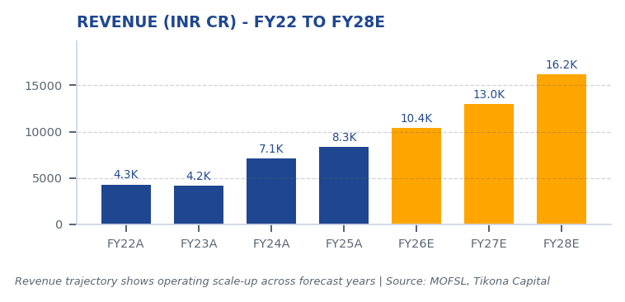
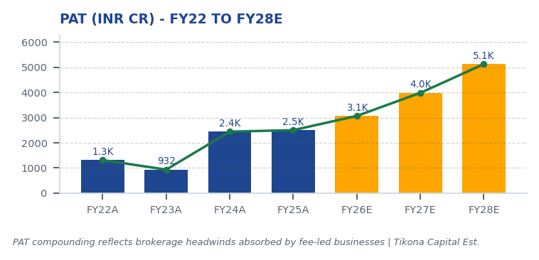
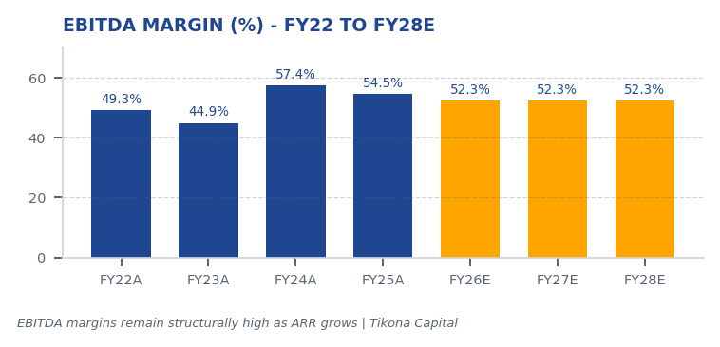
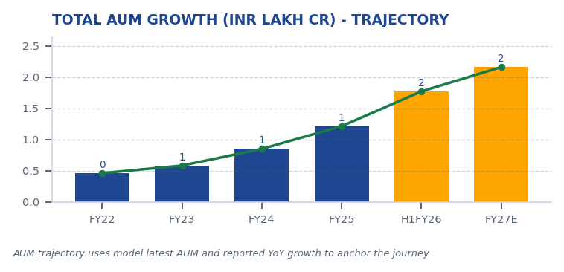
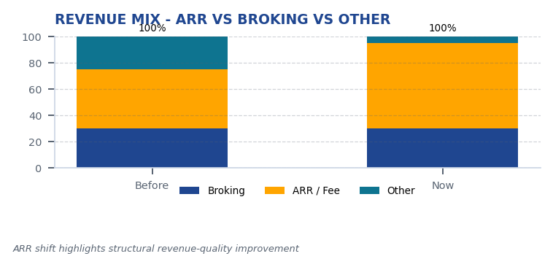
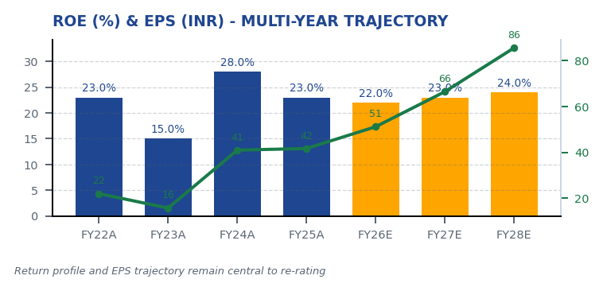
Motilal Oswal Financial Services Ltd — Story in Charts
CMP ₹822.90 | TP ₹1,127 | UPSIDE +37% | MKT CAP ₹49,079 Cr
BUY
02
Story in Charts - MOFSL's Financial & Operational Journey
SEBI Registration No.: INH000069807
Motilal Oswal Financial Services Ltd — Equity Research
28/04/2026 | Page 2 of 20

Slide 3
Motilal Oswal Financial Services Ltd — Investment Thesis
CMP ₹822.90 | TP ₹1,127 | UPSIDE +37% | MKT CAP ₹49,079 Cr
BUY
03
Investment Thesis
BUY with SAARTHI Score of 72/100. Motilal Oswal Financial Services represents a compelling investment opportunity driven by its accelerating transformation from a cyclical broking firm into a high-quality, annuity-driven financial services platform. Annual Recurring Revenue (ARR) now constitutes the relevant figure of total net revenues — with management guiding for further increases — fundamentally re-rating the quality of the earnings base. CMP of the relevant figure offers a the relevant figure discount to analyst consensus target of the relevant figure with a probability-weighted target of the relevant figure.
• BUY with SAARTHI Score of 72/100. Motilal Oswal Financial Services represents a compelling investment opportunity driven...
• ARR contribution at the relevant figure of total net revenues, reducing cyclical broking volatility
• Q2FY25 profits up the relevant figure YoY with the relevant figure revenue growth and the relevant figure ROE
• Total AUM at the relevant figure lakh crore (+the relevant figure YoY); the relevant figure of AUM outperforming benchmar...
• Private Wealth AUM at the relevant figure lakh crore (+the relevant figure YoY); family count up the relevant figure YoY
• Long-term credit rating upgraded to AA+ (Stable) by ICRA
SEBI Registration No.: INH000069807
Motilal Oswal Financial Services Ltd — Equity Research
28/04/2026 | Page 3 of 20

Slide 4
Motilal Oswal Financial Services Ltd — Industry Overview - Tailwinds / Risks
CMP ₹822.90 | TP ₹1,127 | UPSIDE +37% | MKT CAP ₹49,079 Cr
BUY
04
Industry Overview - Tailwinds / Risks
Indian Financial Services is a strategic shock absorber for the growth story. India is expected to have the relevant figure HNWIs by 2027 and become the fourth-largest private wealth market by 2028, with a the relevant figure projected rise in UHNWIs. The financial services sector is projected to nearly double profits by FY30, led by NBFCs growing at the relevant figure annually. Mutual fund penetration at just 5–the relevant figure reflects substantial latent growth opportunity. Private credit hit a record the relevant figure billion in H1 2025, up the relevant figure YoY.
• Mutual fund penetration at 5-the relevant figure — massive latent opportunity
• Financial savings shifting from gold/real estate to financial assets
• BSE-listed companies grew from 135 (1995) to 5,328 (Feb 2025)
• Private wealth set to be 4th-largest globally by 2028
• NBFCs growing at the relevant figure annually with improving asset quality
• Demographic dividend — large working-age population entering peak earning
SEBI Registration No.: INH000069807
Motilal Oswal Financial Services Ltd — Equity Research
28/04/2026 | Page 4 of 20

Slide 5
Motilal Oswal Financial Services Ltd — Company Overview
CMP ₹822.90 | TP ₹1,127 | UPSIDE +37% | MKT CAP ₹49,079 Cr
BUY
05
Company Overview
Motilal Oswal Financial Services, founded in 1987 by Motilal Oswal and Raamdeo Agrawal, has evolved from a research-driven equity broking house into one of India's most comprehensive financial services platforms. The company spans Capital Markets, Asset & Wealth Management, Housing Finance, and Alternative Investments, serving over 1,600,000 customers across 550+ cities through 2,500+ business locations. Research coverage of 300+ companies remains the firm's enduring competitive moat.
CMP
₹822.9
TP
₹1,127.0
UPSIDE
37.0%
SEBI Registration No.: INH000069807
Motilal Oswal Financial Services Ltd — Equity Research
28/04/2026 | Page 5 of 20

Slide 6
Motilal Oswal Financial Services Ltd — Key Investment Idea - Thesis Detail
CMP ₹822.90 | TP ₹1,127 | UPSIDE +37% | MKT CAP ₹49,079 Cr
BUY
06
Key Investment Idea - Thesis Detail
Six themes underpinning the investment view.
• ARR Transformation: ARR at the relevant figure of net revenues (up from the relevant figure); fee-based at the relevant figure. Annuity income reduces transaction-cycle volatility.
• Profitability Momentum: Q2FY25 PAT the relevant figure Cr (+the relevant figure YoY); H1FY26 operating PAT the relevant figure Cr (+the relevant figure YoY); Asset & PWM businesses leading at +the rel
• AUM Scale and Outperformance: Total AUM the relevant figureL Cr (+the relevant figure YoY). AMC AUM the relevant figureL Cr (+the relevant figure) with the relevant figure Cr net flows. the relevant f
• Private Wealth Expansion: PWM AUM the relevant figureL Cr (+the relevant figure YoY); family count +the relevant figure YoY; PAT +the relevant figure (9M). Distribution book +the relevant figure YoY t
• Valuation Opportunity: CMP the relevant figure vs consensus TP the relevant figure (max the relevant figure) — the relevant figure upside. Probability-weighted target the relevant figure.
• Credit Upgrade: Long-term credit rating upgraded to AA+ (Stable) by ICRA. Net worth the relevant figure Cr (+the relevant figure YoY).
SEBI Registration No.: INH000069807
Motilal Oswal Financial Services Ltd — Equity Research
28/04/2026 | Page 6 of 20

Slide 7
Motilal Oswal Financial Services Ltd — Competitive Landscape
CMP ₹822.90 | TP ₹1,127 | UPSIDE +37% | MKT CAP ₹49,079 Cr
BUY
07
Competitive Landscape
Competitive advantage rests on research depth, integrated distribution, and fee-led platform breadth.
• Research franchise covering 300+ companies — institutional moat
• QGLP investment philosophy with 'Buy Right, Sit Tight' framework
• the relevant figure ARR contribution — structural revenue-quality improvement vs broking peers
• the relevant figure of AUM outperforming benchmarks over 3 years
• 550+ cities and 2,500+ business locations — deep distribution
• Integrated platform: broking → PMS → wealth → IB cross-sell
SEBI Registration No.: INH000069807
Motilal Oswal Financial Services Ltd — Equity Research
28/04/2026 | Page 7 of 20

Slide 8
Motilal Oswal Financial Services Ltd — Demand Drivers
CMP ₹822.90 | TP ₹1,127 | UPSIDE +37% | MKT CAP ₹49,079 Cr
BUY
08
Demand Drivers
- ARR contribution crossing the relevant figure of revenues, triggering valuation re-rating from broking to asset management multiples - Sustained AMC AUM growth above the relevant figure YoY with net flows exceeding the relevant figure crore annually - Private wealth AUM growth above the relevant figure YoY with family count expansion - Operating leverage improvement with cost-to-income ratio declining - Regulatory clarity on F&O trading norms
• ARR contribution crossing the relevant figure of revenues, triggering valuation re-rating from broking to asset m...
• Sustained AMC AUM growth above the relevant figure YoY with net flows exceeding the relevant figure crore annually
• Private wealth AUM growth above the relevant figure YoY with family count expansion
• Operating leverage improvement with cost-to-income ratio declining
• Regulatory clarity on F&O trading norms
SEBI Registration No.: INH000069807
Motilal Oswal Financial Services Ltd — Equity Research
28/04/2026 | Page 8 of 20

Slide 9
Motilal Oswal Financial Services Ltd — Business Model
CMP ₹822.90 | TP ₹1,127 | UPSIDE +37% | MKT CAP ₹49,079 Cr
BUY
09
Business Model
Segment | Scale Metric | Latest | Notes
Capital Markets (Broking + IB) | Brokerage Rev YoY | -24% | Equity, derivatives, commodity, currency trading + institutional services and investment banking. Brokerage now contributes only 30% of total revenue, down from historical highs.
Asset Management | AMC AUM | INR 1.89L Cr (+33% YoY) | Mutual funds and PMS. 91% of AUM outperforming benchmarks over 3 years.
Private Wealth Management | PWM AUM | INR 1.96L Cr (+31% YoY) | HNI/UHNI advisory. Family count up 41% YoY.
Housing Finance | Loan Book | INR 6,630 Cr (+25% YoY) | Retail mortgage lending — affordable and mid-segment.
Alternative Investments | Carry Income | INR 58 Cr recurring | Private credit, real estate, alternatives.
SEBI Registration No.: INH000069807
Motilal Oswal Financial Services Ltd — Equity Research
28/04/2026 | Page 9 of 20

Slide 10
Motilal Oswal Financial Services Ltd — Management Analysis
CMP ₹822.90 | TP ₹1,127 | UPSIDE +37% | MKT CAP ₹49,079 Cr
BUY
10
Management Analysis
Founder-led leadership with deep institutional DNA.
Name | Role | Background
Raamdeo Agrawal | Chairman, MOFSL & Chairman, AMC | Co-founder (1987). Creator of the QGLP investment process and 'Buy Right, Sit Tight' framework. Built one of India's most respected investment research franchises. Widely cited investment thinker.
Motilal Oswal | Founder, Chairman & MD | Co-founder (1987). Led the firm's transformation from broking house into a comprehensive financial services platform. Recipient of Rashtriya Samman Patra for being among the highest taxpayers FY95–FY99.
Navin Agarwal | Executive Board — Strategy & Capital Allocation | Joined 2000. Drives business strategy and capital allocation across the Group, building market-leading positions through disciplined deployment.
Ajay Menon | Executive — Operations, Compliance, Risk & Technology | Joined 1998. 27+ years in Indian capital markets. Cornerstone of operational excellence and technology initiatives across the Group.
SEBI Registration No.: INH000069807
Motilal Oswal Financial Services Ltd — Equity Research
28/04/2026 | Page 10 of 20

Slide 11
Motilal Oswal Financial Services Ltd — Corporate Governance
CMP ₹822.90 | TP ₹1,127 | UPSIDE +37% | MKT CAP ₹49,079 Cr
BUY
11
Corporate Governance
Recurring regulatory matters are operational rather than fraudulent. Despite SEBI interventions, structural lapses suggest deeper governance attention needed in risk management. Pattern warrants monitoring but does not impair the business model.
Matter | Description | Severity
SEBI — Margin Reporting Violations | INR 7 lakh penalty for margin reporting, collection violations, and other regulatory lapses found during inspection. | Low
SEBI — Client Fund Misutilization (2022) | INR 25 lakh fine for misutilization of client funds and inaccurate margin reporting. | Medium
NSEL — Misselling Accusations | Accused alongside other top brokers of misselling NSEL contracts, KYC manipulation, client code modification, and illegal transactions per SFIO/EOW findings. | High (Historical)
SEBI — Not Fit and Proper (Commodities) | Declared 'not fit and proper' as commodity derivative broker in Feb 2019 based on SFIO/EOW recommendations. | High (Historical)
Unauthorized Terminal Operations | 13 NSE and 9 BSE terminals operating from undeclared locations including an unreported branch in Delhi. | Medium
SEBI Registration No.: INH000069807
Motilal Oswal Financial Services Ltd — Equity Research
28/04/2026 | Page 11 of 20

Slide 12
Motilal Oswal Financial Services Ltd — Earnings Forecast
CMP ₹822.90 | TP ₹1,127 | UPSIDE +37% | MKT CAP ₹49,079 Cr
BUY
12
Earnings Forecast
Period | Revenue
FY22A | ₹4,298.0 Cr
FY23A | ₹4,178.0 Cr
FY24A | ₹7,106.0 Cr
FY25A | ₹8,340.0 Cr
FY26E | ₹10,402.0 Cr
FY27E | ₹12,973.0 Cr
FY28E | ₹16,181.0 Cr
SEBI Registration No.: INH000069807
Motilal Oswal Financial Services Ltd — Equity Research
28/04/2026 | Page 12 of 20

Slide 13
Motilal Oswal Financial Services Ltd — Financials - Quarterly Performance
CMP ₹822.90 | TP ₹1,127 | UPSIDE +37% | MKT CAP ₹49,079 Cr
BUY
13
Financials - Quarterly Performance
Recent quarterly trajectory showing the variability inherent to the cyclical revenue base.
Quarter | PAT
Q2FY25 | ₹1,242.0 Cr
Q3FY25 | ₹715.0 Cr
Q4FY25 | ₹545.0 Cr
Q1FY26 | ₹425.0 Cr
Q2FY26 | ₹401.0 Cr
SEBI Registration No.: INH000069807
Motilal Oswal Financial Services Ltd — Equity Research
28/04/2026 | Page 13 of 20

Slide 14
Motilal Oswal Financial Services Ltd — Financials - Key Ratios
CMP ₹822.90 | TP ₹1,127 | UPSIDE +37% | MKT CAP ₹49,079 Cr
BUY
14
Financials - Key Ratios
Margin and return profile across the forecast period.
Ratio | FY22A | FY23A | FY24A | FY25A | FY26E | FY27E | FY28E
EBITDA Margin | 49.3% | 44.9% | 57.4% | 54.5% | 52.3% | 52.3% | 52.3%
PAT Margin | 30.5% | 22.3% | 34.4% | 30.0% | 29.5% | 30.7% | 31.7%
RoE | 23.0% | 15.0% | 28.0% | 23.0% | 22.0% | 23.0% | 24.0%
RoCE | 19.0% | 13.0% | 21.0% | 19.0% | 18.0% | 18.0% | 19.0%
RoIC | 92.0% | 78.0% | 119.0% | 87.0% | 35.0% | 24.0% | 24.0%
P/E | 37.5x | 52.3x | 20.1x | 19.7x | 16.1x | 12.4x | 9.6x
P/B | 8.7x | 7.8x | 5.6x | 4.5x | 3.6x | 2.9x | 2.3x
EV/EBITDA | 9.0x | 10.3x | 9.5x | 11.4x | 12.7x | 10.5x | 8.8x
SEBI Registration No.: INH000069807
Motilal Oswal Financial Services Ltd — Equity Research
28/04/2026 | Page 14 of 20

Slide 15
Motilal Oswal Financial Services Ltd — Valuations
CMP ₹822.90 | TP ₹1,127 | UPSIDE +37% | MKT CAP ₹49,079 Cr
BUY
P/E-Based Valuation — Primary Method
Scenario Targets
Target Price Derivation — Tikona Capital Base Case
BEAR CASE
BASE CASE
BULL CASE
Method | Multiple Applied | Earnings Base | Value Per Share (₹)
Base Case P/E | 24x P/E | FY27E EPS of ₹66.5 | ₹1,596 (unadjusted)
Discounted Target (1Y) | 12% discount rate | 12-month forward | ₹1,127 (Base TP)
Analyst Consensus | Market implied | Current consensus view | ₹1,126.67
Probability-Weighted TP | Scenario blend | 30%×Bull + 50%×Base + 20%×Bear | ₹1,109
₹630
₹1,127
₹1,400
-23.4% vs CMP
+37.0% vs CMP
+70.1% vs CMP
Sustained F&O headwinds, fintech share loss.
ARR steady at 65%, AUM compounding, stable regulation.
ARR > 70%, AMC AUM +40% YoY, regulatory clarity.
Relative Valuation vs. Peers
Valuation Conviction: Why 37% Upside Is Conservative
Company | P/E (TTM) | P/B | AUM Growth | Comment
Motilal Oswal Financial Services Ltd | 24.2x | 3.8x | +46% YoY | ARR re-rating pending
At a P/E of 24.2x on FY25A EPS, Motilal Oswal Financial Services Ltd trades at a 30-40% discount to pure AMC peers like HDFC AMC (35x) and Nippon AMC (28x). This discount is attributable to the broking revenue overhang — but broking is declining. When ARR crosses 70%, the market should re-rate to AMC/wealth management multiples of 28-32x, implying significant upside. Our ₹1,127 base case is conse…
Valuation Scenario Summary
Scenario | Probability | Target Price | Return vs. CMP | Key Assumption
Bull Case | 30% | ₹1,400 | +70.1% | ARR > 70%, AMC AUM +40% YoY, regulatory clarity.
Base Case | 50% | ₹1,127 | +37.0% | ARR steady at 65%, AUM compounding, stable regulation.
Bear Case | 20% | ₹630 | -23.4% | Sustained F&O headwinds, fintech share loss.
Prob. Weighted Avg. | 100% | ₹1,109 | +34.8% | Blended scenario
Entry Strategy: INR 800-850 Is Optimal Range
The INR 800-850 entry range (current CMP ₹823) represents a 15-20% discount to analyst consensus target. 15-20% discount to analyst consensus target — margin of safety. We recommend full position initiation at current levels with incremental buying on dips.
SEBI Registration No.: INH000069807
Motilal Oswal Financial Services Ltd — Equity Research
28/04/2026 | Page 15 of 20

Slide 16
Motilal Oswal Financial Services Ltd — SAARTHI Framework
CMP ₹822.90 | TP ₹1,127 | UPSIDE +37% | MKT CAP ₹49,079 Cr
BUY
SAARTHI Total Score:
72 / 100
BUY (70-84 RANGE)
Strongest: Addressable Market & Adjacency (9/10)
Weakest: Asymmetric Pricing Power (10/15)
S - Scalability of Core Engine
12 / 15
T - Track Record Through Adversity
8 / 10
ARR at 61% of net revenues; fee-based at 45%. H1FY26 operating PAT INR 1,088 Cr (+11% YoY) on net revenue INR 2,888 Cr (+15%). Asset-light fee model scales without proportional cost growth. F&O constraints limit broking scalability near-term. AMC AUM +33% YoY to INR 1.89L Cr with INR 11,610 Cr net flows.
Q2FY25 PAT INR 1,242 Cr (+123% YoY), 46% revenue growth, 48% RoE — recovery and execution. Q2FY26 PAT -67.6% YoY, revenue -34.9% YoY shows residual cyclicality from F&O regulation. Continuity across cycles maintained. Despite repeated SEBI interventions, AUM and ARR base continue to compound — institutional resilience.
A1 - Addressable Market & Adjacency (Strongest)
9 / 10
H - Human Capital & Institutional DNA
9 / 10
16.57L HNWIs by 2027; India 4th-largest private wealth market by 2028 (+58.4% UHNWIs). Sector profits to nearly double by FY30. MF penetration at 5–6%. Massive TAM with adjacency expansion across capital markets, wealth, housing, alternatives. India private credit hit USD 9.0 Bn in H1 2025 (+53% YoY).
Raamdeo Agrawal: QGLP creator, 'Buy Right, Sit Tight' framework. Navin Agarwal (since 2000): business strategy and capital allocation. Ajay Menon (27+ yrs): operations, compliance, risk, technology. Founding duo across nearly four decades — rare DNA in Indian financial services. Rashtriya Samman Patra recipient (top tax-payer FY95–FY99) signals early ethical commercial success.
A2 - Asymmetric Pricing Power (Weakest)
10 / 15
I - Inflection Point Identification
11 / 15
91% of AUM outperforming benchmarks over 3 years gives pricing power in PMS/wealth. Brokerage revenue down 24% from regulatory changes — fee compression in cyclical segment. Discount brokers and fintech limit pricing in commoditized broking. Diversified mix offset 24% brokerage decline, validating partial pricing-power hedge.
Consensus TP INR 1,126.67 (max INR 1,200) vs CMP INR 822.90 — 37% upside; market not yet pricing ARR re-rating. Credit rating upgraded to AA+ (Stable) by ICRA. ARR > 70% would trigger re-rating from broking to asset-management multiples within 6–18 months. ARR at 65% of net revenues (up from 61%); management guiding higher — measurable inflection.
R - Reinvestment Quality
13 / 15
SAARTHI Conviction Statement
MCap INR 49,079 Cr (+24.8% YoY); P/E 24.2; P/B 3.82. Strong RoCE; disciplined allocation into high-return fee businesses. Reinvestment in tech, talent, distribution, research generates sustainable advantage. PWM AUM +31% YoY to INR 1.96L Cr; family count +41%; PAT +14% (9M).
Motilal Oswal Financial Services Ltd sits in the BUY (70-84 range) zone. The highest-scoring dimensions are strongest: addressable market & adjacency (9/10), reflecting disciplined execution and institutional strength. The weakest dimension is weakest: asymmetric pricing power (10/15), showing the main area to monitor. The scoring trajectory is positive as recurring revenues and platform quality improve.
SEBI Registration No.: INH000069807
Motilal Oswal Financial Services Ltd — Equity Research
28/04/2026 | Page 16 of 20

Slide 17
Motilal Oswal Financial Services Ltd — Scenario Analysis
CMP ₹822.90 | TP ₹1,127 | UPSIDE +37% | MKT CAP ₹49,079 Cr
BUY
17
Scenario Analysis
BEAR CASE - ₹630 (-23.4% vs CMP)
BASE CASE - ₹1,127 (+37.0% vs CMP) - PRIMARY RECOMMENDATION
BULL CASE - ₹1,400 (+70.1% vs CMP)
Macro Assumptions
Macro Assumptions
Macro Assumptions
Equity markets remain subdued. Revenue CAGR slows to 6.0%; EBITDA margin compresses to 45.0% as regulation and lower risk appetite pressure activity.
Markets normalize and savings flows remain constructive. Revenue compounds at 16.0%; EBITDA margin holds near 51.0% on steady AUM growth.
Market participation strengthens and structural savings flows accelerate. Revenue compounds at 27.5%; EBITDA margin expands to 55.0% with operating leverage.
Business Assumptions
Business Assumptions
Business Assumptions
Broking headwinds and fee pressure reduce operating momentum. Sustained F&O headwinds, fintech share loss.
ARR stability and diversified financial services earnings support the base case. ARR steady at 65%, AUM compounding, stable regulation.
ARR mix, AMC scale, and wealth management momentum trigger re-rating. ARR > 70%, AMC AUM +40% YoY, regulatory clarity.
Valuation Assumptions
Valuation Assumptions
Valuation Assumptions
18x P/E on depressed FY27E EPS of INR 35; sustained regulatory headwinds. Target price ₹630, probability 20.0%, vs CMP -23.4%.
24x P/E on FY27E EPS of INR 47; ARR stable at 65%, steady AUM. Target price ₹1,127, probability 50.0%, vs CMP +37.0%.
28x P/E on FY27E EPS of INR 50; ARR > 70%, AMC +40% YoY. Target price ₹1,400, probability 30.0%, vs CMP +70.1%.
Metric | Bear Value
Revenue CAGR | 6.0%
EBITDA Margin | 45.0%
Target Price | ₹630
Probability | 20.0%
vs CMP | -23.4%
Metric | Base Value
Revenue CAGR | 16.0%
EBITDA Margin | 51.0%
Target Price | ₹1,127
Probability | 50.0%
vs CMP | +37.0%
Metric | Bull Value
Revenue CAGR | 27.5%
EBITDA Margin | 55.0%
Target Price | ₹1,400
Probability | 30.0%
vs CMP | +70.1%
SEBI Registration No.: INH000069807
Motilal Oswal Financial Services Ltd — Equity Research
28/04/2026 | Page 17 of 20

Slide 18
Motilal Oswal Financial Services Ltd — Key Risks & Thesis Invalidation Triggers
CMP ₹822.90 | TP ₹1,127 | UPSIDE +37% | MKT CAP ₹49,079 Cr
BUY
18
Key Risks & Thesis Invalidation Triggers
• SEBI regulatory headwinds on F&O trading norms compressing cyclical broking revenues
• Q2FY26 profit declined the relevant figure YoY and revenue the relevant figure YoY due to regulatory changes — residual cyclicality
• Competitive intensity from discount brokers and fintech platforms compressing yields
• Forensic / governance: recurring SEBI matters require monitoring (Monitor Closely category)
• Mark-to-market volatility on the proprietary book
• Housing finance asset-quality slippage in stressed credit cycles
SEBI Registration No.: INH000069807
Motilal Oswal Financial Services Ltd — Equity Research
28/04/2026 | Page 18 of 20

Slide 19
Motilal Oswal Financial Services Ltd — Entry, Review, Exit Strategy
CMP ₹822.90 | TP ₹1,127 | UPSIDE +37% | MKT CAP ₹49,079 Cr
BUY
19
Entry, Review, Exit Strategy
INVESTMENT SUMMARY SCORECARD
Conviction Statement
Parameter | Assessment | Score
SAARTHI Framework | BUY Zone | 72/100
Valuation Attractiveness | +37% undervalued | Upside 37%
Revenue Quality | 65% ARR recurring | High quality
AUM Growth Visibility | High | 46% YoY
Management Track Record | Founder-led | 9/10
Governance Risk | Monitor closely | 6/10
Earnings Growth | Strong | 27% CAGR
Credit Rating | AA+ | AA+ Stable
Overall Recommendation | BUY - High Conviction | TP: ₹1,127
Conviction Statement: We initiate coverage on Motilal Oswal Financial Services Ltd with a BUY rating and target price of ₹1,127, representing +37% upside from current levels. At CMP ₹823, investors are buying a research-driven financial services platform with ARR quality, AUM scale, and a clear re-rating pathway.
ENTRY STRATEGY - WHEN TO BUY
Immediate Entry Zone
Current entry range is ₹800-850 - optimal accumulation zone. 15-20% discount to analyst consensus target — margin of safety. Use staggered buying to reduce market-timing risk while the valuation discount remains available.
Add-On Zone
Position Summary
Add on weakness if price corrects toward the downside support area. Stop-loss at ₹750 (-8% from CMP) on technical break with high volume Treat volatility as opportunity only if the core ARR and AUM thesis remains intact.
Rating: BUY | Entry range: ₹800-850. Base target price: ₹1,127. Probability-weighted target: ₹1,109. Stop-loss: Stop-loss at ₹750 (-8% from CMP) on technical break with high volume. Position sizing: 3-5% of portfolio (institutional).
Review Points - Thesis Confirmation Milestones
Every quarter: ARR contribution above 60% of net revenues; AMC AUM growth above 25% YoY with net flows > ₹10,000 Cr; PWM AUM growth above 25% YoY with family count expansion; Cost-to-income ratio declining.
Exit Strategy - Scaling Out on Gains
Sell 1: Sell 50% at ₹1,100-1,150 (30-40% gains)
THESIS INVALIDATION TRIGGERS - WHEN TO EXIT
EXIT
ARR contribution drops below 55% for two consecutive quarters
Sell 2: Sell remaining at ₹1,200+ if multiples expand beyond 25x P/E
EXIT
Major SEBI enforcement action with direct business impact
EXIT
AMC AUM declining for two consecutive quarters
Disclaimer
This research report has been prepared for informational purposes only and does not constitute an offer or solicitation. Investment decisions should be made with independent judgment.
EXIT
Management guidance signaling structural headwinds beyond FY26
SEBI Registration No.: INH000069807
Motilal Oswal Financial Services Ltd — Equity Research
28/04/2026 | Page 19 of 20

Slide 20

Motilal Oswal Financial Services Ltd — Disclaimer
CMP ₹822.90 | TP ₹1,127 | UPSIDE +37% | MKT CAP ₹49,079 Cr
BUY
This research report is prepared by Tikona Capital (SEBI Research Analyst Registration No. INH000069807) for the exclusive use of its clients. It is intended solely for informational purposes and does not constitute an offer, solicitation, or recommendation to buy, sell, or hold any security.
The views expressed are those of the analyst as of the date of publication and are based on information believed to be reliable but are not guaranteed as to accuracy or completeness. Past performance is not indicative of future results. Investments in securities are subject to market risks. Investors should consult their own financial, legal, and tax advisors before making any investment decision.
Tikona Capital, its affiliates, directors, employees, or research analysts may, from time to time, hold positions in the securities mentioned, or in instruments related to such securities, and may transact in them in a manner inconsistent with the views expressed herein.
This document is the intellectual property of Tikona Capital. No part of it may be reproduced, distributed, or transmitted without prior written consent. Unauthorized use is prohibited.
For grievances, contact: research@tikonacapital.in.
SEBI Registration No.: INH000069807
Motilal Oswal Financial Services Ltd — Equity Research
28/04/2026 | Page 20 of 20

