Slide 1
Machine learning Project
Pratik Mahesh Marudwar
Pratik.marudwarmit@gmail.com

Slide 2
problem statement
The objective of this Project is to develop a robust model that can accurately predict whether a user belongs to the Healthcare Professional (HCP) category. The ad server logs contain various types of information, such as browser details, IP addresses, geographic locations, search patterns, site URLs, and other relevant data.
Participants are expected to build a machine learning model that can effectively analyse the ad server logs and classify users accurately. The model should be able to identify whether a user belongs to the HCP category. The challenge lies in developing a robust and accurate model that can handle different types of data and user behaviours to make reliable predictions.

Slide 3
Solution
our proposed solution involves the development of machine learning model to predict the characteristics of healthcare professionals.
Model : Healthcare Professional Prediction
We have created a machine learning model that aims to predict whether a person is a healthcare professional or not.
By combining this model, we aim to provide valuable insights and predictions regarding healthcare professionals.
Overall, our solution offers a predictive framework that enables the identification of healthcare professionals and provides insights into their specialization, contributing to more efficient and targeted decision-making in the healthcare industry.

Slide 4
PROJECT STAGES
To develop the machine learning models for predicting healthcare professional status, we followed the following approach:
1. Data ( given )
2. Data Pre-processing
3. Feature Engineering
4. Model Development
5. Model Refinement
6. Model Evaluation and Validation

Slide 5
Approach
Data Preprocessing and Feature Engineering
We performed thorough data preprocessing to handle missing values, outliers, and inconsistencies in the dataset.
Rows with IS_HCP as null values were dropped from the train dataset and converted to int from float.
TAXONOMY had huge missing values so it is dropped.
Data provided Is all text, hence we cannot apply machine learning model directly, to apply ML model I need to convert text data into numerical data
For that applied different encoding Techniques like label Encoding, ordinal Encoding and one hot Encoding. Due to Restrictions in these techniques I was not able to apply them
So decided to use Frequency Encoding, got results with Frequency Encoding, But When we draw Feature Importance, I found out that model is getting over fitted so, I decided to drop feature which does not have any importance.
After Dropping TAXONOMY, KEYWORDS, CHANNELTYPE, PLATFORMTYPE these columns, it results into better model accuracy, Also we do have one columns KEYWORDS which cannot be directly used since it contain keywords in the form of string , To improve accuracy I have applied CountVectorizer for that column and Resulting 523 Total columns and Results into betterment of accuracy.
Got good Results after all these steps but to improve accuracy Again Tried Target Encoding with CountVectorizer got very good Results.
But to improve Results again tried Artificial Neural Network and got good results

Slide 6
Approach
Model Development and Refinement
Implemented various ML models such as Decision Tree, Random Forest, Gradient Boosting, and XGBoost, incorporating different encoding techniques.
Experimented with diverse hyperparameters for each model.
Observed that Random Forest consistently outperforms other models across all encoding techniques.
Random Forest with Target Encoding by adjusting some hyperparameters give a best result

Slide 7
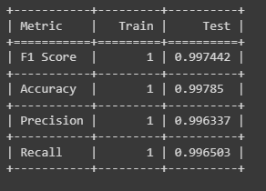
Classification Report
Random Forest (Frequency Encoding and countvectorizer)
Accuracy is 0.9978
F1 Score is 0.9974

Slide 8
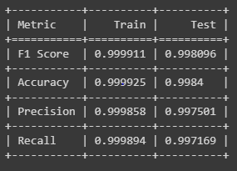
Classification Report
Random Forest (Target Encoding and countvectorizer)
Accuracy is 0.9984
F1 Score is 0.9974

Slide 9
Github url
https://github.com/pratik1208/HealthProPred

Slide 10
THANKS

