Slide 1
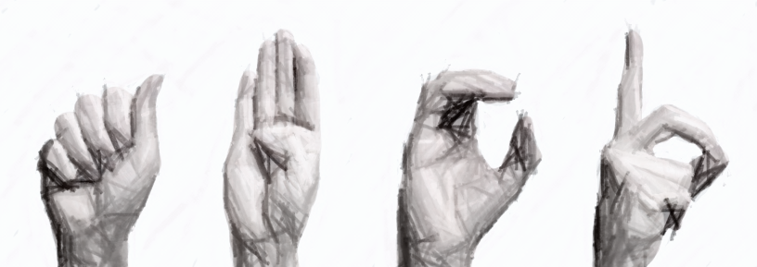
Sign Language Recognition System
Dhanashree Ganpule
Pratik Tamhankar
Shaktidhar Dandapani
Under the Guidance of : Prof. Chitra Bhole

Slide 2
OVERVIEW
Introduction
Existing systems
Literature review
Proposed system
Algorithm and modules
Results
Advantages
Future scope
Conclusion

Slide 3
INTRODUCTION
Sign language – non verbal communication
Normally used by people with speech and hearing impairment.
Visual imagery to convey ideas.
Finger spelling based on hand positions
Facial Expression.

Slide 4

Example of hand gesture Indicating the word “deaf” in American Sign Language

Slide 5
INTRODUCTION - SLRS
Definition : SLRS
Main Goal of the System.
Developing SLRS using
OpenCV
A system for identifying, extracting and mapping hand gestures from multiple backgrounds.
Provide efficient transition of a hand gesture to a decipherable/readable output
Development Environment

Slide 6
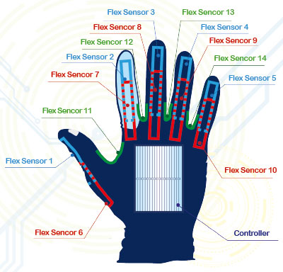
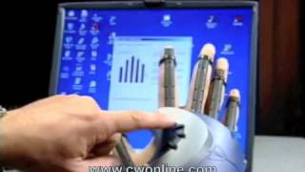
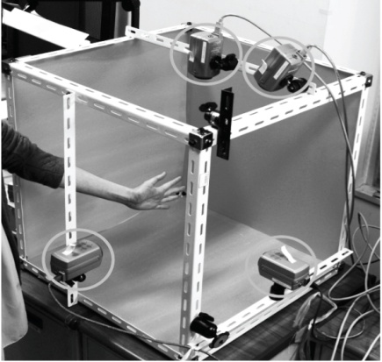
EXISTING SYSTEMS
N
Vision Based Systems
Vision Based
Use of multiple cameras is done, so that position of the user doesn’t become a barrier.
Sensor Based
External hardware such as hand gloves is used for recognition.

Slide 7
DRAWBACKS OF EXISTING SYSTEMS
V
Vision Based Systems :
1. High cost.
2. High complexity.
3. High processing needs.
Sensor Based Systems:
1. High cost.
2. High maintenance.

Slide 8
LITERATURE REVIEW
References
1. Real Time SLR based on neural network architecture..(Priyanka Mekala, Ying Gao, Jeffrey Fan, Asad Davari)
2. Hand Gesture Recognition based on grayscale histogram of the image.(Rustam Rokhimov Igorevich, Pusik Park, Dugki Min, Yongjung Park, Tongchan Choi, Eunmi Choi)

Slide 9
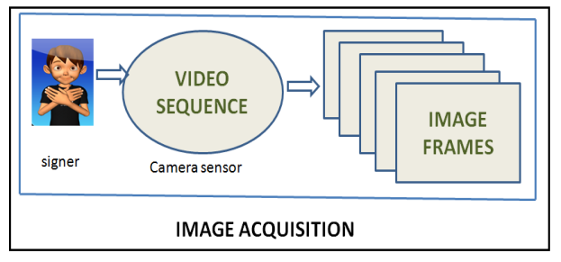
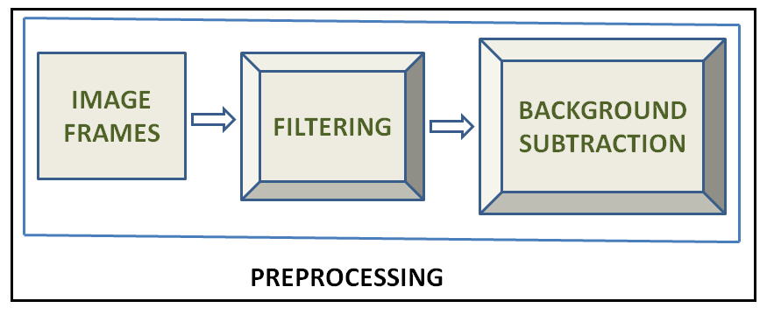
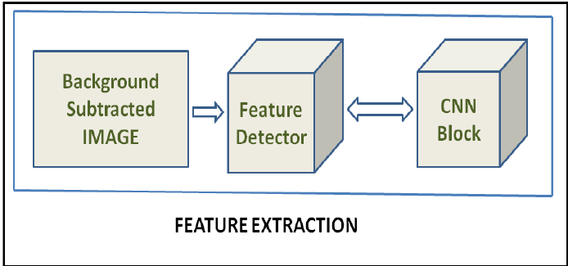
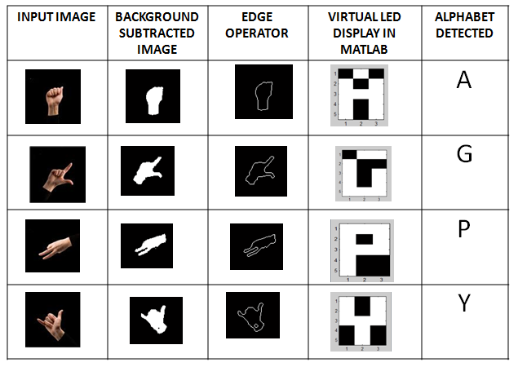
LITERATURE REVIEW ALGORITHM 1
Real Time SLR based on Neural Network Architecture
(Priyanka Mekala, Ying Gao, Jeffrey Fan, Asad Davari)
Stage 1: Feature Extraction Process
Stage 2: Comparison with Images In Database ( Neural Network System)

Slide 10
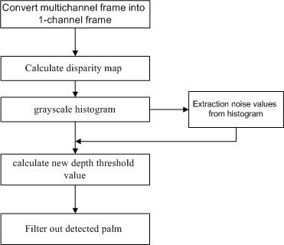
LITERATURE REVIEW ALGORITHM 2
Hand Gesture Recognition based on grayscale histogram of the image.(Rustam Rokhimov Igorevich, Pusik Park, Dugki Min, Yongjung Park, Tongchan Choi, Eunmi Choi)

Slide 11
PROPOSED SYSTEM
Basic System
We aim to implement a hand gesture recognition system on a real time basis with the help of orientation and image processing techniques.
Our system intends to make use of image processing techniques for the pre-processing stage.

Slide 12
OPENCV
Specific
Functions & Data Structures
Efficient
Memory Utilization
Speedy
Direct Machine Code Generation
Open Source
Free License

Slide 13
MODULES OF SLRS
1. Detect gestures of the hand using digital camera.
2. Extraction & Orientation
3. Matching the detected gesture from Saved templates.
Thus Successfully convert the detected gesture into its Equivalent Text

Slide 14
ALGORITHM
Camera Input
Takes the input from the stereo camera input(webcam etc)
Video Sequence
Sequence is generated based on videos captured
Frames
Video Sequence is converted to frames
Grayscale
Convert The frames into histograms
Threshold
Threshold the image into binary format
Edge Detection + Image transforms
Detects the boundaries of the hand + dilate and erode
Distance Transform
Retrieve associated image text
Show the output on Screen
Orientation
Orients the image template about a vertical axis
Image Resizing
Resize the image to specific size
Pattern Matching
Pick the best match from captured images

Slide 15
MODULE 1 : DETECTION
Camera Input
Takes the input from the stereo camera input(webcam etc)
Video Sequence
Sequence is generated based on videos captured
Frames
Video Sequence is converted to frames
Grayscale
Convert The frames into histograms
Threshold
Threshold the image into binary format
Edge Detection + Image transforms
Detects the boundaries of the hand + dilate and erode
FLOW
Distance Transform

Slide 16
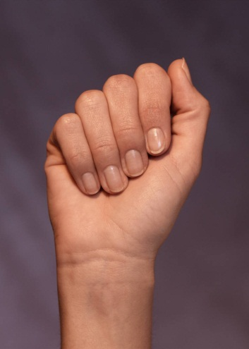

MODULE 2 : ORIENTATION
Consider 4 angles (0,90,180,270)
If image is in any of these angles it gets re oriented to 0 (if loop).
More refinement will be done by using incremental angle.

Slide 17
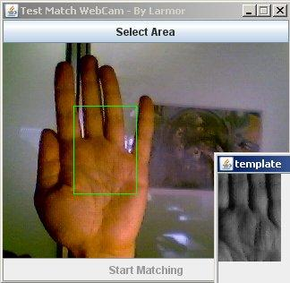
MODULE 3 : TEMPLATE MATCHING
Input from Camera
Template stored in database folder
Match detection

Slide 18
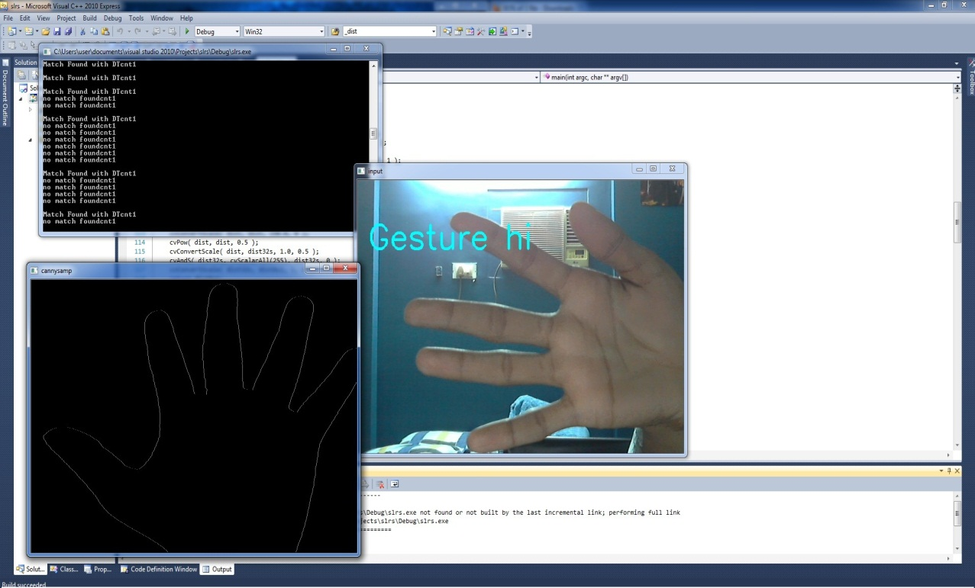
RESULTS
+90 Orientation
Accuracy = 60 % plain background
= 25 % complex background

Slide 19
ADVANTAGES
Single Stereo camera required (any camera).
Fast execution speed.
Template rotation takes less time than input manipulation.
Distance Transform helps determine accurate pixel positions.

Slide 20
FUTURE SCOPE
Embedding the system in cell phones for communication between deaf-dumb and other people.
Our system can also be integrated and be used for multiple-hands gesture recognition, where each image may include several hands
Human machine interactivity. Controlling the systems via gestures.
Motion based gaming.

Slide 21
CONCLUSION
Our system is a real-time processing system.
All modules have been realized in the open source software.
Thorough integration and optimization is to be done.

