Slide 1


BCDV 1010
Smart Contract Development Essentials
2023 January
week 01 - class 04
 | BCDV 1010 Smart Contract Development Essentials | Pratik Patil

Slide 2
Types
Solidity is a statically typed language, which means that the type of each variable (state and local) needs to be specified. Solidity provides several elementary types which can be combined to form complex types.
Value Types:
The following types are called value types because variables of these types will always be passed by value, i.e. they are always copied when they are used as function arguments or in assignments.
Booleans
Integers
Address
Strings
Functions
Enums
 | BCDV 1010 Smart Contract Development Essentials | Pratik Patil

Slide 3
Refrence Types:
Values of reference type can be modified through multiple different names. Contrast this with value types where you get an independent copy whenever a variable of value type is used.
Arrays
Structs
Iterable Mappings
 | BCDV 1010 Smart Contract Development Essentials | Pratik Patil

Slide 4
Arrays
 | BCDV 1010 Smart Contract Development Essentials | Pratik Patil

Slide 5
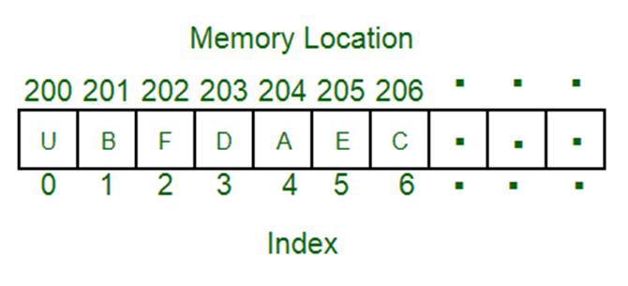
What is an Array?
An array is a collection of items of the same data type stored at contiguous memory locations.
 | BCDV 1010 Smart Contract Development Essentials | Pratik Patil

Slide 6

Types of Array in Solidity
Fixed-size byte arrays
The type of an array of fixed size k and element type T is written as T[k]
E.g: An array of the addresses
 | BCDV 1010 Smart Contract Development Essentials | Pratik Patil

Slide 7

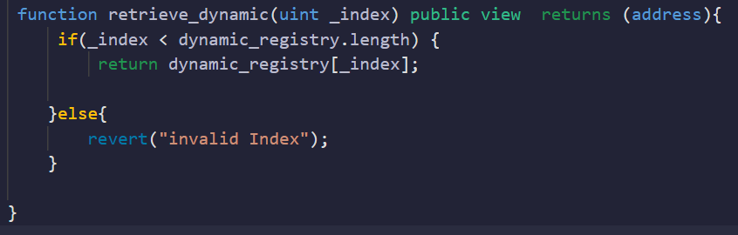
Types of Array in Solidity
Dynamically-sized byte array
The type of an array of dynamic size as T[]
For example, an array of 5 dynamic arrays of uint is written as uint[][5]. The notation is reversed compared to some other languages. In Solidity, X[3] is always an array containing three elements of type X, even if X is itself an array. This is not the case in other languages such as C.
 | BCDV 1010 Smart Contract Development Essentials | Pratik Patil

Slide 8
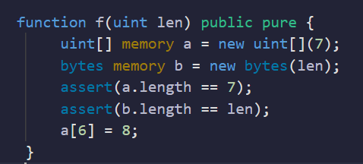
Types of Array in Solidity (Dynamically-sized byte array)
Memory arrays with dynamic length can be created using the new operator. As opposed to storage arrays, it is not possible to resize memory arrays (e.g. the .push member functions are not available). You either have to calculate the required size in advance or create a new memory array and copy every element.
 | BCDV 1010 Smart Contract Development Essentials | Pratik Patil

Slide 9

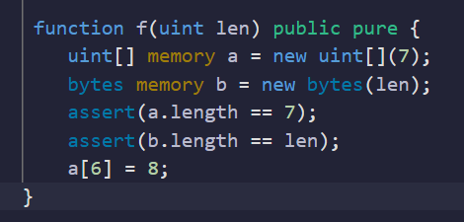
Array Initialization:
1. Arrays can be initialized statically as follows:
2. If Initializing inside a function:
 | BCDV 1010 Smart Contract Development Essentials | Pratik Patil

Slide 10
Array Members
length:
Arrays have a length member that contains their number of elements. The length of memory arrays is fixed (but dynamic, i.e. it can depend on runtime parameters) once they are created.
push():
Dynamic storage arrays and bytes (not string) have a member function called push() that you can use to append a zero-initialised element at the end of the array. It returns a reference to the element, so that it can be used like x.push().t = 2 or x.push() = b.
push(x):
Dynamic storage arrays and bytes (not string) have a member function called push(x) that you can use to append a given element at the end of the array. The function returns nothing.
pop():
Dynamic storage arrays and bytes (not string) have a member function called pop() that you can use to remove an element from the end of the array. This also implicitly calls delete on the removed element. The function returns nothing.
 | BCDV 1010 Smart Contract Development Essentials | Pratik Patil

Slide 11
Structures
 | BCDV 1010 Smart Contract Development Essentials | Pratik Patil

Slide 12
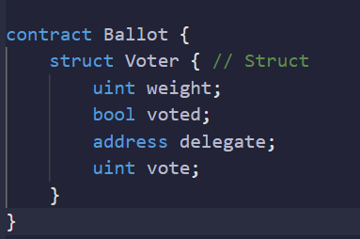
Structs are custom-defined types that can group several variables.
e.g:
 | BCDV 1010 Smart Contract Development Essentials | Pratik Patil

Slide 13
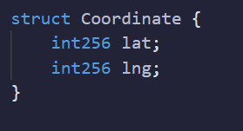
Why do we need Structs?
If we have to group particular values of different types, Structs enable us to do so.
E.g. In the case of geolocation, we always need to store the Longitude and Latitude together.
{ lat: -34.397, lng: 150.644 }
 | BCDV 1010 Smart Contract Development Essentials | Pratik Patil

Slide 14
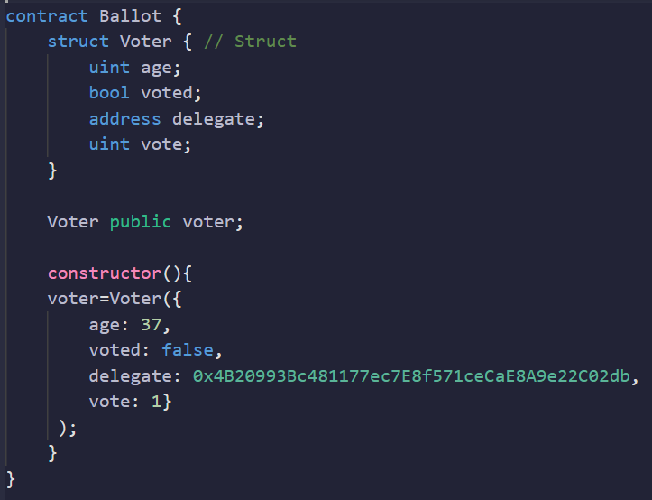
Initializing new Struct
The struct variable can be initialized by passing it JSON format values:
 | BCDV 1010 Smart Contract Development Essentials | Pratik Patil

Slide 15
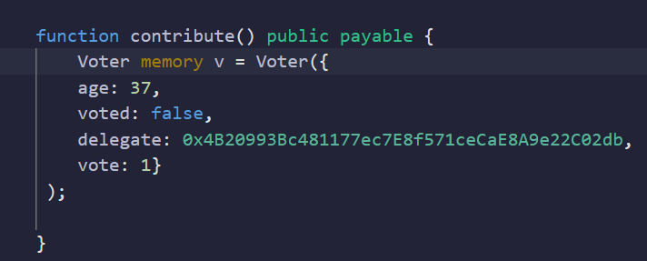
Initializing new Struct
If Initializing the struct inside the function, the storage/memory type of the variable needs to be specified:
 | BCDV 1010 Smart Contract Development Essentials | Pratik Patil

Slide 16
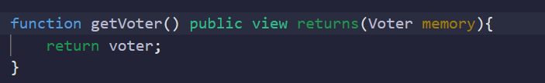
Retrieving new Struct
While retrieving the struct it needs to retrieve in a memory object:
 | BCDV 1010 Smart Contract Development Essentials | Pratik Patil

Slide 17
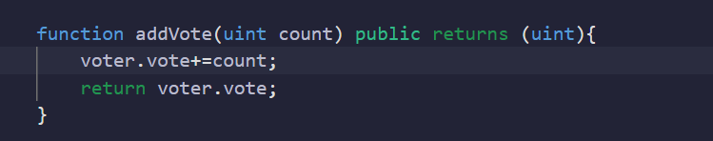
Modifying the Struct
The structs can be easily modified by accessing the keys inside it.
 | BCDV 1010 Smart Contract Development Essentials | Pratik Patil

Slide 18
Enums
 | BCDV 1010 Smart Contract Development Essentials | Pratik Patil

Slide 19
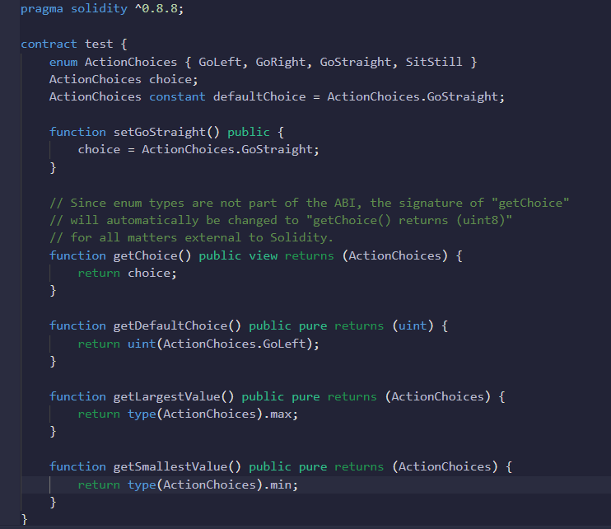
Enums are one way to create a user-defined type in Solidity. They are explicitly convertible to and from all integer types but implicit conversion is not allowed. The explicit conversion from integer checks at runtime that the value lies inside the range of the enum and causes a Panic Error otherwise. Enums require at least one member, and its default value when declared is the first member. Enums cannot have more than 256 members.
 | BCDV 1010 Smart Contract Development Essentials | Pratik Patil

Slide 20
Mappings
 | BCDV 1010 Smart Contract Development Essentials | Pratik Patil

Slide 21
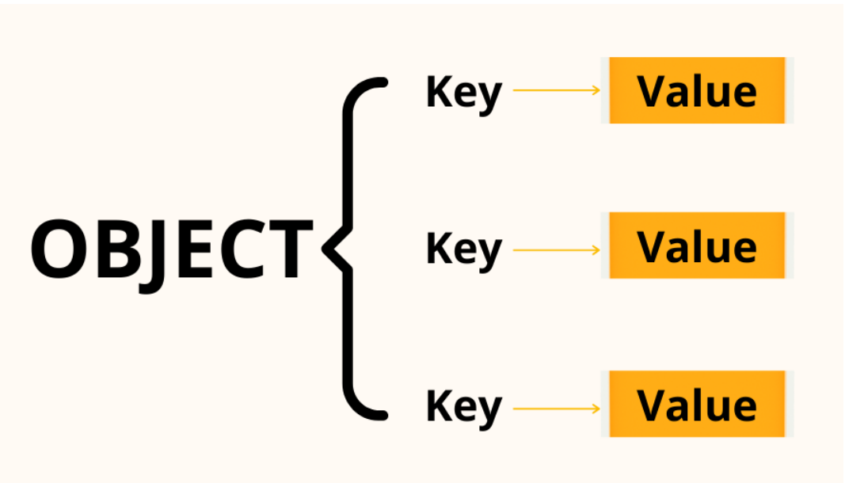
What are key-value pairs?
A key-value pair consists of two related data elements: A key, which is a constant that defines the data set and a value, which is a variable that belongs to the set.
 | BCDV 1010 Smart Contract Development Essentials | Pratik Patil

Slide 22
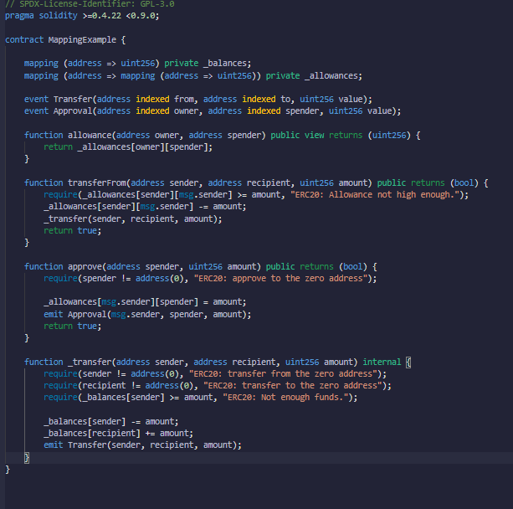
Mapping types use syntax mapping(KeyType => ValueType) and variables of mapping type are declared using the syntax mapping(KeyType => ValueType) VariableName. The KeyType can be any built-in value type, bytes, string, or any contract or enum type. Other user-defined or complex types, such as mappings, structs or array types are not allowed. ValueType can be any type, including mappings, arrays and structs.
 | BCDV 1010 Smart Contract Development Essentials | Pratik Patil

Slide 23
Iterable Mappings
With the mappings, you can easily access the value for the particular key, but accessing the list of keys in the mapping is not possible by itself. For that, we can implement Iterable Mappings where we can also access the keys in the mappings.
Please refer here for more information on Mappings:
 | BCDV 1010 Smart Contract Development Essentials | Pratik Patil

Slide 24
References
 | BCDV 1010 Smart Contract Development Essentials | Pratik Patil

Slide 25
Memory Layouts:
Solidity reserves four 32-byte slots, with specific byte ranges (inclusive of endpoints) being used as follows:
0x00 - 0x3f (64 bytes): scratch space for hashing methods
0x40 - 0x5f (32 bytes): currently allocated memory size (aka. free memory pointer)
0x60 - 0x7f (32 bytes): zero slot
Scratch space can be used between statements (i.e. within the inline assembly). The zero slot is used as initial value for dynamic memory arrays and should never be written to (the free memory pointer points to 0x80 initially).
Solidity always places new objects at the free memory pointer and memory is never freed (this might change in the future).
Elements in memory arrays in Solidity always occupy multiples of 32 bytes (this is even true for bytes1[], but not for bytes and string). Multi-dimensional memory arrays are pointers to memory arrays. The length of a dynamic array is stored at the first slot of the array and followed by the array elements.
 | BCDV 1010 Smart Contract Development Essentials | Pratik Patil

Slide 26
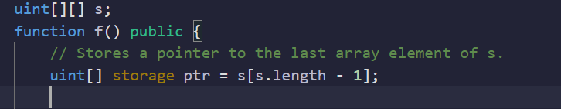
Shallow copy
A shallow copy of an object is a copy whose properties share the same references (point to the same underlying values) as those of the source object from which the copy was made.
In the example below we are referencing a pointer to an array which is already initialized
 | BCDV 1010 Smart Contract Development Essentials | Pratik Patil

Slide 27
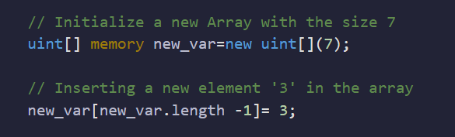
Deep copy
A deep copy of an object is a copy whose properties do not share the same references (point to the same underlying values) as those of the source object from which the copy was made.
In the example below, we have initialized a new variable and pushed element ‘3’ in it. This array has its own new location in the memory.
 | BCDV 1010 Smart Contract Development Essentials | Pratik Patil

Slide 28
Reference links
https://docs.soliditylang.org/en/v0.8.17/types.html#value-types
https://docs.soliditylang.org/en/v0.8.17/types.html#arrays
https://docs.soliditylang.org/en/v0.8.17/types.html#structs
https://docs.soliditylang.org/en/v0.8.17/types.html?highlight=enums#enums
https://docs.soliditylang.org/en/v0.8.17/types.html?highlight=enums#mapping-types
https://docs.soliditylang.org/en/v0.8.17/internals/layout_in_memory.html?highlight=pointer
 | BCDV 1010 Smart Contract Development Essentials | Pratik Patil

