Slide 1


BCDV 1010
Smart Contract Development Essentials
2023 January
week 03 - class 14
 | BCDV 1010 Smart Contract Development Essentials | Pratik Patil

Slide 2
Contract Inheritance
 | BCDV 1010 Smart Contract Development Essentials | Pratik Patil

Slide 3
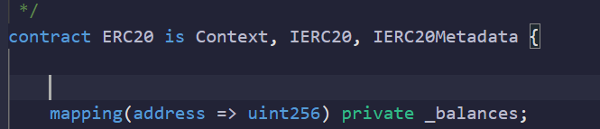
Inheritance is one of the most important features of the object-oriented programming language. It is a way of extending a program's functionality, separating the code, reducing the dependency, and increasing the existing code's re-usability. In Solidity, multiple contracts can be inherited into a single contract.
In the following example, the ERC20 contract is inheriting multiple other smart contracts
The “is” keyword to inherit from a contract or multiple contracts
Once you inherit the contract all the non-private functions in the inherited or the parent contract is accessible in the child contract.
 | BCDV 1010 Smart Contract Development Essentials | Pratik Patil

Slide 4
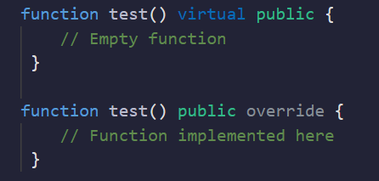
Virtual functions and overrides
If you wish to implement some of the functions with exact same name as in the parent contract, Then in the parent contract you can have a function of type virtual and in the child contract you must override it.
virtual functions are always empty. The function logic is implemented in the override function.
override function must also need to have the same parameters.
 | BCDV 1010 Smart Contract Development Essentials | Pratik Patil

Slide 5
Abstract Contracts
 | BCDV 1010 Smart Contract Development Essentials | Pratik Patil

Slide 6
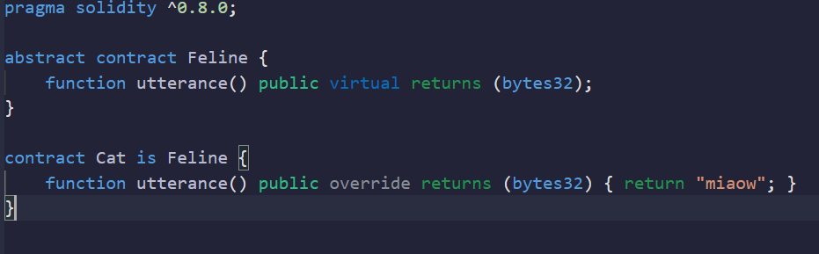
So, If you are creating any contract which contains at least one or more virtual functions (The function which is not implemented) then it must be marked as an abstract contract.
The keyword virtual can only be used inside an abstract contract.
If a contract inherits from an abstract contract and does not implement all non-implemented functions by overriding, it needs to be marked as abstract as well.
 | BCDV 1010 Smart Contract Development Essentials | Pratik Patil

Slide 7
Interfaces
 | BCDV 1010 Smart Contract Development Essentials | Pratik Patil

Slide 8
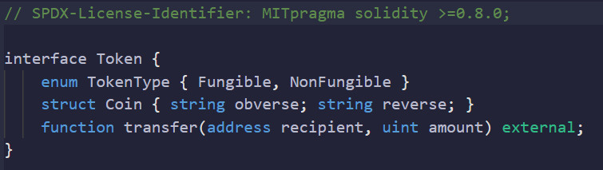
Interfaces are similar to abstract contracts, but they cannot have any functions implemented. There are further restrictions:
They cannot inherit from other contracts, but they can inherit from other interfaces.
All declared functions must be external.
They cannot declare a constructor.
They cannot declare state variables.
 | BCDV 1010 Smart Contract Development Essentials | Pratik Patil

Slide 9
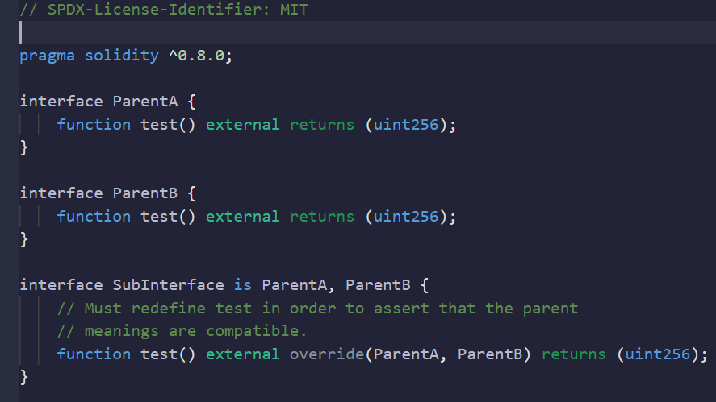
Some of these restrictions might be lifted in the future.
Interfaces are basically limited to what the Contract ABI can represent, and the conversion between the ABI and an interface should be possible without any information loss.
Interfaces are denoted by their own keyword.
Interfaces can inherit from other interfaces. This has the same rules as a normal inheritance.
 | BCDV 1010 Smart Contract Development Essentials | Pratik Patil

Slide 10
Libraries
 | BCDV 1010 Smart Contract Development Essentials | Pratik Patil

Slide 11
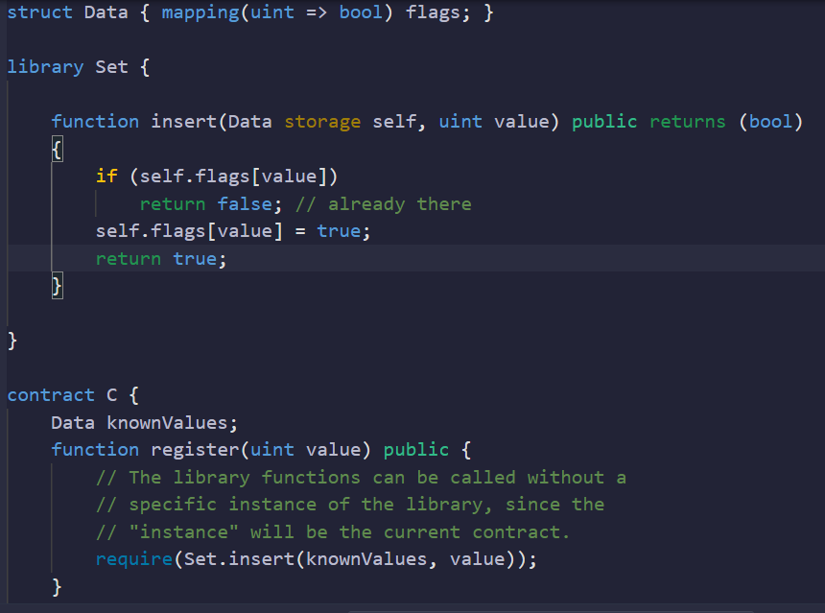
Libraries are similar to contracts, but their purpose is that they are deployed only once at a specific address and their code is reused using the DELEGATECALL feature of the EVM.
 | BCDV 1010 Smart Contract Development Essentials | Pratik Patil

Slide 12
This means that if library functions are called, their code is executed in the context of the calling contract, i.e. this points to the calling contract, and especially the storage from the calling contract can be accessed
Note: Storage means the storage space can be addressed from the caller contract so, we don't need to use the memory, but it does not mean that the data variables in the smart contract can be accessed.
 | BCDV 1010 Smart Contract Development Essentials | Pratik Patil

Slide 13
In comparison to contracts, libraries are restricted in the following ways:
they cannot have state variables
they cannot inherit nor be inherited
they cannot receive Ether
they cannot be destroyed
The directive using A for B; can be used to attach library functions (from the library A) to any type (B) in the context of a contract. These functions will receive the object they are called on as their first parameter (like the self variable in Python)
 | BCDV 1010 Smart Contract Development Essentials | Pratik Patil

