Slide 1


BCDV 1010
Smart Contract Development Essentials
2023 January
week 01 - class 05
 | BCDV 1010 Smart Contract Development Essentials | Pratik Patil

Slide 2
Error Handling
 | BCDV 1010 Smart Contract Development Essentials | Pratik Patil

Slide 3
Solidity uses state-reverting exceptions to handle errors. Such an exception undoes all changes made to the state in the current call (and all its sub-calls) and flags an error to the caller.
Once the error is caught, the transaction fails.
The errors in the solidity can be handled in the following ways:
require
revert
Assert
try/catch
 | BCDV 1010 Smart Contract Development Essentials | Pratik Patil

Slide 4
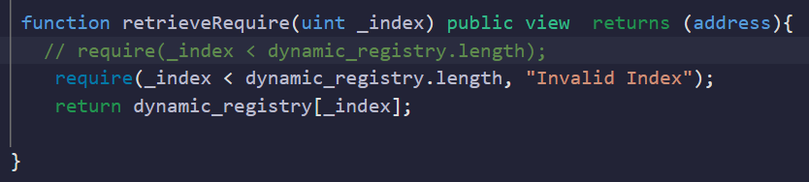
1. Require
require can be used to check for conditions and throw an exception if the condition is not met. It either creates an error without any data or an error of type Error(string). It should be used to ensure valid conditions that cannot be detected until execution time. This includes conditions on inputs or return values from calls to external contracts.
 | BCDV 1010 Smart Contract Development Essentials | Pratik Patil

Slide 5
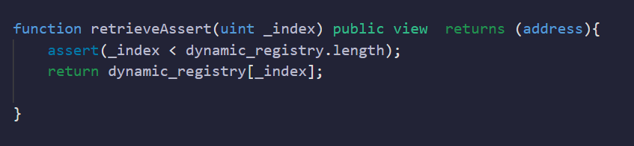
2. Assert
The assert function creates an error of type Panic(uint256). The same error is created by the compiler in certain situations as listed below.
Assert should only be used to test for internal errors, and to check invariants. Properly functioning code should never create a Panic, not even on invalid external input. If this happens, then there is a bug in your contract that you should fix.
 | BCDV 1010 Smart Contract Development Essentials | Pratik Patil

Slide 6
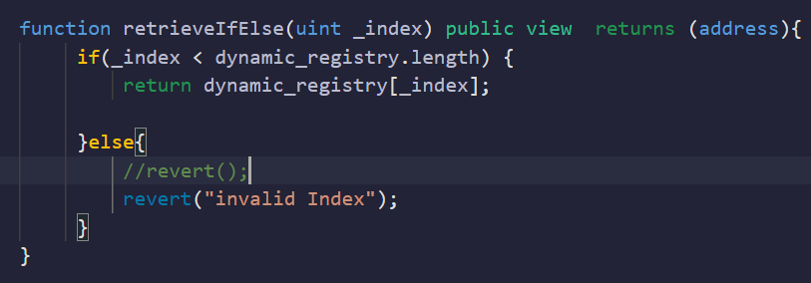
3. revert
A direct revert can be triggered using the revert statement and the revert function. The revert statement takes a custom error as a direct argument without parentheses:
revert CustomError(arg1, arg2);
For backwards-compatibility reasons, there is also the revert() function, which uses parentheses and accepts a string:
revert(); revert(“description”);
The error data will be passed back to the caller and can be caught there. Using revert() causes a revert without any error data while revert("description") will create an Error(string) error.
Note: The revert is always used along with the if-else conditions.
 | BCDV 1010 Smart Contract Development Essentials | Pratik Patil

Slide 7
Events
 | BCDV 1010 Smart Contract Development Essentials | Pratik Patil

Slide 8
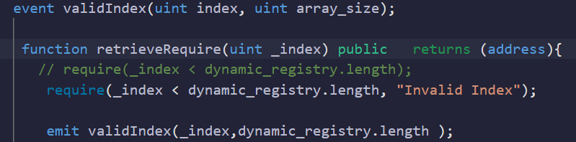
Events in solidity are used to create the logs in the Ethereum ledger. We can pass any type of data as arguments to it. The event can be triggered by using the keyword ‘emit’.
Events are costly, so it’s making sure to use it only where needed in order to keep the transaction costs low.
 | BCDV 1010 Smart Contract Development Essentials | Pratik Patil

Slide 9
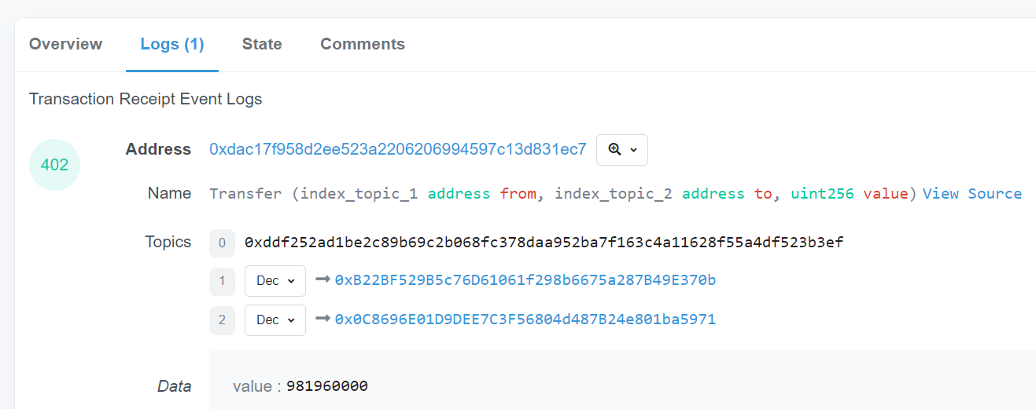
E.g:
You can also see the contract events logged on Etherscan.
https://etherscan.io/tx/0x9ba98d07fcda82cfbc30336bcb2f67899e2bea7577e0e75a0c45a18e58c8c554#eventlog
 | BCDV 1010 Smart Contract Development Essentials | Pratik Patil

Slide 10
Errors
 | BCDV 1010 Smart Contract Development Essentials | Pratik Patil

Slide 11

In case of a failure inside a contract, the contract can use a special opcode to abort execution and revert all state changes. In addition to these effects, descriptive data can be returned to the caller. This descriptive data is the encoding of an error and its arguments in the same way as data for a function call.
e.g:
 | BCDV 1010 Smart Contract Development Essentials | Pratik Patil

Slide 12
Payable
 | BCDV 1010 Smart Contract Development Essentials | Pratik Patil

Slide 13
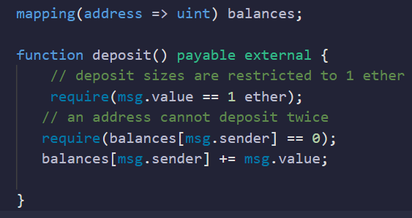
The keyword payable allows someone to send ether to a contract and run code to account for this deposit. This code could potentially log an event, modify storage to record the deposit, or it could even revert the transaction if it chooses to do so.
When a developer explicitly marks a smart contract with the payable type, they are saying “I expect ether to be sent to this function”.
 | BCDV 1010 Smart Contract Development Essentials | Pratik Patil

Slide 14
Units and Globally Available Variables
 | BCDV 1010 Smart Contract Development Essentials | Pratik Patil

Slide 15

Ether Units
A literal number can take a suffix of wei, gwei or ether to specify a subdenomination of Ether, where Ether numbers without a postfix are assumed to be Wei.
 | BCDV 1010 Smart Contract Development Essentials | Pratik Patil

Slide 16
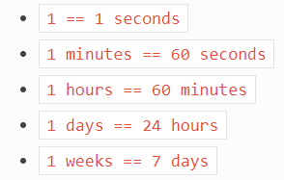
Time Units
Suffixes like seconds, minutes, hours, days and weeks after literal numbers can be used to specify units of time where seconds are the base unit and units are considered naively in the following way:
 | BCDV 1010 Smart Contract Development Essentials | Pratik Patil

Slide 17
Special Variables and Functions
There are special variables and functions which always exist in the global namespace and are mainly used to provide information about the blockchain or are general-use utility functions.
 | BCDV 1010 Smart Contract Development Essentials | Pratik Patil

Slide 18
Block and Transaction Properties
blockhash(uint blockNumber) returns (bytes32): hash of the given block when blocknumber is one of the 256 most recent blocks; otherwise returns zero
block.basefee (uint): current block’s base fee (EIP-3198 and EIP-1559)
block.chainid (uint): current chain id
block.coinbase (address payable): current block miner’s address
block.difficulty (uint): current block difficulty
block.gaslimit (uint): current block gaslimit
block.number (uint): current block number
block.timestamp (uint): current block timestamp as seconds since unix epoch
gasleft() returns (uint256): remaining gas
msg.data (bytes calldata): complete calldata
msg.sender (address): sender of the message (current call)
msg.sig (bytes4): first four bytes of the calldata (i.e. function identifier)
msg.value (uint): number of wei sent with the message
tx.gasprice (uint): gas price of the transaction
tx.origin (address): sender of the transaction (full call chain)
 | BCDV 1010 Smart Contract Development Essentials | Pratik Patil

