Slide 1


BCDV 1025
Enterprise Blockchain
2023 February
week 02 - class 06
 | BCDV 1025 Enterprise Blockchain | Pratik Patil

Slide 2
Chaincode
 | BCDV 1025 Enterprise Blockchain | Pratik Patil

Slide 3
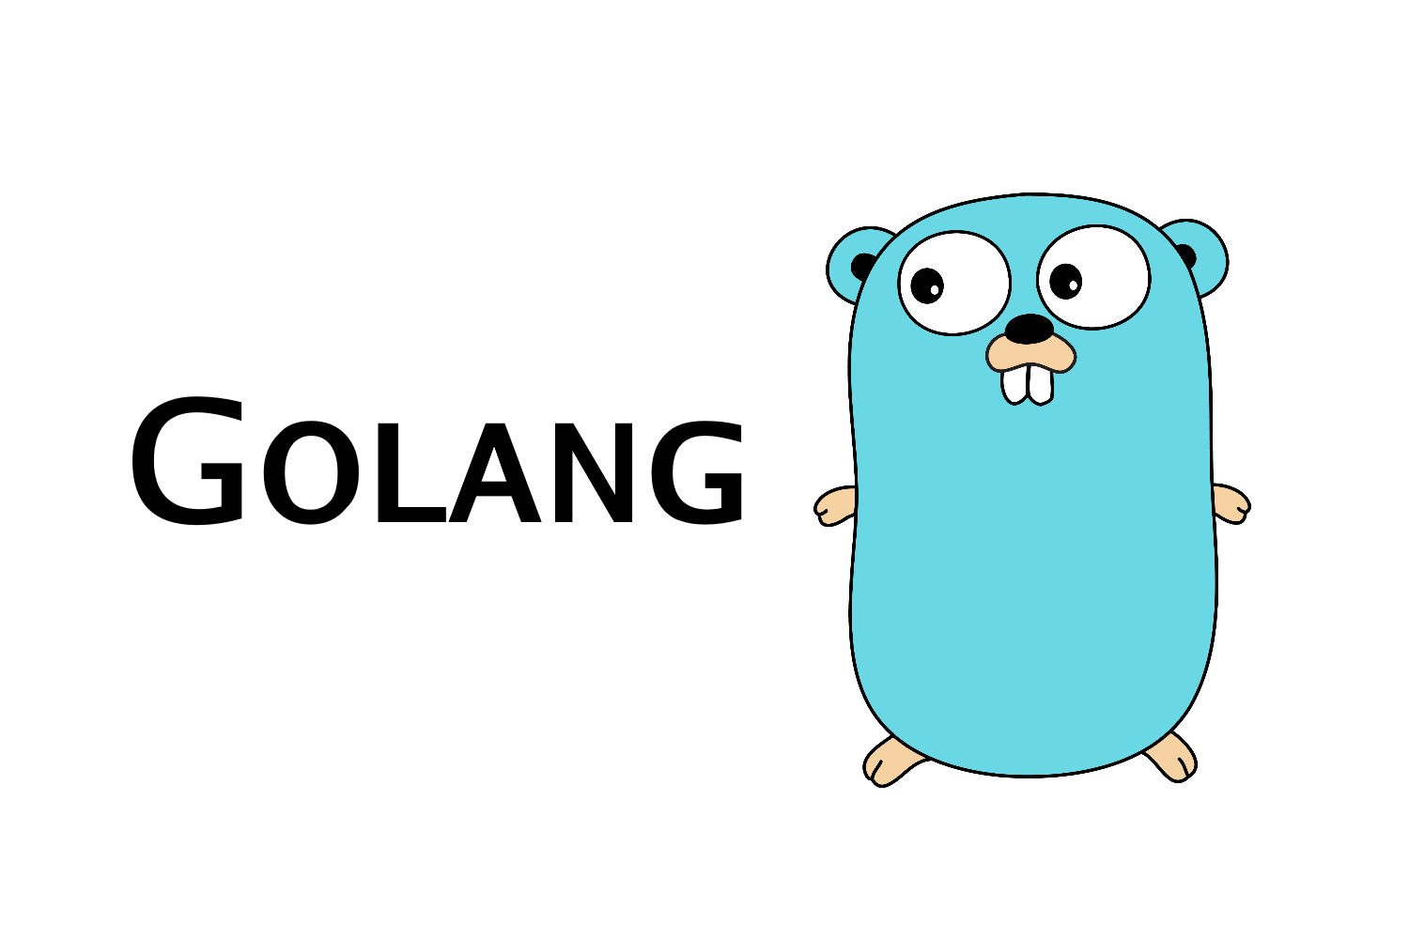


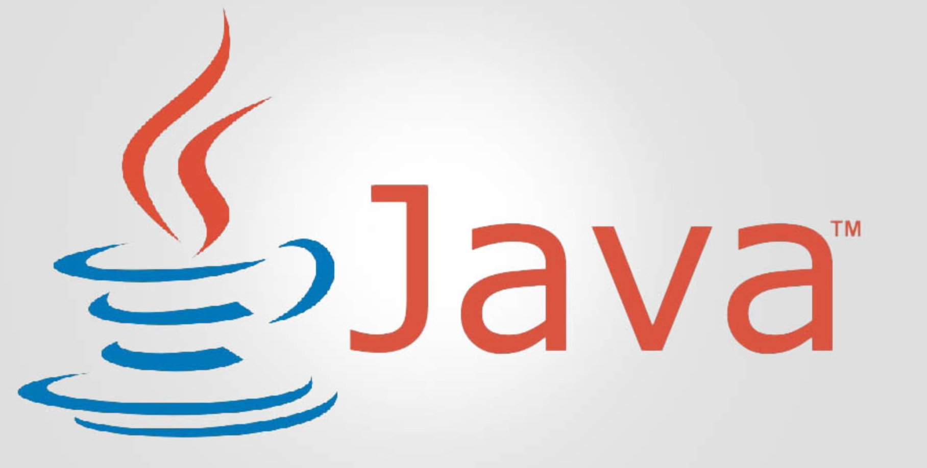
Chaincodes can be written in the following languages:
Golang
Javascript
Typescript
Java
 | BCDV 1025 Enterprise Blockchain | Pratik Patil

Slide 4
fabric-chaincode-api
The library is used to write the chaincodes.
The library gives access to the ‘Contract’ interface.
fabric-shim
The low-level library used by the ‘fabric-chaincode-api’.
It does not provide as many features as ‘fabric-chaincode-api’
Not very secure to use.
 | BCDV 1025 Enterprise Blockchain | Pratik Patil

Slide 5
Types of Chaincode:
1. Regular
It runs inside the Peer container.
The Peer pulls the docker container based on the chaincode language and runs the chaincode,
It can also run locally as a server
The default port is 7052
2. External
It runs the chaincode externally inside the separate server.
Multiple peers can interact with the same chaincode
The chaincode logic cannot be trusted
The destination address needs to be trusted
The chaincode logic can be tampered with
Uses the fabric-shim api
 | BCDV 1025 Enterprise Blockchain | Pratik Patil

Slide 6
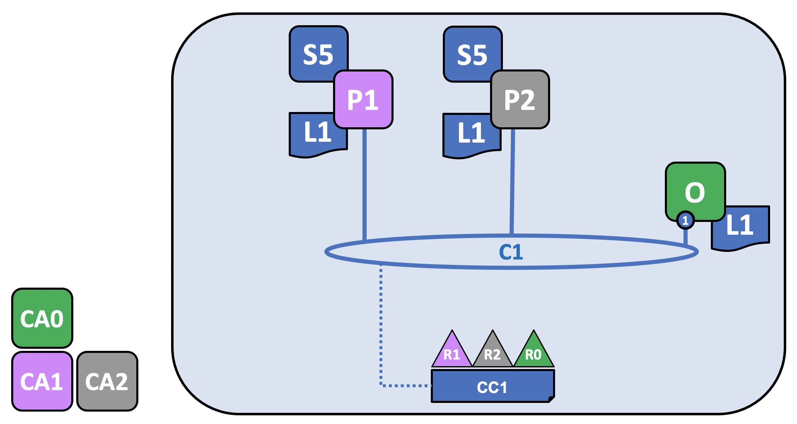
Stages of Chaincode deployment
Installing the necessary dependencies
Packaging the chaincode
Installing the chaincode on each Endorsing Peer Approving the chaincode definition for the channel according to the Lifecycle Endorsing policy
Committing the chaincode definition to the channel (The chaincode package can also be queried from the channel once deployed)
 | BCDV 1025 Enterprise Blockchain | Pratik Patil

Slide 7
Chaincode Operations:
Init - Calling the constructor of the chaincode (Not mandatory)
Invoke - Calling the functions modifying the chaincode state
Query - Calling the functions only reading the chaincode state
 | BCDV 1025 Enterprise Blockchain | Pratik Patil

Slide 8
Chaincode Versioning and Update:
Each chaincode deployment to the channel is versioned
Chaincode definition can be updated with a new version
The new definition needs to be approved by the members as per the lifecycle endorsement policy.
 | BCDV 1025 Enterprise Blockchain | Pratik Patil

Slide 9
Key History:
Key History can be enabled or disabled for any key of the ledger.
If enabled, an entire state history can be retrieved for a particular key
Couchdb is required.
 | BCDV 1025 Enterprise Blockchain | Pratik Patil

Slide 10
Private Data Collections
Private Data collections access policies can be set during the chaincode deployment.
It results in more ROLE based access control for the Read/Write operations
Configuration needs to be provided during the chaincode deployment
The actual data is only stored on the specified peers
On the rest of peers on the network only hash of the actual values are stored.
 | BCDV 1025 Enterprise Blockchain | Pratik Patil

Slide 11
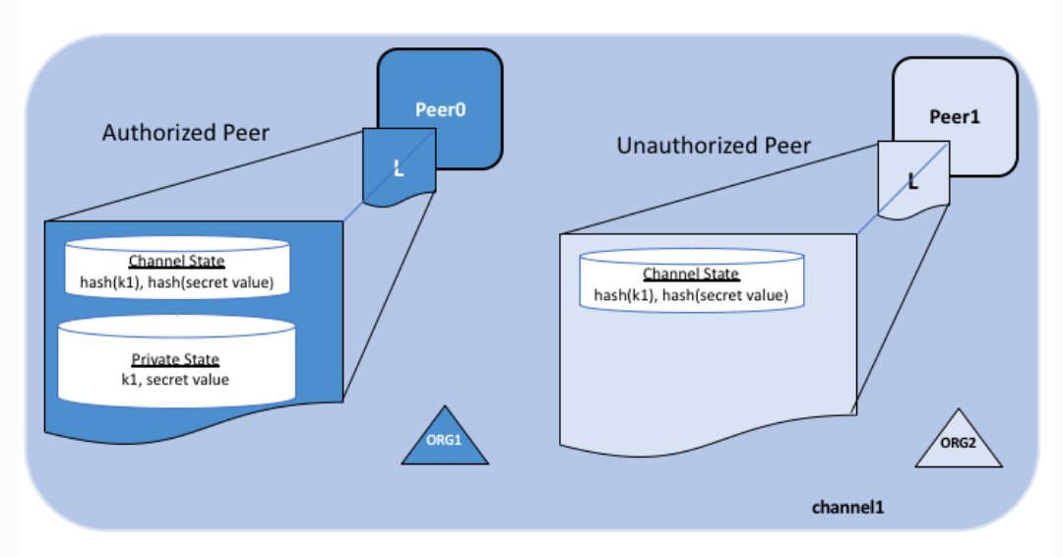
Attribute-based access control
A chaincode has access to the Identity (Public key) of the submitter.
Access control can also be implemented inside the chaincode based on the attributes of the Submitter Identity.
Results in more secure and robust access control.
 | BCDV 1025 Enterprise Blockchain | Pratik Patil

