Slide 1


BCDV 1025
Enterprise Blockchain
2023 February
week 02 - class 03
 | BCDV 1025 Enterprise Blockchain | Pratik Patil

Slide 2
Consensus Mechanism
 | BCDV 1025 Enterprise Blockchain | Pratik Patil

Slide 3
In Hyperledger Fabric, the consensus is achieved once the organization Endorsed the transaction based on the Endorsement Policy.
 | BCDV 1025 Enterprise Blockchain | Pratik Patil

Slide 4
Endorsement Policy
 | BCDV 1025 Enterprise Blockchain | Pratik Patil

Slide 5
Every chaincode has an endorsement policy which specifies the set of peers on a channel that must execute chaincode and endorse the execution results in order for the transaction to be considered valid.
By default, endorsement policies are specified in the chaincode definition, which is agreed to by channel members and then committed to a channel
If you are using Private Data Collections, you will have to specify it in the chaincode definition.
The endorsement Policy is defined in the configtx.yaml
Each channel has its own Endorsement Policy.
Each participating organization must approve the Endorsing Policy and the Chaincode definition.
Once the chaincode definition is approved by all the orgs it is committed to the channel
The endorsement Policy is based on the MSP Role of the organization.
MSP ID and ROLE represent one of the four accepted roles:
member
admin
client
peer
 | BCDV 1025 Enterprise Blockchain | Pratik Patil

Slide 6
Here are a few examples of valid principles:
'Org0MSP.admin': any administrator of the Org0MSP MSP
'Org1MSP.member': any member of the Org1MSP MSP
'Org1MSP.client': any client of the Org1MSP MSP
'Org1MSP.peer': any peer of the Org1MSP MS
The following are the valid Expressions for Endorsement Policy:
AND
OR
OutOf
Once the transaction is Endorsed by each organization based on their individual Endorsement policies the following three types of consensus can be set up to approve the transaction
MAJORITY Orgs
ANY Orgs
ALL Orgs
 | BCDV 1025 Enterprise Blockchain | Pratik Patil

Slide 7
Transaction Flow
 | BCDV 1025 Enterprise Blockchain | Pratik Patil

Slide 8
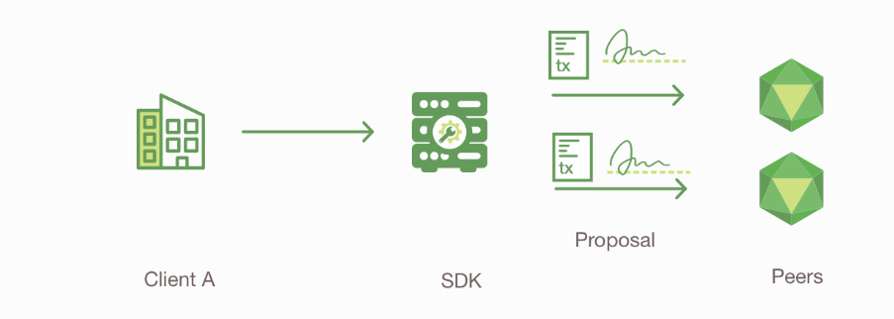
An application leveraging a supported SDK (Node, Java, Go) utilizes one of the available API’s to generate a transaction proposal. The proposal is a request to invoke a chaincode function with certain input parameters, with the intent of reading and/or updating the ledger.
The SDK submits the transaction proposal to a target peer, which will manage the transaction submission on behalf of the client.
The target peer first forwards the transaction proposal to other peers for execution, as required by the endorsement policy.
 | BCDV 1025 Enterprise Blockchain | Pratik Patil

Slide 9
The endorsing peers verify
The transaction proposal is well-formed
It has not been submitted already in the past (replay-attack protection)
The signature is valid (using the MSP)
The submitter (Client A, in the example) is properly authorized to perform the proposed operation on that channel (namely, each endorsing peer ensures that the submitter satisfies the channel’s Writers policy).
5. The target peer verifies the proposal responses are the same prior to proceeding with the transaction submission. If a transaction is submitted without this check, the endorsement policy will still be checked and enforced when each peer validates transactions prior to committing them.
 | BCDV 1025 Enterprise Blockchain | Pratik Patil

Slide 10
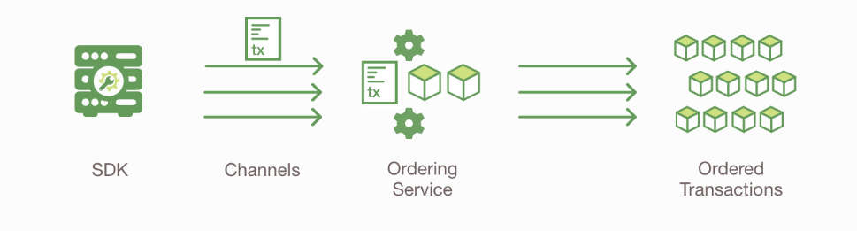
6. The target peer “broadcasts” the transaction proposal and response within a “transaction message” to the ordering service.
7. The ordering service receives transactions, orders them, and creates blocks of transactions per channel.
8. The blocks of transactions are “delivered” to all peers on the channel. The transactions within the block are validated to ensure endorsement policy is fulfilled and ensure that there have been no changes to the ledger state for read set variables since the read set was generated by the transaction execution. Transactions in the block are tagged as valid or invalid.
 | BCDV 1025 Enterprise Blockchain | Pratik Patil

Slide 11
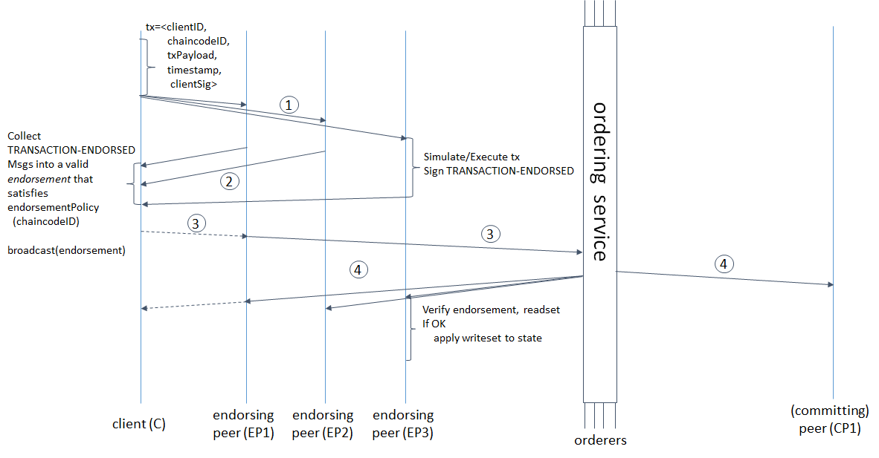
9.Each peer appends the block to the channel’s chain, and for each valid transaction the write sets are committed to a current state database. An event is emitted by each peer to notify the client application that the transaction (invocation) has been immutably appended to the chain, as well as notification of whether the transaction was validated or invalidated.
 | BCDV 1025 Enterprise Blockchain | Pratik Patil

