Slide 1


BCDV 1025
Enterprise Blockchain
2023 February
week 02 - class 08
 | BCDV 1025 Enterprise Blockchain | Pratik Patil

Slide 2
Fabric API
 | BCDV 1025 Enterprise Blockchain | Pratik Patil

Slide 3
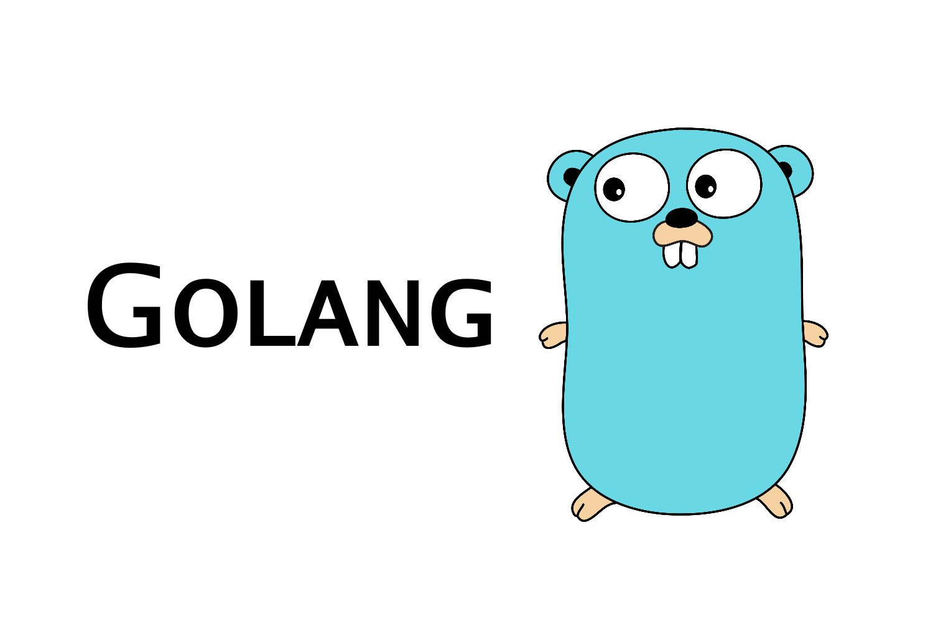


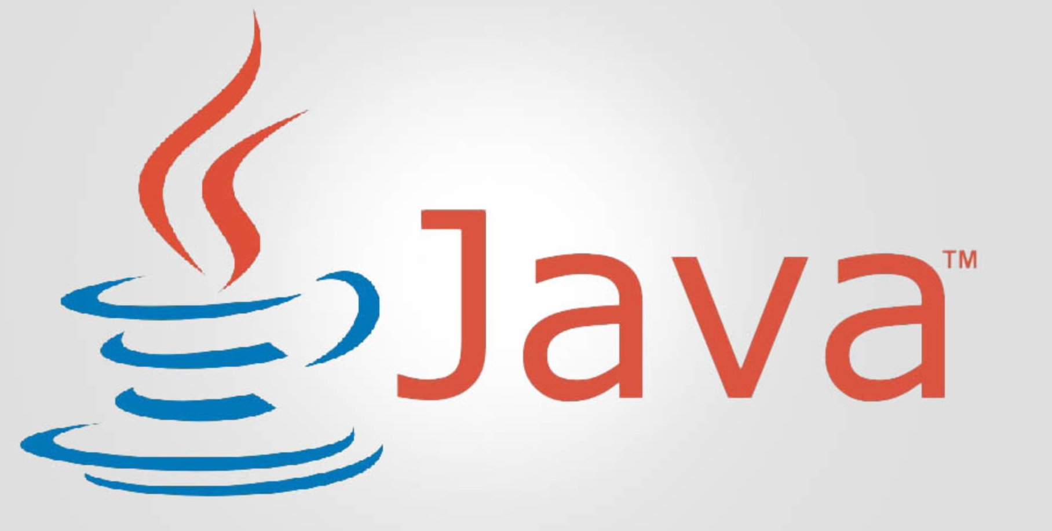
API is used to interact with the Fabric-Chaincode as well as the other components of the fabric network.
Supported Languages:
Javascript
Typescript
Golang
Java
 | BCDV 1025 Enterprise Blockchain | Pratik Patil

Slide 4
API Packages:
1. fabric-network
This package encapsulates the APIs to connect to a Fabric network, submit transactions and perform queries against the ledger, and listen for or replay events.
2. fabric-ca-client
To interact with the fabric-ca to manage user certificates.
3. fabric-common
Encapsulates the common code used by all fabric-sdk-node packages supporting fine grain interactions with the Fabric network to send transaction invocations.
4. fabric-protos
encapsulates the Protocol Buffer files and generated javaScript classes for Hyperledger Fabric.
 | BCDV 1025 Enterprise Blockchain | Pratik Patil

Slide 5
Fabric Gateway:
The gateway peer provides the connection point for an application to access the Fabric network. It is instantiated using the default constructor. It can then be connected to a fabric network using the connect method by passing either a common connection profile definition or an existing Client object. Once connected, it can then access individual Network instances (channels) using the getNetwork method which in turn can access the smart contracts installed on a network and submit transactions to the ledger.
 | BCDV 1025 Enterprise Blockchain | Pratik Patil

Slide 6
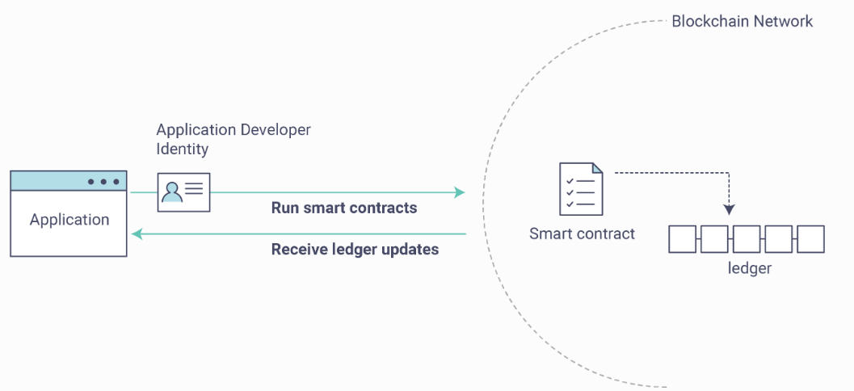
User Identity:
Fabric Gateway needs an identity stored in a wallet in an x509 format. The identity is used when the user invokes the contract. The identity is passed to the chaincode.
 | BCDV 1025 Enterprise Blockchain | Pratik Patil

