Slide 1


BCDV 1026
Blockchain Platforms
2023 March
week 01 - class 01
 | BCDV 1026 Blockchain Platforms | Pratik Patil

Slide 2
What is Cosmos?
Cosmos is an ecosystem of independent interconnected blockchains built using developer-friendly application components and connected with ground-breaking IBC (Inter-Blockchain Communication) protocol.
Cosmos was an open-source community project built by the Tendermint team. Since then, the Interchain Foundation (ICF) has assisted with the development and launch of the network.
Cosmos is a network of interoperable blockchains, each implemented with different properties suitable for their individual use cases. Cosmos lets developers create blockchains that maintain sovereignty free from any "main chain" governance, have fast transaction processing, and are interoperable. With Cosmos, a multitude of use cases becomes feasible.
 | BCDV 1026 Blockchain Platforms | Pratik Patil

Slide 3
INTER‑BLOCKCHAIN COMMUNICATION PROTOCOL
IBC is an interoperability protocol for communicating arbitrary data between arbitrary state machines.
The protocol consists of two distinct layers: the transport layer (TAO) which provides the necessary infrastructure to establish secure connections and authenticate data packets between chains, and the application layer, which defines exactly how these data packets should be packaged and interpreted by the sending and receiving chains.
 | BCDV 1026 Blockchain Platforms | Pratik Patil

Slide 4
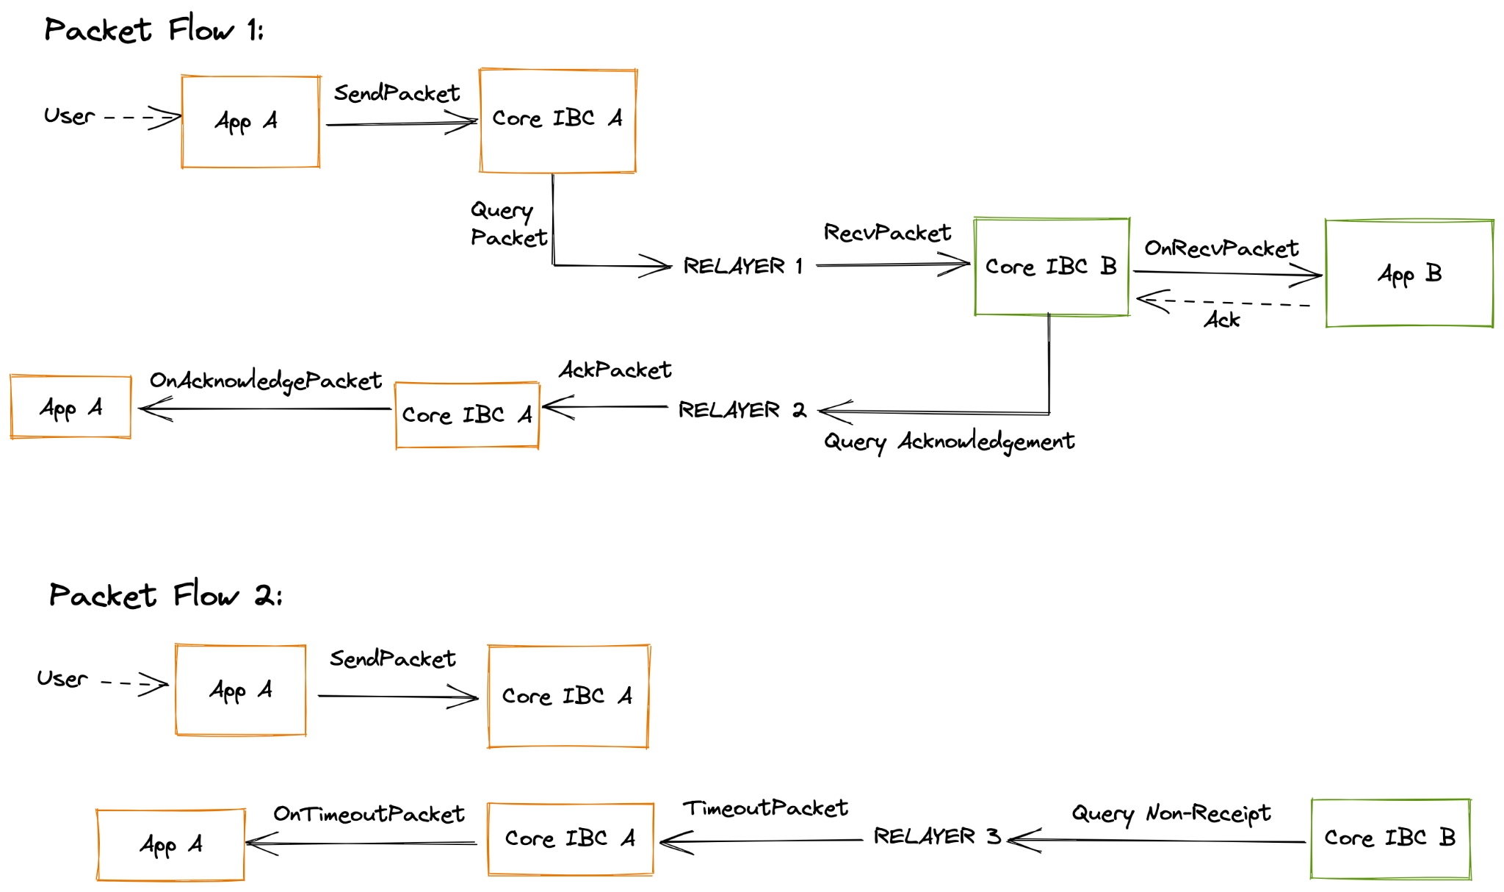
 | BCDV 1026 Blockchain Platforms | Pratik Patil

Slide 5
The IBC application layer can be used to build a wide range of cross-chain applications, including but not limited to token transfers, interchain accounts (delegate calls between two chains), non-fungible token transfers and oracle data feeds.
 | BCDV 1026 Blockchain Platforms | Pratik Patil

Slide 6
Tendermint
Tendermint is a consensus algorithm with Byzantine Fault-Tolerance (BFT) and a consensus engine. It enables applications to be replicated in sync on many machines. Blockchain networks require BFT to ensure proper function even with malfunctioning or malicious nodes present. The result is known as a Replicated State Machine with Byzantine Fault Tolerance. It guarantees BFT properties for distributed systems and their applications.
It does this:
Securely - Tendermint continues working even if up to 1/3rd of machines fail or misbehave.
Consistently - every machine computes the same state and accesses the same transaction log.
Tendermint is widely used across the industry and is the most mature BFT consensus engine for Proof-of-Stake (PoS) blockchains.
 | BCDV 1026 Blockchain Platforms | Pratik Patil

Slide 7
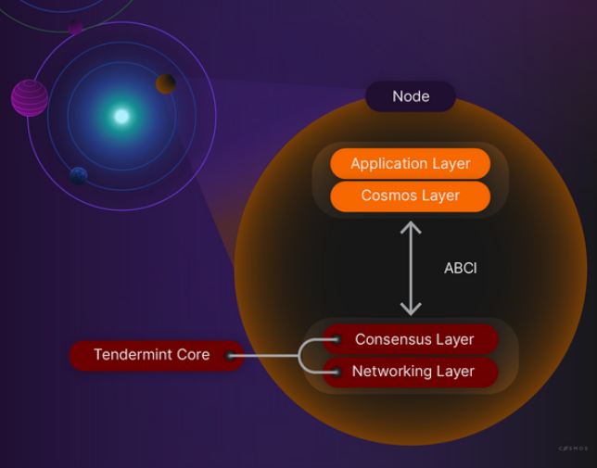
 | BCDV 1026 Blockchain Platforms | Pratik Patil

Slide 8
Cosmos Hub:
It is a public Proof-of-Stake (PoS) blockchain with a native token, ATOM. The Cosmos Hub can be understood as a router facilitating transactions between the chains connected to it. For example, the Cosmos Hub allows for transaction fees to be paid in different tokens as long as the zone trusts the Cosmos Hub and the other zones connected to it.
The reward process in the Cosmos is called Staking.
 | BCDV 1026 Blockchain Platforms | Pratik Patil

