Slide 1
Introduction
This project is an analytical study to predict the risk of having a heart failure. Various data analysis techniques have been used to observe trends between various risk factors for heart diseases. Based on the features, different machine learning models were then implemented to predict whether a person has heart disease.
We also study the ECG of patients and classify them into 5 different categories. To address the problems raised with the manual analysis of ECG signals, many studies in the literature explored using machine learning techniques to accurately detect the anomalies in the signal. We have implemented 3 different implementations for classifying the ECG signals.
Modules:
Heart Failure Prediction
ECG HeartBeat Classification

Slide 2
Heart Failure Prediction
Dataset Features
Age: age of the patient [years]
Sex: sex of the patient [M: Male, F: Female]
ChestPainType: chest pain type [TA: Typical Angina, ATA: Atypical Angina, NAP: Non-Anginal Pain, ASY: Asymptomatic]
RestingBP: resting blood pressure [mm Hg]
Cholesterol: serum cholesterol [mm/dl]
FastingBS: fasting blood sugar [1: if FastingBS > 120 mg/dl, 0: otherwise]
RestingECG: resting electrocardiogram results [Normal: Normal, ST: having ST-T wave abnormality (T wave inversions and/or ST elevation or depression of > 0.05 mV), LVH: showing probable or definite left ventricular hypertrophy by Estes' criteria]
MaxHR: maximum heart rate achieved [Numeric value between 60 and 202]
ExerciseAngina: exercise-induced angina [Y: Yes, N: No]
Oldpeak: oldpeak = ST [Numeric value measured in depression]
ST_Slope: the slope of the peak exercise ST segment [Up: upsloping, Flat: flat, Down: downsloping]
HeartDisease: output class [1: heart disease, 0: Normal]

Slide 3
Algorithms Used
Models implemented:
Extra trees classifier
Gradient Boosting Classifier
Random Forest Classifier
CatBoost Classifier
Light Gradient Boosting Machine
Decision Tree Classifier
Best performing model : Ensemble of the models implemented (except Decision tree) with Soft Voting
Final model : Calibrated version of the best model using pycaret

Slide 4

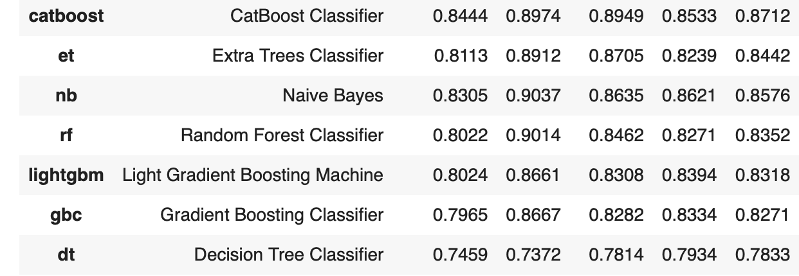
Comparative Performance

Slide 5
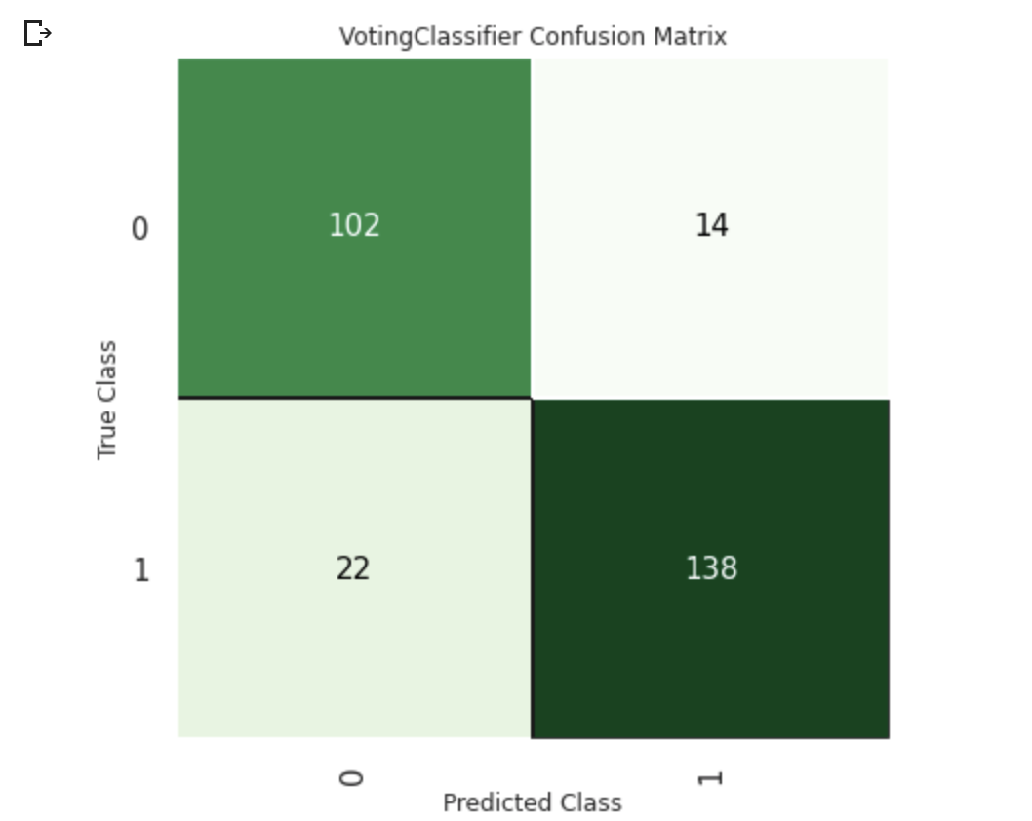
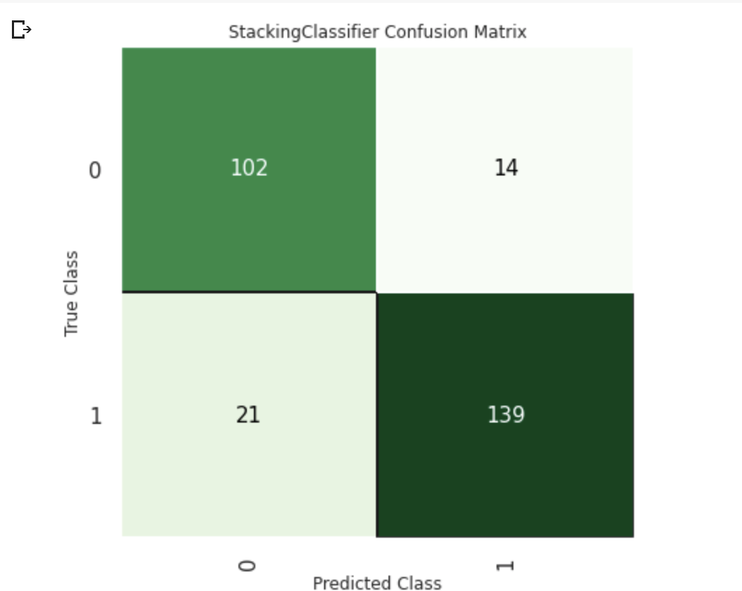
Confusion Matrix
Ensemble model with Soft Voting
Ensemble model

Slide 6
ECG Classification
Algorithms:
Logistic Regression
Random Forest
XgBoost
Performed Minority Sampling using SMOTE technique as data had imbalance
Best performing model - Random Forest

Slide 7
HeartBeat Classification Results
Algorithm | Without SMOTE (Accuracy) | With SMOTE(Accuracy)
Logistic Regression | 91.29 | 66.2
Random Forest Classifier | 97.60 | 98.2
XgBoost Classifier | 84.44 | 75.65

Slide 8
Thank You

