Slide 1

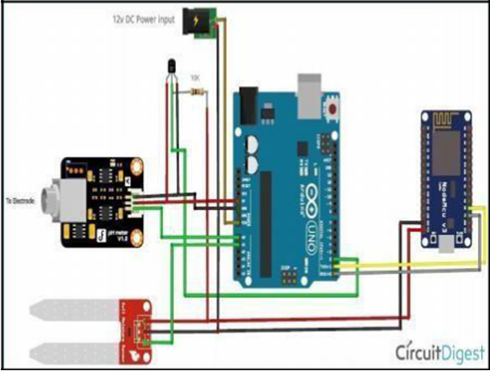
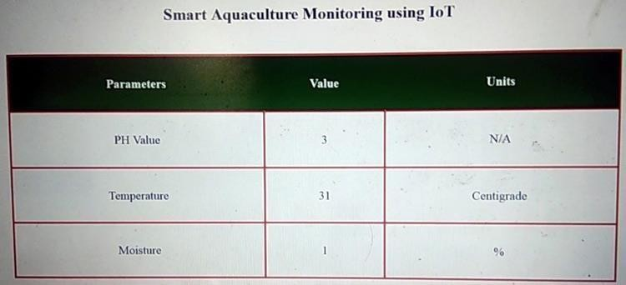
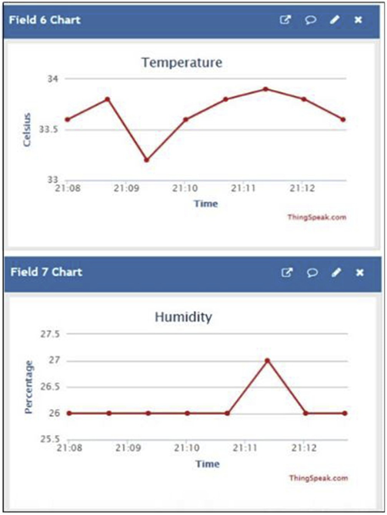
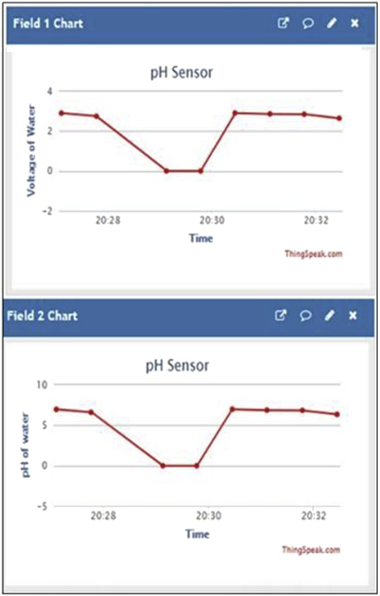
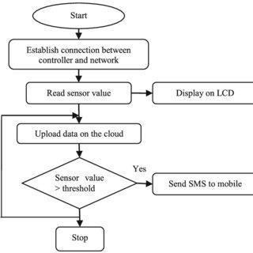
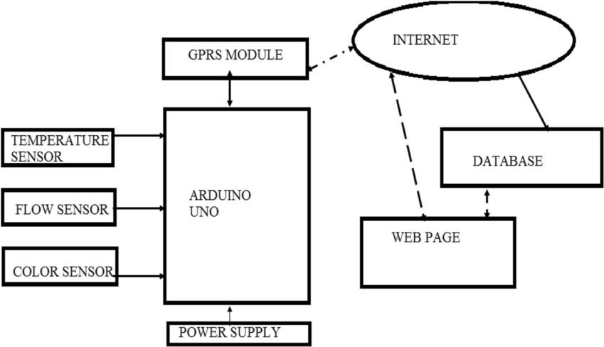
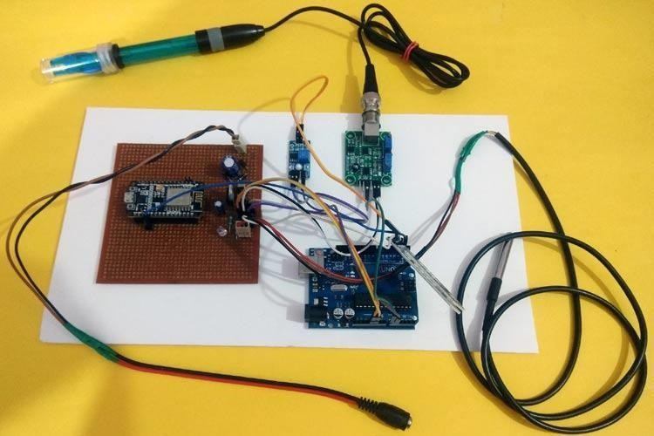
IOE24 - Smart Water Monitoring Quality System Pratik Poojari (18101B0058), Sagar Patil (18101B0014), Project guide- Rasika Ransing
Department of Information Technology
IOE Mini Project Poster Academic Year 2021-22
Abstract Agriculture is the backbone of our country and it is very important to know the parameter of soil and water for efficient harvesting. The various parameters that can be monitored are Soil moisture, pH of water, Temperature, etc. We previously measured these parameters in different tutorials but today we will not only combining them but also display them on a webpage so that they can be monitored from anywhere in the world. Water monitoring is a crucial part of maintaining many environments including industrial buildings, commercial properties and healthcare establishments. Technology has advanced to the extent that there are now highly sophisticated, accurate and convenient smart water monitoring systems which offer a whole host of benefits to property owners. If sampling is the sole way that water quality Is checked, there is unfortunately always the prospect of human error. With advanced water monitoring technology, highly accurate measurements allow building managers, FMs and maintenance teams to detect and gather more data, including dissolved oxygen – a pre-cursor to all types of corrosion. 2. Introduction/Theory Measuring different parameters of soil and water for efficient harvesting using IoT. Modern smart water monitoring systems analyze data continually and instantly alert users to changes in the system, giving peace of mind and reducing the need for unreliable and expensive sampling. Smart systems are also designed to be easy-to-use, allowing easy access of all the data in one place, accessible via any internet enabled device. Without a smart water monitoring system, sampling is the main way water quality checks take place. The problem with sampling Is that results can take weeks to come back, by which time conditions may have changed. Using real-time monitoring, instant data allows pre-cursors to potential issues (such as corrosion) to be flagged up and immediately be addressed before major issues occur. The ability to make real-time decisions during critical moments can be vital in preventing expensive repairs and breakdown. 3. Problem Statement First of all, include all the header files, which will be required throughout the code. Here we are using on wire h and DallasTemperature.hlibrary for a DS18B20 temperature sensor. This can be downloaded from the links given and included in the Arduino library. Similarly, we are using ArduinoJson.hlibrary for sending data from the transmitter to the receiver side.
Next, define the connection pin of Arduino, where the output pin of the DS18B20 sensor will be connected, which is digital pin 2 in my case. Then, objects for one wire class and Dallas Temperature class are defined which will be required in the coding for temperature measurement. Next, the calibration value is defined, which can be modified as required to get an accurate pH value of solutions. Then a JSON Object is defined which will be required for sending parameters from the Transmitter part to the Receiver part. Inside loop(),read 10 sample Analog values and store them in an array. This is required to smooth the output value. Then, we have to sort the Analog values received in ascending order. This is required because we need to calculate the running average of samples in the later stage. Finally, calculate the average of a 6 center sample Analog values. Then this average value is converted into actual pH value and stored in a variable. To send a command to get the temperature values from the sensor, request Temperatures() function is used. 4. Implementation Block Diagram Flowchart 5. Results & DISCUSSION In our project we have tried to simplify the need of common people regarding the knowledge about Smart Water Monitor .We made it easier for the consumers to get the basic knowledge regarding the System. Without a smart water monitoring system, sampling is the main way water quality checks take place. The system proposed in this paper is an efficient, inexpensive IoT solution for real-time water quality monitoring. The developed system having Arduino Mega and request Temperatures target boards are interfaced with several sensors successfully. An efficient algorithm is developed in real-time, to track water quality.
Circuit diagram [Below is the HTML page will be shown in a web browser:] 6. Conclusion Smart meters are changing the way utilities operate—let it be the energy or water segment. The use of these meters along with a well-crafted IoT solution allow water utilities to manage their water distribution practices and provide their customers with clean potable water. These meters are also empowering the consumers to see the value of water meter in reducing cost linked with their consumption of water. Thus this proves that this IoT project can effectively measles parameters of soil and water For effective harvesting. References [1] Microcontroller chip technology, 2001, PICI6F84A Datasheet www.microchip.com. [2] M. Javamard, K.A. Abbas and F. Arivin, “A Microcontroller-Based Monitoring System for Batch Tea Dryer”, CCSE Journal of Agricultural Science,Vol. 1 No. 2,December 2009. [3] E.J. Cho and F.V. Bright, “Integrated chemical sensor array platform based on light emitting diode,xerogel” derived sensor elements, and high-speed pin printing", Analytica Chimica Acta, vol. 470.pp. 101-110, 2007.

