Slide 1
Uber & LYFT Price Prediction
Rahul Sridharan ()
Pratik Randad (002133847)
Prashanti Salunkhe (002133330)
Piyush Kumar Sultania (002135692)

Slide 2
PROBLEM STATEMENT
Which days of the week have the highest fare?
Dynamic Change in Pricing of Uber and Lyft Rides
Impact of day-to-day rising prices on commuters
Analyzing the trips, amount and time spent on rides
Determining the impact of weather and peak time factors on ride costs
Time sensitive issue

Slide 3


Model IMPLEMENTED? Used Machine Learning (ML) Models
01
02
03
GOAL
Why This Model? To easily predict the dynamic pricing
Target? To enable Uber to improve Operations by adjusting services based on predictions

Slide 4


Dataset Information
The dataset was retrieved from Kaggle.com
The dataset had lot of inconsistencies in format, which we needed to transform and define the categorical values and the features having some attributes
We then performed the EDA(Exploratory Data Analysis) with various Visualizations such as Split Plots, Bar Graphs and Scatter plots.

Slide 5


Slide 6
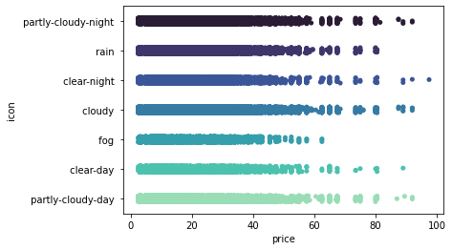
Strip Plot: Price Range based on Weather

Slide 7
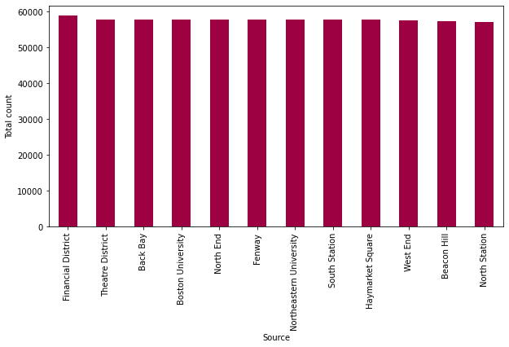
Bar Plot: Rides based on source of Destinations

Slide 8
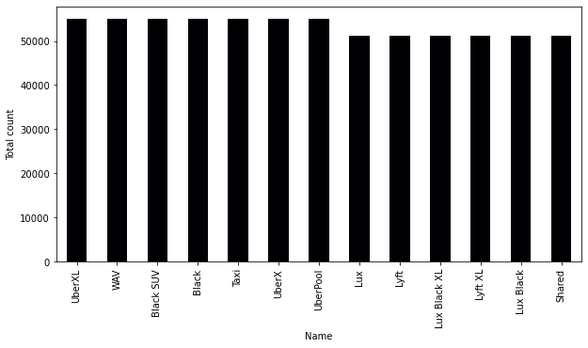
Bar Plot: Total Rides based on Car Type

Slide 9
MODELS USED
1
Linear Regression
2
Decision Tree
3
Random Forest
4
Gradient Boosting

Slide 10
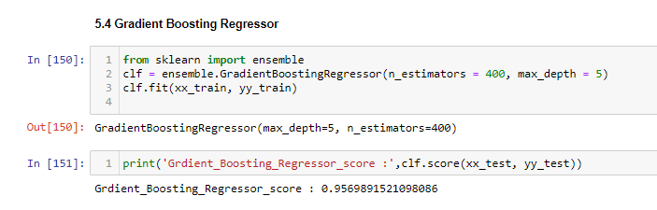
RESULT METRICS & CONCLUSION
We evaluated all the 4 model’s scores which are noted below –
Model | Score
Linear Regressor | 0.41973282820736557
Decision Tree Regressor | 0.9350893669242692
Random Forest Regressor | 0.9464565853684954
Gradient Boosting Regressor | 0.9569891521098086
According to the parameters that we used for gauging the model performance we found that - Gradient Booster model is the best for Uber/Lyft Price Predictions

Slide 11
Thank You!

