Slide 1
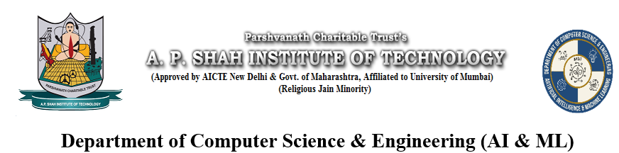
Payroll Management System
Made by
Pranet Pednekar – 22106098
Aditya Rawat – 22106022
Pratik Redekar – 22106029
Raj Patil – 22106135
Project Guide
Prof. Sayali Badhan

Slide 2
Outline
Introduction
Literature Survey of the existing systems
Limitations of the existing systems
Problem statement
System Design
Technologies and methodologies
Key Features
Implementaion
Conclusion
References

Slide 3
Introduction
A payroll system is an accounting method used to process, streamline, and manage wages paid to employees. It calculates salaries after the deduction of taxes, benefits payments, track hours worked, issues payments through check or direct deposit and keeps accurate records of all employees.
This web application is reduced as much as possible to avoid errors while entering data. It also provides error message while entering invalid data. It is user-friendly as no formal knowledge is required to use the system.

Slide 4
Objectives:
The objective of making Payroll management system is to help manage Payroll, Deductions, Taxes, managing leaves of employee etc.

Slide 5
Problem Statement:
Design and develop an Employee Payroll Management System that automates the payroll processing tasks, ensuring accuracy, efficiency, and compliance with relevant regulations.

Slide 6
Literature Survey
Based on the literature survey on payroll, it is evident that there is a significant body of research and analysis in this field. The studies cover various aspects of payroll management systems, including the importance of computerized payroll processing, the correlation between user-friendly budget documents and citizen participation, the advantages of outsourcing payroll management, and the features and benefits of automated payroll systems. The literature emphasizes the importance of payroll management systems in administering employees’ salaries, calculating taxes and social security, maintaining financial records, and ensuring that employees receive the appropriate amount of pay.

Slide 7
Key Features: Employee Information Management: The system should maintain a comprehensive database of employee information including personal details, salary details, tax information, and other relevant data. Salary Calculation: Implement algorithms to calculate salaries based on various parameters such as attendance, overtime, leaves, bonuses, and deductions.
Tax Management: Incorporate features to handle tax calculations, deductions, and compliance with tax laws.

Slide 8
Leave Management: Allow employees to apply for leaves and manage their leave balances. Ensure that salary calculations consider leave deductions accurately. Display Monthly Salary : It is the process of paying workers at the end of a pay period, which is typically a month. User Interface: Design a user-friendly interface that facilitates easy navigation and interaction for HR administrators, managers, and employees.

Slide 9
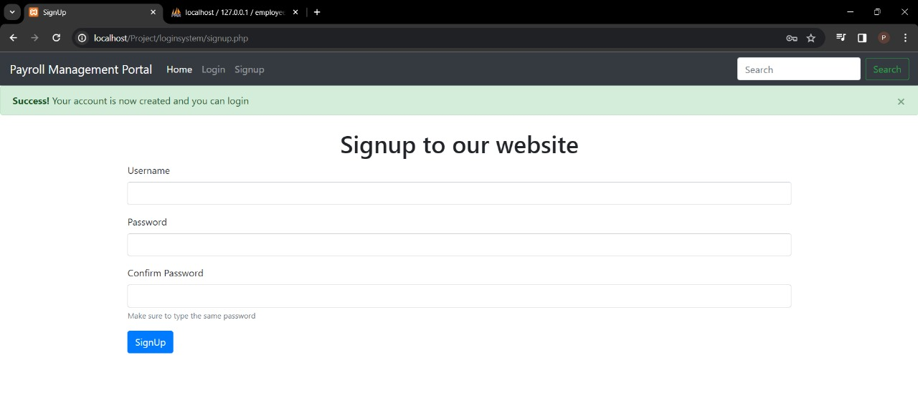
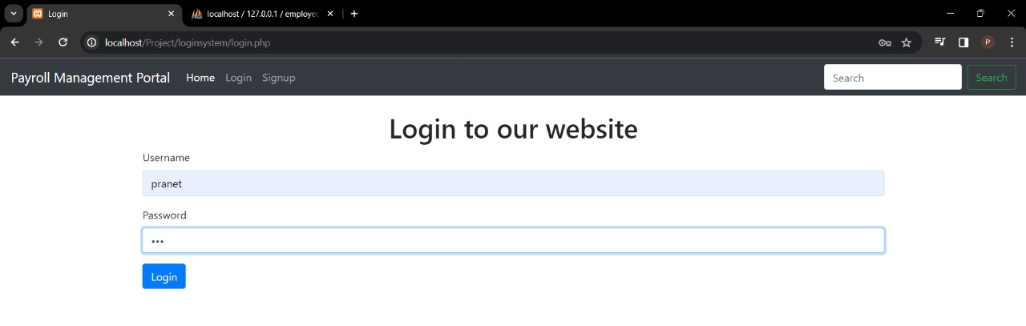
Implementation

Slide 10
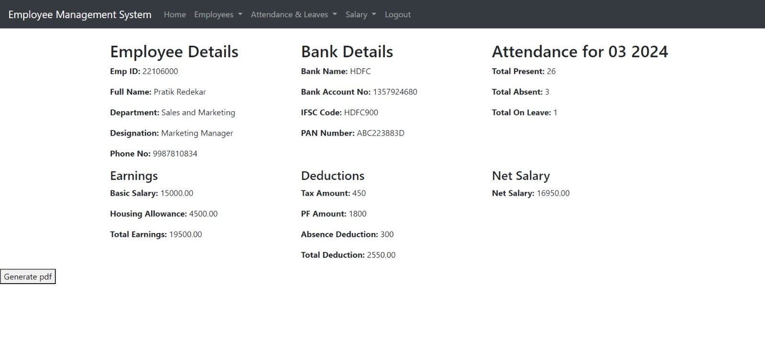
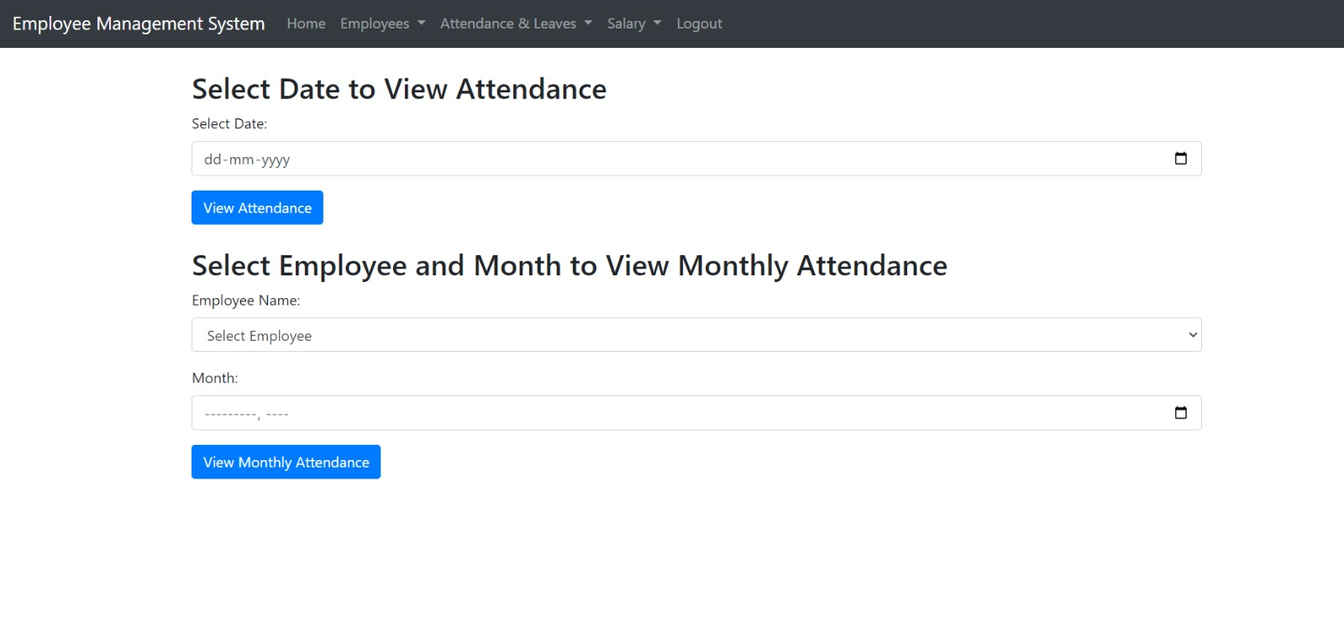

Slide 11
Block Diagram
Enter credentials
Invalid Credentials
LOGIN
Valid credentials
ADMIN
USER
Manage employee
Edit Profile
Take attendance
View attendence
Manage leaves
Apply leaves
Salaries
Download salary slip
Logout
Logout

Slide 12
Technologies and methodologies
Technology:-
Frontend: HTML, CSS, Bootstrap JS and JavaScript for user.
Backend: PHP
DBMS: MySQL
Tools used(XAMPP): For providing HTTP server capabilities.

Slide 13
Methodology:-
•Requirements Gathering: Conduct thorough requirements analysis to understand the needs and expectations of managers, and employees. Define clear and measurable requirements to guide the development process. •Design Phase: Design the architecture, database schema, and user interfaces of the payroll management system based on the gathered requirements. Use design patterns and best practices to ensure scalability, maintainability, and usability.

Slide 14
•Development: Implement the system functionalities according to the defined requirements and design specifications. Follow coding standards, perform code reviews, and write unit tests to ensure code quality and reliability. •Testing: Conduct comprehensive testing, including unit testing, integration testing, and user acceptance testing (UAT), to identify and fix defects, validate functionality, and ensure the system meets quality standards.

Slide 15




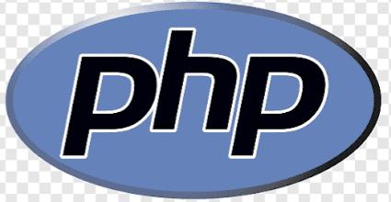


Slide 16
Conclusion
The conclusion of this project marks the culmination of extensive efforts in designing and developing a robust system that automates payroll processing tasks, streamlines administrative workflows, and ensures adherence to regulatory requirements. By integrating advanced algorithms, intuitive user interfaces, and robust security measures, the system provides a seamless experience for HR administrators, managers, and employees alike.

Slide 17
References
Reference: https://www.estartindia.com/knowledge-hub/blog/objective-of-the-payroll-management-system
Research Paper: IJFMR https://www.ijfmr.com › papersPDF A Study on PayRoll- Management System

Slide 18
Thank You...!!

