Slide 1

Online Shopping Mall: SortCart.com
Agenda:
1. Overview of Website
2. Features
3. User Stories
4. Database Schemas
Pratik Sawant PS00501599
Prashant Dwivedi PD00501983
Copyright © 2016 SoftCart. All Rights Reserved.

Slide 2
Online Shopping Mall: SortCart.com
ADMIN
USER
7 Major TestCases(Total)
2 Major TestCases
17 SubCases
View
Add
Update
Delete
Generate Report
View Products
My Orders
My Cart
My Wishlist
View Profile
Update Profile
Products
Copyright © 2016 SoftCart. All Rights Reserved.

Slide 3
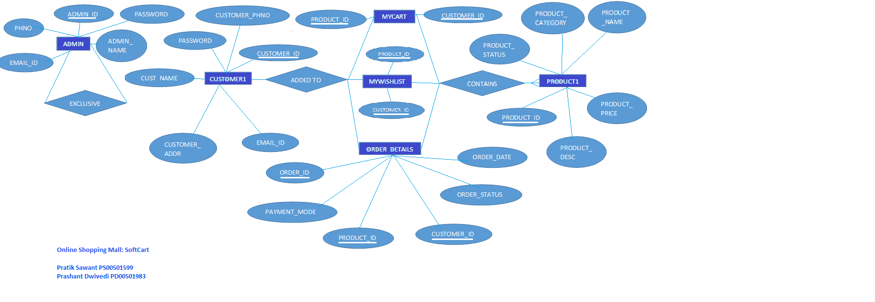
Online Shopping Mall: SortCart.com
ER Diagram
Copyright © 2016 SoftCart. All Rights Reserved.

Slide 4

Online Shopping Mall: SortCart.com
Website Demo
Copyright © 2016 SoftCart. All Rights Reserved.

Slide 5
Online Shopping Mall: SortCart.com
Thank You!
Copyright © 2016 SoftCart. All Rights Reserved.

