Slide 1
Analysis of Binary Exponential Backoff Algorithm in Distributed MAC Protocols
Section -1
Group 13
Networks
Khushi Panchal
Divyaraj Vaghela
Pratik Agrawal
Datt Suthar

Slide 2
Background and Motivation
Course Perspective:
Study of Medium Access Control (MAC) protocols
Understanding Binary Exponential Backoff Algorithms (BEBA)
Application of probability and Markov chain modeling
Analysis of distributed network behavior
Real-World Perspective:
Used in WiFi (IEEE 802.11) networks
Multiple devices share the same communication channel
Requires coordination without central control
Affects network reliability and user experience
Motivation:
Need to understand channel access mechanisms
Aim to improve efficiency and scalability of networks

Slide 3
Base Paper Overview
Analyzes the Binary Exponential Backoff (BEB) algorithm
Focuses on distributed MAC protocols
Proposes a generalized analytical framework
Uses Markov chain-based modeling
Identifies differences from traditional assumptions
Highlights non-uniform channel access behavior
Validates results using simulation studies

Slide 4
Problem Formulation
Problem: When multiple nodes attempt transmission:
Collisions occur
Throughput decreases
Delay increases
Channel efficiency drops
We use BEBA to minimize these problems and analyse it using Discrete markov chain

Slide 5
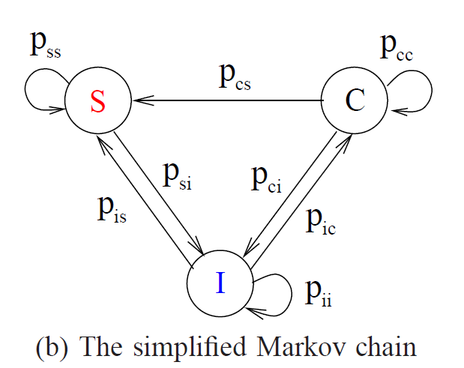
Mathematical Model
Channel states:
Idle (I)
Success (S)
Collision (C)
Probability equations:
Idle probability:
Pᵢᵢ = (1 - τ)ᴺ
Success probability:
Pᵢₛ = Nτ(1 − τ)ᴺ⁻¹
Collision probability:
Pᵢ꜀ = 1 − Pᵢᵢ − Pᵢₛ
N = number of nodes
τ = transmission probability = 2/CW
CW = Contention window
Backoff value = (0,CW-1)

Slide 6
Deterministic Approach
arrival_interval = max(1, int(round(1/p)))
self.backoff = (CW//2 + node_id) % CW
Expected backoff counter:E[R] = (CW − 1)/2
Initialization: starts with CW_min (0,CW_min-1)
Success: CW resets to CW_min (0, CW-1)
Collision: CW*2 till CW_max (0,CW*2-1)
KPIs: Throughput = Successful transmissions / T
Collision rate = Collisions / T

Slide 7
Randomized Approach
Fully randomized:
self.backoff = self.rng.integers(0, self.cw)
Initialization: starts with CW_min and assigns random backoff
Success: CW resets to CW_min and random backoff generated
Collision: CW * 2 till CW_max and random backoff recalculated
2. Randomized only at collison:
Initialization / Success:
self.backoff = (CW//2 + node_id) % CW
Collision:
self.backoff = np.random.randint(0, self.cw)
Initialization: deterministic backoff using CW_min
Success: CW resets to CW_min using deterministic formula
Collision: CW * 2 till CW_max and random backoff generated

Slide 8
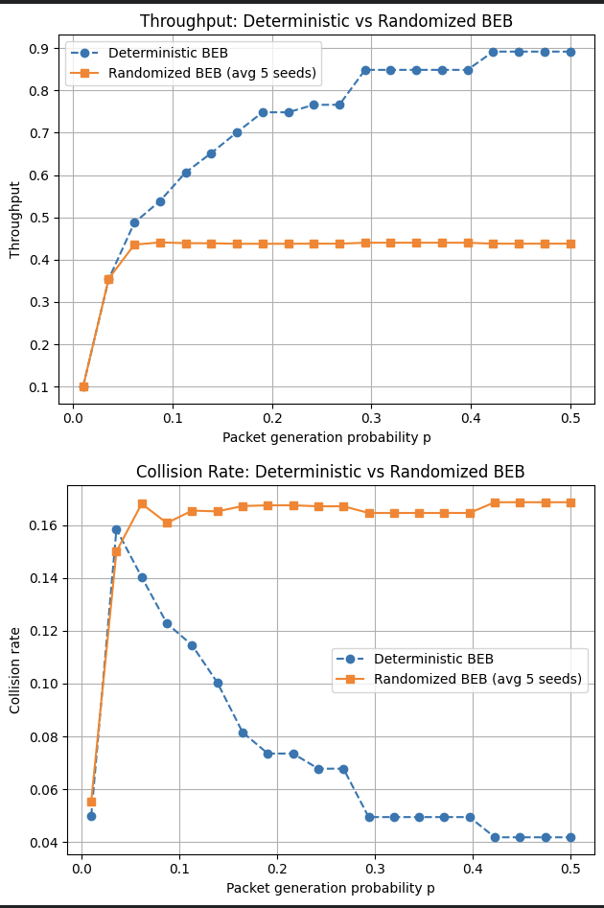
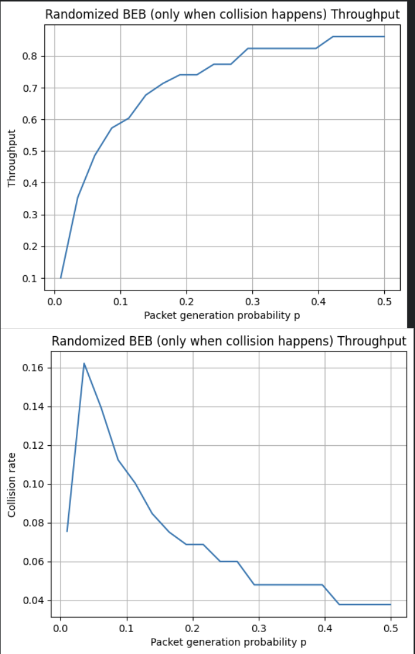
Results

Slide 9
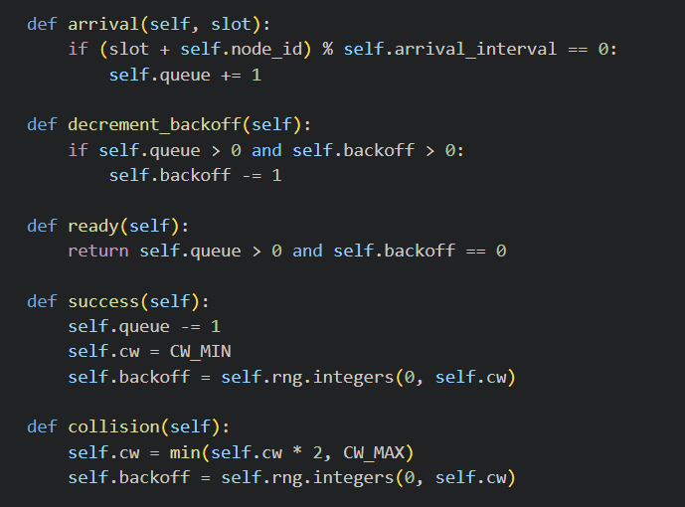
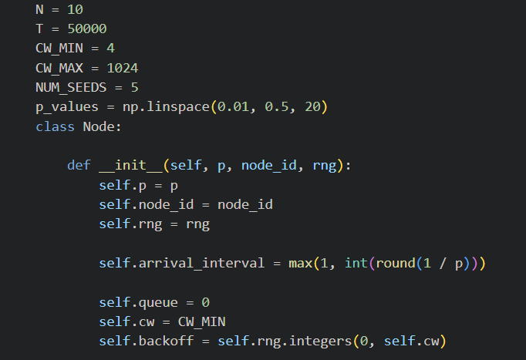
Coding and Simulations
Language: Python 3
Libraries:
NumPy (default_rng, randint)
Matplotlib
Environment: Jupyter Notebook

Slide 10
Inference – Domain Perspective
Uses probability to model unpredictable behavior
Helps decide outcomes like idle, success, or collision
Converts observations → meaningful decisions
Can be deterministic or probabilistic
Used to analyze and predict system performance

Slide 11
Inference – Computer Science Perspective
Inference = algorithm taking input and producing output
Input: packet arrival (p), backoff, queue state
Processing: BEB logic + backoff mechanism
Output: idle / success / collision decision
Uses randomness: np.random.rand() and np.random.randint()
Performance measured using throughput and collision rate
Notes:
E is an electric field,
Pole on ZOOM: The diode Cathode corresponds to the n-type region while anode corresponds to the p-type region (True , False)

Slide 12
References
https://www.ideals.illinois.edu/items/11087/bitstreams/40891/object

Slide 13
Thank You

