Slide 1
HPC Clusters and Architecture

Slide 2
Agenda
HPC Clusters and Architecture
HPC system components
Parallel file systems
Performance Parameters for supercomputers
Cluster Design and network considerations
Components of supercomputer Network
Building a Linux cluster
HPC cluster security

Slide 3
What is HPC
Definition1:
High Performance Computing (HPC) uses parallel processing to run complex application programs rapidly, effectively, and with high reliability. The term applies especially to systems that function above a teraflop or 1012 floating-point operations per second. The term HPC is occasionally used as a synonym for supercomputing, although technically a supercomputer is a system that performs at or near the currently highest operational rate for computers.
Definition2:
High-performance computing (HPC) is a technique for quickly processing massive volumes of data and carrying out difficult computations.

Slide 4
What is a Supercomputer?
  A supercomputer is a type of computer that has far higher processing capabilities than a general-purpose computer like a desktop or laptop for personal use.
  A supercomputer is a highly reliable computing system that can process data at rates measured in billions of floating-point operations per second (FLOPS) or instructions per second.
  Supercomputers are purpose-built computers used by engineers and scientists to tackle scientific and mathematical challenges.

Slide 5
What is HPC Architecture?
In the HPC architecture, a cluster of connected computer servers offers exceptional performance over that of a single machine.
How do clusters work?
A group of computers working on the same set of tasks collectively is referred to as a "cluster". In an HPC design, a group of computers collectively function as a single node that may take jobs and perform calculations.
A HPC Cluster is what?
An HPC cluster is a network of connected computing computers. Depending on the requirements of the application, a cluster may consist of thousands of computers. Every server in an HPC cluster is referred to as a node. These nodes are run in parallel to increase processing speed and enhance system performance.

Slide 6
HPC Architecture
An HPC architecture is an ensemble made up of several systems, moving components, and hardware that has been optimized. To tie it all together, you need more than just glue and tape; you also need carefully thought-out software and file systems, accelerated hardware, and the newest in performance-improving networking and computing technologies.

Slide 7
HPC System Key Components
Key Components:
Compute
Network
Storage
Security

Slide 8
Key Components:
Compute
The compute component, as its name implies, is concerned with processing data, running programs or algorithms, and resolving issues.
HPC depends heavily on computation. It might be a standalone machine or a component of the high-performance computing cluster. As an illustration, an HPC compute node has two clusters, each of which includes a single CPU, a hard disk, RAM, and a network card. Temporary files may be kept on compute nodes.Keep in mind that HPC concentrates on distributed computing to swiftly and effectively address complex and bigger problems.
The high-performance system is constructed and streamlined using clusters of computing machines connected over a network. The software, apps, and algorithms that are performed on these compute servers enable them to carry out and finish a variety of activities.

Slide 9
Key Components:
Network:
Fast and dependable networking is essential for a successful HPC design, whether it is for ingesting external data, moving data between computing resources, or transporting data to or from storage resources.
Many individuals mistakenly think that local area networks and the internet are the same as HPC networks. These are two distinct architectures, though. Packaging restrictions and wire length are just two of the variables taken into account while designing an HPC network. Several apps run smoothly on the network thanks to its smart physical network structure. In HPC networks, common topologies include:
    Bus
    Point to Point
    Mesh or Grid
    Torus
Make sure your HPC system's networking component allows the fast transfer of data between compute servers and storage. The entire HPC system will be compromised if the network is subpar.

Slide 10
Key Components:
Storage:
While a computer system's slowest component is typically its external storage, an HPC system's storage will operate more quickly to accommodate HPC workloads.
A crucial part of the HPC infrastructure that keeps the CPU running at high speeds is storage systems. It efficiently reads and writes data from disk drivers at the same time.
Due of their extensive data retrieval and storage needs, HPC systems demand a particular strategy. A smart HPC system features optimized storage components that send and receive data from the compute servers rapidly and effectively.

Slide 11
HPC Architecture tool
Tools
HPC Schedulers
Load Balancer
Cluster Management tool

Slide 12
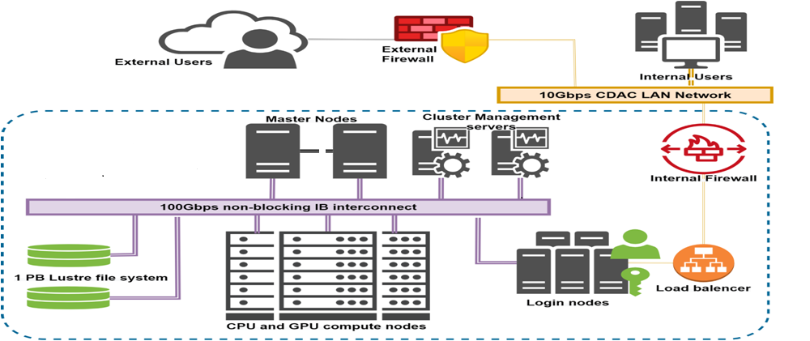
HPC Architecture Diagram

Slide 13
HPC cluster components
Head or Master Node
Login Node
Compute Nodes (CPU & GPU nodes)
Storage System(Parallel file system)
Infiniband Interconnection

Slide 14
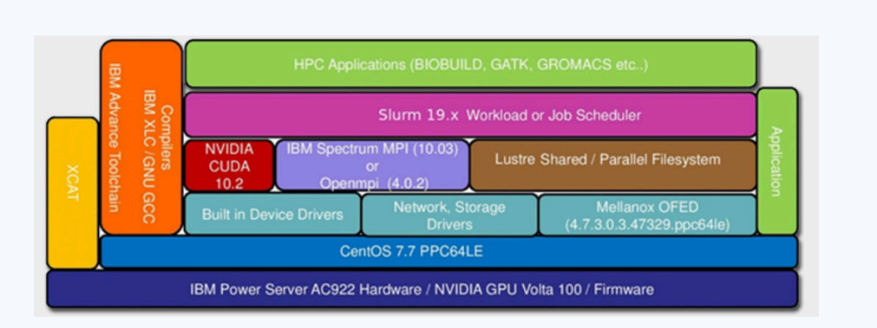
HPC Software Stack

Slide 15
HPC: Challenges
Cost
Scalability
Data Management
Programming
Support for software and tools
Power consumption and cooling

Slide 16
Parallel file systems

Slide 17
File Systems
What is a file system?
A file system serves two primary purposes:
To keep the files namespace organized and up to date
To keep the contents
What is Data in file system?
They are in accordance with the actual file contents and their properties.
What are Metadata in file system?
An assortment of data about files is known as metadata. They include, for instance:
Placement of data on the disks
data sizes
dates of creation, update, and last access
The UID, GID and the permissions

Slide 18
Local sequential File Systems
Definition
A local sequential file system is one that cannot be accessed remotely.
Its operating system is the only client that can access it.
There is often no parallelism (many simultaneous accesses).

Slide 19
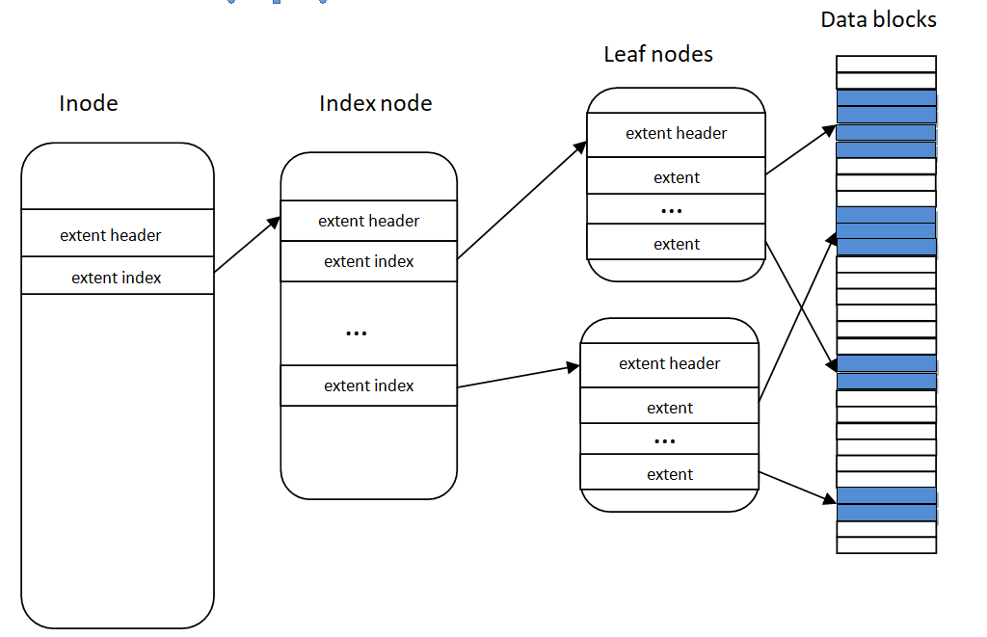
Example: Structure a file on ext4 file system

Slide 20
Parallel File Systems
Definition:
A parallel file system is intended to allow several clients to access a file system at the same time. The level of parallelism differs from that of a basic shared file system:
Multiple clients can read and write at the same time.
The data distribution. If the data is dispersed among numerous data servers, the client will obtain high speed.
This parallelism is invisible to the client, who perceives the file system as if it were local.
A parallel file system must efficiently manage possible conflicts between several clients in addition to the functions of a local file system. The recommended method is to limit and control concurrent accesses to a certain file or directory by using locks.

Slide 21
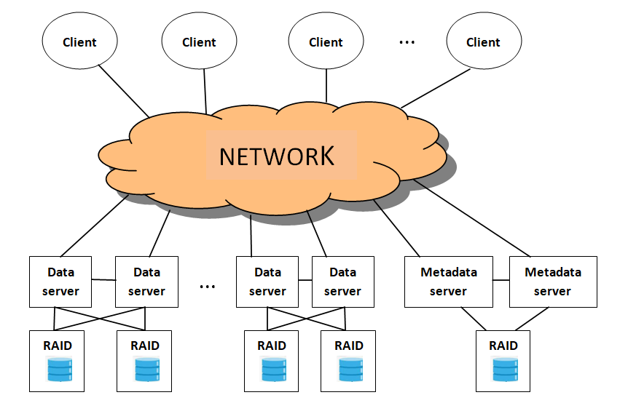
Architecture – Parallel File System

Slide 22
Typical architecture- Parallel File System
A parallel file system consists of :
Clients that read and write data to the file system
Metadata servers, They handle metadata and data placement on disks, as well as access control locks, to prevent clients from modifying the same area of a file at the same time
A number of data servers to store data. Data and metadata can be handled by the same server in some parallel file systems
One or more networks (dedicated or not) to connect these components.

Slide 23
Main parallel file systems
The most commonly used parallel file systems in supercomputers are:
Lustre
GPFS
PVFS2/OrangeFS
PanFS

Slide 24
Lustre
Lustre architecture
Lustre is an open source parallel file system. It runs on all major networks (InfiniBand, TCP/IP, etc.).
A Lustre system consists of the following components:
Metadata servers (MDS) that maintain a Meta Data Target (MDT) file system
A collection of data servers known as Object Storage Servers (OSS) that handle a number of Object Storage Targets (OST).

Slide 25
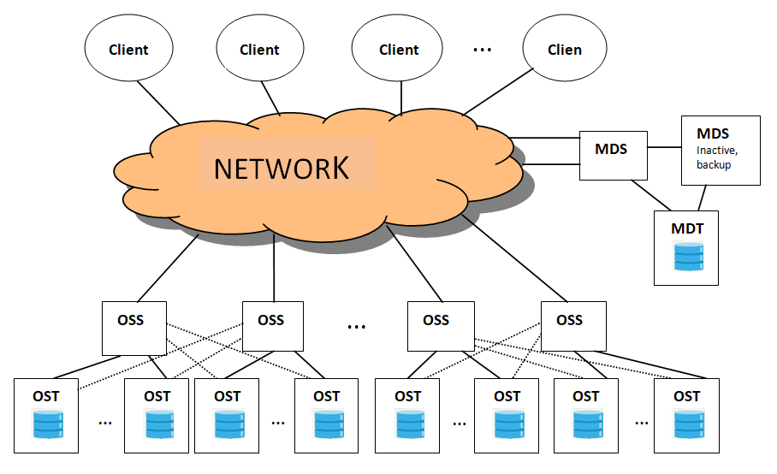
Architecture - Luster

Slide 26
Lustre
How does Lustre work?
When a client needs to access a file, it contacts the MDS, which gives information on the OSTs that contain the data or on which it will be able to write; the MDS modifies metadata as needed; and the client then connects directly with the OSSs to read or write data.
The OSSs maintain the locks, which are set at byte intervals on each OST.

Slide 27
Performance Parameters for supercomputers

Slide 28
Performance Parameters for supercomputers
Supercomputer performance is represented using a standard rate that indicates the number of floating-point arithmetic computations a system can complete per second.
FLOPS is an abbreviation for floating-point operations per second. The letter "S" in the acronym "FLOPS" stands for "second" and is used in conjunction with the letter "P" (for "per") to represent a rate, gigabits per second (Gbps).
The theoretical peak performance (Rpeak) capabilities of their systems, represented in FLOPS. The Rpeak of a system is calculated by multiplying the number of processors by their clock speed, and then multiplying that product by the number of floating-point operations the processors can perform in one second on standard benchmark programs like the LINPACK DP TPP and HPC Challenge (HPCC), as well as the SPEC integer and floating-point benchmarks.

Slide 29
HPL - A Portable Implementation of the High-Performance Linpack Benchmark
HPL stands for High-Performance Linpack benchmark. The code solves a uniformly random system of linear equations and returns the time and floating-point execution rate using a standard operation count algorithm.
HPL is developed in portable ANSI C and requires both an MPI implementation and a BLAS or VSIPL library. HPL's choice of software dependencies provides portability as well as performance.
HPL is frequently one of the first programs run on big computer installations to get a result suitable for submission to TOP500.

Slide 30
HPL
On distributed-memory computers, HPL is a software package that solves a (random) dense linear system in double precision (64 bits) arithmetic. As a result, it may be considered a portable and freely accessible implementation of the High Performance Computing Linpack Benchmark.
Precision, performance, and scalability
The HPL package includes a testing and timing tool that allows you to assess the correctness of the answer as well as the time it took to compute it. The optimum performance that this program can achieve on your machine is determined by a number of variables. Nonetheless, with some restrictions on the interconnection network, the algorithm presented here and its attached implementation are scalable in the sense that their parallel efficiency is constant in relation to the per processor memory usage.

Slide 31
Cluster Design and network considerations

Slide 32
Cluster Design and network considerations
The major requirements while designing a cluster is
  Physical facilities to house the cluster.
  Hardware requirements.
  Software requirements.

Slide 33
Facilities requirements.
    In cluster design and implementation, facilities are frequently the most decisive aspect.
To implement HPC, we require
  Physical Area
    Adequate physical floor space to house the server racks, with enough space between them for safety, and the necessary supports to hold the racks of additional servers.

Slide 34
Facilities requirements.
Power Supply
  Uninterrupted power supply to operate the servers, cooling, to avoid any potential data loss.
  Redundant power supply in the event of an emergency to ensure all servers are operating at optimum capacity.
Adequate cooling capacity to manage heat.
  Proper cooling of all the servers including the storage servers in order to ensure that the data centre operates at a nominal temperature.
  Servers operating 24X7 give out a lot of heat, it is very essential to ensure that they are brought down to a nominal temperature, otherwise the servers might overheat and we might see a performance drop.

Slide 35
Facilities requirements.
  Ample security from physical threats.
  Physical security is required to protect the data centre from intruders and other threats.
  Proper safety measures for safety hazards such as fires, natural disasters and such things need to be taken into consideration and implemented.
  A BMS(building management system) needs to be integrated to control and maintain all the facilities required to run a cluster.

Slide 36
Compute requirements.
Building an HPC cluster requires various things:
  Servers
    Servers can be based on the requirements of the cluster and can be a normal CPU server, or it can also be specialized servers with high memory or with GPU cards
    A typical cluster requires at the minimum 3 types of nodes, Head Nodes, Compute Nodes and Login/Client Nodes.
    All these must be kept in mind while designing any cluster, and based on your requirements and available physical facilities.

Slide 37
Compute requirements
Storage
  In terms of storage, depending on the requirements, ample amount of storage for running required applications must be mounted on the servers.
  Since this is a cluster, a shared parallel file system is a must, to ensure all the users can simultaneously access their files from storage.
  The storage servers need to be connected through high speed network for running applications so high bandwidth storage media like SSD can be considered in a RAID volume.

Slide 38
Compute requirements
  A Dedicated network
  All nodes need to be connected to each other and to the storage through high speed internet, in order to facilitate the smooth running of large applications like real time weather simulations.
  Best case would be to use Infiniband connections for high speed interconnections, but it will depend on the budget, if that is viable option or a proper Fiber Channel cable to connect them is a must.
  Most importantly a backup network switch must be placed at strategic points to avoid point of failure and ensure network doesn’t collapses.

Slide 39
Software requirements.
A cluster for HPC should have a wide range of libraries to support various applications. One of the most popular open source software repository is OpenHPC. It contains a wide array of applications and libraries for various Linux systems, including but not limited to,
  Cluster Provisioning tools
  System Resource Manager
  System Management tools
  MPI packages
  Intel and GNU compilers
  Debuggers and Profilers

Slide 40
Network Considerations
While designing a cluster, one should take into considerations the network requirements and what provisions can be made,
  What type of network interface would be best ?
  How many points of failures are there ?
  What type of network media would be most viable ?
Keeping these in mind, enough network switches must be placed strategically to ensure no network disruption.
FC or Infiniband are the most commonly used network mediums in a cluster as they can provide higher network bandwidth than a normal Ethernet medium can provide.

Slide 41
Components of supercomputer Network

Slide 42
Computer networks
A computer network is a collection of computers that share resources that are located on or provided by network nodes. To interact with one another, computers employ standard communication protocols across digital links. These linkages are made up of telecommunication network technologies based on physical linkage, optical, and wireless radio-frequency means, which may be configured in a number of network topologies.
A computer network's nodes can be personal computers, servers, networking devices, or other specialized or general-purpose hosts. They are recognized by network addresses and maybe by hostnames. Hostnames function as node labels and are seldom modified after initial assignment. Network addresses are used by communication protocols such as the Internet Protocol to locate and identify nodes.
Many characteristics may be used to classify computer networks, including the transmission media used to convey signals, bandwidth, communications protocols used to arrange network traffic, network size, topology, traffic management techniques, and organizational goal.

Slide 43
Components of Supercomputer Network
NIC
Switches
Firewalls
Network Mediums

Slide 44
Network Interface Cards (NIC)
A network interface controller (NIC) is a piece of computer hardware that links the computer to network media and interpret low-level network information. For example, the NIC may have a cable connector for wired transmissions or an antenna for wireless transmission and receiving, as well as the related circuitry.

Slide 45
Network Switches
Network switches differ from hubs in that they forward frames exclusively to the ports participating in the connection, whereas hubs transmit frames to all ports. Switches often feature a large number of ports, allowing for device star topology and the cascading of more switches.
Switches function at the OSI model's data connection layer (layer 2), bridging traffic between two or more network segments to form a single local network. It routes data frames between ports depending on the target MAC address in each frame. By studying the source addresses of incoming frames, it learns the relationship of physical ports to MAC addresses and only forwards the frame when necessary. If an unknown destination MAC is specified, the device broadcasts the request to all ports except the source, and the location is determined from the response.
Switches separate the collision domain of the network while maintaining a single broadcast domain. Network segmentation through switching assists in breaking down a big, congested network into an aggregation of smaller, more efficient networks.

Slide 46
Firewall
A firewall is a network hardware or piece of software that manages network security and access regulations. Firewalls are used to protect connections between safe internal networks and potentially vulnerable external networks like the Internet. Firewalls are commonly set to deny unrecognized access requests while permitting activities from recognized sources. The importance of firewalls in network security develops in tandem with the steady increase in cyber threats.
There are two types of firewalls
  Hardware firewalls
  Software firewalls

Slide 47
Types of Network medium
There are many types of network mediums available today, the most commonly used ones are as follows,
  Ethernet
  FC
  Infiniband

Slide 48
Ethernet
It was originally commercially available in 1980 and was first standardized as IEEE 802.3 in 1983. Since then, Ethernet has been modified to handle larger data rates, a greater number of nodes, and longer network distances while retaining a high degree of backward compatibility. Ethernet has essentially substituted rival wired LAN technologies such as Token Ring, FDDI, and ARCNET over time.
As a shared medium, the original 10BASE5 Ethernet employs a thick coaxial wire. 10BASE2, which employed a smaller and more flexible cable that was both cheaper and easier to use, primarily replaced this. Twisted pair and fiber optic lines are used in combination with switches in more contemporary Ethernet variations. Ethernet data transmission rates have risen throughout time, from 2.94 Mbit/s to the most recent 400 Gbit/s, with speeds up to 1.6 Tbit/s under development. Several wiring and signaling versions of the OSI physical layer are included in the Ethernet specifications.

Slide 49
Fiber Channel
Fibre Channel (FC) is a high-speed data transport system that delivers raw block data in order and without loss.Fibre Channel is usually utilized to connect computer data storage to servers in commercial data centers through storage area networks (SAN).
Because the switches in a network act in together as one huge switch, Fibre Channel networks form a switched fabric. Fibre Channel is usually transmitted through optical fiber cables within and between data centers, but it can also be carried over copper cabling. Data rates supported include 1, 2, 4, 8, 16, 32, 64, and 128 gigabits per second as a result of advancements in succeeding technology generations. This is currently known as Gigabit Fibre Channel (GFC) in the industry.
Fibre Channel has several upper-level protocols, including two for block storage.Fibre Channel Protocol (FCP) is a protocol used to transfer SCSI commands over Fibre Channel networks.FICON is a Fibre Channel protocol that delivers ESCON commands used by IBM mainframe systems. By conveying NVMe protocol directives, Fibre Channel may be utilized to transport data from storage systems that employ solid-state flash memory storage media.

Slide 50
Infiniband
InfiniBand (IB) is a high-performance computing networking communications technology with extremely high throughput and low latency. It is used to link data between and inside computers. InfiniBand is also utilized as a direct or switched connectivity between servers and storage systems, as well as a storage-to-storage link. It is scalable and has a switched fabric network topology. Until around 2016, it was the most regularly utilized interconnect in the TOP500 ranking of supercomputers.
Mellanox (bought by Nvidia) makes InfiniBand host bus adapters and network switches, which are utilized in the product lines of significant computer system and database suppliers. IB competes with Ethernet, Fibre Channel, and Intel Omni-Path as a computer cluster connection.

Slide 51
Building a Linux cluster

Slide 52
Building a Linux cluster – Hardware
Determine the hardware components and resources required first.
  One head node, at least a dozen identical compute nodes, an Ethernet switch, a power distribution unit, and a rack are all necessary. Determine the amount of electricity, cooling, and space necessary accordingly..
  Decide IP address you want for your private networks, the nodes name, what software packages you want installed, and what technology you want to give parallel computing capabilities
Build the compute nodes.
  You must assemble the computing nodes or purchase pre-built servers. For the entire system to function properly, all processors, network adapters, and motherboards must be similar.
Install the servers into the rack.
  Begin from the bottom to prevent the rack from becoming top heavy.
  Install the Ethernet switch on the server's roof.
Install the Ethernet switch above the server chassis.
  Configure the switch: change the IP address to the static address you chose in step 1, and disable unneeded routing protocols like SMTP Snooping.
Install the PDU (Power Distribution Unit).
  Depending on how much current your nodes use at maximum load, 220 volts may be required for high performance computation.

Slide 53
Building a Linux cluster - Software
With all the hardware setup you can begin the software configuration process.
  Not only is Linux the de facto operating system for HPC clusters, but it is also the best platform for scientific computing.
  Begin by updating the motherboard BIOS and firmware, which should be the same across all nodes.
  Install your choice Linux distribution on each node, with a graphical user interface for the master node.
Connect the computing nodes via a network.
  Connect all nodes in the cluster using a private Ethernet network.
  The head node can also serve as an NFS, PXE, DHCP, or TFTP server.
Install the message-passing interface, resource-manager, and other necessary libraries.
  First you will need a portable bash management system, such as the Slurm Resource Manager, which allows you to break-up and distribute tasks to multiple machines.
  Next you will need to install the message passing interface, necessary for the individual processes on the separate compute nodes to share the same data.
  the multi-threading math libraries and compilers to build your parallel computing programs.
Test the cluster by running some applications on it.

Slide 54
HPC cluster security

Slide 55
HPC cluster security
Perimeter Firewall (UTM)
Cluster Firewall ( HA load balancer and IPS )
Geographical filtering
Isolated Network
Secured authentication
Physical security with ACS(access control system)
CCTV surveillance(24/7)

Slide 56
Perimeter Firewall-UTM
A perimeter firewall is a security application that protects the boundary between a private and public network. Its purpose is to keep undesired or suspicious data packets out of the network. By scanning each data packet that attempts to enter the network, it defends against cyber attacks and other malicious traffic.
A perimeter firewall can also serve as a proxy service, acting as a middleman between clients and the internet, allowing an administrator more access control.
A perimeter firewall can identifies if a data packet contains a threat by examining the information in the packet's header and the payload of the packet itself.
The term UTM firewall, or simply UTM (Unified Threat management), refers to a hardware or software device capable of assembling various security functions such as packet filtering, proxy, intrusion detection and prevention systems, malware protection, and application control, among others..

Slide 57
Cluster Firewall ( HA load balancer and IPS )
Instead of employing a single firewall to defend the network, two or more firewalls are deployed in a cluster. These firewalls synchronize with one another through a heartbeat connection, which notifies one firewall if the other goes down.
Through SYN cookies and delayed binding, highly available load balancers safeguard your firm from Distributed Denial of Service (DDOS) attacks. They also do frequent health checks to guarantee that your applications and servers are still capable of handling the number of transaction requests. They divert traffic to application copies and backup servers when they detect an impending failure.

Slide 58
Geographical filtering & Isolated Network
Geo-blocking, geoblocking, or geolocking is a technique that limits Internet access depending on the user's geographical location.
An isolated local network is made up of servers that are linked in an environment that is not connected to any other network. There is no network link to a bigger internal network or the Internet with this approach.
This isolated environment provides well-defined physical, network, and security features since there is no possibility of remote exploitation from a huge number of unknown sources.

Slide 59
Secured authentication & ACS
In order to ensure safe access to online accounts and resources, user authentication is required.
CAPTCHA stands for the Completely Automated Public Turing Test to Distinguish Between Computers and Humans. CAPTCHAs are technologies that may be used to distinguish between real users and automated users such as bots.
ACS
Access control is a method of controlling who enters a facility, and we normally refer to an electronic security system when we talk about a physical access control system. To authorize someone to enter specified places, they often utilize an identification such as an access card. It also give provide valuable data to help track how your buildings and sites are being used.

Slide 60
Supercomputer details with images

Slide 61
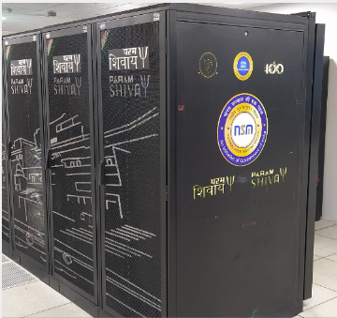
PARAM Shivay
The supercomputer with a capacity of 837 TFLOPS was created at the Indian Institute of Technology (IIT), Banaras Hindu University (BHU), at a cost of Rs 32.5 crore as part of the National Super Computing Mission.

Slide 62
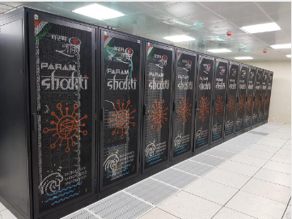
PARAM Shakti
The cutting-edge supercomputing system is a supercomputing facility developed at IIT Kharagpur as part of the NSM, having a peak computing capacity of 1.66 PetaFlops.
PARAM Shakti was created and commissioned by C-DAC to meet the computing demands of IIT Kharagpur and the region's neighboring research, engineering, and scientific establishments.

Slide 63
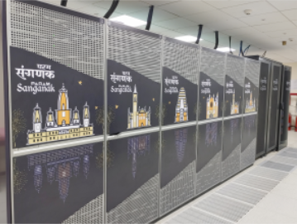
PARAM Sanganak
The supercomputing facility developed under the National Supercomputing Mission's construction method, with a peak computing capacity of 1.67 PetaFlops.
C-DAC constructed and commissioned PARAM Sanganak to meet the computing demands of IIT Kanpur and other regional research and engineering institutes.
It is powered by Intel Xeon Cascade Lake CPUs, and NVIDIA Tesla V100 and HDR100 graphics cards.

Slide 64
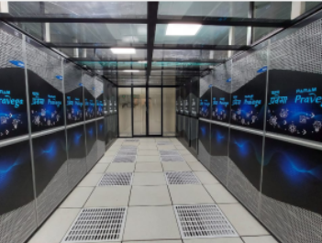
PARAM Pravega
The supercomputing facility is developed under the National Supercomputing Mission, with a peak computing capability of 3.3 PetaFlops.
C-DAC built and commissioned Param Pravega to meet the computing demands of IISc, Bengaluru.
It is powered by Intel Xeon Cascade Lake CPUs and NVIDIA V100 SXM2 graphics. The system is constructed using cutting-edge hardware and software technologies.

Slide 65
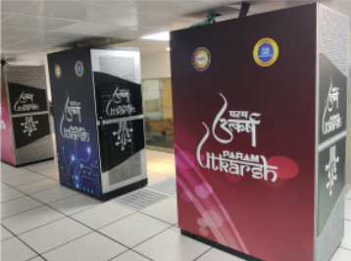
PARAM Utkarsh
PARAM Utkarsh is a High Performance Computing System hosted at C-DAC, Bangalore by the Government of India's National Supercomputing Mission (NSM).
PARAM Utkarsh is powered by an Intel Cascade Lake processor and an NVIDIA Tesla V100 GPU with a 100Gbps non-blocking infiniband connection. it is equipped with 50,000+ compute cores (CPU & GPU) and a liquid cooling system.
PARAM Utkarsh has a maximum computational power of 838 Teraflops.

Slide 66
Access Remote HPC Cluster

Slide 67
How to login to PARAM Utkarsh
Remote access from Linux Desktop
There is no need to install any extra packages because both Mac and Linux computers include an SSH client. Connect to an SSH server by entering the following command into the terminal :
Remote access from Windows Desktop
Any SSH client : MobaXterm/ Putty
$ ssh –X username@hostaddress
EX: $ ssh -X abc@paramutkarsh.cdacb.in
Enter the displayed Captcha (case sensitive)
Enter Password

Slide 68
Job Scheduler - SLURM
When you login to HPC cluster, you land on Login nodes
Login nodes are not meant to run jobs
These are used to submit jobs to Compute Nodes. You can setup your files and data on Login node. If compilation/installation of an application is required, user must do it on login node
To submit job on the cluster, you need to write a scheduler job script
SLURM – Simple Linux Utility for Resource Management
It is a workload manager that provides a framework for job queues, allocation of compute nodes, and the start and execution of jobs

Slide 69
SLURM
    How to set Environment ?
By default no applications set in your environment. User must explicitly set required ones
Module is the utility (also command name) to enable use of applications / libraries / compilers available on the HPC cluster
The purpose of module is to provide the production environment for a given application
Module structure on Cluster
  apps/<application name>/version : Application available on cluster
  complier/<compiler name>/version : Compilers available on the cluster
  lib/<library name>/version : Available libraries

Slide 70
SLURM Commands
$ sinfo Provides the basic information about the resources on HPC cluster like
    Partitions such as CPU/GPU/High memory nodes
    Number of nodes for each type and their names
    Status of the nodes
$ scancel <job ID> To cancel the submitted job
$ scontrol hold <job ID> To hold the job that is queued in system
$ scontrol release <job ID> To release the held job
$ scontrol show job <job ID> Provides information about submitted job
$ srun To get resources in interactive mode
EX: $ srun --partition=cpu --export=ALL --nodes=2 --ntasks=2 --mem=10G --time=00:30:00 --pty bash -i

Slide 71
Module
How to load module on PARAM Utkarsh?
To check the available software installed on HPC system:
$ module avail
  List of precompiled applications
  Different compilers and libraries (compilers include GNU, Intel, PGI)
To check the currently loaded modules in your shell
$ module list
To load a module use following command:
$ module load <module_name>
Module load compiler/intel/2018.2.199 (to set Intel compilers version 2018 in your environment)
Module load apps/namd/2.12/impi2018/cpu (to set NAMD app version 2.12 in your environment)

Slide 72
Designing and running first program on HPC

Slide 73
Compiling and executing the program
Module to be loaded
$module load compiler/intel/2018.4.057
Compilation:
$ mpicc mm_mpi.c -o mm_mpi1
Execution:
$ sbatch mm_mpi.sh

Slide 74
Job script to run in CPU nodes
#!/bin/sh
#SBATCH -N 2 # specify number of nodes
#SBATCH --ntasks-per-node=20 # specify number of cores per node (CPU max 48 cores in one node)
#SBATCH --time=06:50:20 # specify walltime in HH:MM:SS, max value 72:00:00
#SBATCH --job-name=mm_mpi # specify name of the job
#SBATCH --error=job.%J.err # specify error file name
#SBATCH --output=job.%J.out # specify output file name
#SBATCH --partition=cpu # name of the partition: available options "standard, cpu, gpu, hm"
ulimit -s unlimited
#list of modules you want to use, for example
module load compiler/intel/2018.4.057
#run the program
time mpirun -np 4 ./mm_mpi1

Slide 75
Job script to run in GPU nodes
#!/bin/sh
#SBATCH -N 2 # specify number of nodes
#SBATCH --ntasks-per-node=2 # specify number of cores per node (GPU max 2 cards in one node)
#SBATCH --time=06:50:20 # specify walltime in HH:MM:SS, max value 72:00:00
#SBATCH --job-name=mm_mpi # specify name of the job
#SBATCH --error=job.%J.err # specify error file name
#SBATCH --output=job.%J.out # specify output file name
#SBATCH --partition=gpu # name of the partition: available options "standard, cpu, gpu, hm“
ulimit -s unlimited
# list of modules you want to use, for example
module load compiler/intel/2018.4.057
# run the program
time mpirun -np 4 ./mm_mpi1

