Slide 1
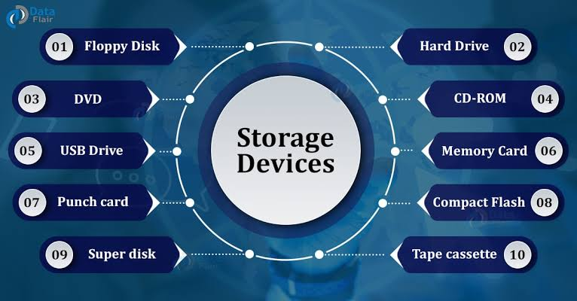
Storage Devices

Slide 2
Storage devices
Storage Devices
RAID Levels
File Systems
Storage Techniques

Slide 3
Storage Devices
Primary and Secondary.
Hard disk drives
Tape Drives
Cloud storage

Slide 4
HDD types
Parallel Advanced Technology Attachment (PATA)
Serial ATA (SATA)
Small Computer System Interface (SCSI)
Serial attached SCSI(SAS)
Solid State Drives (SSD)

Slide 5
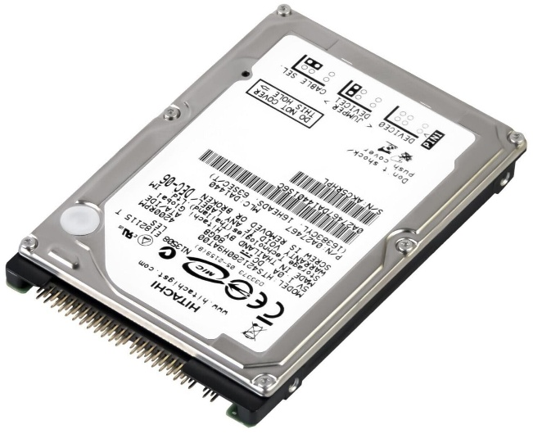
P A T A
Parallel ATA Standards
IDE & EIDE interfaces
Data transfer rate upto 133MB/s
Max 4 disks

Slide 6
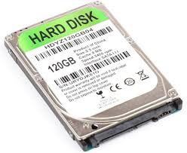
S A T A
More Flexible
One disk per controller
Higher storage capacity
Speed from 150MB/s
Hot plug

Slide 7
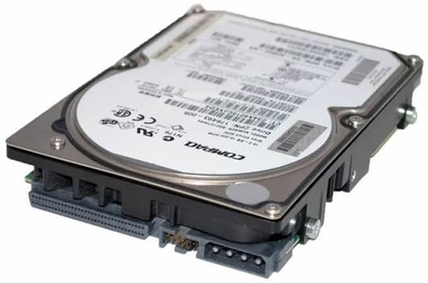
S C S I (small Computer System Interface)
Faster
More reliable
Greater scalability
Suited for large amount of data
Higher throughputs

Slide 8
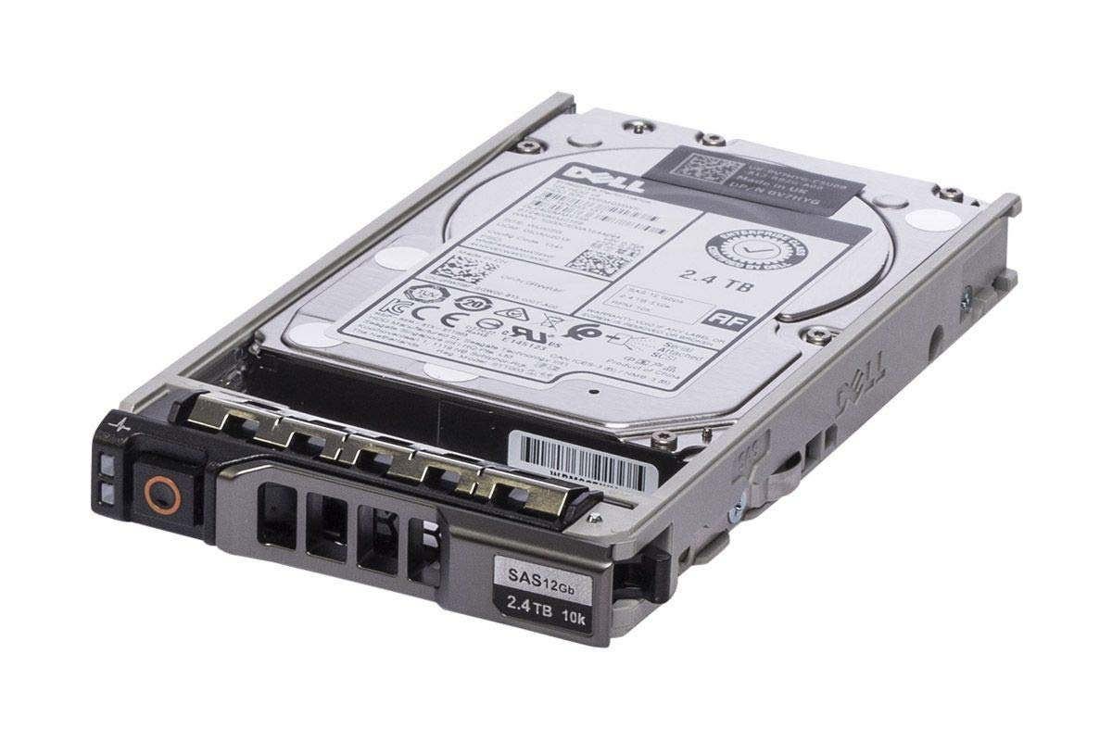
S A S (Serial Attached SCSI)
Replaces parallel SCSI
Data rate beyond 10Gb/s
Devices upto 65000
Supports dual ports for redundancy
Can connect SATA drives also

Slide 9
S S D ( Solid State Device)
Faster access
Less susceptible to shock
Low latency
Less power consumption

Slide 10
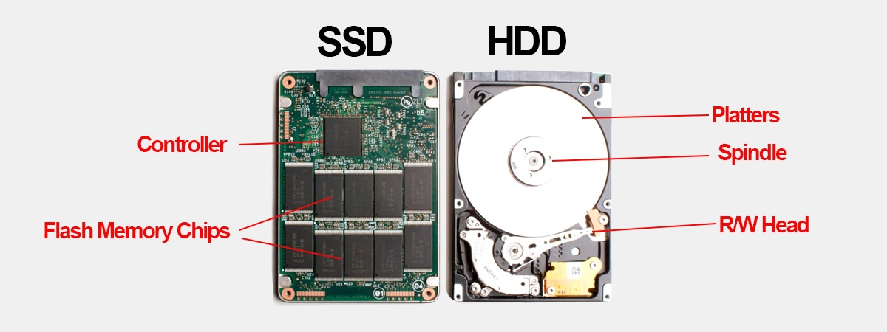
SSD vs HDD

Slide 11
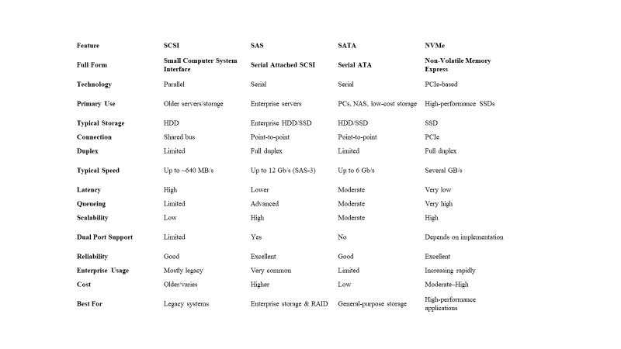
Drive Comparison

Slide 12
Speed Comparison
Interface | Approx. Theoretical Bandwidth
SCSI | ~0.64 GB/s
SATA III | ~0.6 GB/s
SAS-3 | ~1.5 GB/s per lane
NVMe PCIe Gen3 ×4 | ~3.9 GB/s
NVMe PCIe Gen4 ×4 | ~7.9 GB/s
NVMe PCIe Gen5 ×4 | ~15.8 GB/s

Slide 13
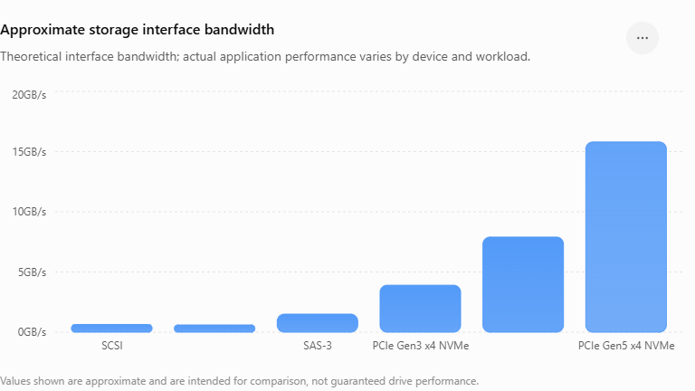

Slide 14
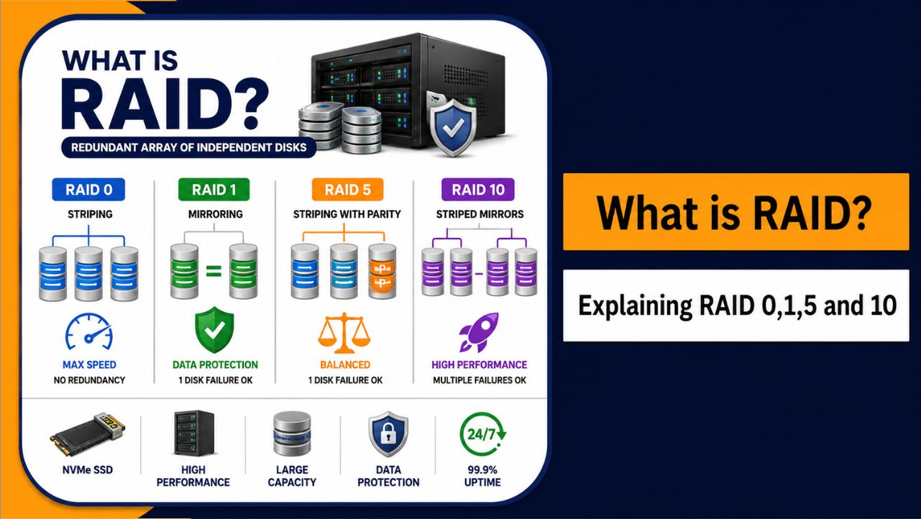
RAID (Redundant Array)

Slide 15
R A I D
Redundant Array of Inexpensive Disks
Basic idea is to connect multiple disks together to provide increased performance
large storage capacity
faster access to reading data
redundant data

Slide 16
R A I D levels
RAID Level 0
RAID Level 1
RAID Level 5
RAID Level 6
RAID Level 10

Slide 17

Striping
Take file data and map it to different disks
Allows for reading data in parallel

Slide 18
Mirroring
Keep two copies of data on two separate disks
Gives good error recovery
if some data is lost, get it from the other
source
Expensive
requires twice as many disks
Write performance can be slow
have to write data to two different spots.

Slide 19


Parity & RAID
Some RAID groups have one or more disk drives that contain parity information that allows them to rebuild data if a drive failure occurs. This parity information is derived from the data stored on the disk by using the logical ‘exclusive OR’ operation.

Slide 20
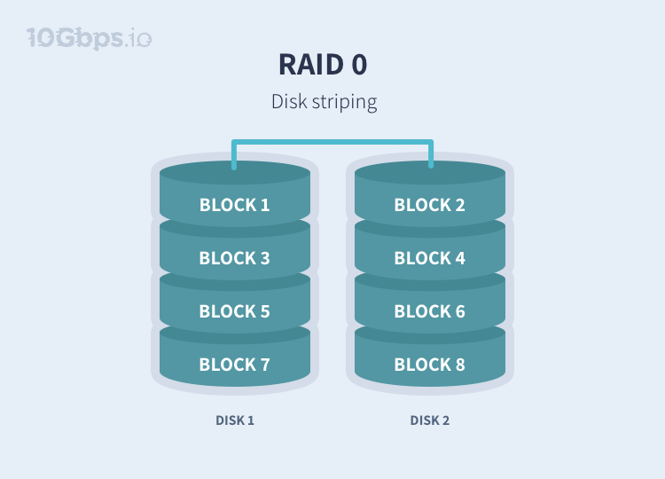
R A I D 0(Striping)

Slide 21
R A I D 0(Striping)
Minimum number of disks: 2
Pros: Increased performance (Write and read speeds).
Cons: No redundancy.
Business use: Live streaming, IPTV

Slide 22
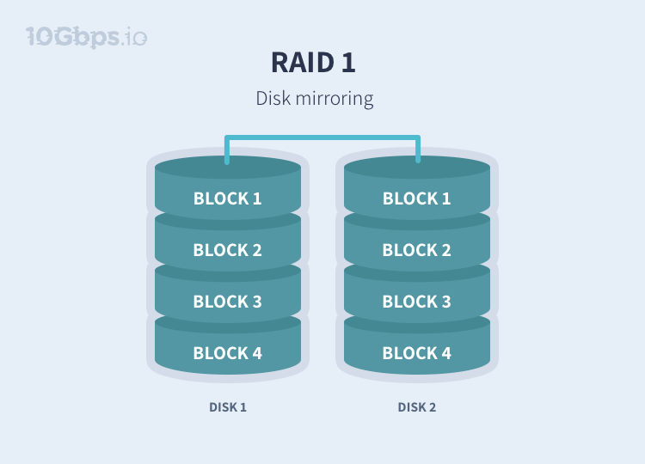
R A I D 1(Mirroring)

Slide 23
R A I D 1(Mirroring)
Minimum number of disks: 2
Pros: Fault tolerance and easy data recovery. Increased read performance.
Cons: Lower usable capacity. Higher cost per megabyte (double the amounts of drives is required to achieve desired capacity).
Business use: Standard application servers where data redundancy and availability is important.

Slide 24
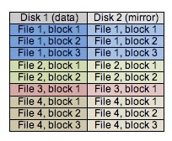
R A I D 1(Mirroring)

Slide 25
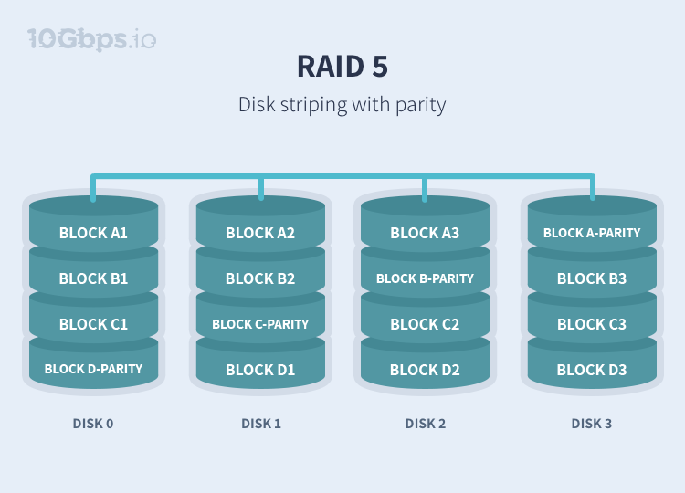
R A I D 5(Striping with parity)

Slide 26

R A I D 5
RAID5 is easily the most popular RAID level used today because it’s a great all-rounder.
RAID 5 incorporates striping of data just like in a RAID 0 array, however, in a RAID 5 the redundant pieces of parity data that are also distributed across the drives. Having the parity blocks staggered across each drive
allows any single drive in the RAID 5 array to fail without any data loss.

Slide 27
R A I D 5(Striping with parity)
Minimum number of disks: 3
Pros: Fault tolerance and increased performance (lower than RAID 0)
Cons: Lower performance with servers performing large amounts of write operations because of parity overhead.
Ideal use: File storage servers and application servers.

Slide 28
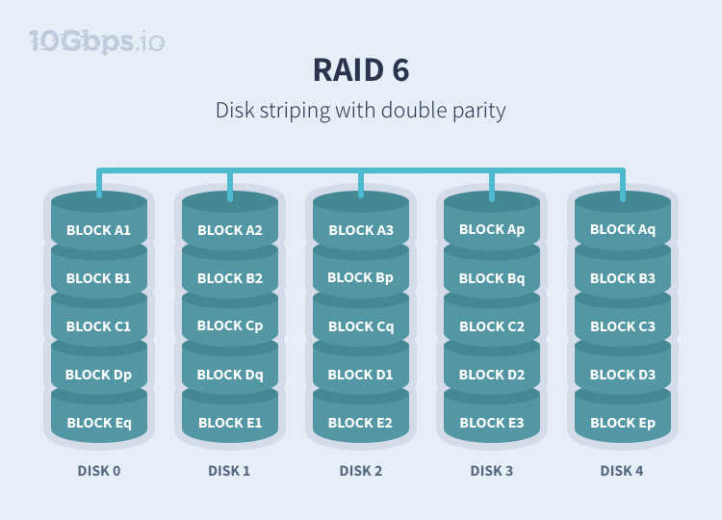
R A I D 6 (Striping with 2 parity)

Slide 29
R A I D 6 (Striping with 2 parity)
Minimum number of disks: 4
Pros: Even higher redundancy than RAID 5. Increased read performance.
Cons: Lower performance with servers performing large amounts of write operations because of parity overhead.
Ideal use: Large file storage servers and application servers.

Slide 30

R A I D 10
RAID0+1 is most easily described as a RAID1 of RAID0s, or a mirror of
two striped arrays.
No complex parity calculations
An inexpensive controller is sufficient for performance

Slide 31
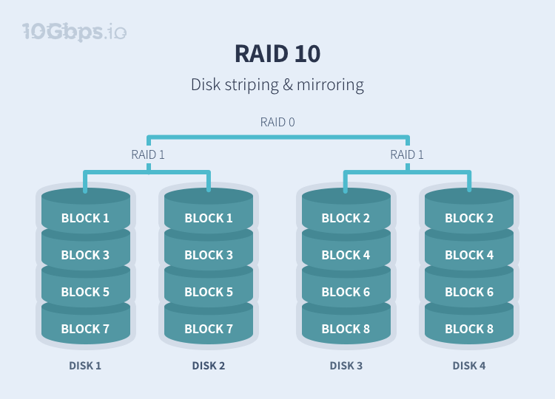
R A I D 10(striping + mirror)

Slide 32
R A I D 10(striping + mirror)
Minimum number of disks: 4
Pros: Very high performance. Fault tolerance.
Cons: Lower usable capacity/High cost. Limited scalability
Ideal use: Highly utilized database servers/ servers performing a lot of write operations.

Slide 33

R A I D 3 & 4
This level of RAID is relatively uncommon today, as in most situations where RAID3 could be used, RAID5 is a better choice. The exception to this is applications which require a very high sustained read rate, where
RAID3 marginally outperforms RAID5. In a home system, game levels faster from RAID3 than RAID5.
RAID3 is unique in that it uses byte level striping as opposed to block level striping. This means that every file is split up amongst the striped drives equally, byte-by-byte.

Slide 34
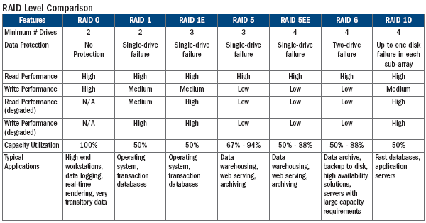
R A I D Comparison

Slide 35
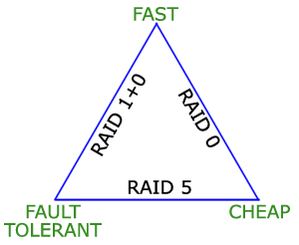
RAID Level to choose

Slide 36
File Systems
A filesystem is the methods and data structures that an operating system uses to keep track of files on a disk or partition;
the way the files are organized on the disk.
The word is also used to refer to a partition or disk that is used to store the files or the type of the filesystem.

Slide 37
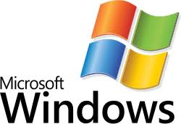
Windows File Systems
FAT
File Allocation Table
NTFS
New Technology File System

Slide 38

Linux File Systems
EXT2/3/4 – Journaling file systems
JFS
ReiserFS
XFS

Slide 39
NFS (Network File System)
Network File System (NFS) is a distributed file system protocol for allowing a user on a client computer to access files over a computer network much like local storage is accessed.

Slide 40
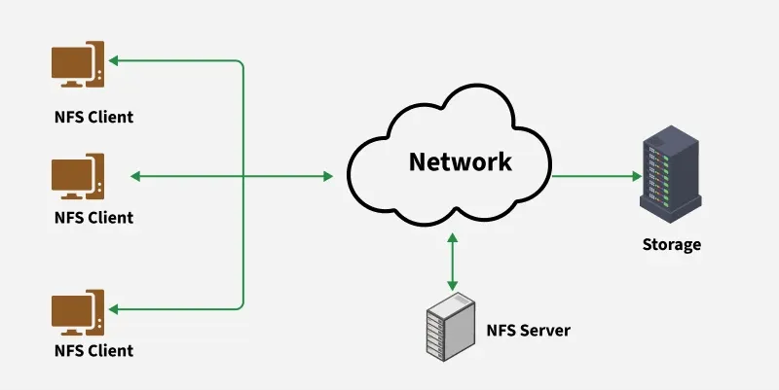
Network File System(NFS)

Slide 41
Storage Devices
DAS – Direct Attached Storage
NAS – Network Attached Storage
SAN – Storage Area Network

Slide 42
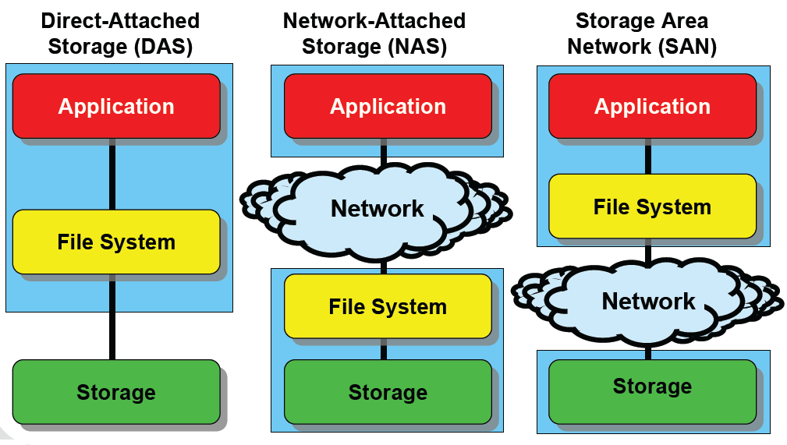

Slide 43
D A S (Direct Attached Storage)
A disk subsystem is attached directly to HBAs in one or
more hosts. This is also called server-centric storage
because it is captured and physically cabled to the server.
Ideal for local data provisioning
Quick deployment for small environments
Simple to deploy in simple configurations
Reliability
Low capital expense
Low complexity

Slide 44
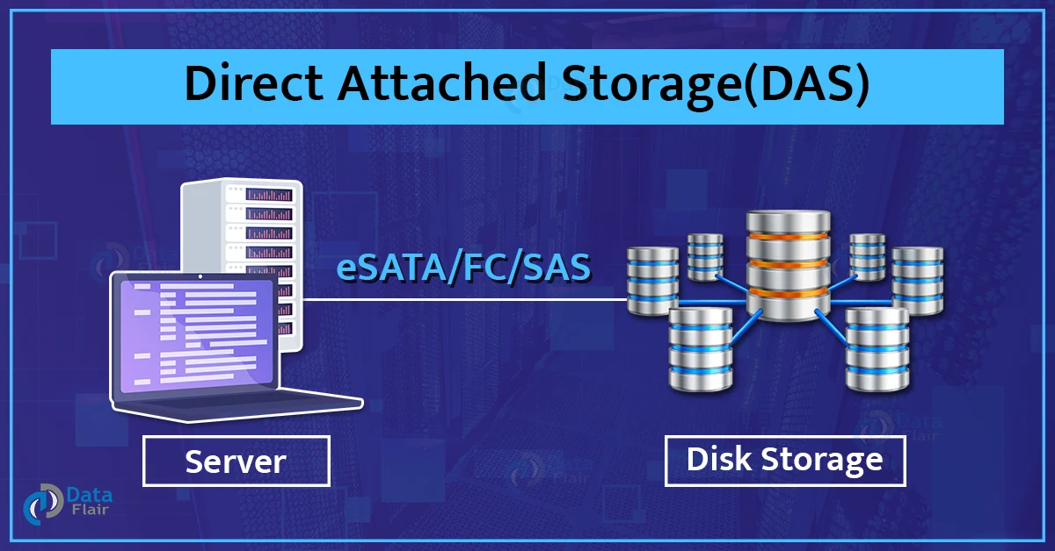
Direct Attached Storage

Slide 45
Physical Elements of DAS
Parallel SCSI and serial attached SCSI (SAS) are
technologies designed to be inside DAS or within a storage array.
They are not viable SAN technologies.

Slide 46
DAS Management
Host provides:
Disk partitioning (Volume management)
File system layout
Data addressing
Direct Attached Storage managed individually through the server and the OS

Slide 47
DAS Challenges
Hosts must be directly connected
Data availability issues
Many single points of failure, (Bus, multiple path software, host, application)
Data slowdowns possible
CPU congestion, caching, multi-pathing
Volumes are not globally available to all hosts
Scalability concerns

Slide 48
DAS Challenges
Scalability is limited
Number of connectivity ports to hosts
Number of addressable disks
Distance limitations
Downtime required for maintenance

Slide 49
Network Attach Storage(NAS)
Network-attached storage is a file-level computer data storage server connected to a computer network providing data access to a heterogeneous group of clients.
NAS is specialized for serving files either by its hardware or software.

Slide 50
N A S
The advantage to this method is that several servers can share storage on a separate unit.
Unlike DAS, each server does not need its own dedicated storage which enables more efficient utilization of available storage capacity.
The servers can be different platforms as long as they all use the IP protocol.

Slide 51
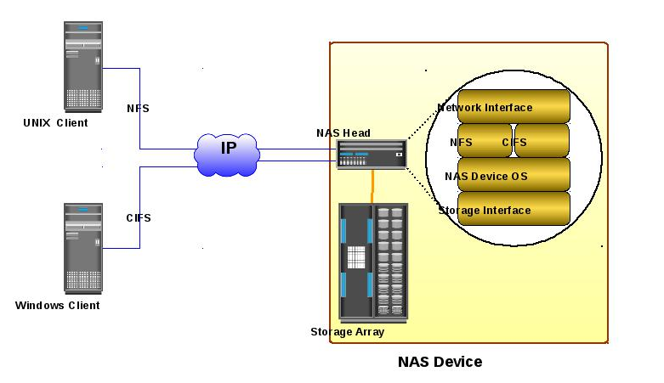
N A S

Slide 52
Why NAS?
Supports global information access
Improves efficiency
Provides flexibility
Centralizes storage
Simplifies management
Scalability
High availability – through native clustering
Provides security integration to environment (user authentication and authorization)

Slide 53
Storage Area Network(SAN)
SANs are primarily used to enhance storage devices, such as disk arrays and tape libraries, accessible to servers so that the devices appear to the operating system as locally attached devices.

Slide 54
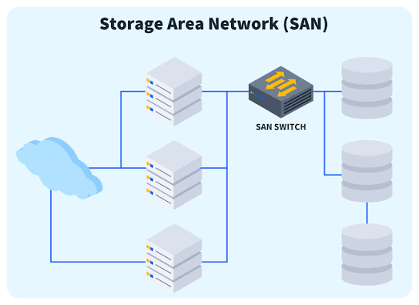
SAN Storage

Slide 55
S A N
Principal Components of SAN are
- Cable
HBA
Switches

Slide 56
SAN cabling
FC is a high-speed data transmission technology used to connect multiple hosts and storage devices over fiber-optic or copper cables.
Fibre Channel (FC) SANs have the reputation of being expensive, complex and difficult to manage.

Slide 57
Single-Mode Fiber or Multimode Fiber
Single-mode fiber is used for longer distances and multimode fiber for shorter distances. Single-mode fiber has a much smaller core than multimode fiber and is designed for transmission of a single ray or mode of light as a carrier.
Multimode is designed to carry multiple light rays or modes concurrently, each at a slightly different reflection angle within the optical fiber core.

Slide 58
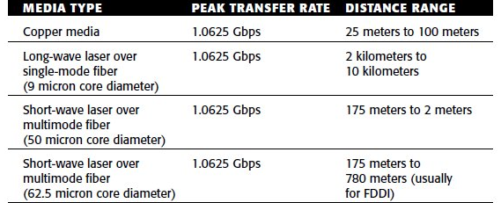
Single-Mode Fiber or Multimode Fiber

Slide 59
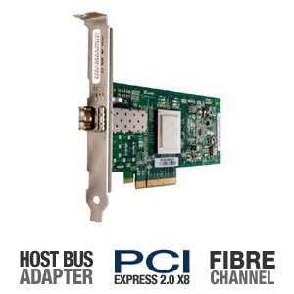
Host bus Adapter(HBA)

Slide 60
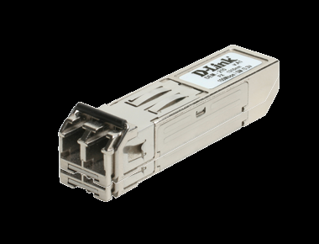
HBA Interface

Slide 61
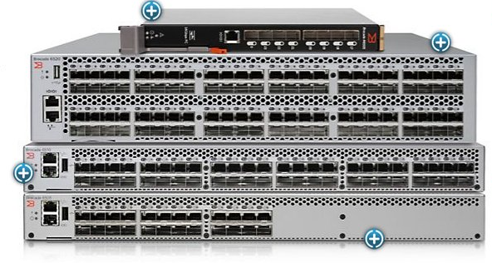
SAN Switch

Slide 62
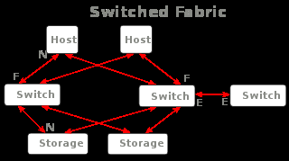
SAN Fabric
The hardware that connects workstations and servers to storage devices in a SAN is referred to as a "fabric." The SAN fabric enables any-server-to-any-storage device connectivity through the use of Fibre Channel switching technology.

Slide 63
SAN Topologies
Point to Point topology
FC-AL
Switched Fabric

Slide 64
SAN High Availability
SANs can be classified into the following three availability
levels:
● Level 1 —Path-level redundancy
● Level 2 —Switch-level redundancy
● Level 3 —Fabric-level redundancy

Slide 65
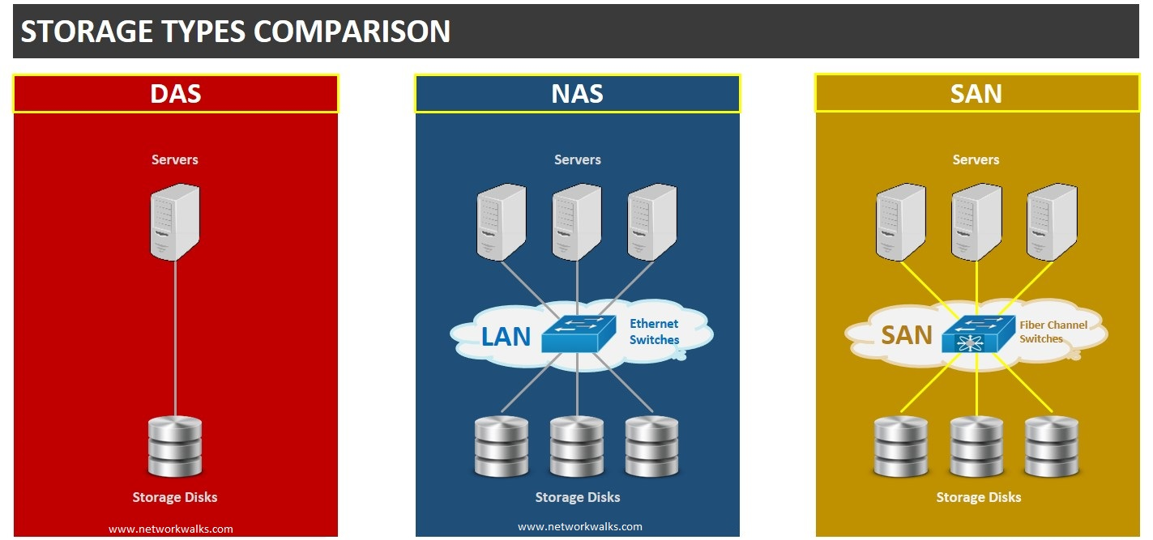

Slide 66
