Slide 1
Analysis on Effects of News Sentiments on Stock Predictions
TEAM 59

Slide 2
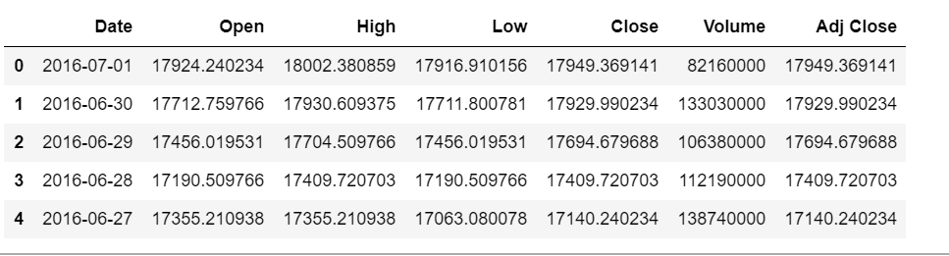
Stocks
A stock is a general term used to describe the ownership certificates of any company. A share, on the other hand, refers to the stock certificate of a particular company.

Slide 3
Terms Related to Stocks
Open - The opening price is the price at which a security first trades upon the opening of an exchange on a trading day
When trading is done for the day on a recognized exchange, all stocks are priced at close. The price that is quoted at the end of the trading day is the price of the last lot of stock that was traded for the day and is closing stock.
The price of this stock is the closing stock.
The closing price of a stock is only its cash value at day's end, whereas the adjusted closing price factors in things like dividends, stock splits and new stock offerings.
The adjusted closing price reflects the change in stock value caused by new offerings from the corporation. New offerings are when a corporation may choose to offer additional shares of stock

Slide 4
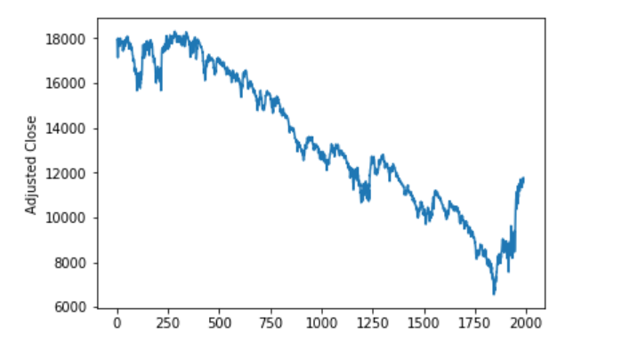
Dow Jones Industrial Average
The Dow Jones Industrial Average (DJIA), or simply the Dow is a stock market index that indicates the value of 30 large, publicly owned companies based in the United States, and how they have traded in the stock market during various periods of time. These 30 companies are also included in the S&P 500 Index.

Slide 5
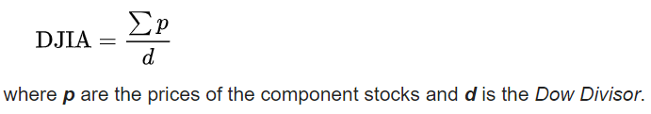
The value of the Dow is not a weighted arithmetic mean^{[5]} and does not represent its component companies' market capitalization, but rather the sum of the price of one share of stock for each component company.
To calculate the DJIA, the sum of the prices of all 30 stocks is divided by a divisor, the Dow Divisor. The divisor is adjusted in case of stock splits, spinoffs or similar structural changes, to ensure that such events do not in themselves alter the numerical value of the DJIA. This initially made the DJIA a simple arithmetic average. The present divisor, after many adjustments, is less than one :

Slide 6
Why do Stock prices change based on News reports?
Negative news will normally cause individuals to sell stocks. Bad earnings reports, poor corporate governance, economic and political uncertainty, as well as unexpected, unfortunate occurrences will translate to selling pressure and a decrease in stock price.
Positive news will normally cause individuals to buy stocks. Good earnings reports, increased corporate governance, new products and acquisitions, as well as positive overall economic and political indicators, translate into buying pressure and an increase in stock price.
But it's difficult, if not impossible, to capitalize on news. The impact of new information on a stock depends on how unexpected the news is. This is because the market is always building future expectations into prices.

Slide 7
Natural Language Processing
Natural Language Processing, or NLP for short, is broadly defined as the automatic manipulation of natural language, like speech and text, by software.
Natural Language
It refers to the way we, humans, communicate with each other.
Think about how much text you see each day:
Signs
Menus
Chats
Email
SMS

Slide 8
NLP is used to analyze text, allowing machines to understand how human’s speak. This human-computer interaction enables real-world applications like automatic text summarization, sentiment analysis, topic extraction, named entity recognition, parts-of-speech tagging, relationship extraction, stemming, and more. NLP is commonly used for text mining, machine translation, and automated question answering.
Sentiment Analysis:
Sentiment analysis is contextual mining of text which identifies and extracts subjective information in source material, and helping a business to understand the social sentiment of their brand, product or service while monitoring online conversations.
The applications of sentiment analysis are broad and powerful. The ability to extract insights from social data is a practice that is being widely adopted by organisations across the world.
Shifts in sentiment on social media have been shown to correlate with shifts in the stock market.

Slide 9
Market Sentiment
Market sentiment refers to the overall attitude of investors toward a particular security or financial market. It is the feeling or tone of a market, or its crowd psychology, as revealed through the activity and price movement of the securities traded in that market.
Investors typically describe market sentiment as bearish or bullish. When bears are in control, stock prices are going up. When bulls are in control, stock prices are going down. Emotion often drives the stock market, so market sentiment is not always synonymous with fundamental value. That is, market sentiment is about feelings and emotion, whereas fundamental value is about business performance.

Slide 10
Frequency Based Sentiment Analysis
Rule Based Sentiment Model:-
We added some rules to take into account negations, intensity markers (“more”, “extremely”, “absolutely”, “the most”, …), nuance, and other semantic structures that appear very often near sentimental phrases and change their meanings
For eg : “The food wasn’t very tasty”, we want to understand that “not very tasty” is less negative than “not tasty” or “not tasty at all”.
When we process a given sentence, we attribute every word a positive and a negative score and calculate the overall scores by a precise analysis of the semantical structure.

