Slide 1
Store Management System
VibeHub

Slide 2
WHAT THE PROJECT IS?
ENTERTAINMENT STORE MANAGEMENT SYSTEM.
The project aims to deliver a comprehensive solution designed to redefine how VibeHub operates and manages their entertainment retail business. The proposed outcome is a tailored application that addresses the unique challenges and demands of the entertainment industry.

Slide 3
Idea Behind Choosing It
The idea behind choosing this topic for our project was to design a comprehensive system which allows us to implement the knowledge the gained throughout the coursework and think of database designing from a technical as well as business perspective. Entertainment being a major industry in the modern business world made this project lucrative to start with.

Slide 4
DATASET
Our dataset consists of tables which are mostly in the third normal form. The columns are selected such that the required atomic data can be fetched from them. Other columns selected are used to enforce the entity integrity and preserve the referential integrity in the database.

Slide 5
Lookup Tables
Table Name | Columns
genre_lookup | genre
state_lookup | state_value
status_lookup | txn_status
category_lookup | category

Slide 6
MAIN TABLES
01
02
03
STORES
EMPLOYEES
CUSTOMERS
STORE_ID
STORE_STREET
STORE_CITY
STORE_STATE
STORE_COUNTRY
STORE_ZIPCODE
STORE_PHONE
STORE_EMAIL
EMPLOYEE_ID
EMPLOYEE_FIRSTNAME
EMPLOYEE_LASTNAME
EMPLOYEE_SSN
EMPLOYEE_EMAIL
EMPLOYEE_PHONE
EMPLOYEE_DOB
EMPLOYEE_STORE_ID
EMPLOYEE_SALARY
EMPLOYEE_JOBTITLE
EMPLOYEE_JOINING_DATE
EMPLOYEE_TERMINATION_DATE
EMPLOYEE_PASSWORD
CUSTOMER_ID
CUSTOMER_FIRSTNAME
CUSTOMER _LASTNAME
CUSTOMER _EMAIL
CUSTOMER _PHONE
CUSTOMER _DOB
CUSTOMER _AGE
CUSTOMER_RENTAL_COUNT
CUSTOMER_LATE_COUNT
CUSTOMER_PASSWORD

Slide 7
MAIN TABLES
04
05
06
STORE INVENTORY
ITEMS
RATINGS
ITEM_ID
ITEM_NAME
ITEM_CATEGORY
ITEM_GENRE
ITEM_PRICE
ITEM_LATE_FEE
ITEM_AVG_RATING
ITEM_TOTAL_RATINGS
RATING_ID
RATING_BY_CUSTOMER_ID
RATING_ITEM_ID
RATING_VALUE
RATING_COMMENT
INVENTORY_STORE_ID
INVENTORY_ITEM_ID
ACTUAL_QUANTITY
AVAILABLE_QUANTITY

Slide 8
MAIN TABLES
07
TRANSACTIONS
TRANSACTION_ID
TRANSACTION_EMPLOYEE_ID
TRANSACTION_CUSTOMER_ID
TRANSACTION_ITEM_ID
TRANSACTION_STORE_ID
TRANSACTION_RENTAL_DATE
TRANSACTION_ESTIMATED_RETURN_DATE
TRANSACTION_ACTUAL_RETURN_DATE
TRANSACTION_STATUS
TRANSACTION_AMOUNT

Slide 9
MODELLING
Our initial Conceputal Model was developed in line with the Business Requirements we decided.
The logical model was derived from the conceptual model based on our implementation in SQL Server keeping in mind the nuances of this DBMS. There were some changes made to the logical model to fit the operations.

Slide 10
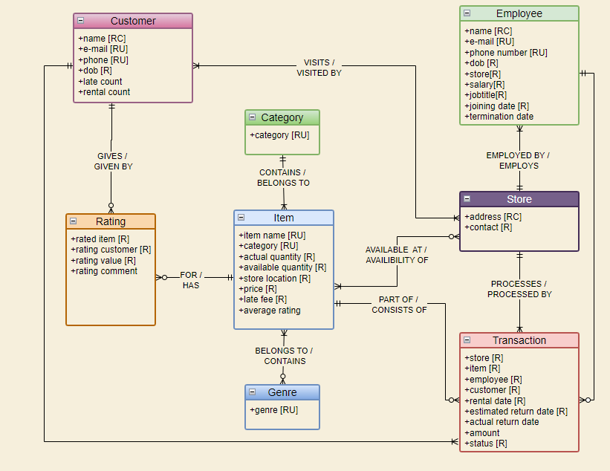
MODELLING
Conceptual Data Model

Slide 11
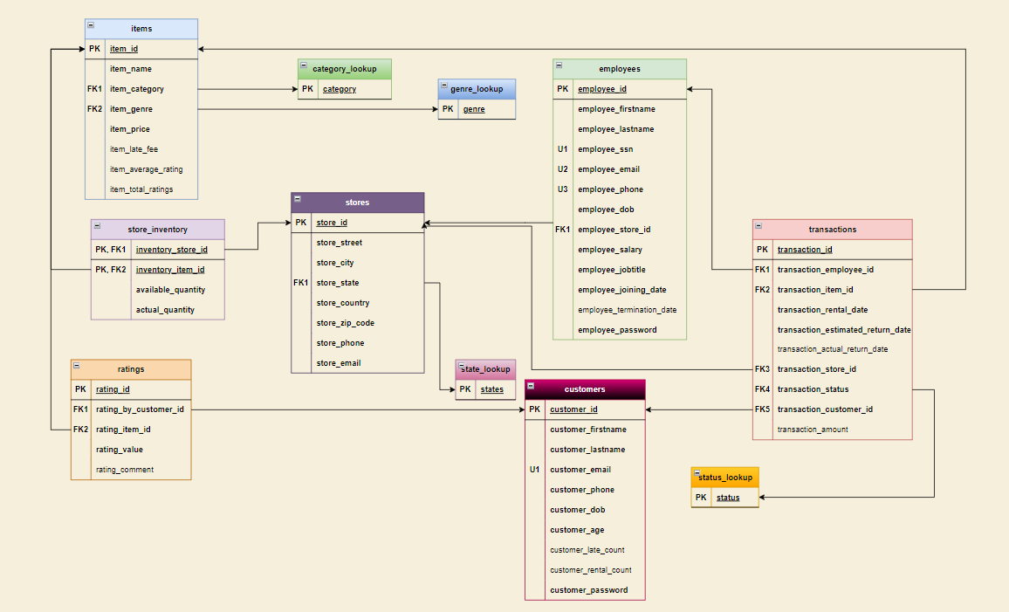
MODELLING
Logical Data Model

Slide 12
Programmability
AREAS OF IMPROVEMENT
Features
More features can be added for which we have a provision in our database such as Ratings, Insights, etc.
PowerApps does not support Triggers, Procedures and other programmability features. Thus, the automation and Programmability aspect of this project can be improved.

Slide 13
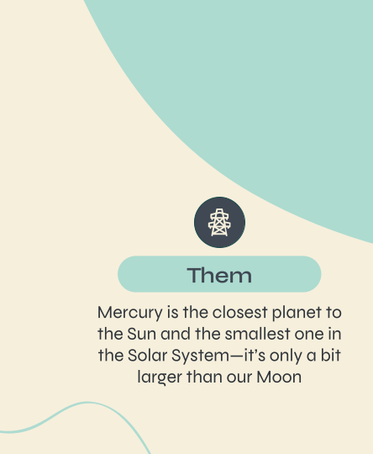
PRODUCT DEMO

Slide 14
TEAM DataDynamos
Pratik Barot
Mayura Vartak
prbarot@syr.edu
mvartak@syr.edu

