Slide 1
DataSmith AI
Multi-Modal Agentic AI Application
Text · Images · PDFs · Audio · YouTube
Built with FastAPI · LangChain · Groq · Qdrant · Whisper

Slide 2
Problem Statement
Why does this need to exist?
Users deal with content in many formats — PDFs, images, audio, videos — with no single tool to handle all of them.
Most AI assistants are stateless: they can't refer back to a file you uploaded two messages ago.
Generic chatbots guess at your intent instead of asking a clarifying question when something is unclear.
Switching between transcription tools, OCR tools, and summarizers is slow and fragmented.
There is no lightweight, self-hosted alternative that avoids sending sensitive documents to external cloud APIs.

Slide 3
Solution — DataSmith AI
One agent. Any file. Any task.
DataSmith AI is an agentic application that accepts any file type, extracts its content, understands what the user wants to do, and autonomously executes the right task — or asks a smart follow-up question if the intent is unclear.
Any Input
Smart Routing
• Text prompts
• LLM-based intent detection
• JPG / PNG images
• Clarifies before acting
• PDFs (text + scanned)
• Audio auto-summarizes
• MP3 / WAV / M4A audio
• Context-aware follow-ups
• YouTube links
All Local
Live Feedback
• Whisper runs on-device
• WebSocket streaming
• BGE-M3 embeddings local
• Token-by-token output
• Qdrant local file store
• Execution log panel
• No sensitive data leaves
• Per-request cost display

Slide 4
Key Features
Everything the rubric asked for — and more
OCR extraction with confidence scoring
Sentiment analysis: label + confidence + justification
PDF parsing + automatic OCR fallback for scanned pages
Code explanation: language, bugs, time complexity
Whisper speech-to-text with audio duration
Action item extraction from meeting notes
YouTube transcript fetching from any URL
RAG Q&A using hybrid dense + sparse retrieval (RRF)
Summarization: 1-line + 3 bullets + 5-sentence paragraph
Conversational answering for general questions

Slide 5
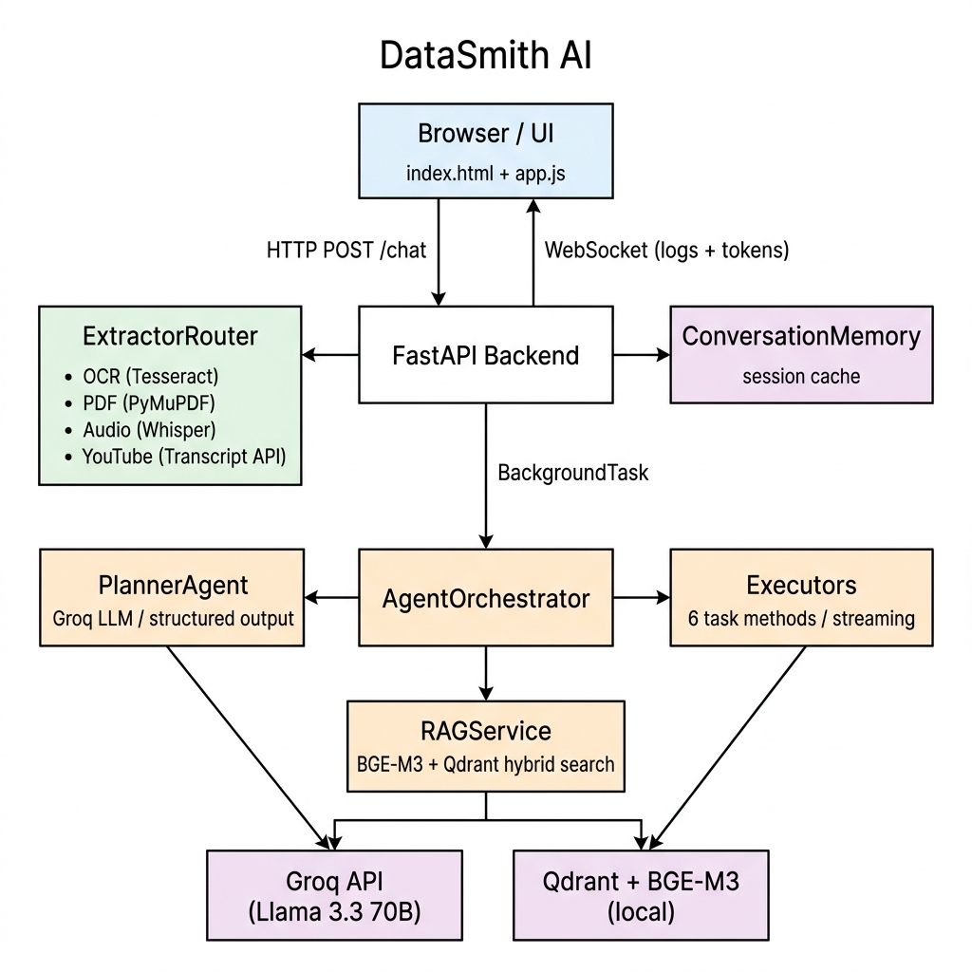
How It Works
End-to-end request flow
1
User Input
Types a message or uploads a file. Session ID generated in browser.
2
Extraction
ExtractorRouter picks the right service: OCR / PyMuPDF / Whisper / YouTube.
3
Memory Check
If follow-up text: inject previous document context from ConversationMemory.
4
Intent Planning
PlannerAgent (Groq LLM) classifies task or asks a clarification question.
5
Task Execution
Correct Executor is called via dynamic dispatch. Streams tokens over WebSocket.
6
RAG (if needed)
Document Q&A: BGE-M3 encodes query → Qdrant hybrid search → inject context.
7
Result Delivery
Final answer + execution logs + cost estimate sent to the browser.

Slide 6
Architecture Overview
Multi-layer, event-driven design
Frontend
Browser / app.js
HTTP POST + WebSocket
API Layer
FastAPI routes.py
Extraction · Memory · BG Task
Agent Layer
Orchestrator · Planner · Executors · RAG
Dynamic dispatch · Streaming · Hybrid search
Storage
Groq API (cloud) + Qdrant + BGE-M3 (local)
LLM inference · Vector retrieval

Slide 7
Tech Stack
Everything runs locally except the LLM API call
Backend
LLM / AI
Extraction
• FastAPI
• Groq API
• Whisper (local)
• Python 3.12
• Llama 3.3 70B
• Tesseract OCR
• Uvicorn
• LangChain Groq
• PyMuPDF
• LangChain
• tiktoken (cost)
• YouTube Transcript API
RAG / Vectors
Frontend
Dev / Infra
• Qdrant (local)
• HTML / CSS / JS
• pytest
• BGE-M3 (local)
• WebSocket API
• python-dotenv
• FlagEmbedding
• Fetch API
• pydantic-settings
• RRF Fusion
• marked.js (markdown)
• FFmpeg + Tesseract (sys)

Slide 8
Bonus Features
Going beyond the rubric requirements
Multi-Agent Orchestration
Cost Estimator
PlannerAgent and Executors are completely separate classes with no shared state. Clean handoff: Planner classifies → Orchestrator dispatches → Executor streams.
Every request shows an estimated API cost before execution using tiktoken token counts and real Groq pricing ($0.59/1M input tokens). Displayed live in the UI.
Hybrid RAG (Dense + Sparse)
Session Conversation Memory
BGE-M3 generates both dense and sparse (lexical) vectors. Qdrant fuses results using Reciprocal Rank Fusion for better accuracy than cosine similarity alone.
ConversationMemory caches the last extracted document per session. Follow-up messages automatically get document context injected — no re-upload needed.
Audio Auto-Summarize
OCR Confidence Scoring
If audio/video is uploaded with no explicit instruction, the orchestrator bypasses the ambiguity check and defaults straight to summarization.
Tesseract confidence scores are averaged per extraction. If avg < 80%, a warning is automatically prepended to the extracted text.

Slide 9
DataSmith AI
Thank You
✔ Multi-modal input (Text · Image · PDF · Audio · YouTube)
✔ Agentic intent detection with clarification logic
✔ Real-time streaming via WebSocket
✔ Local RAG with hybrid dense + sparse retrieval
✔ Cost estimation · OCR confidence scoring · Audio duration

