Slide 1
Android Mobile Application
Canteen Application
Gateway to the dynamic Android Application of Canteen and hotels in the country. A component of canteen management, developed under BSC-IT education Project. Which is useful for canteen managers and its helps peoples to get online order, you can also use these app to order online food

Slide 2
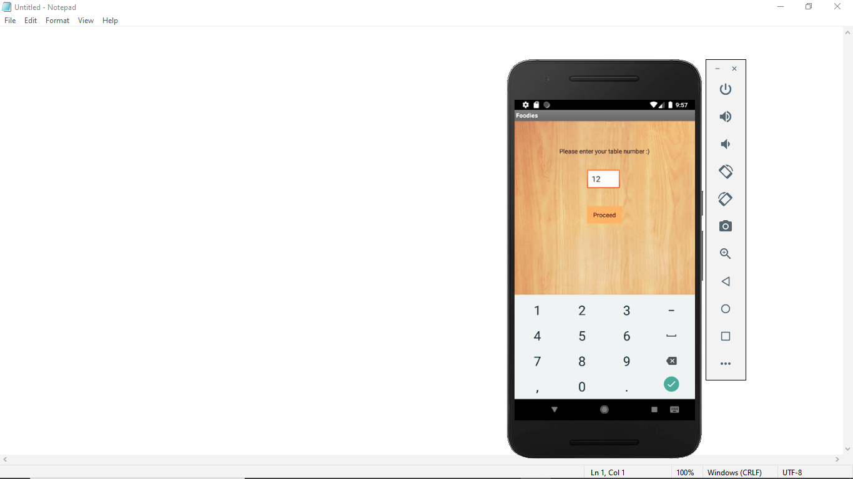
HOME SCREEN
Now you can see the home screen of our application
It will show following option
Like:
1} Table Number
2} Food Types
3} Food Item
4} Billing
5} Receipt
6} Help
You can select any Option here like
Proceed

Slide 3
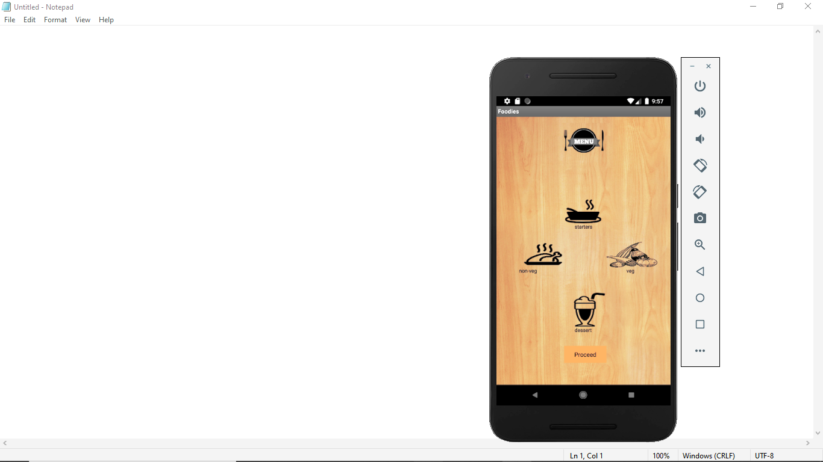
Open Your Application
When you click on you will see these page
Proceed
1} you will see the Food Types
A} Starters
B} Veg
C} Non-Veg
D} Dessert

Slide 4
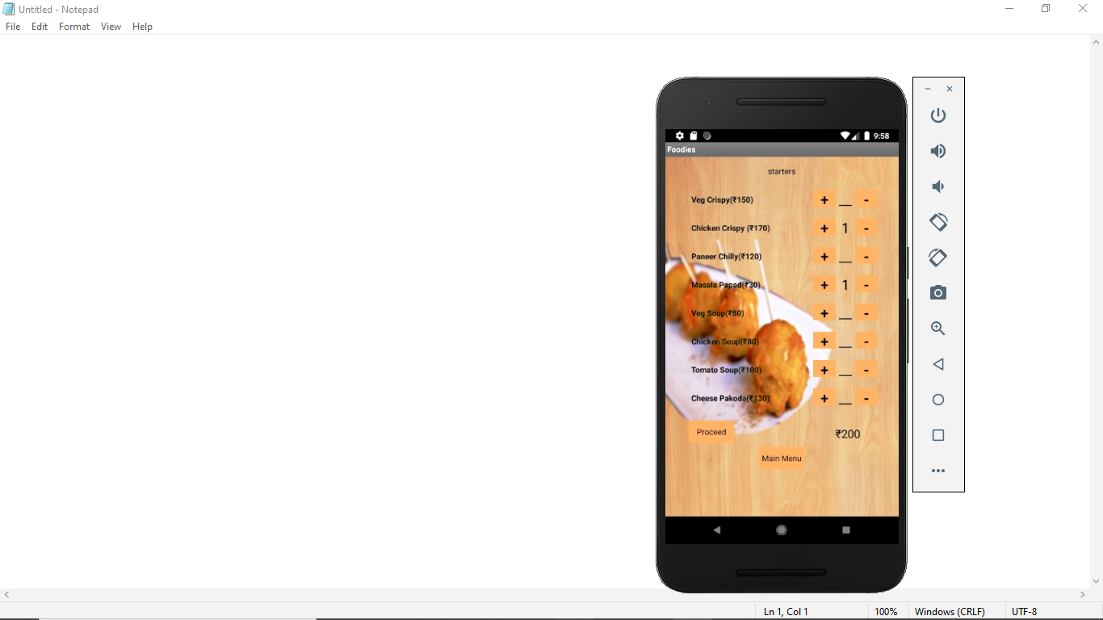
Open Your Application
When you click on you will see these page
Proceed
1} you will see the Food Items
2} then select item quantity then proceed
3} it’s automatically calculated your order
Now you can pay bill

Slide 5
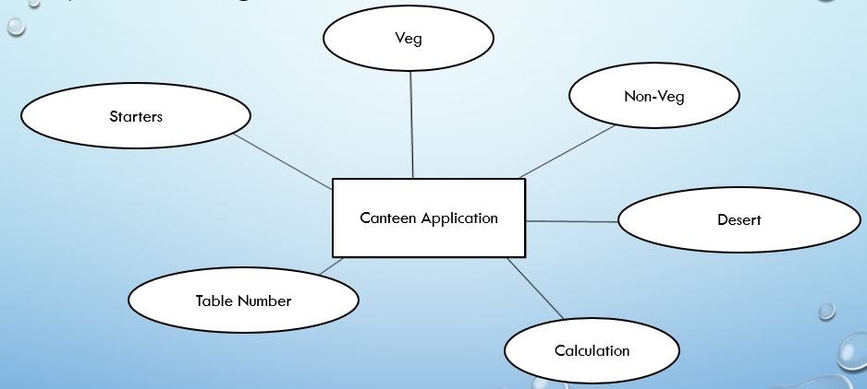
1) Data flow diagram :

Slide 6
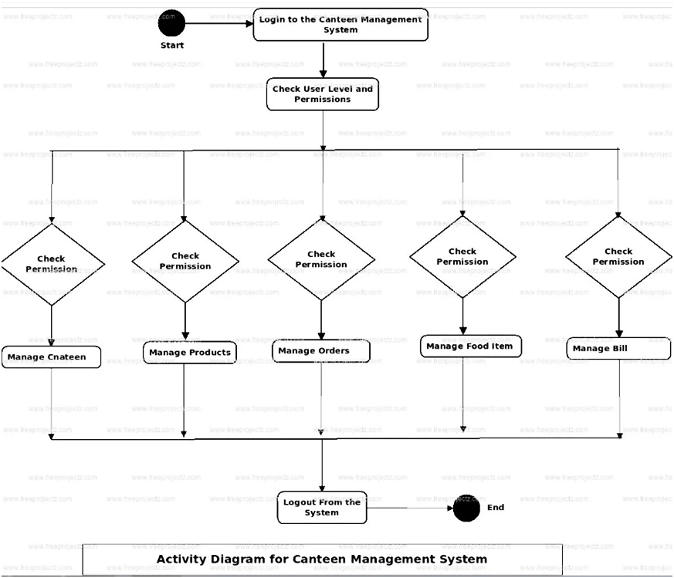
2} Activity Diagram:

Slide 7
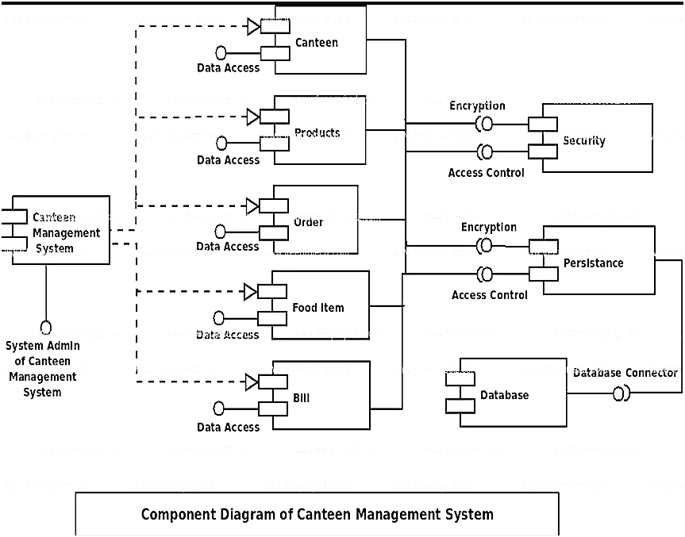
3) Use case diagram:

Slide 8
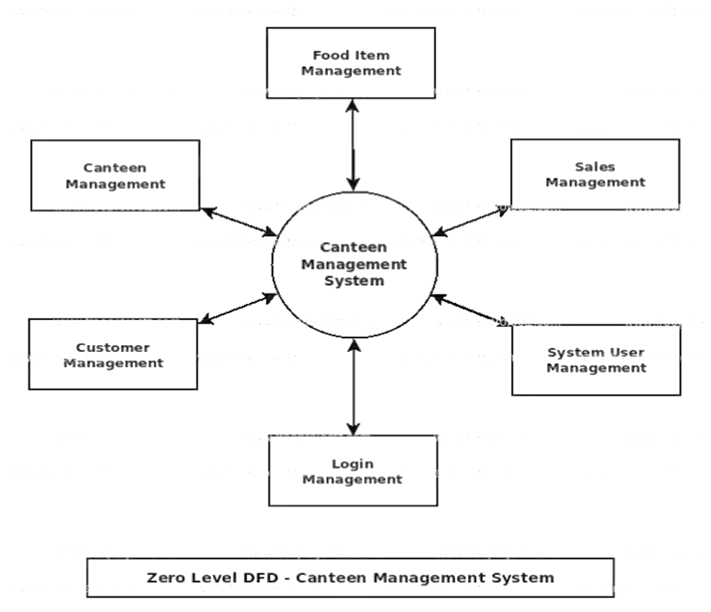
4) Component Diagram:

Slide 9
6) Flow chart diagram of
“CANTEEN APPLICATION”
Start
Start the application
Enter the table number.
Select option from list of services.
If selected to desert.
Enter details.
Proceed orders.
If selected to veg and no-veg
Enter input details
Save data.
If select to pay a water
Enter input details
Save and print –the bill
Stop
Enter Table Number
Services
Desert, Veg & Non-Veg
Save Data
Send A Request
Print
Receive Response
Print
Stop

Slide 10
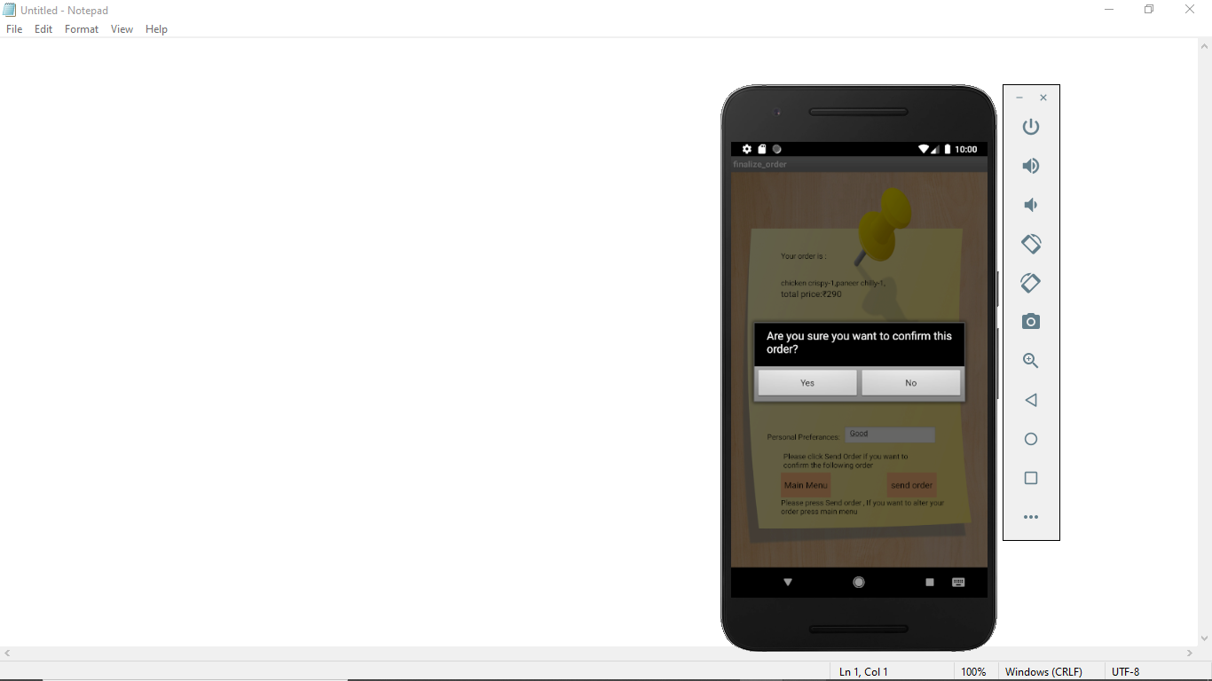
Reference:
1}websites
www.Microsoft.org
www.slideshare.com
www.androidtutoriallpoint.com
www.wikipedia.com
www.youtube.com
www.google.com
2}Books
Advance mobile programing

Slide 11
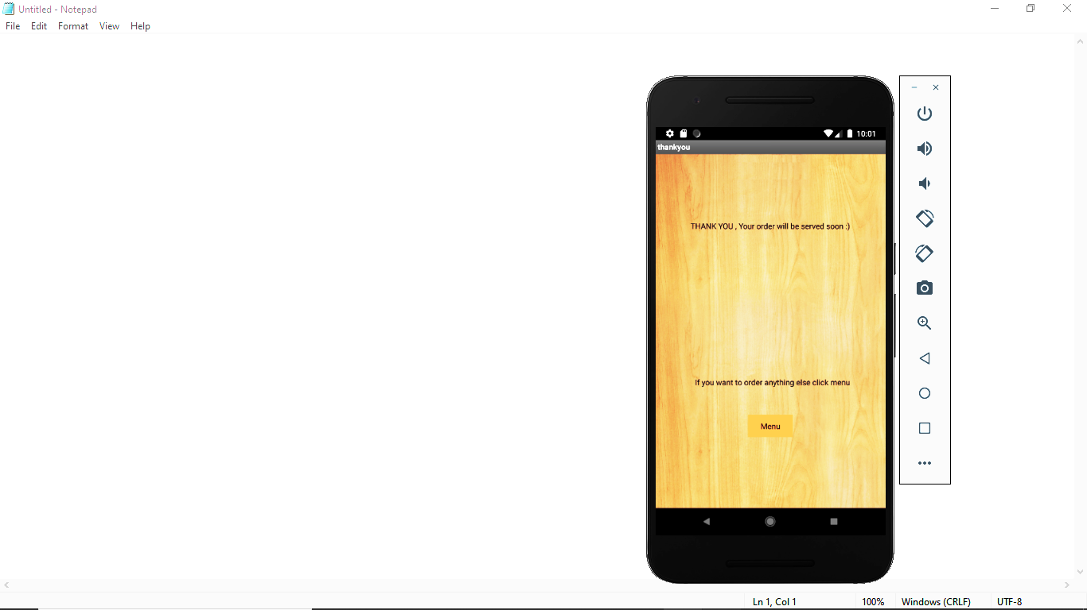
THANK YOU
For
Watching
And I hope You Like this Presentation

