Slide 1

FIRE_FIGHTING_ROBOT
Fire fighting is an important job but it is very dangerous occupation. Due to that, Robots are designed to find a fire, before it rages out of control. It could be used to work with fire fighters to reduce the risk of injury to victims. The robot development is consisting of three elements which is the hardware, electronic, and programming.

Slide 2

INTRODUCTION
Aims to develop microcontroller based fire fighting robot.
Monitors the areas where natural calamities and bomb explosion occurs.
Sense fire, smoke and temperature at the site of disaster by using flame and smoke sensors mounted on the robot.
If fire is detected with the help of sensors , MCU operates water pump mechanism.

Slide 3


PROJECT OBJECTIVES
To develop and design a fire fighting robot by using Arduino microcontroller.
Design and development of low cost fire fighting robot.
To design a robot that is able to avoid obstacles, detect fire next extinguish fire.
Run automatically fire fighting robot.
To determine the use of multiple sensor for various sensing on the robot.
To reduce and save human life especially fireman who expose to danger while extinguish the fire.

Slide 4

EXISTING SYSTEM
Fire Hydrant System
Fire Sprinkler System
Fire Alarm System
Deluge System
Foam Top pourer System
CO2 Gas Suppression System
Fire Vehicle
Manual Fire Fighting Vehicle
Now moving to the proposed system automated with the use of fire ir sensor, identifying fire and while ensuring human safety we can also see a few more advantages as following.

Slide 5
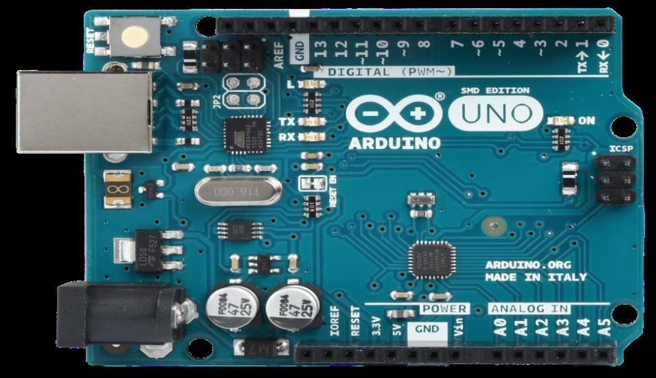
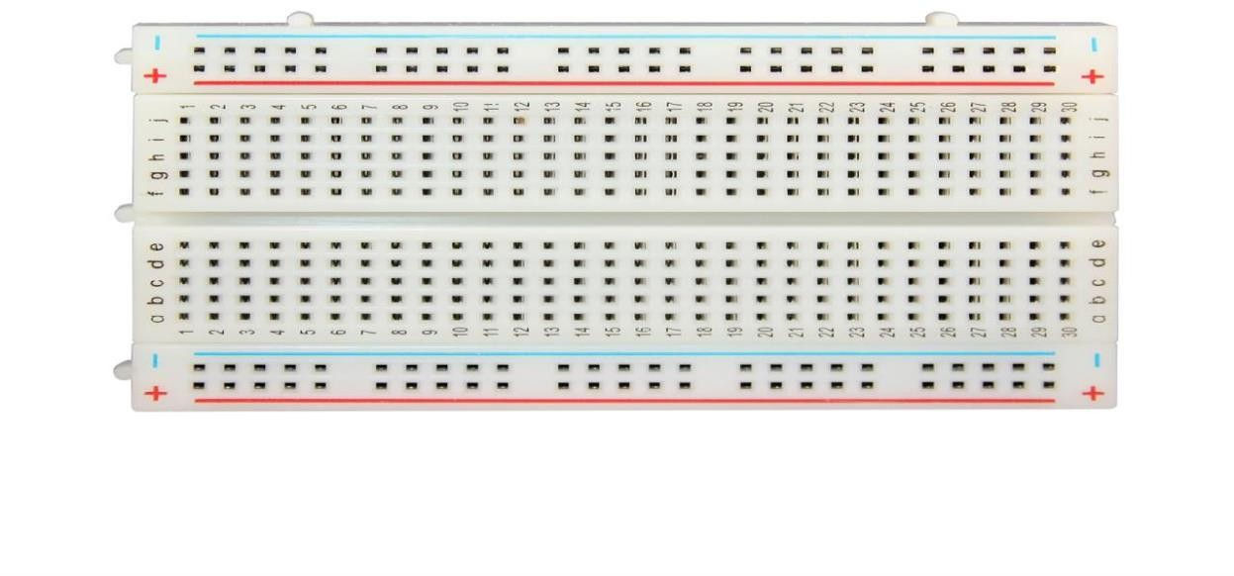
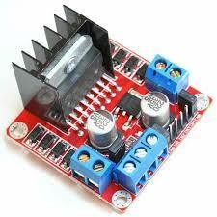
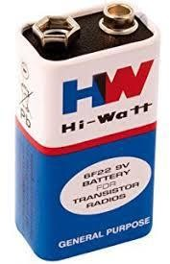
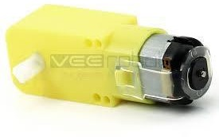
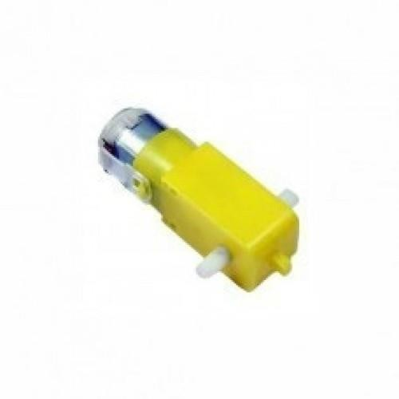


COMPONENTS
Arduino Uno
L298N motor driver
L293 motor driver
BO motor, Wheels
Chassis
Servo motor
Container
Jumper wire ( F-M ) (M-M )
Breadboard
Mini water pump
Flame Sensor
Battery

Slide 6
PROCEDURE
Phase I - Mechanical Part Design
Phase II - Hardware And Circuit Design
Phase III - Programming
i} Base on the functions that the robot will perform
ii} Determine where to place the internal components that will necessary to make the robot operational,
iii} Minimize the weight of load that the robot carrying to reduce the power needed by the robot, and
iv} Minimize the gravity centre for easy to spot the stability point while static or moving condition.
v} The microcontroller validates the SMS and then perform specific task on the device.
i} Save the time in designing and developing interface between electronics component.
ii} Save the time purchasing and choosing the suitable components,
iii} Eliminate the frustration on soldering, testing and downloading program.
iv} Reduce unstable condition of self develop controller board.
v} With UIC00A/B, program can be loaded in less than 5 seconds.
vi. Maximum current is 0.5A.
i} Open arduino ide.
ii} Start coding.
iii} Compile code by clicking on compile option.
iv} Upload code into arduino uno using upload option.
v} When code is done uploading you will able to see done uploading message on terminal.

Slide 7

ADVANTAGES
The fire fighting robot helps to detect the exact direction of the fire source, It has the capability of sensing accurately with increased flexibility, Low cost in the long run, It is reliable and economical, by placing the sensors appropriately we can efficiently detect the location of the fire.
To detect the exact direction of the fire source. •
Capability of sensing accurately with increased flexibility. •
Reduce human effort. •Reliable and economical.
Not sensitive to weather conditions

Slide 8
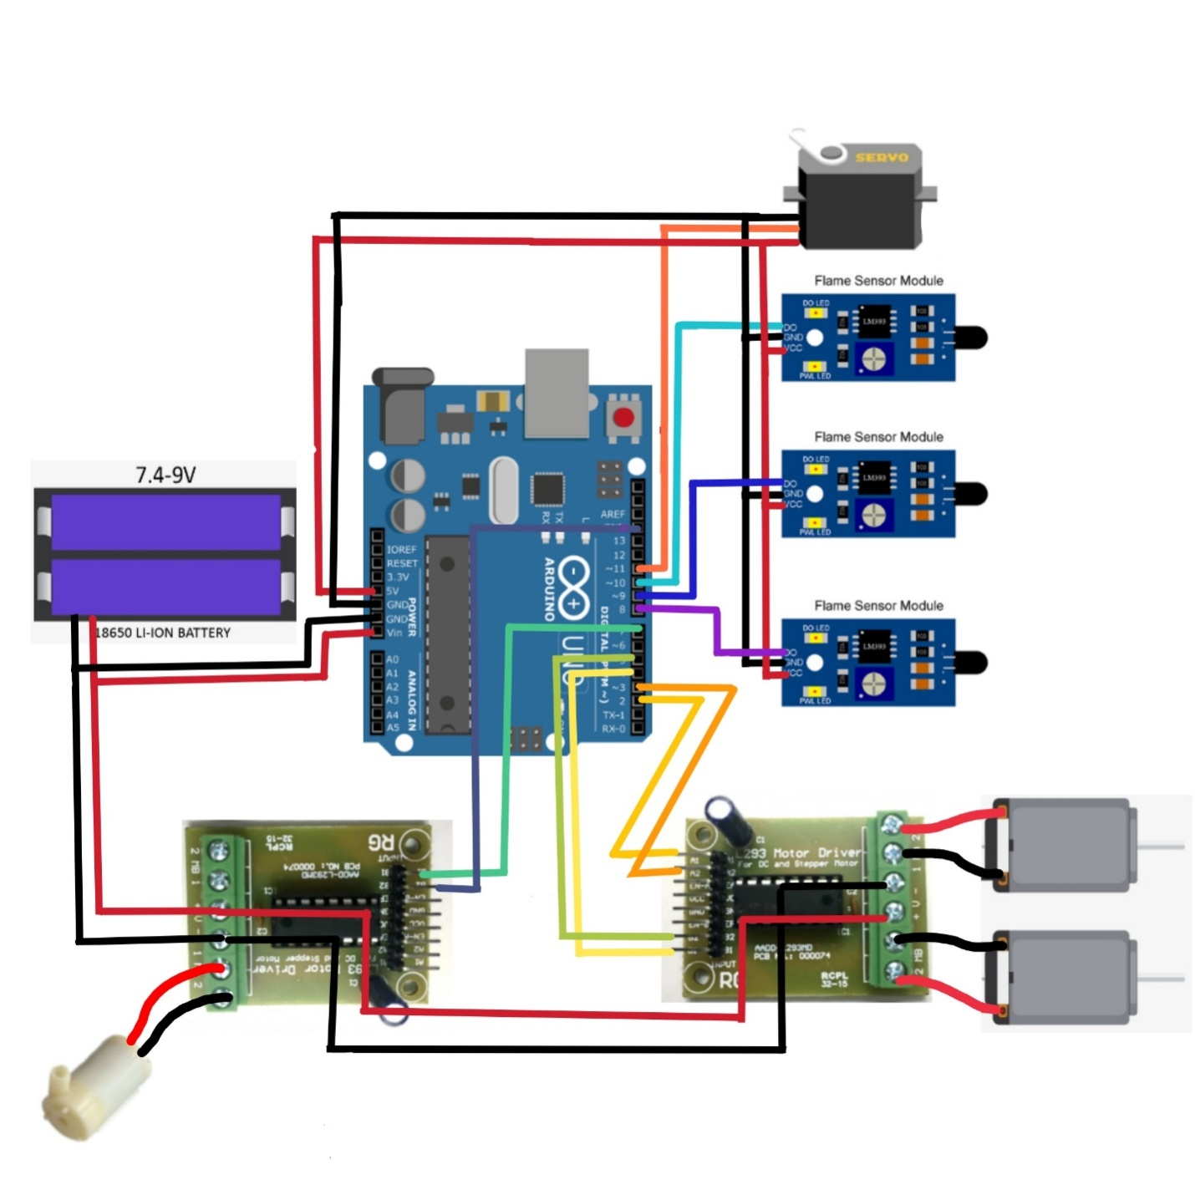

CIRCUIT DIAGRAM:
1} the diagram shows circuit connection from arduino uno to all component .
2} it has two motor driver L293 & L298n.
3} L293 motor driver connect to the bo motors and its input pin connected to 2,3,4&5 no. pin.
4} other L298n motor driver connect to the water pump and its input pins connected to 7&14 no. pin.
5} flame sensor & servo motor power through the arduino uno and its input pin connected to the pin no. 11.
6} flame sensor data pin is connected to 8,9&10 pins .
7} the power input goes through VCC and GND.

Slide 9
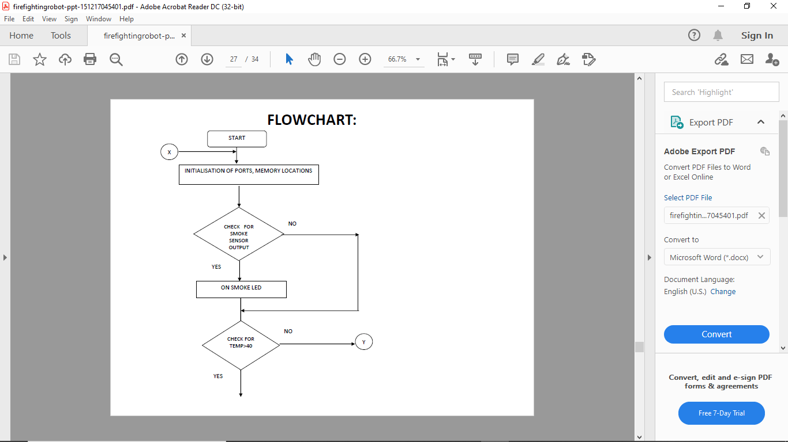

FLOW CHART DIAGRAM
Switch on
Initialization of ports, memory location
Check for fire sensor / smoke sensor output
If yes then on smoke led
Else don’t on led
Check temperature is more than 40
If yes then start fire extinguishing operation
Else stay still and continue detection

Slide 10
REFERENCE
1}Websites
https://www.arduino.cc/
http://www.ijarcet.org/
http://www.youtube.com/
http://www.slideshare.net/
http://www.instructables.com/
http://www.electronicshub.org/
http://www.circuitstoday.com/
2}Books
Arduino Applied: Comprehensive Projects for Everyday Electronics.
Arduino Project Handbook.
Building Arduino PLCs (The essential techniques you need to develop Arduino-based PLCs).
Building Arduino Projects for the Internet of Things (Experiments with Real-World Applications).

Slide 11
THANK YOU
For
Watching
And I hope You Like this Presentation
Created By Pratik Bondre

