Slide 1
Stock Market Prediction
Team name: BigD
Viral Parmar, Pratik Bongale, Abhishek shakwala

Slide 2
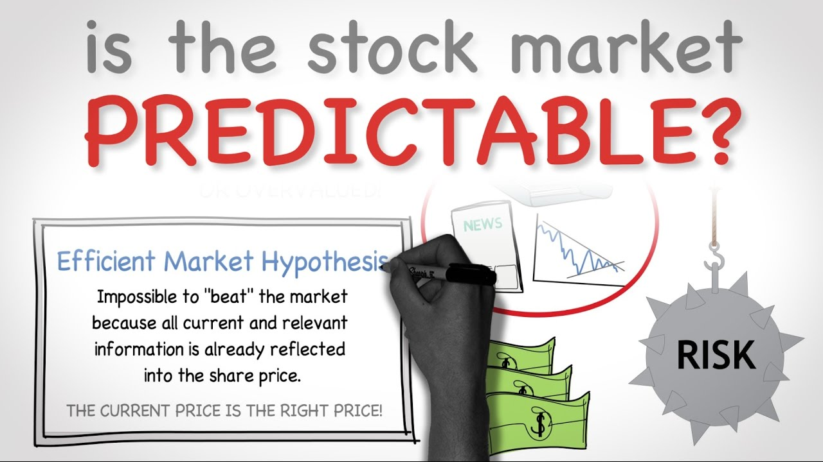

Slide 3
Motivation
Age of Data
Challenging to predict stock prices
Challenge: Effective Market Hypothesis states that probability of predicting the price of the stock is equivalent to that of tossing a coin.
CHALLENGE ACCEPTED!

Slide 4
Dataset
The total S&P 500 index price with stock prices of 500 companies from April 2017 to August 2017 in minutes (to keep our analysis details and very low level).
Number of records: 41266
Number of attributes: 501 (500 companies + 1 S&P aggregated index)
https://finance.yahoo.com/

Slide 5
Cleaning and Preparation
Select Top 5 companies from S&P500
Microsoft, Apple, Facebook, Google, Amazon
Augment the dataset
Percentage change of stock price
Rolling average of returns
Delta change - How much did the stock price change as compared to price 10 minutes earlier?
Delta lag - shift the obtained returns 1 minute in the future so that when we find the S&P index returns for 09:05 AM we are looking at the returns from S&P index at 09:06 AM.

Slide 6
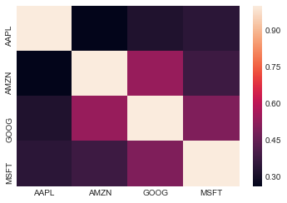
Correlation
Positive correlation among the companies within the same sector.
Google and Amazon have the best correlation.

Slide 7
Risk Analysis
Bootstrapping using Quantile
Predict the risk of investing into given stock.
Results:
If Amount invested in Apple: $100000
Risk of investing in apple stock = $2199.21
Monte Carlo Simulation
Simulates the uncertainty that affects the value of stocks.
Create a random market condition and make predictions.

Slide 8
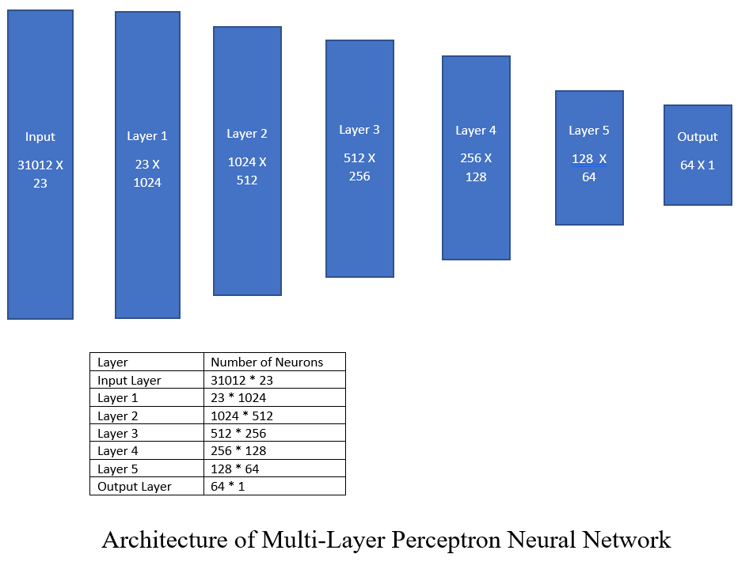
Implementation of Neural Network

Slide 9
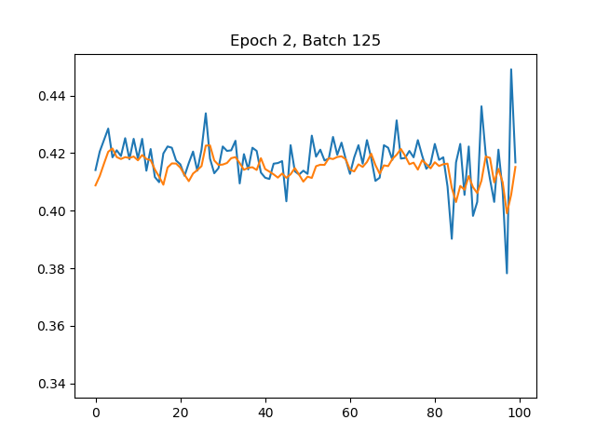
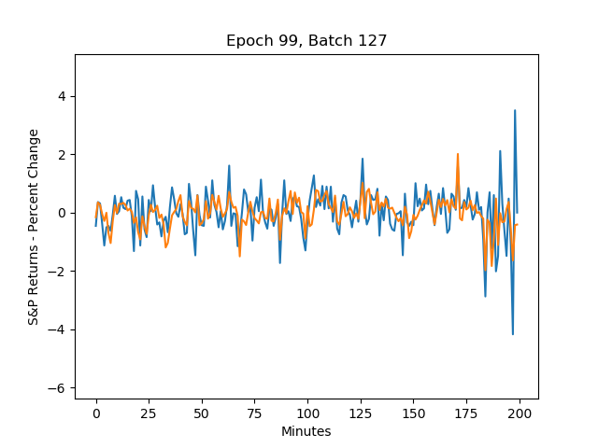
Results
SSE: 20.254
SSE: 32.76

Slide 10
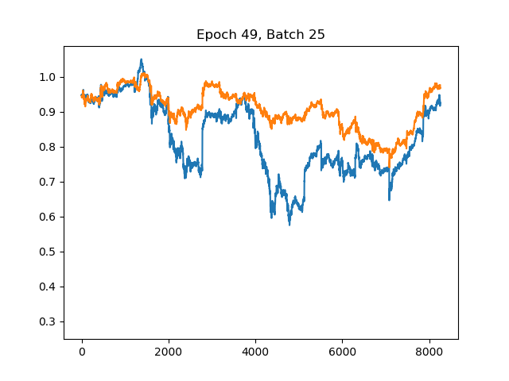
Results
SSE: 14.56
SSE: 35.87

Slide 11
Future Scope
Add some sentiments to it ☺.
Use a LSTM-RNN model – Best for Time series data.
Globalization affects stock markets, so include different stock indices.
Fine tune the hyper parameters.

Slide 12
References
https://en.wikipedia.org/wiki/S%26P_500_Index
https://medium.com/mlreview/a-simple-deep-learning-model-for-stock-price-prediction-using-tensorflow-30505541d877
https://finance.yahoo.com/
https://finance.google.com/finance
https://www.quandl.com/

