Slide 1
Car Logo Detection and Recognition using Template Matching
Presented By -
Pratik Bongale, M.S., Computer Science Dept.,
Rochester Institute of Technology

Slide 2
Why Logo Detection
Vehicle Manufacturer Recognition(VMR) is a popular vision based application.
Used for:
Secure access
Extensions for model recognition

Slide 3
Algorithm
Select a logo template
Create a Scale space of template
Reduce noise using Gaussian filter
Resize the query image to size 500x500
For each template in scale space:
Calculate the correlation between query_image and template_image.
Find the peak of correlation.
Crop the region around the peak point.
Compute cross-correlation between the cropped peak_region and template.
Degree of confidence = correlation co-efficient obtained.
Return the image with maximum degree of confidence.

Slide 4
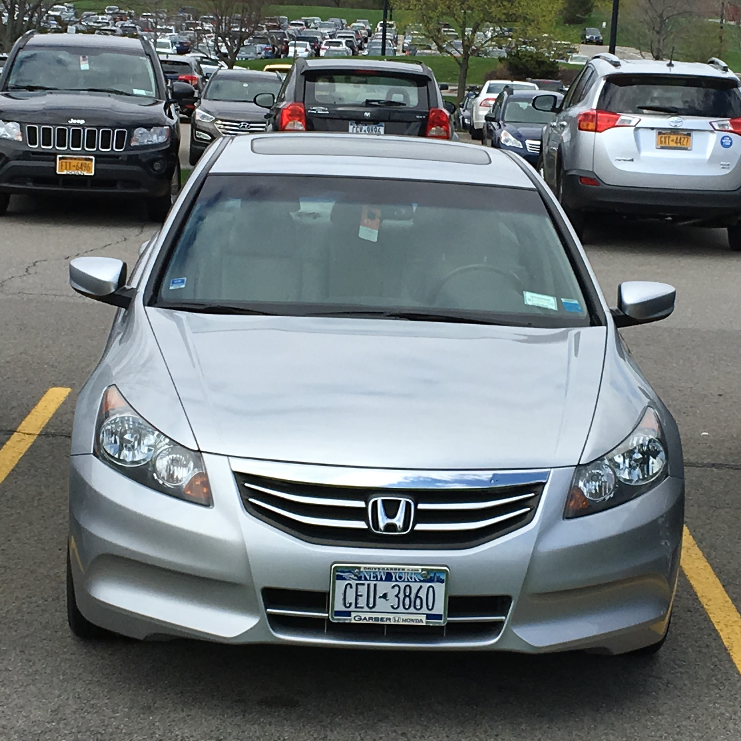
Input Image Specifications
Input Image:
Front view or rear view of car.
Best results with aspect ratio 1:1.
Rotation angle 0⁰
Scale can vary to an extent.

Slide 5
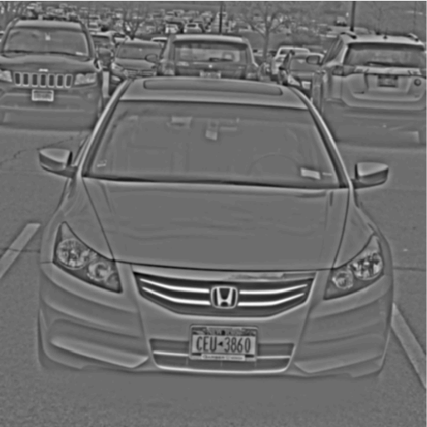
Preprocessing Image
Conversion to gray scale
Initial noise cleaning using Gaussian filter
Resizing image to 500x500 pixels
Contrast adjustment
Imadjust
Image – local-avg + global-avg

Slide 6
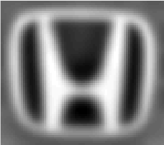
Creating a template
Extract logo from an arbitrary image using ginput()
Resize the logo to size 70x80
Remove aliasing using Gaussian blur
Fix illumination changes across the template

Slide 7
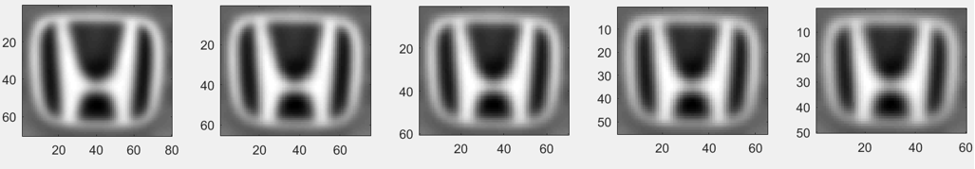
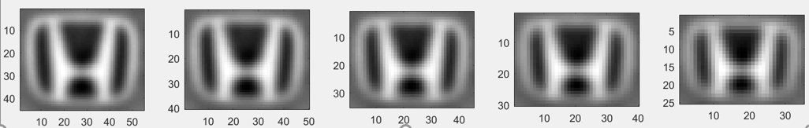
Creating Scale Space of the template
Repetitively resize and blur the processed template.

Slide 8
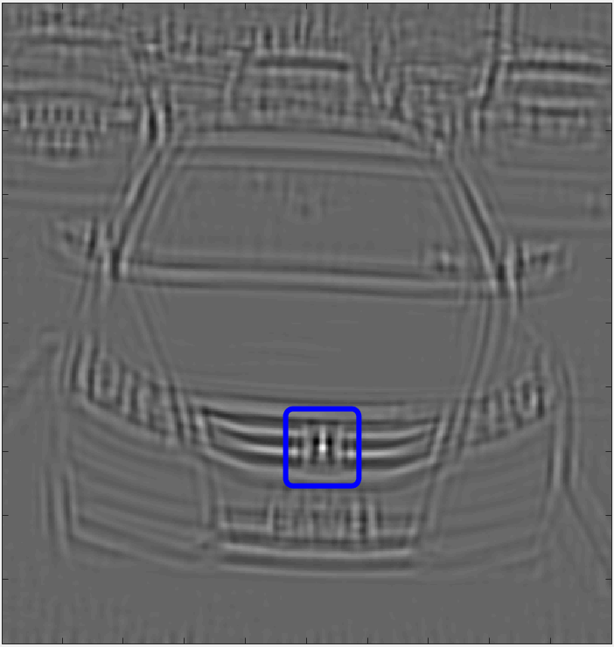
Cross-Correlation
T = template - mean( template )
I = im_query – local_avg( im_query )
Correlation = imfilter( I, T )
Peak_region = peak( Correrelation )

Slide 9
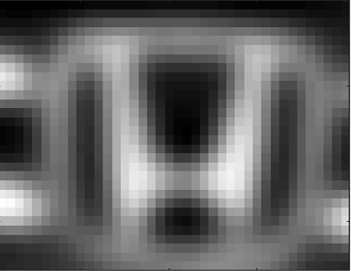
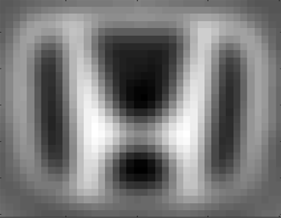
Degree of Confidence
Find the correlation between the detected region and template
Corr_coefficient = corr2( Peak_region, Template )
Peak Region
Template

Slide 10
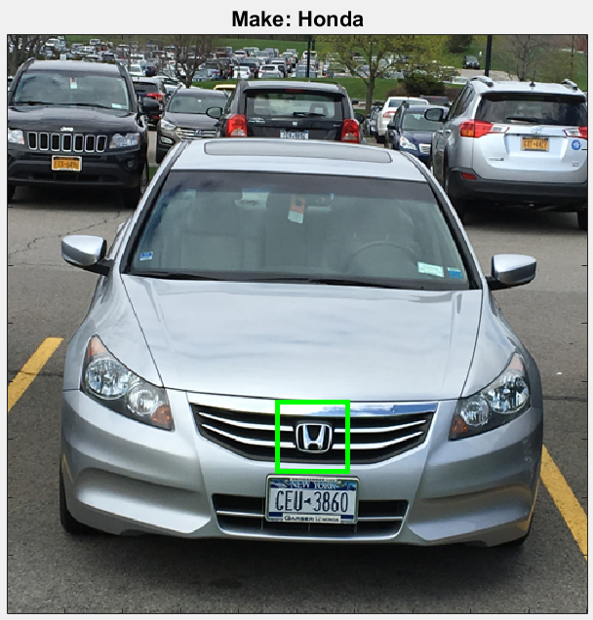
Logo Recognition
Repeat for templates of different brands.
Brand with highest degree of confidence
is selected.

Slide 11
Test Summary
Brand | Total Images | Correctly Detected | Accuracy
Honda | 122 | 112 | 91%
Toyota | 119 | 105 | 88%

Slide 12
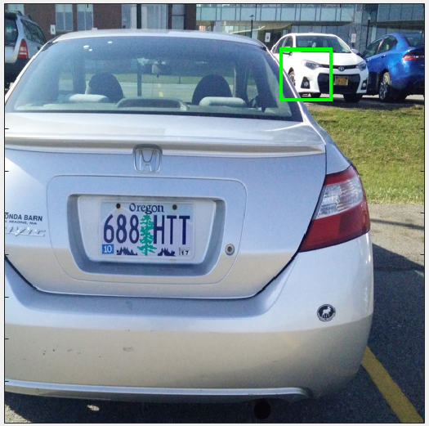
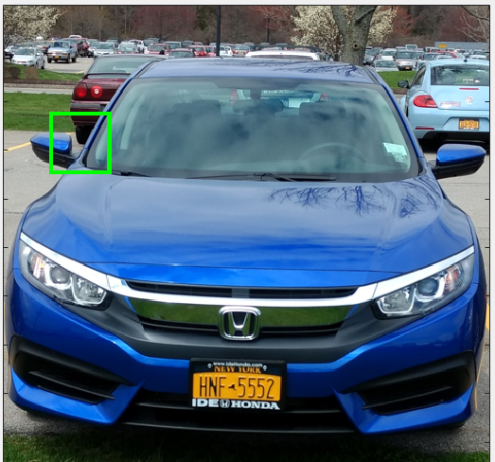
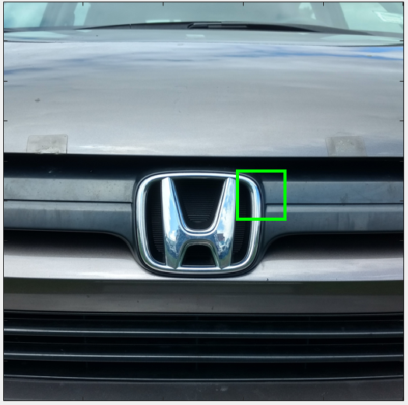
Problems
Logo detection in Shadows
Very large logo size

Slide 13
Thank You

