Slide 1
Convert HAR file to SWAGGER file
Team 98- AI Techothon Internal

Slide 2
Introduction
The ".har file to Swagger file" project aims to develop a tool that can convert HTTP Archive files (.har) into Swagger/OpenAPI specification files.
The tool will provide an automated and streamlined solution for transforming network traffic data captured in .har format into a Swagger specification, which is widely used for documenting RESTful APIs.

Slide 3
Motivation
HTTP Archive files (.har) are commonly used to record and analyze network traffic data. However, when it comes to documenting APIs, Swagger is a popular choice due to its rich features, ecosystem support, and compatibility with various API development tools.
Converting .har files to Swagger specifications manually can be time-consuming and error-prone. This project aims to automate this conversion process, making it more efficient and reliable.

Slide 4
Motivation
Advantages of Swagger/OpenAPI
It has a friendly user interface that maps out the blueprint for APIs.
Documentation is comprehensible for both developers and non-developers like clients or project managers.
Specifications are human and machine readable.
Generates interactive, easily testable documentation.

Slide 5
Key Features
Har File Parsing: Develop a parser to read .har files and extract relevant information, such as HTTP requests, headers, parameters, and response details.
Swagger Generation: Implement a logic to transform the parsed data into a Swagger/OpenAPI specification file.
Schema Inference: Analyze the captured request and response payloads to infer data schemas and generate corresponding Swagger schema definitions.
Path and Operation Generation: Map the captured requests to Swagger paths and generate corresponding HTTP operations (GET, POST, PUT, etc.) with relevant details.
Parameter Extraction: Extract path parameters, query parameters, and request body parameters from the captured requests and include them in the Swagger specification.
Response Mapping: Map the captured response details, including status codes, headers, and response bodies, to appropriate Swagger definitions.
Web Interfaces: Provide Web interface user interfaces to facilitate easy usage and interaction with the conversion tool.

Slide 6
Potential Technologies
The project can be implemented using a combination of the following technologies and tools:
Programming Language: Python for parsing and generating files
Libraries: Python libraries like "haralyzer" for parsing .har files
Swagger/OpenAPI Libraries: swagger_ui for Swagger Doc Editor Generator
User Interface: Flask and web-based front-end is html and javascript for the graphical user interface

Slide 7
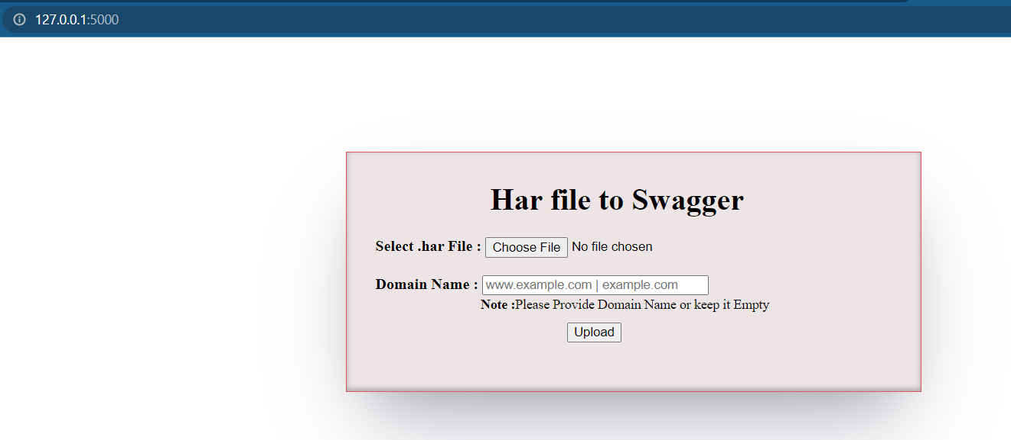
Functional Use Case
GO to http://127.0.0.1:5000/ URL link we can see the UI interface.
"Select .har File" From this we can add our .har file.
In the Domain Name we can put the domain name as per the .har file or we can keep it empty.
After uploading the .har file It will generate a "har_Swagger.json" json file.

Slide 8
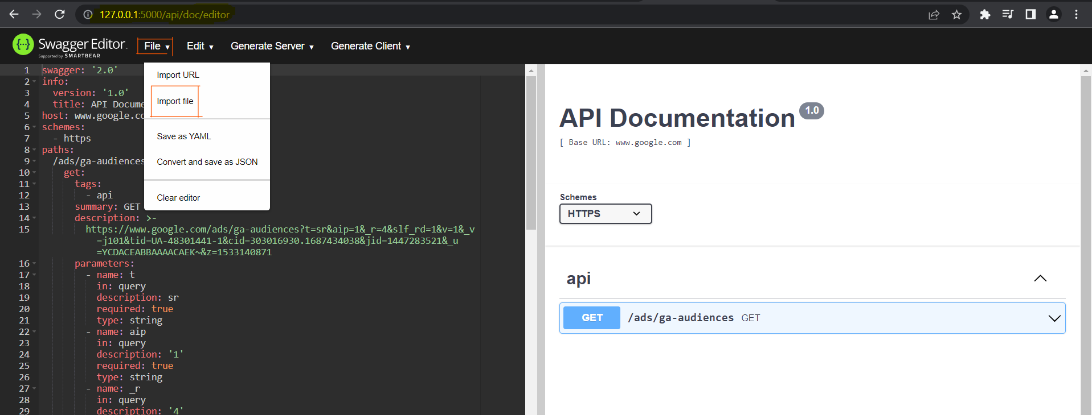
Functional Use Case
Go to http://127.0.0.1:5000/api/doc/editor it will redirect the swagger editor, after that from the “File” section we can “Import file” for importing the json file which is downloaded in the previous step
On the right-hand side we can get the Swagger API documentation properly.

Slide 9
Deliverables

Slide 10
Contribution Guidelines
Git URL for the repository: https://github.com/pratikc10/harSwag
You can read readme document.
Anyone can clone git repository

Slide 11
Future Enhancements
As we move ahead, we can enhance the UI of the website.
We can create Google Chrome Extension for the smooth functionality.
We can also create a mobile application for this.

Slide 12
Conclusion

