Slide 1

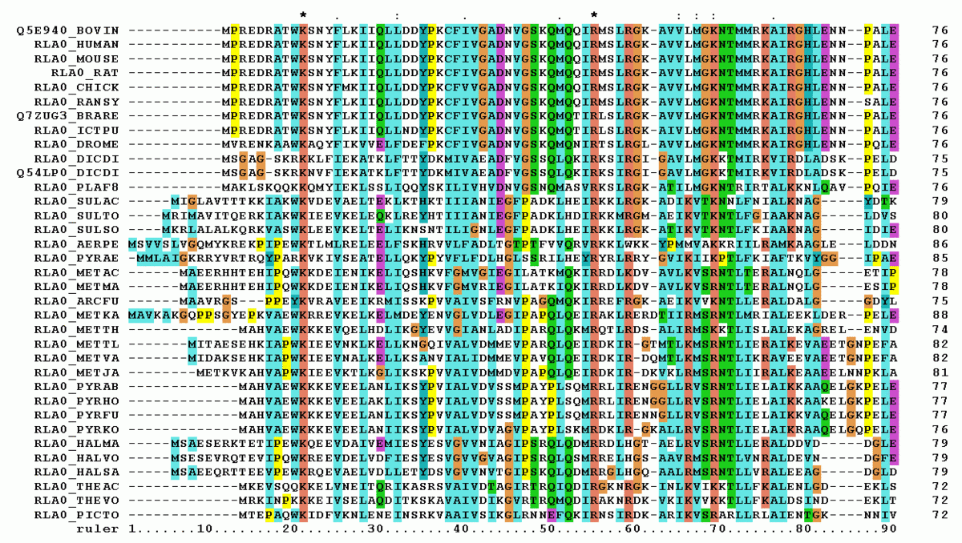
Shape and voice command detection using DTW algorithm
Poonam Dashrath Paraskar(1427297)
Pratik Desai(1438367)

Slide 2
Index
Introduction
Limitation Euclidean Distance
Dynamic Time Warping Algorithm(DTW)
Advantages and Disadvantages of DTW algorithm.
Implementation details of DTW and voice command recognition and results
Pothole detection results
Conclusion & Future scope

Slide 3
Introduction
Project focuses on Dynamic Time Warping algorithm:
It is a distance-based approach is a prevalent technique used in time series classification.
This non-parametric method combines distance measurements with a classifier, often employing the k-nearest neighbor (KNN) algorithm
In several fields, the Dynamic Time Warping algorithm (DTW) is a well-known algorithm. Although it was first developed in the 1960s and widely researched in the 1970s by using it for voice recognition, it is today utilized in a variety of fields, including handwriting and online signature matching , and identification of gestures and sign language.

Slide 4
Euclidean Distance Limitation:
It is a simple and intuitive measure that calculates the distance between two time series as the straight-line distance between their corresponding points.
But it is inappropriate to use in time series classification because, only amplitude is considered when computing the similarity using Euclidean distance of two time series, regardless of phase shift, time shifting, or distortion.
Example for Time series comparison using Euclidean Distance:

Slide 5
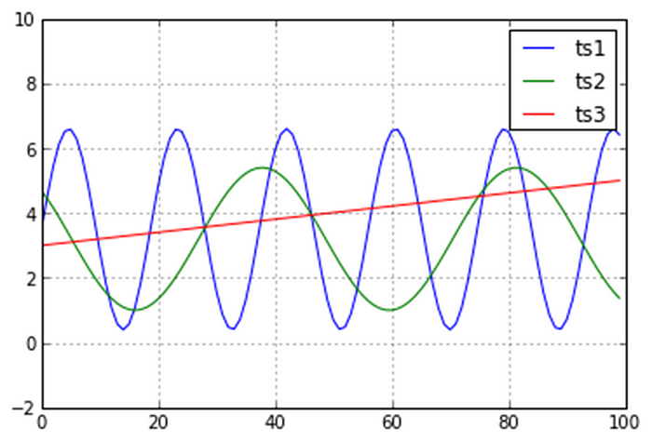
Euclidean distance focuses on maintaining the temporal order, it estimates the distance in a pointwise fashion.
This phenomenon is happening because the Euclidean Distance is comparing the amplitudes of the curves, without allowing any time stretch.
Fig. 1. Examples of time series to compare

Slide 6
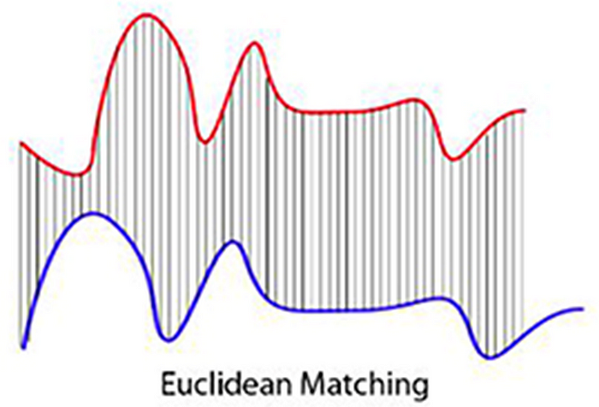
Fig. 2. Result of time series to compare using Euclidean Matching

Slide 7
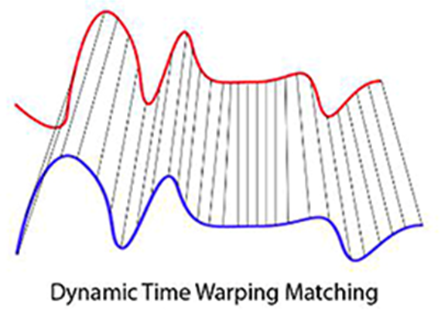
Dynamic Time Warping Algorithm:
The Dynamic Time Warping has been introduced to avoid the problem of the Euclidean Distance.
It was initially developed for speech recognition, but eventually it grow in applications.
By determining the optimal alignment between them and reducing the impacts of time distortion and shifting, DTW enables you to quantify the similarity between the time series.
Fig 3. Result of DTW on the same example as of Euclidean distance

Slide 8
Dynamic time warping (DTW) is a way to compare two, usually temporal, sequences that do not perfectly sync up. It is a method to calculate the optimal matching between two sequences.
It works mainly based on three and some additional constraints.
The warping path is found using a dynamic programming approach to align two sequences:
Boundary condition: This constraint ensures that the warping path begins with the start points of both signals and terminates with their endpoints.
Monotonicity condition: This constraint preserves the time-order of points so that it doesn’t go back in time.
Continuity (step-size) condition: This constraint limits the path transitions to adjacent points in time so that it doesn’t jump in time.

Slide 9
Advantages and Disadvantages of DTW Algorithm:
Advantages:
The DTW algorithm is a helpful distance measure to have in your toolkit since it can assist you in determining the best alignment between two sequences.
When working with two non-linear sequences, this technique is especially helpful if one of the sequences is a non-linear extended or reduced counterpart of the other.
Noise Tolerance: DTW is relatively robust to noise and small variations in the data. It can find meaningful matches even in the presence of noise or minor distortions.
Disadvantages:
Computational Complexity: DTW can be computationally intensive, especially for long time series or large datasets.
Sensitivity to Parameter Tuning.
Memory Usage

Slide 10
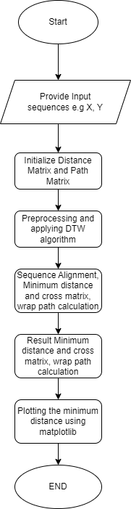
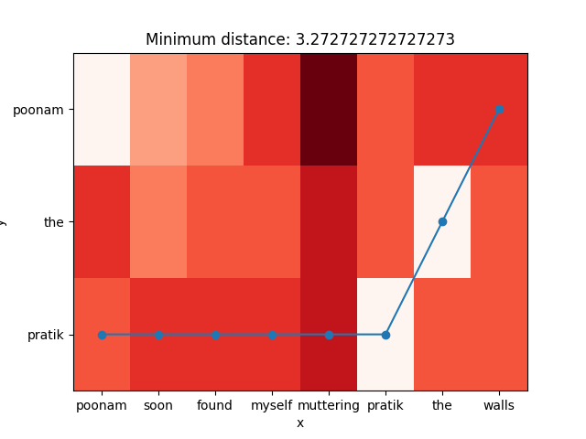
Implementation Details of DTW and voice command recognition :
Many Python packages calculate the DTW
by just providing the sequences and the type of distance,
which is usually Euclidean.
dtw_distance, warp_path = fastdtw(x, y, dist=euclidean)
2. We are using SciPy’s distance function.
Result matrix:
Minimum distance
calculated by DTW
algorithm and
traceback path.

Slide 11
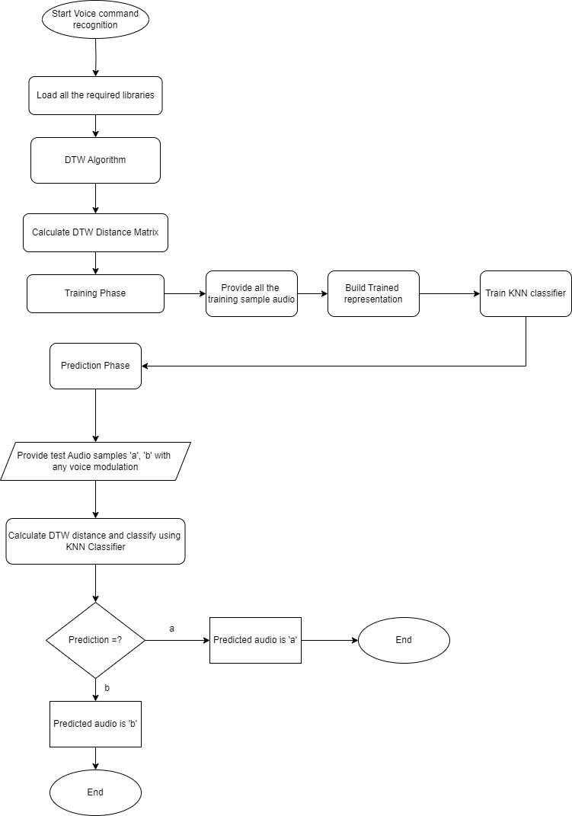
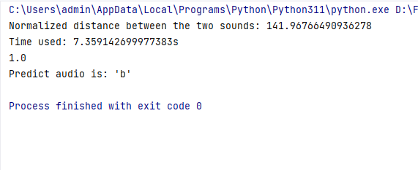
Voice command Recognition:
Result: Prediction of audio command by using KNN classifier.
Normalized distance between trained sound and test sound.

Slide 12
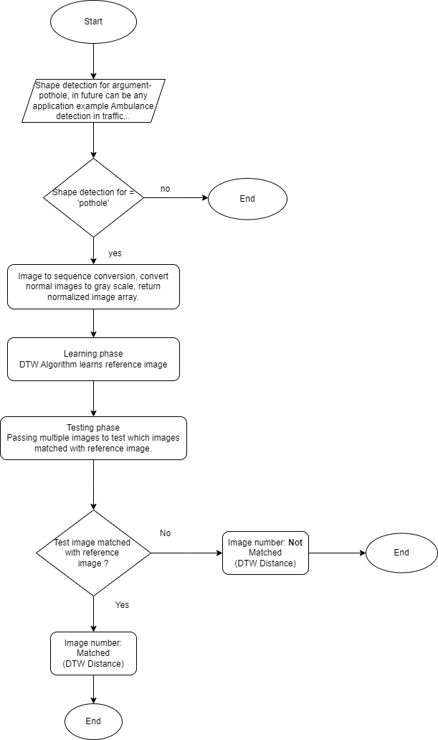
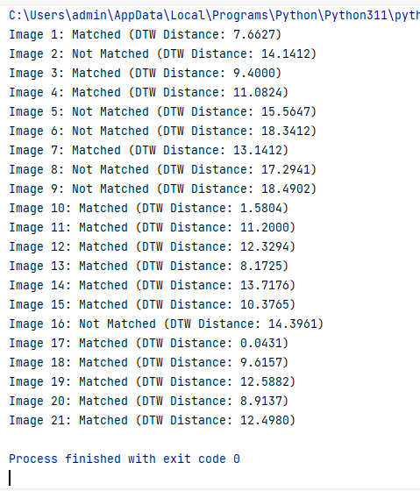
Pothole Detection (shape) :
Result: In the result below we can see that result in the form of image number – Matched/No matched, and DTW distance.

Slide 13
Conclusion & Future Scope:
We have described and demonstrated the working of dynamic time warping algorithm and worked on two use cases namely shape (pothole detection), voice command recognition at low level.
Understanding complex algorithm like DTW is a key take away from working on this project.
In the future we hope to extend the technique to higher level representations such as Voice-Activated Smart Devices, Security Systems as Voice recognition can enhance the security of access control systems, ensuring that only authorized individuals gain entry to restricted areas.

