Slide 1
0/1 KnapSack
Using Genetic Algorithm (Local Search)
Pratik Goyal
B18BB024
Supervisor:
Dr. Yashaswi Verma

Slide 2

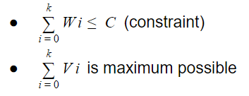
Problem Description
Knapsack problem is a combinatorial optimization task
Given parameters:
Knapsack capacity = ‘C’
Number of items = ‘n’
An array of weights = W1, W2, W3, ……... , Wn
An array of values = V1, V2, V3, …………., Vn
Our task is to choose k items such that:

Slide 3
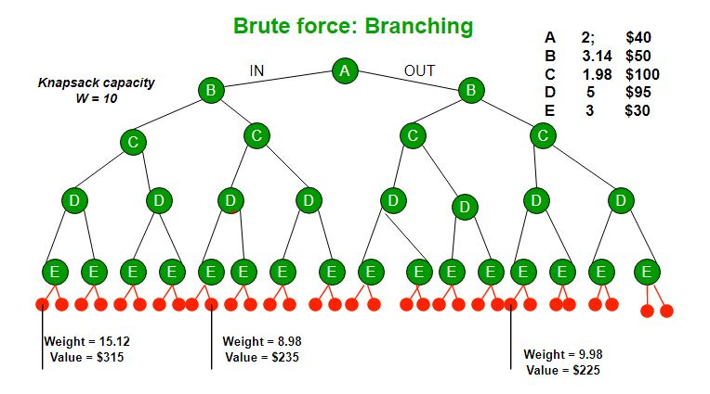
General approach
Recursion
Brute force approach
Increase exponentially
Most of the time it is not feasible
Time complexity: O (2^n)
Space complexity: O (2^n)

Slide 4
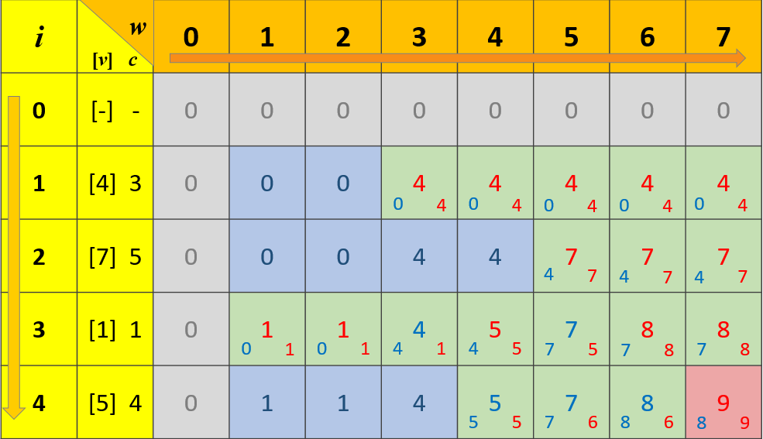
General approach
Dynamic programming
Advantage:
Gives optimal answer
Very fast
Limitations:
Trade off between space and time
Time complexity = O(N * W)
Space complexity = O(N * W)
Complexities depend upon the knapsack capacity (W)

Slide 5
Genetic algorithm (Proposed Approach)
Choose a random population
Apply genetic algorithms to find the best score
Fitness function and selection
Crossing over
Random mutation
Output best fitted score
Repeat it for ‘k’ iterations and choose the maximal answer

Slide 6
Genetic algorithm (Proposed Approach)
Won’t guarantee optimal answer but will give satisfactory results
Time complexity = O(K * N * N)
Space complexity = O(N * N)
The complexity depends on the population size
Unlike dynamic programming approach N here is the population size
In my implementation it is equal to number of items
Changing the population size will change the complexity.
K is the number of iteration

Slide 7
Worked Example
Let’s consider the test case 1 of the project.
N = 4
Capacity (C) = 10
weight = {5, 4, 6, 3}
satisfaction = {10, 40, 30, 50}
Randomly chosen Population
{{1, 0, 0, 1}, {1, 1, 0, 1}, {0, 0, 1, 0}, {0, 1, 0, 1}}
1 -> chosen item
0 -> not chosen item
A set will contain ‘n’ population of ‘n’ members each

Slide 8
Worked Example
Fitness score and selection
If the final weight of chosen items > knapsack capacity: Fitness Score = -1
Else: Fitness Score = ∑ Value or Satisfaction points of chosen items
{{1, 0, 0, 1} {60}, {1, 1, 0, 1} {-1}, {0, 0, 1, 0} {30}, {0, 1, 0, 1} {90}}
Sorting in descending order
{{0, 1, 0, 1} {90}, {1, 0, 0, 1} {60}, {0, 0, 1, 0} {30}, {1, 1, 0, 1} {-1}}

Slide 9
Worked Example
Crossing over
Point = 3 for first and second
Point = 4 for third and fourth
{{0, 1, 0, 1} {90}, {1, 0, 0, 1} {60}, {0, 0, 1, 1} {80}, {1, 1, 0, 0} {50}}
Adding random mutations
Only on 10% of the population size
Find the their final score and output the best result
{0, 1, 0, 1} {90}

Slide 10
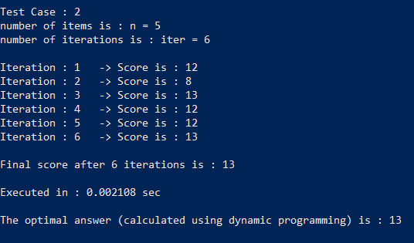
Test case -> 2

Slide 11
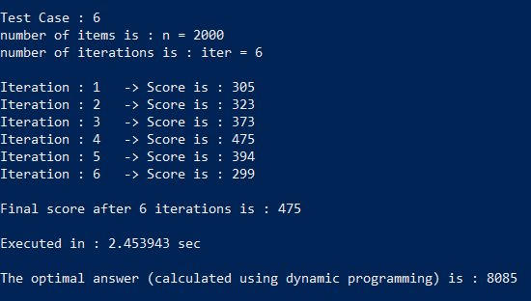
Test case -> 6

Slide 12
Thank You !

