Slide 1

VEHICLE EMERGENCY SUPPORT SYSTEM
BY:
Pratik Gon | Pratik Satpathy | Pijush Das | Anonyo Sanyal
GUIDED BY:
Dr. Sutirtha Kumar Guha, Associate Processor, MSIT

Slide 2
Domain of the project -> Edge Computing
Application of the Domain -> Vehicle Support System
The problems we face-
In busy areas – High load on the service centres.
In Isolated areas – lack of utilization of nearby resources.
Many contributions has been done in this field, but they increase load on the service stations.
Unoptimized system – both as users and service centres
Target -> To map the idea of Edge Computing in solving the problem.
The Outcome -> ‘Vehicle Emergency Support system’
Lack of automation and filtration of the problem.
Introduction - The Idea!

Slide 3
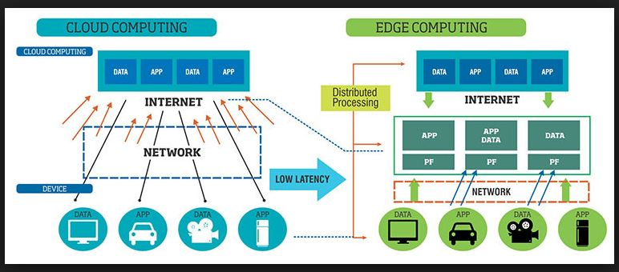
EDGE COMPUTING
Edge computing is a distributed, open IT architecture that brings computation closer to the source of the data that available in local system by minimizing the amount of long-distance communication, instead of relying on the cloud at one of a dozen data centers to do all the work.
It features decentralized processing power, enabling mobile computing and Internet of Things (IoT) technologies.
To support needs today and tomorrow, computing power and storage is being inserted out on the network edge in order to lower data transport time and increase availability.
DOMAIN DEFINITION

Slide 4
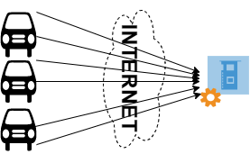
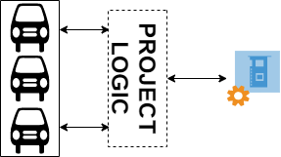
EDGE COMPUTING – Project Perspective
In conventional system all the data(problems) generated from numerous vehicle, are directly send to the Service-station to process which encounters high traffic load and very hard to serve all the cars if all the problems comes in same instance of time.
In our project we introduce a model ,in between car and Service-station that can filter the problems at the edge of the data source to minimize the load upon network instead of relying on the Service-station to do all the work .

Slide 5
Reduce load on the service station by filtering the data using edge computing.
Make the system time efficient by breaking the long waiting queue.
Design a system which will be cost effective by saving the fuel consumption.
Reach out with the service in remote arear in very efficient way .
OBJECTIVES

Slide 6
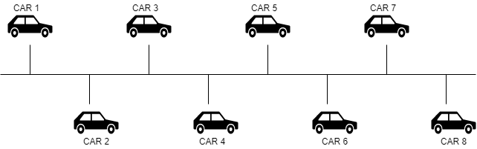
Filtering Process
The existing system needs to be automated for the benefit of the user. We propose a 3-phase system for supporting the cars in case of emergency. Initially effected car will go through phase-1 for support, if it does not get the help it will go to next phase.
In phase-1 neighbor car will be communicated. Phase-2 comprises of service car support. Phase-3 needs intervene of service station.
In Phase 1 cars would be connected with each other using bus topology concept so that each car will be connected to each other as shown in figure .

Slide 7
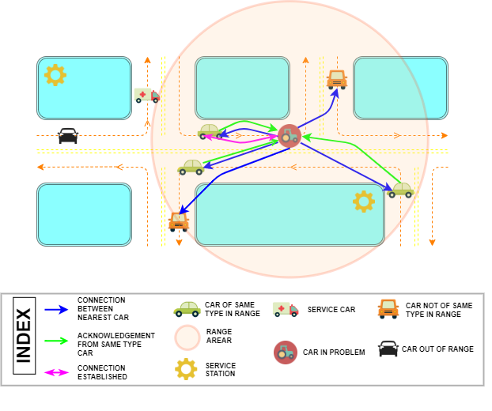
Filtering Process
The car that needs help will act as a hub or head of the cluster. In other words, the bus network of cars turns into a cluster network with the effected car as hub as shown in figure . Hub car now triggers distress signals to the nearby cars. Process will be successfully terminated when neighbor car in the cluster is found to be able to provide the assistance to the effected car.

Slide 8
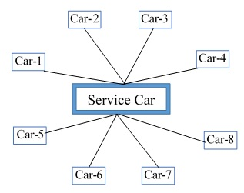
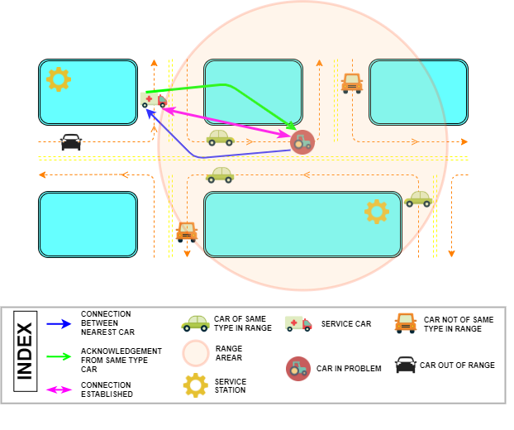
In Phase-2 service car would be introduced in the network. Each car of the network would be connected with the service car using star topology concept as shown in figure.
The network would be converted into a cluster as shown in figure . In the cluster stressed car will act as cluster head and will produce distress signal. Process will be successfully terminated when service car in the cluster is found to be able to provide the assistance to the effected car.
Filtering Process

Slide 9
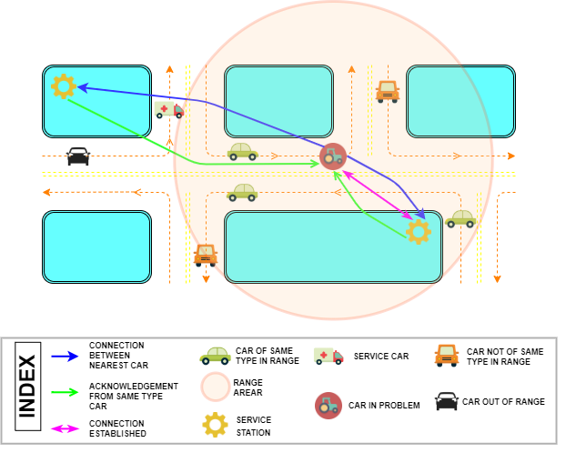
Filtering Process
In Phase-3 service station would be accessed by the affected car. As the issue remains unsolvable by the neighbor cars or service car, it would be escalated to the service station. A cluster would be constructed with affected car as the cluster head as shown in figure . Service station would be selected based on the possible quick response time.

Slide 10
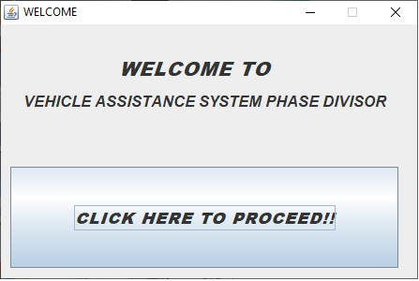
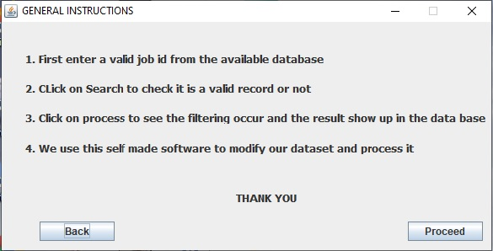
EXPERIMENT
In this section, our proposed edge computing-based assistance system is implemented on a dataset. The result is compared with conventional assistance method where issues are directed and processed at corresponding service center in terms of time and distance travelled. Our proposed method is implemented using C language on a Notebook PC with CPU 2 GHZ

Slide 11
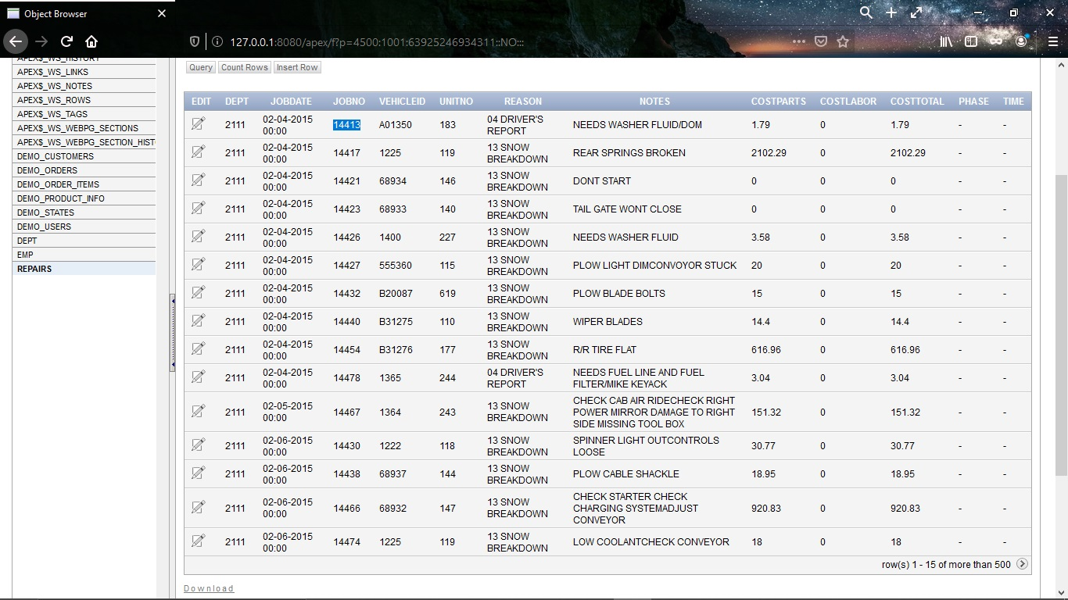
EXPERIMENT
We have tested on 680 cases and evaluate that data depending upon expertise opinion by setting the phase and time taken to solve the problem

Slide 12
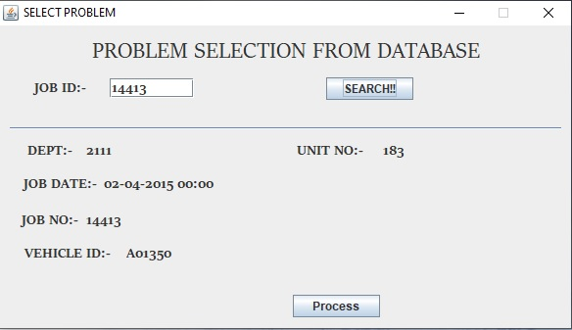
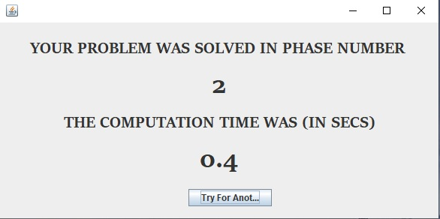
Here through the designed system we are searching the problem by JOB ID and getting the result in terms of phase and time .
EXPERIMENT

Slide 13
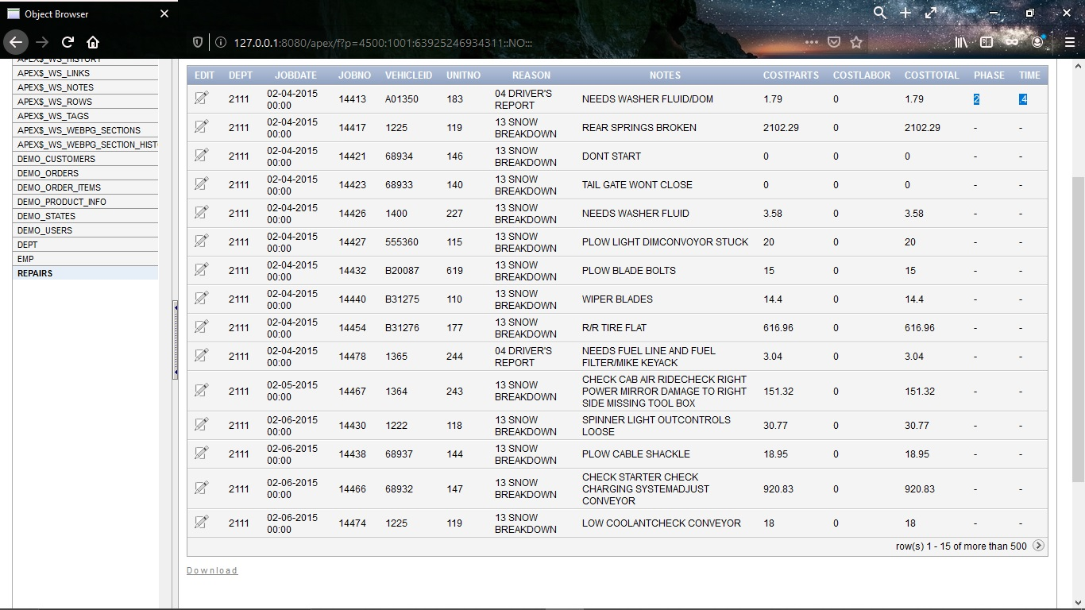
EXPERIMENT
Using this self-made application and implementing the idea of our proposed system we found the following results.

Slide 14
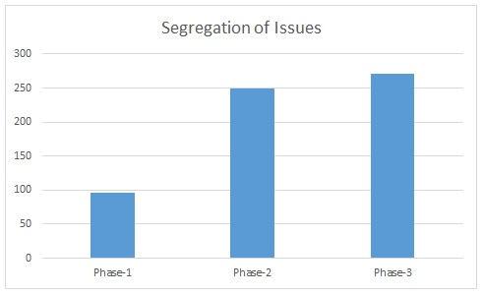
EXPERIMENT
In the figure we see case wise segregation of problems based on our proposed system. We see 50% reduction in number of cases going to the service station.

Slide 15
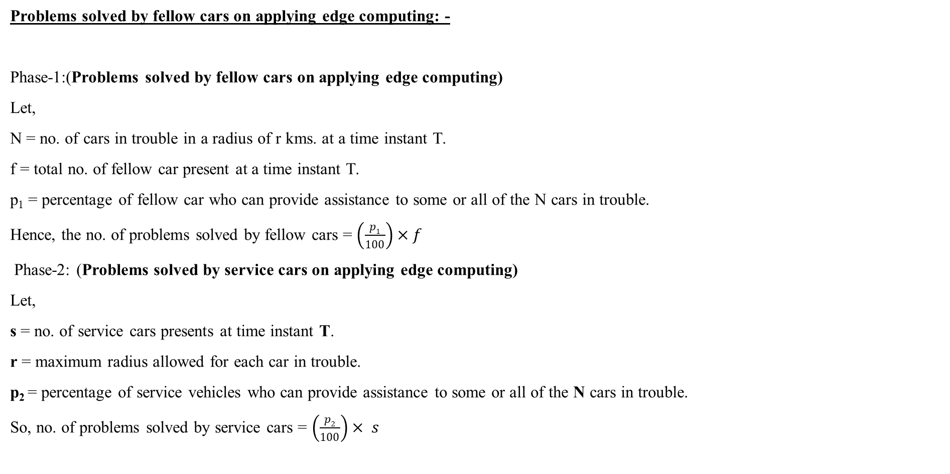
ANALYSIS
Problems solved by fellow cars on applying edge computing: -
Phase-1:(Problems solved by fellow cars on applying edge computing)
Let,
N = no. of cars in trouble in a radius of r kms. at a time instant T.
f = total no. of fellow car present at a time instant T.
p₁ = percentage of fellow car who can provide assistance to some or all of the N cars in trouble.
Hence, the no. of problems solved by fellow cars = $\left(\frac{p1}{100}\right)×f$
Phase-2: (Problems solved by service cars on applying edge computing)
Let,
s = no. of service cars presents at time instant T.
r = maximum radius allowed for each car in trouble.
p₂ = percentage of service vehicles who can provide assistance to some or all of the N cars in trouble.
So, no. of problems solved by service cars = $\left(\frac{p2}{100}\right)× s$

Slide 16
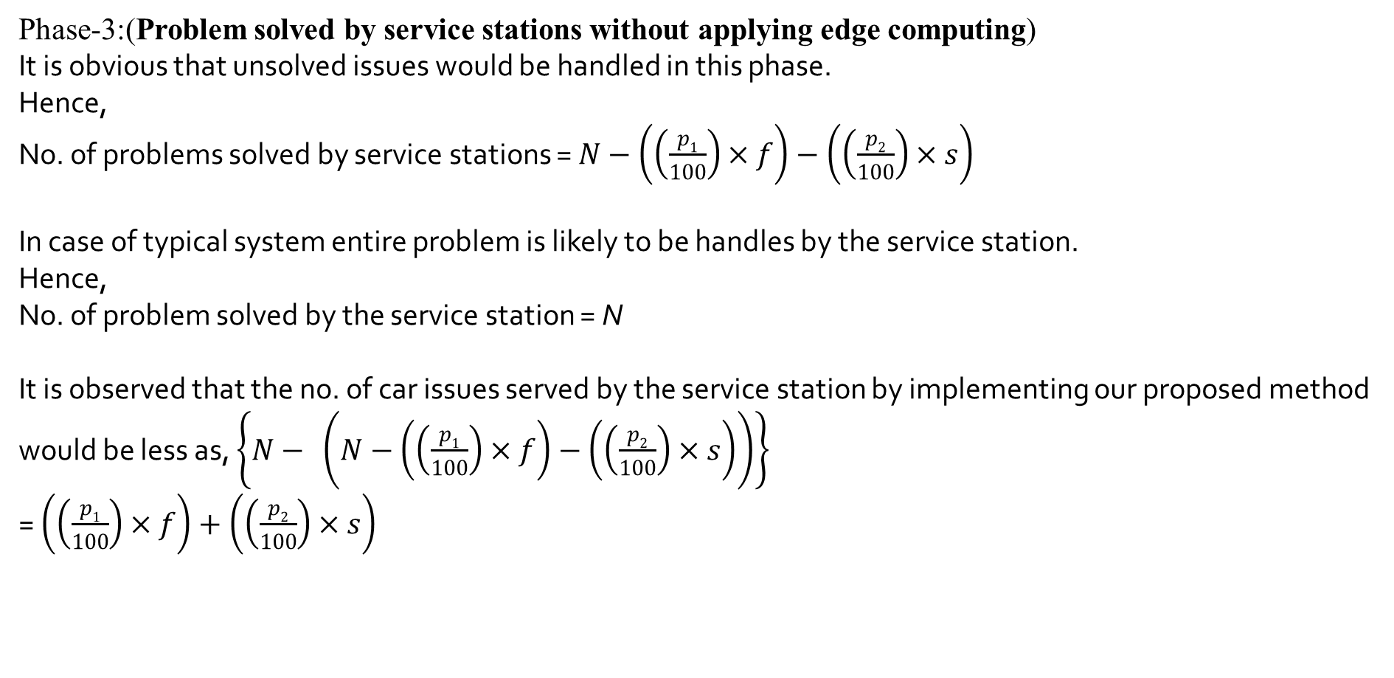
ANALYSIS
Phase-3:(Problem solved by service stations without applying edge computing)
It is obvious that unsolved issues would be handled in this phase.
Hence,
No. of problems solved by service stations = $N−\left(\left(\frac{p1}{100}\right)×f\right)−\left(\left(\frac{p2}{100}\right)×s\right)$
In case of typical system entire problem is likely to be handles by the service station.
Hence,
No. of problem solved by the service station = N
It is observed that the no. of car issues served by the service station by implementing our proposed method would be less as, $\left\{N− \left(N−\left(\left(\frac{p1}{100}\right)×f\right)−\left(\left(\frac{p2}{100}\right)×s\right)\right)\right\}$ = $\left(\left(\frac{p1}{100}\right)×f\right)+\left(\left(\frac{p2}{100}\right)×s\right)$

Slide 17
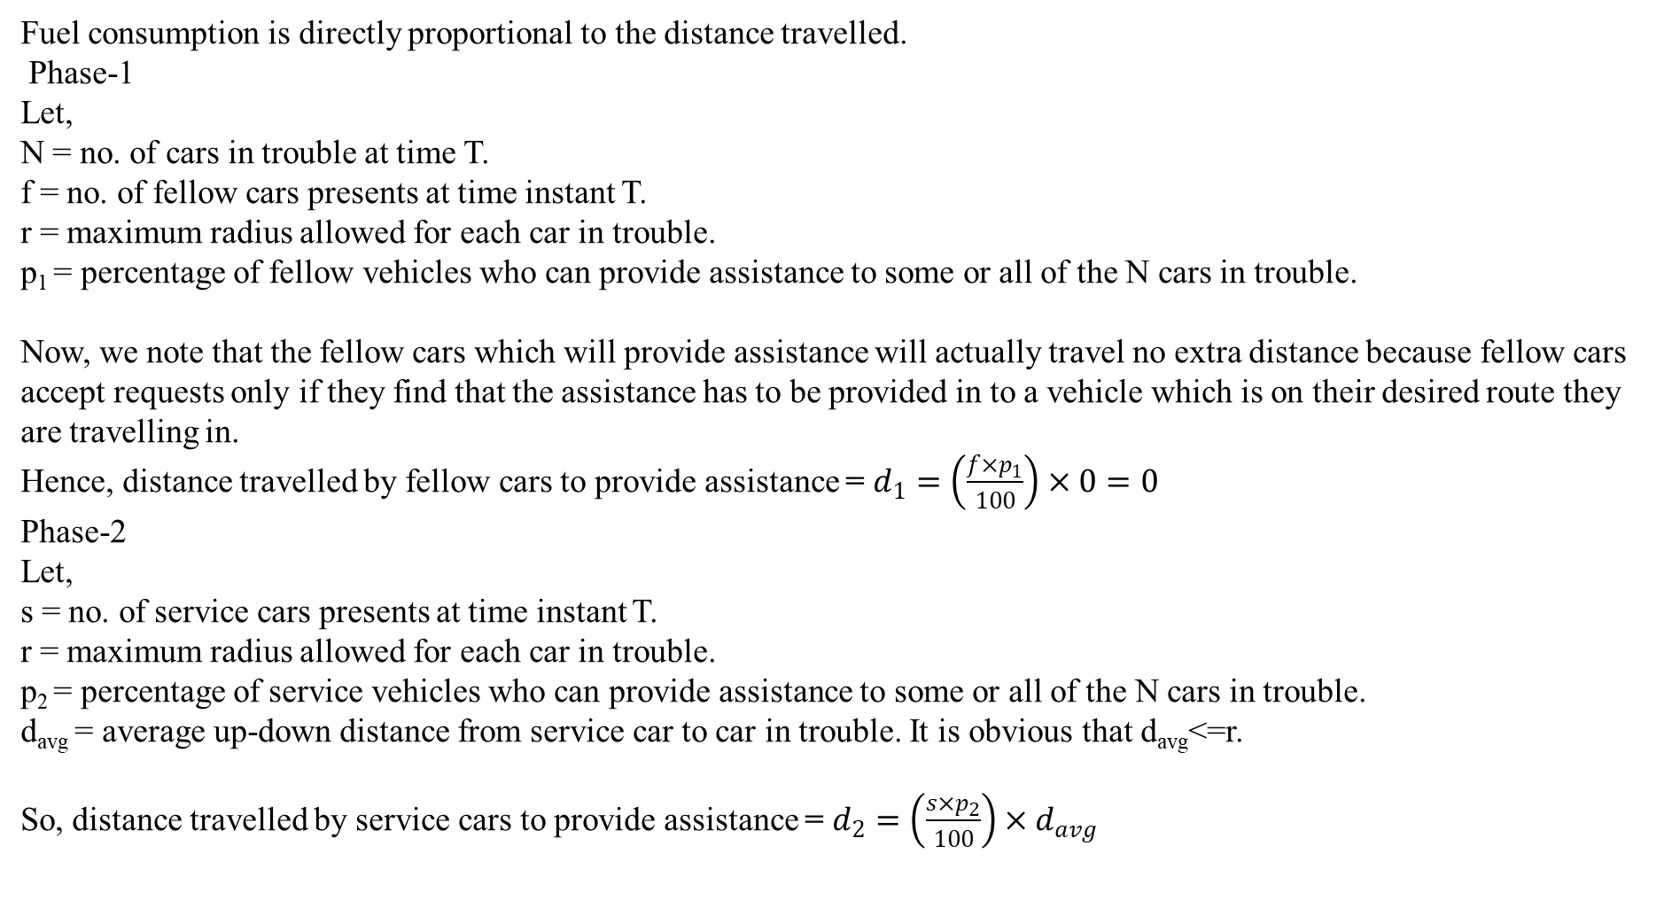
ANALYSIS
Fuel consumption is directly proportional to the distance travelled.
Phase-1
Let,
N = no. of cars in trouble at time T.
f = no. of fellow cars presents at time instant T.
r = maximum radius allowed for each car in trouble.
p₁ = percentage of fellow vehicles who can provide assistance to some or all of the N cars in trouble.
Now, we note that the fellow cars which will provide assistance will actually travel no extra distance because fellow cars accept requests only if they find that the assistance has to be provided in to a vehicle which is on their desired route they are travelling in.
Hence, distance travelled by fellow cars to provide assistance = $d_{1}=\left(\frac{f×p_{1}}{100}\right)×0=0$
Phase-2
Let,
s = no. of service cars presents at time instant T.
r = maximum radius allowed for each car in trouble.
p₂ = percentage of service vehicles who can provide assistance to some or all of the N cars in trouble.
d_{avg} = average up-down distance from service car to car in trouble. It is obvious that d_{avg}<=r.
So, distance travelled by service cars to provide assistance = $d_{2}=\left(\frac{s×p_{2}}{100}\right)×d_{avg}$

Slide 18
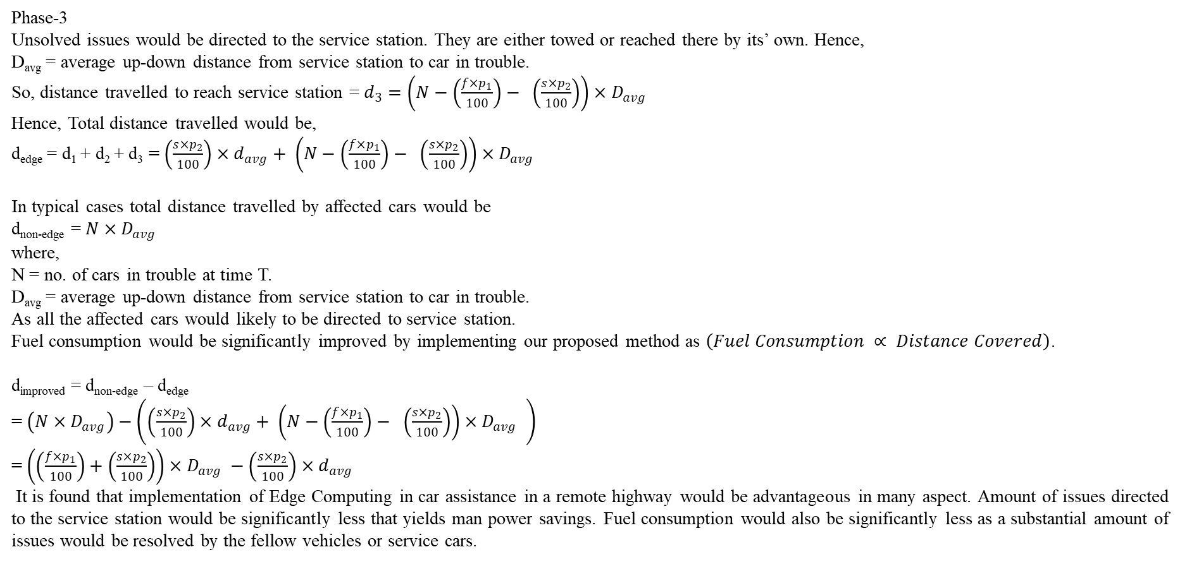
ANALYSIS
Phase-3
Unsolved issues would be directed to the service station. They are either towed or reached there by its’ own. Hence,
D_{avg} = average up-down distance from service station to car in trouble.
So, distance travelled to reach service station = $d_{3}=\left(N−\left(\frac{f×p_{1}}{100}\right)− \left(\frac{s×p_{2}}{100}\right)\right)×D_{avg}$
Hence, Total distance travelled would be,
d_{edge} = d₁ + d₂ + d₃ = $\left(\frac{s×p_{2}}{100}\right)×d_{avg}+ \left(N−\left(\frac{f×p_{1}}{100}\right)− \left(\frac{s×p_{2}}{100}\right)\right)×D_{avg}$
In typical cases total distance travelled by affected cars would be
d_{non-edge} = $N×D_{avg}$
where,
N = no. of cars in trouble at time T.
D_{avg} = average up-down distance from service station to car in trouble.
As all the affected cars would likely to be directed to service station.
Fuel consumption would be significantly improved by implementing our proposed method as $\left(Fuel Consumption ∝ Distance Covered\right)$.
d_{improved} = d_{non-edge} – d_{edge}
= $\left(N×D_{avg}\right)−\left(\left(\frac{s×p_{2}}{100}\right)×d_{avg}+ \left(N−\left(\frac{f×p_{1}}{100}\right)− \left(\frac{s×p_{2}}{100}\right)\right)×D_{avg} \right)$
= $\left(\left(\frac{f×p_{1}}{100}\right)+\left(\frac{s×p_{2}}{100}\right)\right)×D_{avg} −\left(\frac{s×p_{2}}{100}\right)×d_{avg}$
It is found that implementation of Edge Computing in car assistance in a remote highway would be advantageous in many aspect. Amount of issues directed to the service station would be significantly less that yields man power savings. Fuel consumption would also be significantly less as a substantial amount of issues would be resolved by the fellow vehicles or service cars.

Slide 19
CONCLUTION
A Vehicle Emergency Support System is proposed in this project to reduce the expenditure in terms of human resource and fuel consumption.
It is observed based on the real time data set that more than 50% issues would be resolved by the fellow vehicles or service cars.
It is advantageous over the typical system that need the entire issues at service station and then analyze and decide centrally.
This assistance system can of great help in case of autonomous vehicle systems.in case they need assistance they call for assistance in an autonomous way. They call for help to the servers. In case of mass failure of autonomous cars, the servers will have a lot of pressure on itself. Then edge computing comes to the rescue.
The time taken to solve the problem using this autonomous system is considerably lesser than a manual approach or a GPRS enabled approach where we search for nearest assistance center in the web.
Edge computing makes the entire process faster by filtering the entire process into multiple levels and reduces unnecessary pressure on the upper layers.
Keeping all these factors in mind we conclude that our system ‘Vehicle Emergency Support System’ is a much enriched and better idea.

Slide 20
This work has been sent as a paper in 2020 IEEE International Conference for Convergence in Engineering (ICCE, Record number #50343) which is likely to be held in September 2020 in Kolkata.

Slide 21
REFERENCES
[1] Eric Hamilton, “What is Edge Computing: The Network Edge Explained”, cloudwards.net, 2018.
[2] Tuyen X. Tran, Mohammad-Parsa Hosseini, Dario Pompili, “Mobile Edge Computing: Recent Efforts and Five Key Research Directions”, IEEE COMSOC Communications-Frontiers, Volume 12, Issue 4, pp. 29-33, 2017
[3] Xiang Sun, Nirwan Ansari, “EdgeIoT: Mobile Edge Computing for the Internet of Things”, IEEE Communications Magazine, Volume 54, Issue 12, pp. 22-29, 2016.
[4] Wenlu Hu, Ying Gao, Kiryong Ha, Junjue Wang, Brandon Amos Zhuo Chen, Padmanabhan Pillai, Mahadev Satyanarayanan, “Quantifying the Impact of Edge Computing on Mobile Applications”, APSys’16, Hong Kong, 2016.
[5] Yuan Ai, Mugen Peng, Kecheng Zhang, “Edge computing technologies for Internet of Things: a primer”, Digital Communications and Networks, ScienceDirect, Volume 4, Issue 2, pp. 77-86, 2018.
[6] Saravanan Kannan, Arunkumar Thangavelu, RameshBabu Kalivaradhan, “An Intelligent Driver Assistance System (I-DAS) for Vehicle Safety Modelling using Ontology Approach”, International Journal of UbiComp, Volume 1, Issue 3, pp.15-29, 2010
[7] Yimin Zhou, Gang Wang, Guoqing Xu, Guoqiang Fu, “Safety driving assistance system design in intelligent vehicle”, IEEE International Conference on Robotics and Biomimetrics (ROBIO 2014), Bali, Indonesia, 2014
[8] Vipin Kumar Kukkala, Jordan Tunnell, Sudeep Pasricha, Thomas H Bradley, “Advanced Driver-Assistance System: A Path Toward Autonomous Vehicles”, IEEE Consumer Electronics Magazine, Volume 7, Issue 5, pp. 18-25, 2018.
[9] Kyudong Park, Jiyoung Kwahk, Sung H. Han, Minseok Song, Dong Gu Choi, Hyeji Jang, Dohyeon Kim, Young Deok Won, In Sub Jeong, “Modelling the Intrusive Feelings of Advanced Driver Assistance Systems Based on Vehicle Activity Log Data: Case Study for the Lane Keeping Assistance System”, International Journal of Automotive Technology, Volume 20, pp. 455-463, 2019.

Slide 22
THANK YOU

