Slide 1
EDA On
Online Courses from Harvard and Mit

Slide 2
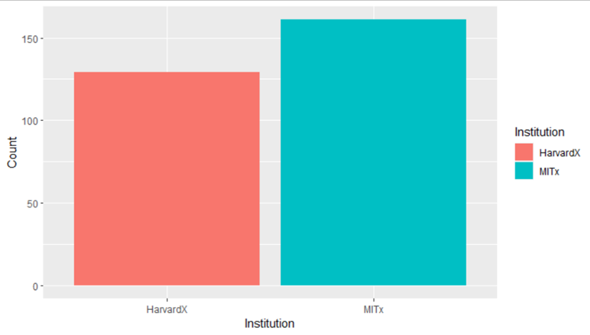
How many courses did each institution have?

Slide 3
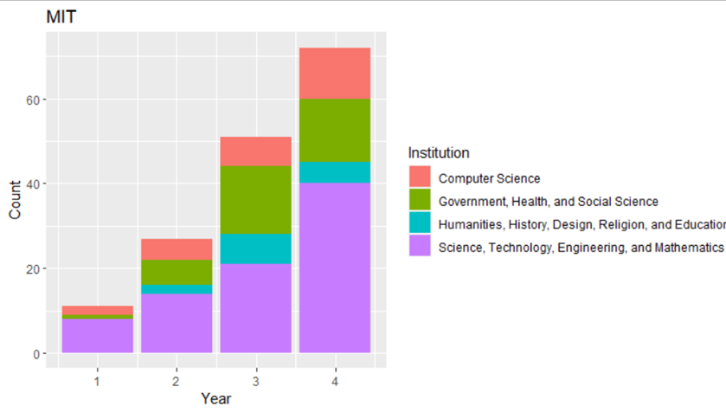
Did the number of lectures increase?

Slide 4
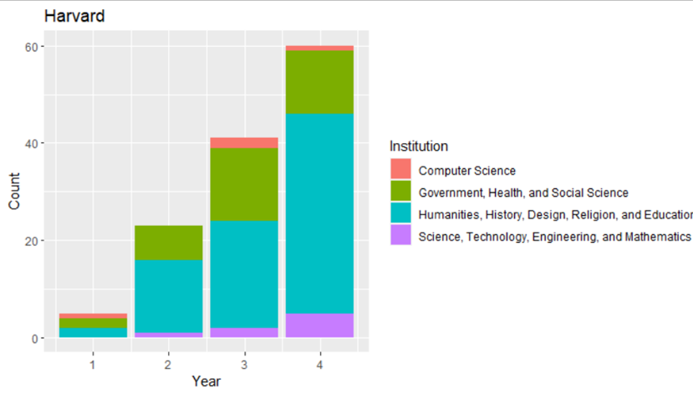
Did the number of lectures increase?

Slide 5
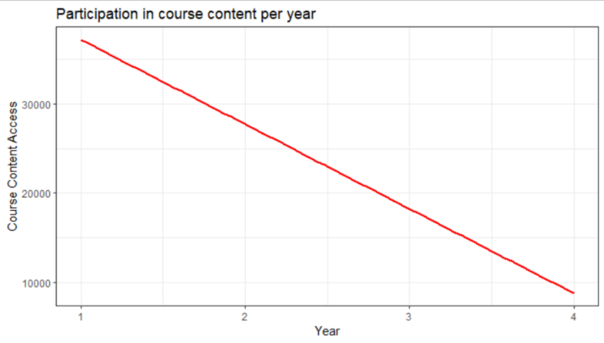
How is the participation per year going on?

Slide 6
References:
1. Chuang, I. (2017) Online courses from Harvard and MIT, Kaggle. Available at: https://www.kaggle.com/datasets/edx/course-study/code?datasetId=736&amp;language=R (Accessed: October 28, 2022).
2. YOO, HYUNSIK (2017) Things that affect the certification rate, Kaggle. Kaggle. Available at: https://www.kaggle.com/code/macgongmon/things-that-affect-the-certification-rate (Accessed: October 28, 2022).

