Slide 1






“Event Booking System”
Presented by: Pratik Hinge
Vivek Kumar Nand Vivekanand Choudhary Mrunalini Netkar

Slide 2
Area of Application:
Our event booking web application specializes in facilitating seamless coordination for music concerts, art exhibitions, and comedy shows.
Geared towards event organizers, the platform offers an intuitive interface for managing event details such as ticketing, seating arrangements, and promotional activities. Organizers can efficiently plan and execute events of varying scales, ensuring a smooth workflow. Meanwhile, for attendees, the application provides a user friendly experience to browse, select, and book tickets for these diverse events. Whether it's a captivating music concert, an inspiring art exhibition, or a laughter-filled comedy show, our platform enhances the overall event experience. With a focus on key locations and venues within cities, our application ensures that both organizers and attendees have a centralized hub for successful and memorable events

Slide 3
Need of the System:
Organizing and participating in events can be a complex and time consuming process, often plagued by challenges such as inefficient planning, limited accessibility, and fragmented communication. Our event booking web application addresses these pain
points by providing a centralized and user-friendly solution for both event organizers and attendees. For organizers, the system streamlines the event planning workflow, offering tools to manage ticketing. The application also enhances communication and collaboration among event teams, fostering a more efficient planning process. On the
attendee side, the need for a simplified and accessible platform for discovering and booking events is met. Our system ensures a seamless and personalized experience,
allowing attendees to explore and reserve tickets for music concerts, art exhibitions, and comedy shows with ease. By addressing these critical needs, our event booking web
application aims to revolutionize the event management landscape, making it more efficient, organized, and enjoyable for all stakeholders.

Slide 4

Business Use Cases:
Admin Organizer Attendee

Slide 5
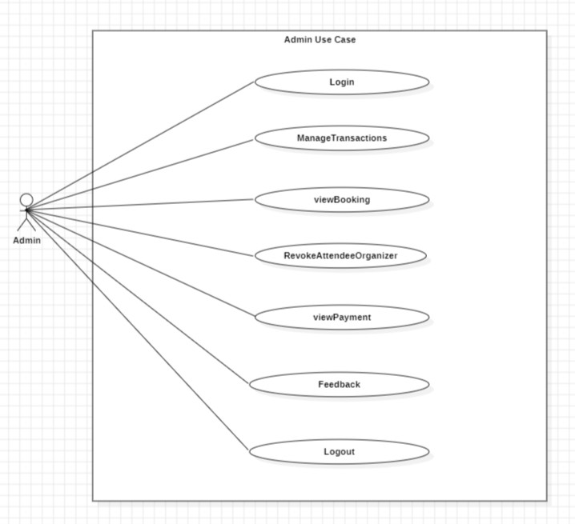
Use Case:
Admin:--

Slide 6
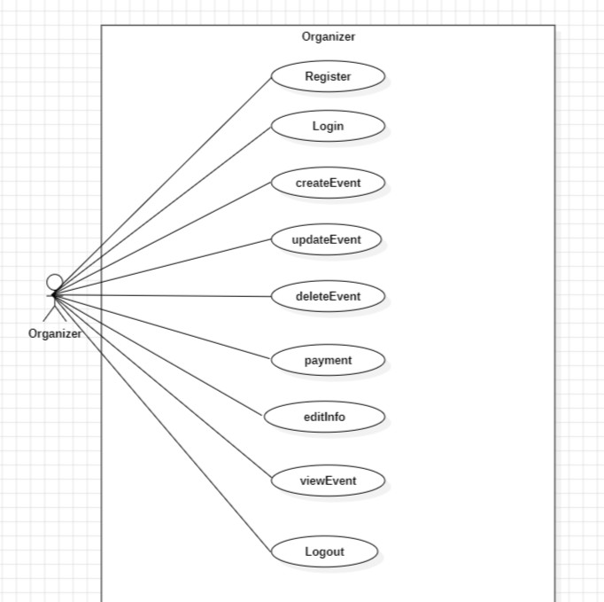
Use Case:
Organizer:--

Slide 7
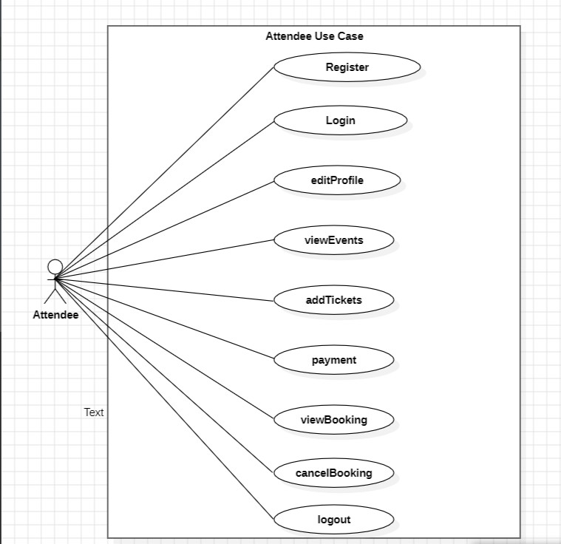
Use Case:
Attendee:--

Slide 8
Users and Use Case:
Admin:--
1.login 2.manageTransactions 3.viewBooking 4.revokeAttendeeOrganizer 5.viewPayment
6.feedback

Slide 9
User and Use Case:
Organizer:--
register
login
createEvent
updateEvent
deleteEvent.
payment
editInfo
viewEvent
logout

Slide 10
User and Use Case:
Attendee:--
1.register 2.login 3.editProfile 4.viewEvents. 5.addTickets 6.payment 7.viewBooking 8.cancelBooking 9.logout

Slide 11
Project MetThodology:
Phase 1:--
In phase one we have implemented Registration and Login for all Modules such as registration for Organizer and Attendee whereas Admin has only Login.
Phase 2:--
In phase two we have impleme_{A}n_{d}te_{d}d_{a}al_{l}l_{it}t_{t}h_{l}e_{e} C_{b}R_{it}U_{o}D_{f}o_{b}p_{o}e_{d}ra_{y}ti_{t}o_{e}n_{x}s_{t}such as add event , delete event, update the event, view the event ,delete attendee and organizer , view payments for attendees who booked tickets and organizer who booked for the event, view bookings done
, cancel the booking .
Phase 3:-- In the third phase of our project, we introduced the implementation of transactions. Transactions are essentially a way to ensure that multiple operations related to the booking process either happen entire or don't happen at all. This is crucial for maintaining the integrity and consistency of data in our system

Slide 12
GitHub Repository:
https://github.com/Vv3kS/EventBooking.git

Slide 13
Testing approacTh:
Testing done at different tiers-->
Rest API using postman.
Manual testing for react components

Slide 14
Future extensions:
More Ticket Choices: Allow organizers to offer different types of tickets (like VIP or regular) with different prices and perks.
Pick Your Seat: Let attendees choose where they want to sit in the venue from a map.
Get Reminders: Send reminders so people don't forget about
their booked events.
Share on Social Media: Make it easy for users to share their booked events on platforms like Facebook or Instagram Find Similar Events: Recommend other events people might like based on what they've booked before

Slide 15
Experience and Lesson Learnt:
The event booking project taught us a lot about dealing with a complex system. We had to juggle many different parts, like user sign-ups, managing events, selling tickets, and sending
notifications. It was like putting together a big puzzle! We also learned how to use Git and GitHub, which helped us work together smoothly. Sometimes, things didn't go as planned—we ran into unexpected problems and bugs in the code. But each time, we learned something new and figured out how to fix it.
Overall, the project showed us the importance of breaking things down into smaller pieces, listening to user feedback, and working together as a team to solve problems. It was a valuable learning experience that will help us in future projects

Slide 16
THANKYOU

