Slide 1
IOT Based Pump Control System
Guided By : Mr A. S. Dabhole
Presented By : Pratik Rohane

Slide 2
INTRODUCTION
Internet of Things
Ability to collect and transfer data over Internet
Control from ANYWHERE!
Effective merging the digital and physical world
Reduce Energy Consumption

Slide 3
OBJECTIVE
Monitor Pump Status
Send Command to the Controller
Control Pump System over Internet
SYSTEMS
Control Unit system
User Interface (Cloud)

Slide 4
CONTROL UNIT
Controller
Wi-Fi Module
Relay
Current Sensor
Indicator

Slide 5
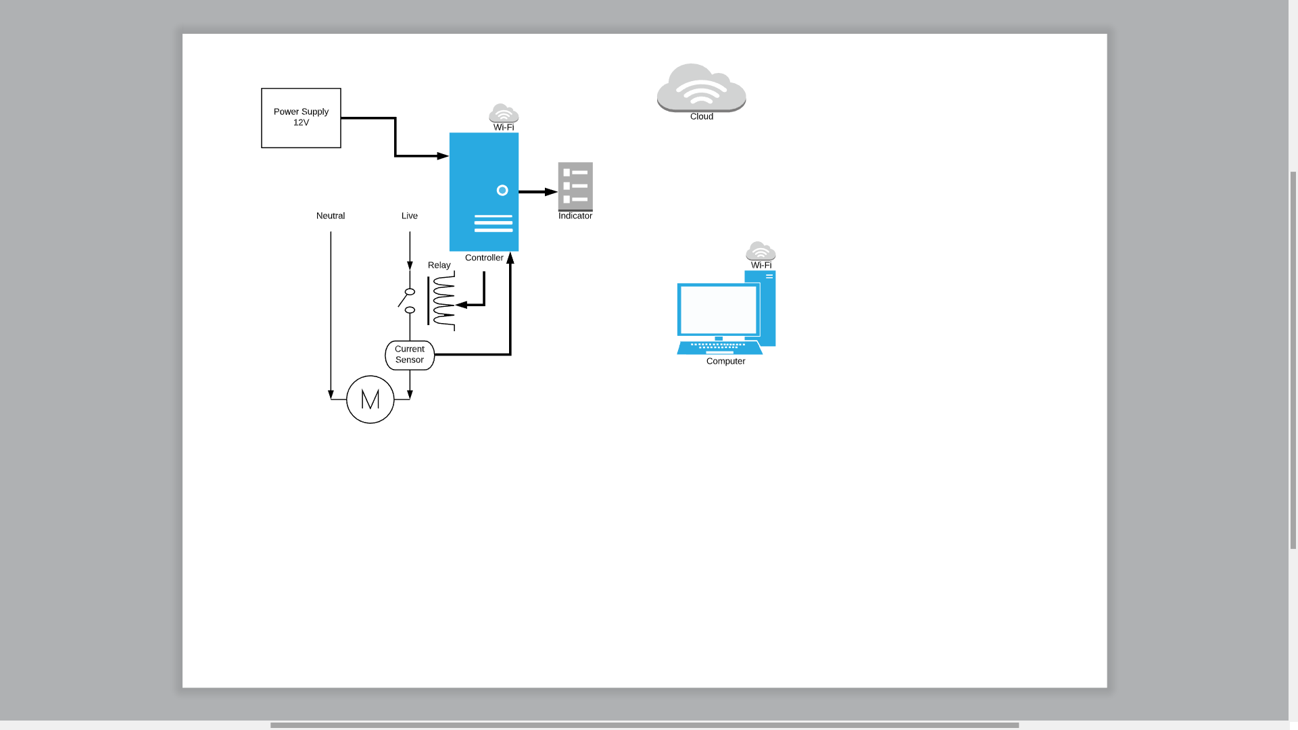
ARCHITECHTURE

Slide 6
INDICATOR
LED3
Internet
LED2
Wi-Fi
LED1
System

Slide 7
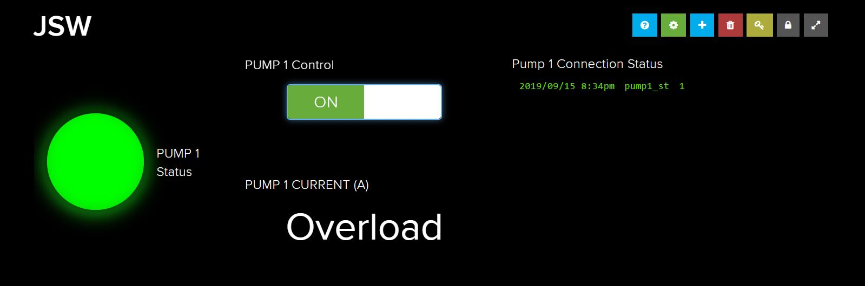
USER INTERFACE

Slide 8
THANK YOU!

