Slide 1

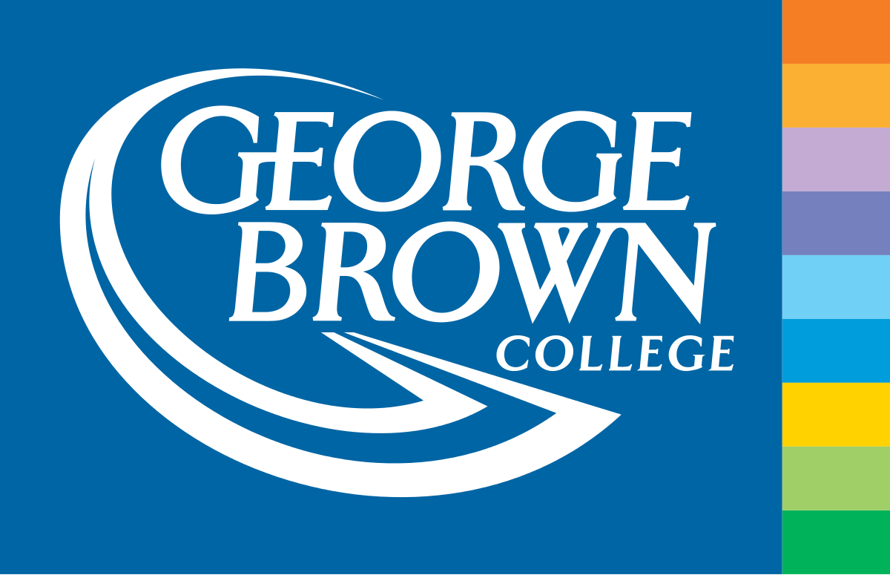
LAND-ON-BLOCK
Land registry and transfer on Blockchain

Slide 2

Person behind the idea!
Pratik is agile professional with five years of experience in FinTech domain as Business Analyst.
Got an idea while finding my father’s land records from govt. office and faced lots of issues
Time taken: 3.5 months
Determine to solve the issue with help of Blockchain and help state government to make land records and transfer transparent for all citizens

Slide 3



Problem statement
Missing land records
Fraudulent land records –
~1/3rd of legal dispute are of land claims
Lack of Transparency and accessibility

Slide 4
Introducing LAND-ON-BLOCK!

Slide 5
Benefits
Business Overhead reduction
Reduction fraud & mistakes
Easy accessibility & Improved traceability

Slide 6
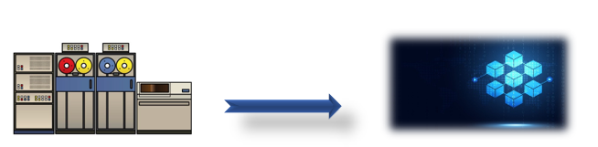
Land Registry on Blockchain
Land records on Legacy system
Land records on Blockchain

Slide 7
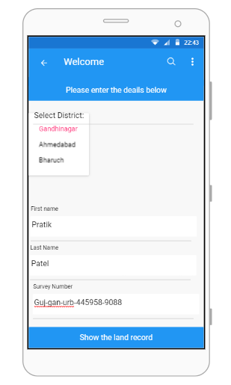
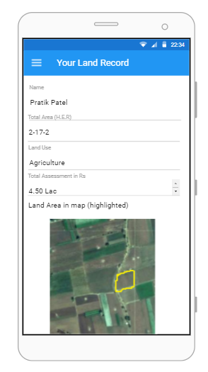
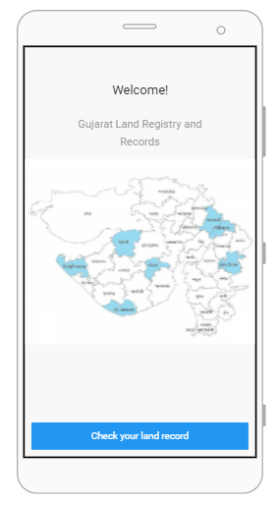
How the app would look like?
Land Registry check
Home Page
Fill out information
Get the information

Slide 8
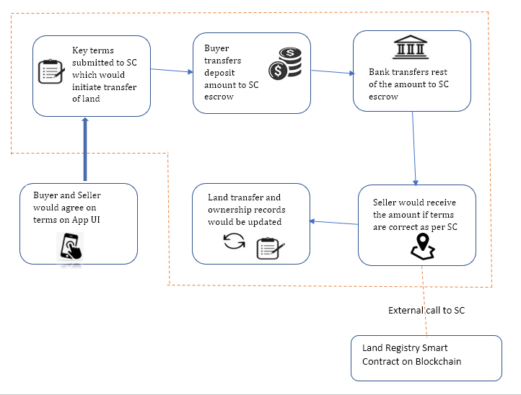
Land Transfer- How it works in background?

Slide 9
Market opportunity
Advantage of Digital India initiatives
Present online land records are only on web and vague
Increase in usage of Mobile Applications and data
India witnessed a massive jump in its data traffic. A report by Nokia revealed it grew nearly 60x in the past five years — the highest globally.

Slide 10
Want to be part of a success story?
Current efforts by various state governments to make land records online – needs improvement
Let’s help India to make land records digital, transparent and Trustworthy at the touch of fingertips
You can contribute with your technical and domain expertise on our forum with your proposals on https://www.landonblock.org/forum

