Slide 1
vcluster - How we put virtual kubernetes cluster inside another kubernetes cluster
Pratik Jagrut
#ossummit
@pratikjagrut
Notes:
Hello everyone, last day of conference, after lunch talk and you guys still showed up you guys must be real geeks. Fact about post lunch talk is some of you are bound to fall asleep. But I’ll try to finish it before you start dozing off.
Before starting the talk, I want to thank OSS team, who have provided me this podium to talk and to hide my shaking legs from you people.

Slide 2








Hi, I’m Pratik
Software Engineer @ Loft Labs, Inc.
Based in and made in India
Product
Open Source
pratikjagrut
@pratikjagrut
Kiosk
jsPolicy
pratikjagrut
Notes:
Little disclaimer, this is my first attempt to become a conference speaker, so I might fumble in between so just bare with me for a while.
Before jumping to the talk little bit about me and my company.
My name is Pratik.
I’m a software engineer at Loft Labs.
From my accent most of you must have already guessed I’m from India.
but the company is based in USA and I work remotely from India.
If you like the talk or interested in technology I work on or just for a casual conversation you can ping me on my social handles shown up here.
At Loft we work at bunch of technologies.
Loft is our commercial offering, it enables large companies to provide self serviced isolated namespaces to large number of teams or developers.
At loft we work at bunch of different open source and cool projects.
Our oldest project is DevSpace, which let’s you develop an application directly inside Kubernetes.
It essentially a replacement for docker-compose, designed for K8S.
Then Kiosk, is multi-tenancy extension for Kubernetes
Then jsPolicy, it is a policy engine that lets you write policies in javascript or typescript.
And then there is a vcluster which we’re here to talk about.

Slide 3
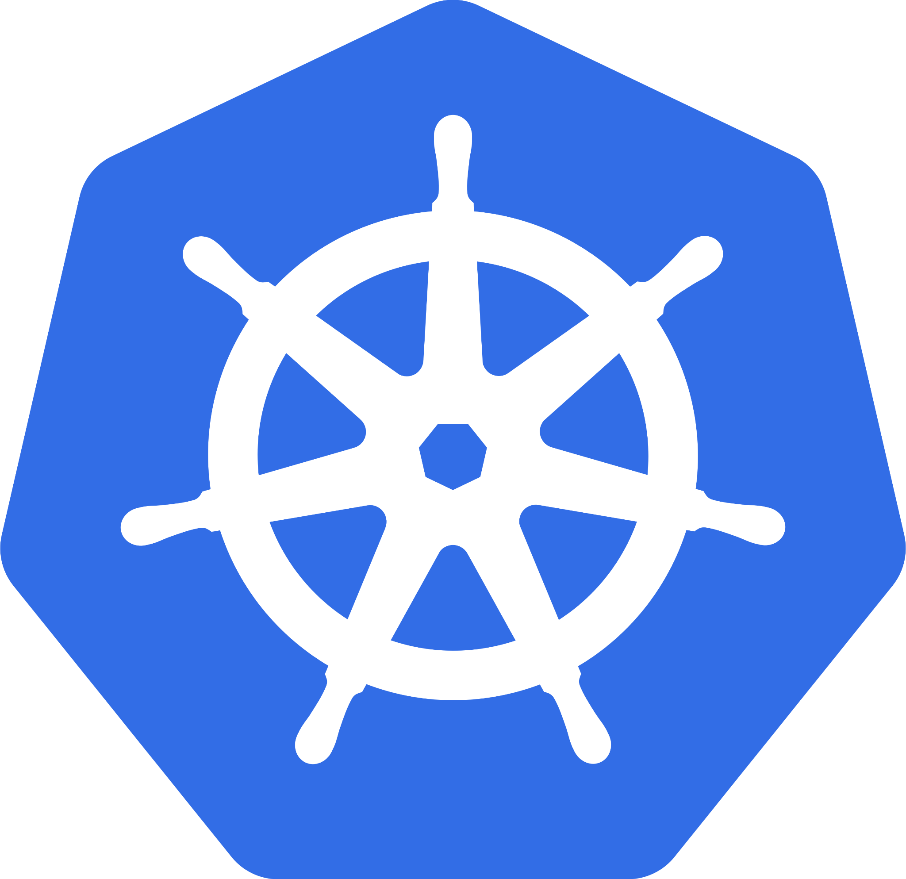
What is Kubernetes?
Kubernetes is a portable, extensible, open source platform for managing containerized workloads and services, that facilitates both declarative configuration and automation. It has a large, rapidly growing ecosystem. Kubernetes services, support, and tools are widely available.
- Kubernetes documentation
Notes:
Before I start with the vcluster I’ll try to establish some context.
I assume everyone attending this talk knows K8S.
If not then maybe you can have your post lunch siesta, just kidding, don’t sleep.
For those who’re new to K8S or getting started, this is the definition of K8S from documentation.
When I started working on k8s this doesn’t made any sense to me.
So someone I know told me that k8s is a container manager, which controls and governs the overall working and life cycle of containers.
And then as I started working more and more in k8s this definition started making sense to me.

Slide 4
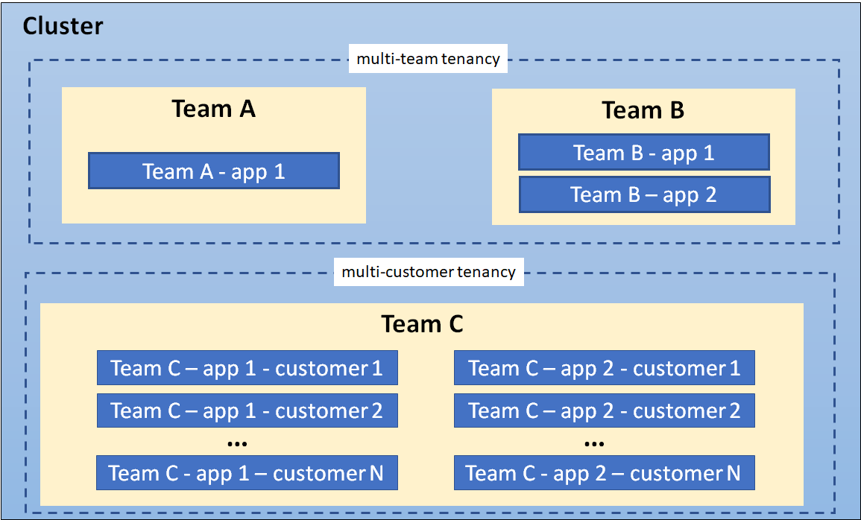
What is Multi-tenancy in K8S?
Sharing clusters between
Teams
Customers
Saves cost
Simplifies administration
Security
Access for tenants
Isolation
image source: k8s multi-tenancy doc
Notes:
Now, one of the hot topic around K8s is multi-tenancy.
I’ll try to explain it what is it and why should we care about it as simply as I could.
So as the name suggest, multi-tenancy is something related to more than one tenants.
Basically It means to share a cluster between multiple, teams or customers.
Why should we care for mullti-tenancy?
Because, it saves cluster cost, simplifies administration.
Imagine someone spinning up 1000 single tenant clusters, and now the overhead to manage this 1000 clusters is very high, and if you also gotta maintain ingress controller, cert manager, prometheus and metrics controller in all of this cluster, that’s lots of work.
The diagram here is from k8s docs, shows the multi-team tenancy and and multi-customer tenancy cluster architecture.
Achieving a stable multi-tenant cluster poses some challenges, like security, defining what type of access to be given to the user and isolation and we see many other challenges as we go deep in this area.

Slide 5
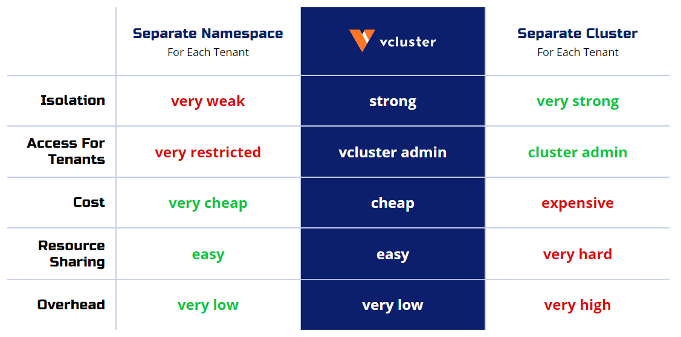
VS
Notes:
K8s by default provides namespaces to handle the multi-tenancy.
We can setup the network policies, limit ranges, resource quotas and other things to lockdown and isolate the tenants.
But what if some tenants needs to access to clusterwide resources, like some teams could be working on new CRD.
Some user might be given admin access but what if they breaks the cluster, then you’ll have to spin up a new one and this could cause issues to other users in same cluster
So you can see there is lot of work and overhead when we use namespace based multi-tenancy.

Slide 6
Best of both worlds?
???
Notes:
Is there a pragmatic solution for this?
If you’ve noticed in this diagram, the pros and cons of both the approaches are opposite on both side.
So, can’t we just have a middle ground best of both the worlds?

Slide 7
vcluster - Solution for multi-tenancy
Notes:
This is what with vcluster we’re trying to achieve.
It tries to give you benefits of separate cluster at the cost of namespace.
If you see the diagram vcluster tries to achieve the middle ground, the isolation in vcluster is stronger than the namespace whereas the cost of vcluster is cheaper than the separate cluster.

Slide 8

What is vcluster?
vcluster or virtual cluster is light weight k8s cluster
Runs on top of another k8s cluster
Has its own control plane
Easy to create and destroy
Virtual clusters are like virtual machines for Kubernetes
Virtual Clusters
Host Cluster
Notes:
Vcluster or virtual cluster is k8s distribution that runs on top of another k8s cluster.
It has its own controlplane, so no 2 tenants will interact with same api server or with the host api server.
It is lightweight and compare to the full fledge k8s cluster it take very little time to provision.
Like virtual machines, virtual cluster partitions host cluster into multiple logical clusters.

Slide 9
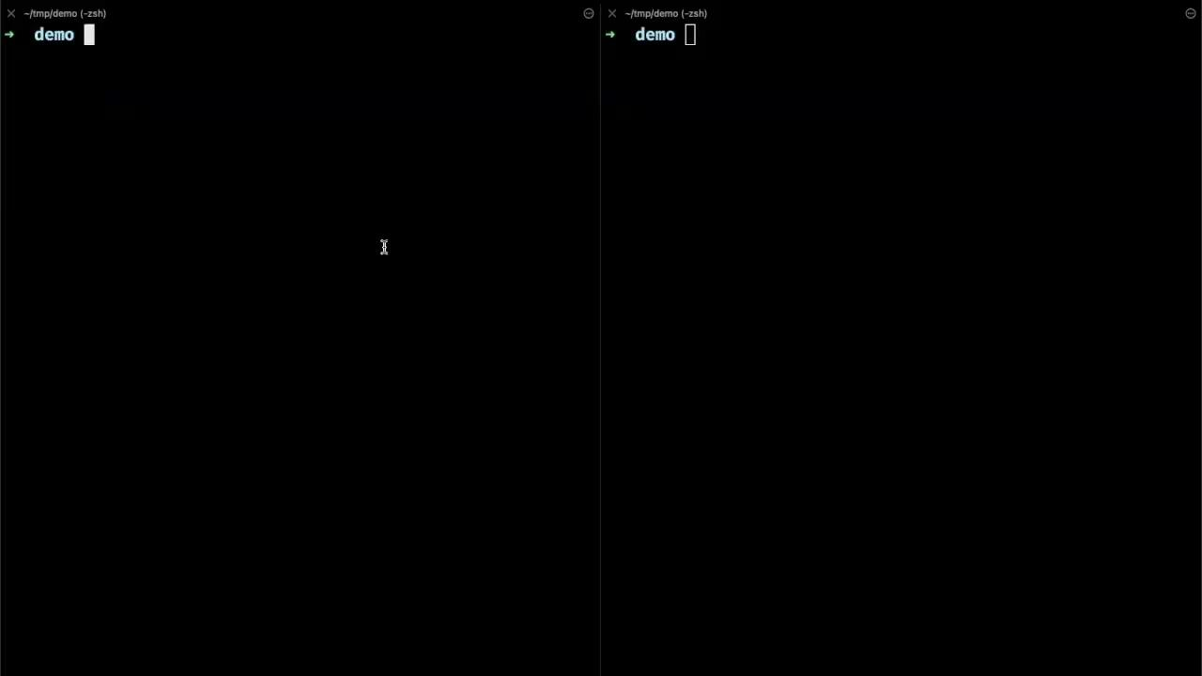
DEMO
Notes:
I’ve small demo here. I’ll show how to create, list and connect to vcluster.
list command lists the virtual clusters present in your cluster
then we can create virtual cluster using create command, vc1 is the name of virtual cluster.
if we get namespaces we can see a new namespace created inside host cluster where our virtual cluster resides.
to connect to virtual cluster we use connect command
now if you get namespaces here you’ll see the namespaces in virtual cluster.
Namespaces on both side of terminal are different.

Slide 10
vcluster - How does this work?
Virtual Clusters = Control Planes Running In Another Cluster
Pod 1
Pod 2
...
...
Workloads
Namespace 1
Namespace 2
Namespace 3
API Server
Data Store (etcd)
Controller Manager
Scheduler
Control Plane
Notes:
Let’s discuss what happened in demo.
How did we do this?
Basically a virtual cluster is a control plane running in another cluster.
So as we know control plane consist of API server, data store, controller manager and scheduler.
Then this control plane is responsible for managing the workloads.
Workload is basically pods running in Namespaces.
As a user we only talk with API server, that is our only point of communication.
So what vcluster does is it spins up API server and some other components as pods in namespace.

Slide 11
vcluster - How does this work?
Virtual Clusters = Control Planes Running In Another Cluster
Control Plane Running As Pod
API Server
...
...
...
Workloads
Namespace 1
Namespace 2
Namespace 3
API Server
Data Store (etcd)
Controller Manager
Scheduler
Control Plane
Notes:
So now when we connect to virtual cluster we connect to the API server running in the pod.

Slide 12
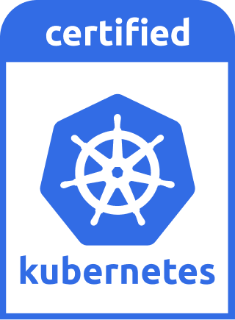
vcluster - Architecture
vcluster Service
vcluster Pod
API Server + Controller Manager
Data Store (sqlite, etcd, …)
Syncer
vcluster StatefulSet (vc1)
host-namespace
API Server
Data Store (etcd)
Controller Manager
Scheduler
Control Plane
Notes:
Let’s look at this from the architecture perspective.
virtual cluster mainly has 2 components. A statefulset and service.
The statefulset creates a pod where virtual lcuster lives in.
This pod has 2 continaters, one is running a control plane, consist of API server, data store and controller manager, and other one is a syncer.
So when user connects to the vcluster it connects to the vlcuster’s API server through vcluster service, this is a k8s service in host namespace so you can expose it via ingress or LB.
and this control plane is CNCF certified that means it passes all the conformance tests and works exactly as regular cluster.

Slide 13
vcluster - Workload - Create namespace
$
kubectl create namespace ns1
ns1
vcluster Service
vcluster Pod
API Server + Controller Manager
Data Store (sqlite, etcd, …)
Syncer
vcluster StatefulSet (vc1)
host-namespace
Notes:
Let’s look at the workload creation.
So when user creates a namespace, it is created in virtual cluster i.e it creates an entry in virtual cluster’s data store

Slide 14
vcluster - Workload - Create deployment
nginx-deploy
nginx-pod-1
$
kubectl create deployment nginx-deploy -n ns1 --image=nginx
ns1
vcluster Service
vcluster Pod
API Server + Controller Manager
Data Store (sqlite, etcd, …)
Syncer
vcluster StatefulSet (vc1)
host-namespace
Notes:
similarly when user creates deployment it creates the entry of deployment and pods in data store.
Now you must’ve noticed we do not have scheduler in the vcluster.
and without scheduler the pod is a just an entry in data store.
So here we’ve a syncer.
This is what it makes vcluster truly virtual.
What it essentially does is, it copies the pods from vcluster to underlying host cluster namespace and then host cluster scheduler schedules this pods on node.

Slide 15
vcluster - Syncer syncs Pods To Host Namespace / “Real” Cluster
nginx-deploy
nginx-pod-1
ns1
vcluster Service
vcluster Pod
nginx-pod-1
API Server + Controller Manager
Data Store (sqlite, etcd, …)
Syncer
vcluster StatefulSet (vc1)
host-namespace

Slide 16
vcluster - Naming conflicts?
nginx-deploy
nginx-pod-1
nginx-deploy
nginx-pod-1
ns1
ns2
vcluster Service
vcluster Pod
nginx-pod-1
API Server + Controller Manager
Data Store (sqlite, etcd, …)
Syncer
nginx-pod-1 ?
vcluster StatefulSet (vc1)
host-namespace
Notes:
virtual cluster essentially is a k8s cluster, so we can have multiple namespaces and workloads in them
what happens if we create same name workload in different namespaces?
Does the underlying host cluster namespace runs into pod name conflicts?
So the answer is NO.

Slide 17
vcluster - Workload nomenclature
nginx-deploy
nginx-pod-1
nginx-deploy
nginx-pod-1
ns1
ns2
vcluster Service
vcluster Pod
nginx-pod-1-x-ns1-x-vc1
API Server + Controller Manager
Data Store (sqlite, etcd, …)
Syncer
nginx-pod-1-x-ns2-x-vc1
vcluster StatefulSet (vc1)
host-namespace
Notes:
vcluster before syncing resources down changes the names.
It follows certain pattern.
The first part of the name is the name of the resource
and then the namespace name
and the last part is virtual cluster’s name,
because we can create multiple virtual clusters inside one host namespace.

Slide 18
vcluster - What resources does syncer sync?
SYNCER, by-default, only syncs resources needed by POD to run
Syncs
Does not Sync
Pods, with:
Mounted ConfigMaps and Secrets
Persistent volumes and claims
Services
Endpoints
Nodes(configurable)
etc.
Higher Level Resources
Deployments
StatefulSets
DaemonSets
CustomResourceDefinitions
Not mounted ConfigMaps, Secrets
etc.
Syncer syncs back the status of each object
Enabling the synchronization of optional resources is possible through vcluster configuration
Notes:
Syncer only syncs what is necessary for pod to run,
like mounted configmaps,
secrets
pv and pvc,
services,
endpoints.
and it does not sync higher level resources like
deployments,
statefulsets
daemonsets
and CRDs
syncer syncs back the status of each object to the respective virtual cluster object
there are so many other resources that can be enabled or disabled to sync using sync flag or using a config file.

Slide 19

DEMO
Notes:
This is the same virtual cluster we created in last demo
the pod vc1 is running and has 2 containers, control plane and syncer
now we connect to our virtual cluster
we create nginx deployment
and we can see the pod is in running state..
now we disconnect and see the pod is scheduled in host namespace with altered name.

Slide 20
vcluster - Key features
Isolation mode
Rootless mode
Pause and resume cluster
Expose vcluster API server via Ingress, LB, etc.
You can install k3s, k0s, k8s or eks distro using --distro flag
vcluster in vcluster
Notes:
vcluster comes with lots of feature and we’re continuously working on adding new features on each release.
Some of the key features are:
Isolation mode: When the virtual custer is run in this mode,
it creates resources quotas,
limit range,
network policy
and applies pod security standards so the workload to be strictly isolated.
Rootless mode, it runs virtual cluster’s containers syncer and control plane in non root mode.
virtual cluster can be paused and resumed at any time, when it is paused, it scale down the vcluster statefulset or deployment and delete the workloads created by vcluster and resource besides pvs are not being used.
the api server can be exposed via ingerss or LB
using vcluster you can install k3s, k0s, vanilla k8s or eks distro
so you can do mix and match, trying k3s on top of eks
and little bit nasty, but you can also install vcluster inside another vcluster making it nested virtual cluster

Slide 21
vcluster - Use Cases
Ephemeral CI/CD Environments
Integration, End-To-End, Acceptance Testing
Instant Preview Environments Per Pull-Request
Remote Development Environments
Experimentation
Cluster Simulations
More Resilient Multi-Tenant Clusters In Production
Demo and training environments
Notes:
virtual cluster has lots of practical world applications some of the use cases could:
for ci/cd environment
remote developement
you can do experimentation such as trying different versions of kubernetes
cluster simulations
and multi-tenant cluster in production
and for demo and training purposes

Slide 22
vcluster - Getting started
Download CLI &&
Getting Started: https://www.vcluster.com/docs/quickstart
GitHub: https://github.com/loft-sh/vcluster
Website: www.vcluster.com
Twitter: https://twitter.com/loft_sh
$ vcluster create my-vc
Notes:
To get started with vcluster you just have download the CLI
and create your virtual cluster
The documentation is very well written and easy to understand.
You can find vcluster on GITHUB and can contribute to the project.

Slide 23
Thank you and Questions?
you can write me on my social handles or at pj@loft.sh
Notes:
If anyone has any question can come here and speak in the mike, because the talk is being streamed online.

