Slide 1
EEE 2004 – Measurement and Instrumentation FINAL PROJECT REVIEW
PROJECT TOPIC : IOT based air quality index monitoring
TEAM MEMBERS:
SHREYA BISWAS:20BEI0072
PRATIK JAIN:20BEI0091
PULKIT SARAF:20BEI0092
Faculty Guide :
Dr. p.Arulmozhivarman

Slide 2
CURRENT STATUS
We have decided the overflow of the project and ordered the required devices and we are presently studying Arduino in depth.
MOTIVATION
The level of pollution has increased with times by lot of factors like the increase in population, increased vehicle use, industrialization and urbanization which results in harmful effects on human wellbeing by directly affecting health of population exposed to it. In order to monitor. In this project we are going to make an IOT Based Air Pollution Monitoring System in which we will monitor the Air Quality over a web server using internet and will trigger an alarm when the air quality goes down beyond a certain level.

Slide 3
LITERATURE SURVEY
1) Monika Singh Et al. in August 2019 proposed an Air Pollution Monitoring System. This system uses an Arduino microcontroller connected with MQ135 and MQ6 gas sensor which senses the different types of gases present in the environment. It was then connected to the Wi-Fi module which connects to the internet and LCD is used to display the output to the user and buzzer alerts when the ppm crosses certain limit. Their applications were industrial perimeter monitoring, indoor air quality monitoring, site selection for reference monitoring stations, making data available to users.
2) Nithin Et al. in November 2018 used IoT by measuring the concentration of gas using various sensors which were observed through serial monitor of Arduino. This data is collected in Thing speak channels by means of Ethernet shield which is available in live for further processing. These analyzed results were viewed through thing speak in a graphical format. Then the average pollution level was calculated using MATLAB analysis and the time controlled results were viewed through an android app. Further based on the location, the air quality index value was obtained through the android app. Along with this, the health effects were also displayed in this app, so that the users can stay aware of the pollution levels.

Slide 4
PROBLEM STATEMENT
TOPIC -IOT based air quality index monitoring
Our project supports the advanced technology and the concept of healthy life. This system enables people to monitor the amount of pollution in an area on their mobile phones using the application/website and also on an LCD Display. This system is budget friendly and therefore can be easily purchased in the market for a safer and healthier future.

Slide 5
OBJECTIVES
In IoT Based Air Pollution Monitoring System we will monitor the Air Quality over a webserver using internet and will trigger an alarm when the air quality goes down beyond a certain level, means when there are sufficient amount of harmful gases are present in the air like CO2, smoke, alcohol, benzene and NH3. It will show the air quality in PPM on the LCD so that we can monitor it very easily. The alarm will set off to alert the user to switch on appliances (exhaust fan, Fan) to remove excess of gas from the room or cabin and maintain the air quality at a certain range.

Slide 6
METHODOLOGY
WORKFLOW
PHASE – 1
Detection of Air Pollutant Level It indicates the early phase of the project. An IoT based air pollution detection kit is developed. It deals with the collection of data from gas sensors connected to Arduino and the information is sent to the cloud platform that stores it.
PHASE – 2
Creating the interface This stage involves the clarification of the various components for optional performance. MCP3008 is a 10 bit converter which is calibrated to convert analog data to digital with on-board sample and hold circuitry. The data collected is stored, processed and can be monitored using the Mobile Application. Users can review the stored data through the
application.
PHASE – 3
Execution and Testing The various components are interfaced together and the project deliverables are built with the help of different circuit designs. The testing, debugging and troubleshooting of the design is performed to test the performance of the design under various conditions. If a circuit design fails to pass the tests, then a newer circuit design should be completed, implemented and tested.

Slide 7
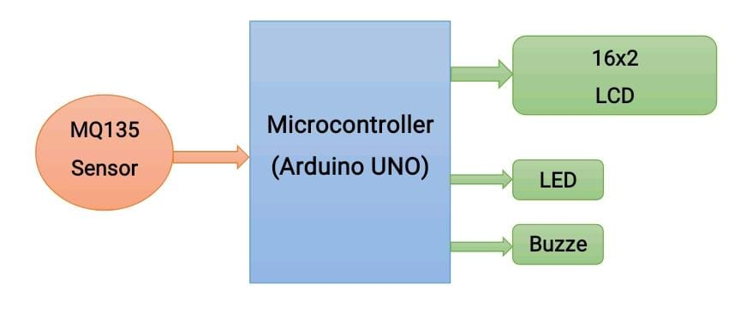
ALGORITHM

Slide 8
Design Implementation- Hardware details
MQ135 Gas sensor
Arduino Uno
16X2 LCD
Breadboard
10K potentiometer
1K ohm resistors
220 ohm resistor
Buzzer

Slide 9
RESULTS achieved TILL DATE
The hardware part was completed using sensor MQ135gas sensor, Arduino, LCD, LED and Resistor .
The implementation was done when the Arduino was connected to the laptop using the port .
After running and compiling the code using Arduino IDE we were successfully able to find the air quality index of the surrounding .

Slide 10
LESSONS LEARNED & SCOPE FOR IMPROVEMENT
Implementation of Arduino code into the project helped us know more about the features and wide reach of this electronics platform .
Addition of ESP8266 would be a step forward in improvement of the project as it can store the data which can be used in the future.
Implementing the model in the large scale so that it is available for common people.
The project has many scopes of improvement which involves
wide and deep research.

Slide 11
Standards Adopted
IEEE P2413 Standard.
2. Every safety-related hardware component and part used within the scope of ISO 26262 is subject to standard qualification.

Slide 12
TIMELINE
JANUARY
FEBRUARY
MARCH
APRIL

Slide 13
Role and Responsibilities
Pulkit Saraf: Hardware implementation in the project .
Pratik Jain: Software simulation of circuit and hardware implementation .
Shreya Biswas: Software implementation required in the project and documentation.

Slide 14
REFERENCE
1.J. J. Caubel, T.E. Cados, T.W.Krichstetter,(2018)‘ANew Black Crabon Sensor for Dense Air Quality Monitoring Networks’, IEEE.
2.Harsh Gupta,Dhananjay Bhardwaj,HimanshuAgrawal, Vinay Anand Tikkiwal, ArunKumar,(2019)‘AnIoTBasedAir Pollution Monitoring System for Smart Cities’, ICSETS.
3. G. Lo Re, D. Peri, S. D. Vassallo, (2013) ‘A mobile application for assessment of air pollution exposure’, IEEE.
4. Monika Singh, Misha Kumari, PradeepKumarChauhan, (2019) ‘IoT Based Air Pollution Monitoring System using Arduino’, International Research Journal of Engineering and Technology, IRJET.
5.Nitin SadashivDesai,JohnSahayaRaniAlex,(2017)‘IoT based air pollution monitoring and predictor system on Beagle Bone Black’, International Conference on Nextgen Electronic Technologies, ICNET.
6. K. S. E. Phala, A. Kumar, and Gerhard P. Hancke, ‘Air Quality Monitoring System Based on ISO/IEC/IEEE 21451 Standards’, IEEE.

Slide 15
Thank You!!

