Slide 1
SUBJECT: DESIGN AND ANALYSIS OF ALGORITHM
SUBJECT CODE: CSE21PCL251

Slide 2
SYLLABUS
UNIT – I
Introduction To Algorithms:
Definition of Algorithms, Properties of Algorithms, Expressing Algorithm, Sorting techniques –Bubble Sort, Insertion sort, Selection sort, Heap sort, Order of Growth, Asymptotic Notations, Performance Analysis of Recursive and Non-recursive algorithms.
UNIT – II
Divide and Conquer: Introduction to Divide and Conquer Technique, Binary Search, Min-Max, Merge Sort, Quick Sort.
UNIT - III
Greedy Algorithms: Introduction to Greedy Technique, Greedy Method, Optimal Merge Patterns, Huffman Coding, Knapsack Problem, Activity Selection Problem, Job Sequencing with Deadline, Minimum Spanning Tree, Single- Source Shortest Path Algorithm.

Slide 3
UNIT - IV
Dynamic Programming: General strategy, Characteristics of Dynamic Programming Longest common subsequence,
Multistage graphs ,All pair shortest path algorithm- Floyd-Warshall & Algorithm, The Knapsack Problem, Traveling Salesperson ,Application of Dynamic Programming.
UNIT – V
Branch and Bound, Backtracking Strategy: Backtracking: General strategy and characteristics, N-queen problem, Four–Queens Problem, Eight–Queen Problem, graph coloring, subset sum problem, Hamiltonian Circuit Problem
Branch and Bound: Introduction, 15- Puzzle Problem, Comparisons between Backtracking and
Branch and Bound.
Complexity Classes: P, NP, NP complete problems

Slide 4
TEXT BOOKS
Fundamentals of Computer Algorithms, Ellis Horowitz, Satraj Sahni and Rajasekharan,3rd Edition University Press.
A. V. Aho, J. E Hopecroft and J.D. Ullman, The design and analysis of algorithm, Addision- Wesley,1974
“Udit Agarwal, “Algorithms, Design and Analysis”, Dhanpat Rai &Co.

Slide 5
REFERENCES
Introduction to Algorithms, second edition, T.H. Coremen, C.E Leiserson, R.L.Rivest and C. Stien, PHI Pvt . Ltd./Pearson Education.
Algorithm Design; Foundations, Analysis and Internet Examples, M.T. Goodrich and R. Tamassia, John Wiley and sons.

Slide 6
INTRODUCTION
The word algorithm comes from the name of the person author
-Abu Jafar Mohammed Ibn Musa Al khowarizmi who wrote
A text book entitled-”Algorithmi de numero indorum” Now term” Algorithmi ”in the title of the book led to the term Algorithm.
An algorithm is an effective method for finding out the solution for a given problem. It is a sequence of instruction
That conveys the method to address a problem
Algorithm : Step by step procedure to solve a computational problem is called Algorithm.
or
An Algorithm is a step-by-step plan for a computational procedure that possibly begins with an input and yields an output value in a finite number of steps in order to solve a particular problem.

Slide 7
INTRODUCTION
An algorithm is a set of steps of operations to solve a problem performing calculation, data processing, and automated reasoning tasks.
An algorithm is an efficient method that can be expressed within finite amount of Time and space.
The important aspects of algorithm design include creating an efficient algorithm to solve a problem in an efficient way using minimum time and space.
To solve a problem, different approaches can be followed. Some of them can be efficient with respect to time consumption, whereas other approaches may be memory efficient.

Slide 8
PROPERTIES OF ALGORITHM
TO EVALUATE AN ALGORITHM WE HAVE TO SATISFY THE FOLLOWING CRITERIA:
INPUT: The Algorithm should be given zero or more input.
OUTPUT: At least one quantity is produced. For each input the algorithm
produced value from specific task.
3.DEFINITENESS: Each instruction is clear and unambiguous.
4.FINITENESS: If we trace out the instructions of an algorithm, then for all cases, the algorithm terminates after a finite number of steps.
5.EFFECTIVENESS: Every instruction must very basic so that it can be carried out, in principle, by a person using only pencil & paper.

Slide 9
ALGORITHM (CONTD…)
A well-defined computational procedure that takes some value, or set of values, as input and produces some value, or set of values, as output.
Written in a pseudo code which can be implemented in the language of programmer’s choice.
PSEUDO CODE: A notation resembling a simplified programming language, used in program design.

Slide 10
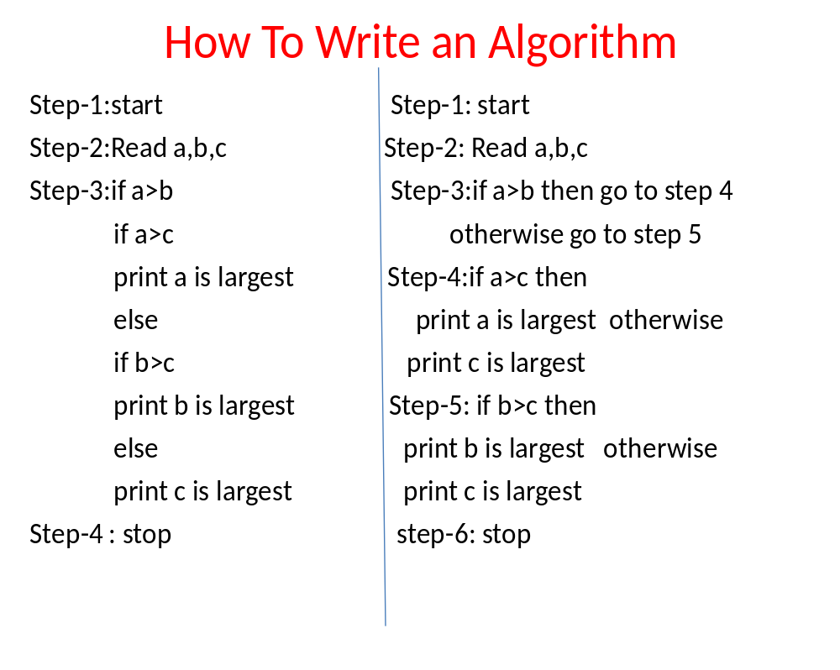

Slide 11
Differences
Algorithm Program
1.At design phase 1.At Implementation phase- Expression of an algorithm in a programming language
2.Natural language 2.written in any programming language
3.Person should have 3.Programmer
Domain knowledge
4.Analyze- Computing Time 4.Testing – Debugging
& Storage & Profiling

Slide 12
ALGORITHM SPECIFICATION
Algorithm can be described (Represent) in four ways.
Natural language like English:
When this way is chooses, care should be taken, we should ensure that each & every statement is definite.
(no ambiguity)
2. Graphic representation called flowchart:
This method will work well when the algorithm is small & simple.
3. Pseudo-code Method:
In this method, we should typically describe algorithms as program, which resembles language like Pascal & Algol(Algorithmic Language).
4.Programming Language:
we have to use programming language to write algorithms like
C, C++,JAVA etc.

Slide 13
PSEUDO-CODE CONVENTIONS
Comments begin with // and continue until the end of line.
Blocks are indicated with matching braces { and }.
An identifier begins with a letter. The data types of variables are not explicitly declared.
node= record
{
data type 1 data 1;
data type n data n;
node *link;
}
4. There are two Boolean values TRUE and FALSE.
Logical Operators
AND, OR, NOT
Relational Operators
<, <=,>,>=, =, !=

Slide 14
5. Assignment of values to variables is done using the assignment statement. <Variable>:= <expression> ;
6. Compound data types can be formed with records. Here is an example,
Node. Record
{
data type – 1 data-1;
.
.
.
data type – n data – n;
node * link;
}
Here link is a pointer to the record type node. Individual data items of a record can be accessed with → and period.

Slide 15
Contd…
7. The following looping statements are employed.
For, while and repeat-until While Loop:
While < condition > do
{
<statement-1>
..
..
<statement-n>
}
For Loop:
For variable: = value-1 to value-2 step step do
{
<statement-1>
.
.
.
<statement-n>
}

Slide 16
repeat-until:
repeat
<statement-1>
.
.
.
<statement-n>
until<condition>
8. A conditional statement has the following forms.
→ If <condition> then <statement>
→ If <condition> then <statement-1>
Else <statement-1>

Slide 17
Case statement:
Case
{
: <condition-1> : <statement-1>
.
.
.
: <condition-n> : <statement-n>
: else : <statement-n+1>
}
9. Input and output are done using the instructions read & write. No format is used to specify the size of input or output quantities

Slide 18
Contd…
10. There is only one type of procedure: Algorithm, the heading takes the form,
Algorithm Name (Parameter lists)
consider an example, the following algorithm fields & returns the maximum of n given numbers:
algorithm Max(A,n)
// A is an array of size n
{
Result := A[1];
for i:= 2 to n do
if A[i] > Result then
Result :=A[i];
return Result;
}

Slide 19
Issue in the study of algorithm
1. How to create an algorithm.
2. How to validate an algorithm.
3. How to analyses an algorithm
4. How to test a program.
1 .How to create an algorithm: To create an algorithm we have following design technique
a) Divide & Conquer
b) Greedy method
c) Dynamic Programming
d) Branch & Bound
e) Backtracking

Slide 20
2.How to validate an algorithm: Once an algorithm is created it is necessary to show that it computes the correct output for all possible legal input , this process is called algorithm validation.
3.How to analyses an algorithm: Analysis of an algorithm or performance analysis refers to task of determining how much computing
Time & storage algorithms required.
Computing time-Time complexity: Frequency or Step count method
Storage space- To calculate space complexity we have to use number
of input used in algorithms.
4.How to test the program: Program is nothing but an expression
for the algorithm using any programming language. To test a program
we need following
Debugging: It is processes of executing programs on sample data sets
to determine whether faulty results occur & if so correct them.
Profiling or performance measurement is the process of executing a
correct program on data set and measuring the time & space it takes
to compute the result.

Slide 21
ANALYSIS OF ALGORITHM
PRIORI POSTERIORI
1.Done priori to run algorithm 1.Analysis after running on a specific system it on system.
2.Hardware independent 2.Dependent on hardware
3.Approximate analysis 3.Actual statistics of an algorithm
4.Dependent on no of time 4.They do not do posteriori
statements are executed analysis

Slide 22
Problem: Suppose there are 60 students in the class. How will you calculate the number of absentees in the class?
Pseudo Approach
1.Initialize a variable called as Count to zero, absent to zero, total to 60
2.FOR EACH Student PRESENT DO the following:
Increase the Count by One
3.Then Subtract Count from total and store the result in absent
4.Display the number of absent students

Slide 23
Problem: Suppose there are 60 students in the class. How will you calculate the number of absentees in the class?
Algorithmic Approach:
1.Count <- 0, absent <- 0, total <- 60
2.REPEAT till all students counted
Count <- Count + 1
3.absent <- total - Count
4.Print "Number absent is:" , absent

Slide 24
Need of Algorithm
1. To understand the basic idea of the problem.
2. To find an approach to solve the problem.
3. To improve the efficiency of existing techniques.
4. To understand the basic principles of designing the algorithms. To compare the performance of the algorithm with respect to other techniques.
6. It is the best method of description without describing the implementation detail.
7. The Algorithm gives a clear description of requirements and goal of the problem to the designer.
8. A good design can produce a good solution.
9. To understand the flow of the problem.

Slide 25
PERFORMANCE ANALYSIS
Performance Analysis: An algorithm is said to be efficient and fast if it take less time to execute and consumes less memory space at run time is called Performance Analysis.
SPACE COMPLEXITY:
The space complexity of an algorithm is the amount of Memory Space required by an algorithm during course of execution is called space complexity .There are three types of space
Instruction space :executable program
Data space: Required to store all the constant and variable data space.
Environment: It is required to store environment information needed to resume the suspended space.
2. TIME COMPLEXITY:
The time complexity of an algorithm is the total amount of time required by an algorithm to complete its execution.

Slide 26
What is Complexity?
• Complexity refers to the computational resources required by an algorithm.
• It is measured in terms of:
- Time Complexity: How much time an algorithm takes.
- Space Complexity: How much memory an algorithm uses.

Slide 27
Time Complexity
• Time Complexity describes the amount of time taken by an algorithm to run, as a function of the size of the input.
• Common time complexities:
- O(1): Constant time
- O(log n): Logarithmic time
- O(n): Linear time
- O(n²): Quadratic time
- O(2ⁿ): Exponential time

Slide 28
If the input values are increased then the time complexity will changes.
comments = 0 step
Assignment statement= 1 step
condition statement= 1 step
loop condition for n times = n+1 steps
body of the loop = n steps

Slide 29
Example: Time Complexity
Consider a simple loop:
for (int i = 0; i < n; i++) {
printf("%d", i);
}
• The loop runs 'n' times, so the time complexity is O(n).

Slide 30
TIME COMPLEXITY
The time T(p) taken by a program P is the sum of the compile time and the run time(execution time)
Statement |  | S/e | Frequency | Total
1. Algorithm Sum(a,n) |  | 0 | - | 0
2.{ |  | 0 | - | 0
3. | S=0.0; | 1 | 1 | 1
4. | for i=1 to n do | 1 | n+1 | n+1
5. | s=s+a[I]; | 1 | n | n
6. | return s; | 1 | 1 | 1
7. | } | 0 | - | 0
Total |  |  |  | 2n+3

Slide 31
Space Complexity
• Space Complexity describes the amount of memory used by an algorithm.
• It includes:
- Input Space: Memory required to store the input.
- Auxiliary Space: Extra memory used by the algorithm (temporary variables, etc.).
• Example:
In Bubble Sort, auxiliary space is O(1) since only a few variables are used.

Slide 32
Example: Space Complexity
Consider Bubble Sort:
void bubbleSort(int arr[], int n) {
int i, j, temp;
for (i = 0; i < n-1; i++) {
for (j = 0; j < n-i-1; j++) {
if (arr[j] > arr[j+1]) {
temp = arr[j];
arr[j] = arr[j+1];
arr[j+1] = temp;
}
}
}
}
• Auxiliary space is O(1) (constant) as only variables i, j, and temp are used.

Slide 33
Examples:
1.Algorithm sum(a,,b,c)
{
a=10; a-1
b=20; b-1
c=a+b; c-1
}
s(p)=c+sp
3+0=3
0(n)=3

Slide 34
2. algorithm sum(a,n)
{
total-=0; - 1
Fori=1 to n do -1,1
Total=total+a[i]--n
Return total

Slide 35
KINDS OF ANALYSIS
1.Worst-case: (usually)
• T(n) = maximum time of algorithm on any input of size n.
2.Average-case: (sometimes)
• T(n) = expected time of algorithm over all inputs of size n.
• Need assumption of statistical distribution of inputs.
3.Best-case:
• T(n) = minimum time of algorithm on any input of size n.
COMPLEXITY:
Complexity refers to the rate at which the storage time grows as a function of the problem size

Slide 36
Best, Worst, and Average Case
• Best Case:
The minimum time an algorithm takes (e.g., when the array is already sorted).
• Worst Case:
The maximum time an algorithm takes (e.g., when the array is sorted in reverse).
• Average Case:
The expected time for a random input.

Slide 37
Analysis of an Algorithm
The goal of analysis of an algorithm is to compare algorithm in running time and also Memory management.
Running time of an algorithm depends on how long it takes a computer to run the lines of code of the algorithm.
Running time of an algorithm depends on
1.Speed of computer
2.Programming language
3.Compiler and translator
Examples: binary search, linear search

Slide 38
ASYMPTOTIC ANALYSIS:
Expressing the complexity in term of its relationship to know function. This type analysis is called asymptotic analysis.
The main idea of Asymptotic analysis is to have a measure of efficiency of an algorithm , that doesn’t depends on
1.Machine constants.
2.Doesn’t require algorithm to be implemented.
3.Time taken by program to be prepare.

Slide 39
ASYMPTOTIC NOTATION
        ASYMPTOTIC NOTATION: The mathematical way of representing the Time complexity.
        The notation we use to describe the asymptotic running time of an algorithm are defined in terms of functions whose domains are the set of natural numbers.
        Definition : It is the way to describe the behavior of functions in the limit or without bounds.
        Asymptotic growth: The rate at which the function grows…
        “growth rate” is the complexity of the function or the amount of resource it takes up to compute.
        Growth rate Time +memory

Slide 40
They are 3 asymptotic notations are mostly used to represent time complexity of algorithm.
1.Big oh (O)notation
2.Big omega (Ω) notation
3.Theta(Θ) notation
4.Little oh notation
5.Little omega(Ω) notation

Slide 41
1.Big oh (O)notation
1.Big oh (O)notation : This notation mainly represent upper bound of algorithm run time.
Big oh (O)notation is useful to calculate maximum amount of time of execution.
By using Big-oh notation we have to calculate worst case time complexity.
Formula : f(n)<=c g(n) n>=n_{0 ,} c>0 ,n₀ >=1
Definition: Let f(n) ,g(n) be two non negative (positive) function
now the f(n)=O(g(n)) if there exist two positive constant c,n0 such that,
f(n)<= c.g(n) for all value of n0>0 & c>0

Slide 42


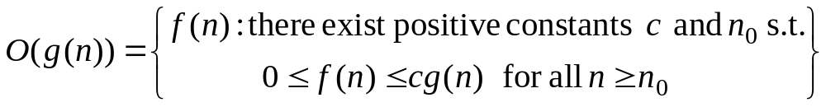



1.Big O-notation
For a given function , we denote by the set of functions
We use O-notation to give an asymptotic upper bound of a function, to within a constant factor.
means that there existes some constant c s.t. is always for large enough n.

Slide 43
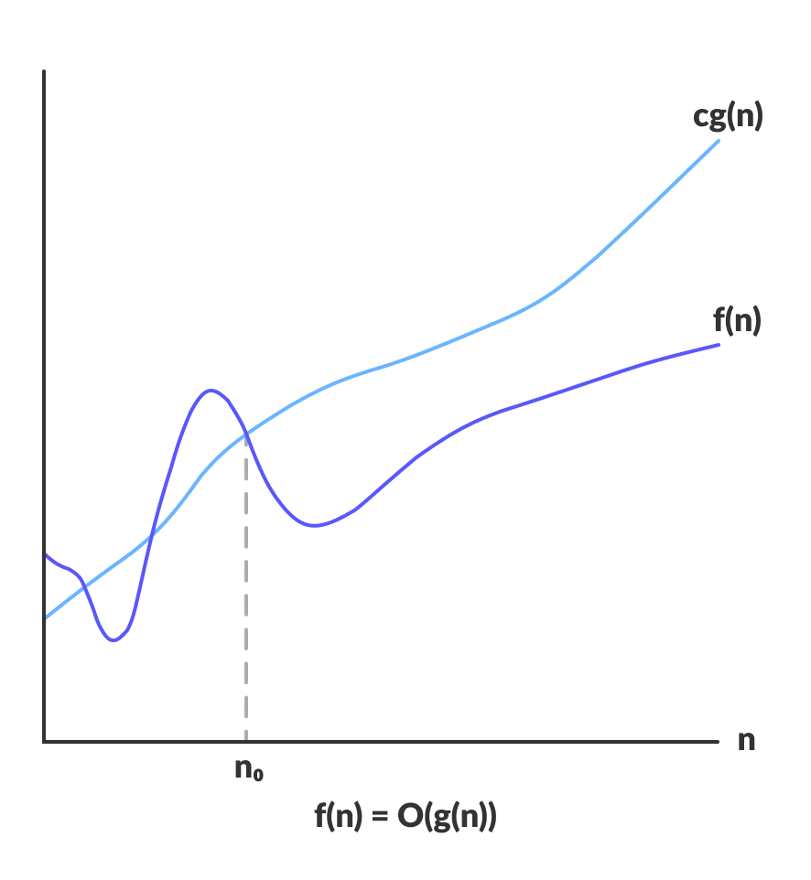

Slide 44
Examples
Example : f(n)=2n +3 & g(n)= n
Formula : f(n)<=c g(n) n>=n_{0 ,} c>0 ,n₀ >=1
f(n)=2n+3 & g(n)=n
Now 3n+2<=c.n
3n+2<=4.n
Put the value of n =1
5<=4 false
N=2 8<=8 true now n0>2 For all value of n>2 & c=4
now f(n)<= c.g(n)
3n+2<=4n for all value of n>2
Above condition is satisfied this notation takes maximum amount of time to execute .so that it is called worst case complexity.

Slide 45
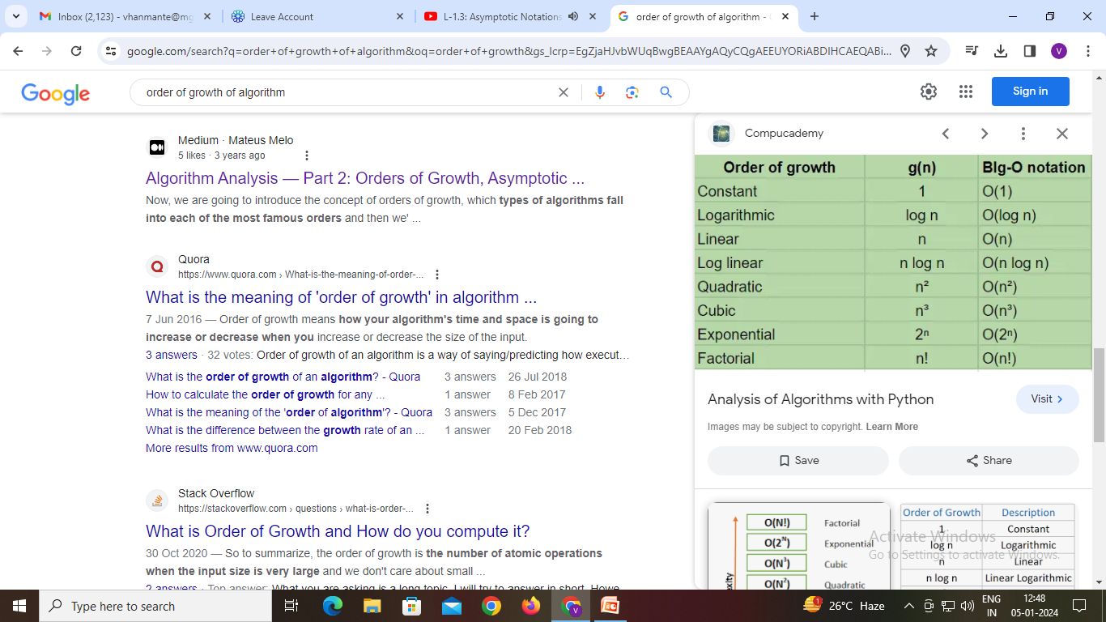
Order of growth

Slide 46
2.Ω-Omega notation
Ω-Omega notation : It represent Lower bound of algorithm run time.
By using Big Omega notation we can calculate minimum amount of
time. We can say that it is best case time complexity.
Formula : f(n)>=c g(n) n>=n_{0 ,} c>0 ,n₀ >=1
where c is constant, n is function
Lower bound
Best case

Slide 47

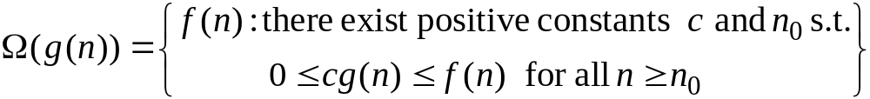


Ω-Omega notation
For a given function , we denote by the set of functions
We use Ω-notation to give an asymptotic lower bound on a function, to within a constant factor.
means that there exists some constant c s.t.
is always for large enough n.

Slide 48
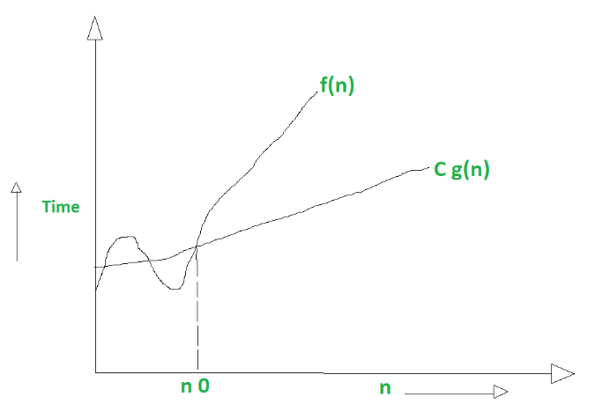

Slide 49
Examples
Example : f(n)=3n +2
Formula : f(n)>=c g(n) n>=n_{0 ,} c>0 ,n₀ >=1
f(n)=3n+2
3n+2>=1*n, c=1 put the value of n=1
n=1 5>=1 true n0>=1 for all value of n
It means that f(n)= Ω g(n).

Slide 50

3. -Theta notation
Theta (Θ) notation : Asymptotic “Equality”(same rate).
It represent average bond of algorithm running time.
By using theta notation we can calculate average amount of time.
So it called average case time complexity of algorithm.
Formula : c₁ g(n)<=f(n)<=c₂ g(n)
where c1, c2 are constant, n is function
Average bound

Slide 51


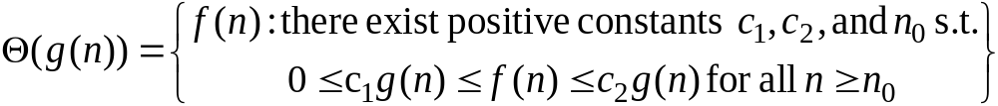







-Theta notation
For a given function , we denote by the set of functions
A function belongs to the set if there exist positive constants and such that it can be “sand- wiched” between and or sufficienly large n.
means that there exists some constant c₁ and c₂ s.t. for large enough n.

Slide 52
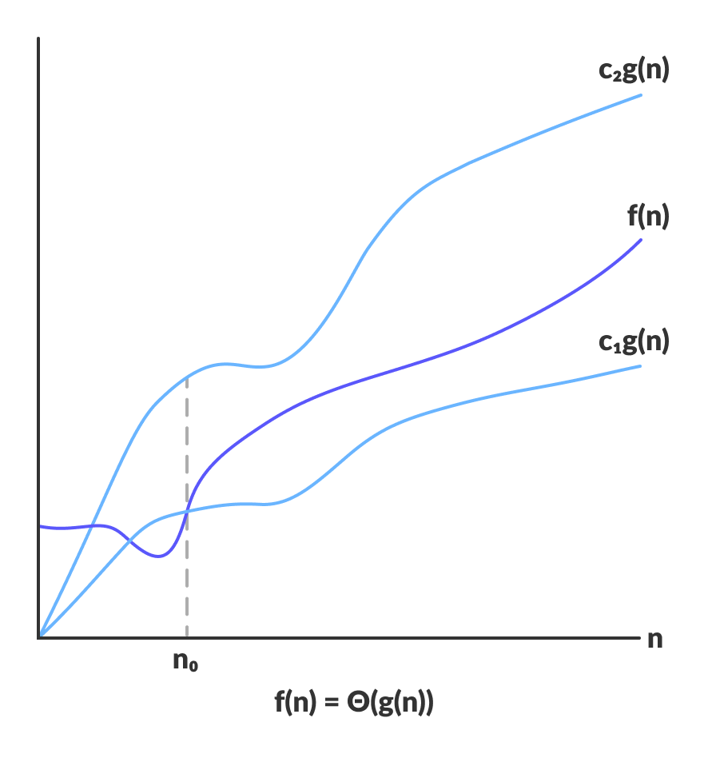

Slide 53
Examples
Example : f(n)=3n+2
Formula : c₁ g(n)<=f(n)<=c₂ g(n)
f(n)=2n+3
1*n<=3n+2<=4*n now put the value of n=1 we get 1<=5<=4 false
n=2 we get 2<=8<=8 true
n=3 we get 3<=11<=12 true
Now all value of n>=2 it is true above condition is satisfied.

Slide 54
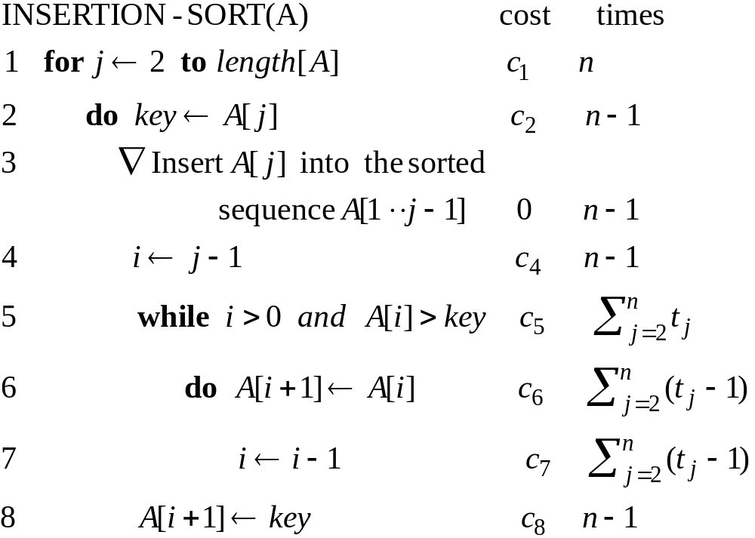
ANALYSIS OF INSERTION-SORT(CONTD.)

Slide 55
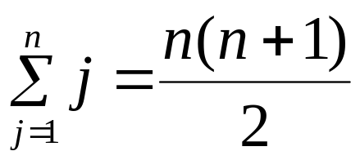
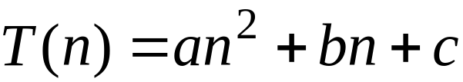
ANALYSIS OF INSERTION-SORT(CONTD.)
The worst case: The array is reverse sorted
(t_{j} =j for j=2,3, ...,n).

Slide 56
RANDOMIZED ALGORITHMS
A randomized algorithm is an algorithm that employs a degree of randomness as part of its logic.
The algorithm typically uses uniformly random bits as an auxiliary input to guide its behavior, in the hope of achieving good performance in the "average case" over all possible choices of random bits.
An algorithm that uses random numbers to decide what to do next anywhere in its logic is called Randomized Algorithm..
Example: Quick sort

Slide 57
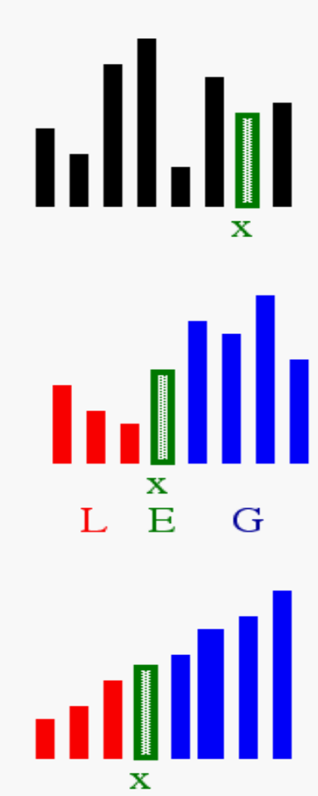
QUICK SORT
Select: pick an arbitrary element x in S to be the pivot.
Partition: rearrange elements so that elements with value less than x go to List L to the left of x and elements with value greater than x go to the List R to the right of x.
Recursion: recursively sort the lists L and R.

Slide 58
UNIT – II Divide and Conquer
Introduction to Divide and Conquer Technique, Binary Search, Min-Max, Merge Sort, Quick Sort.

Slide 59
DIVIDE AND CONQUER
Given a function to compute on ‘n’ inputs the divide-and-conquer strategy suggests splitting the inputs into ‘k’ distinct subsets, 1<k<=n, yielding ‘k’ sub problems.
These sub problems must be solved, and then a method must be found to combine sub solutions into a solution of the whole.
If the sub problems are still relatively large, then the divide-and-conquer strategy can possibly be reapplied.

Slide 60
If the problem p and the size is n , sub problems are n1, n2 ….nk, respectively, then the computing time of D And C is described by the recurrence relation.
T(n)= { g(n) n small
T(n1)+T(n2)+……………+T(nk)+f(n);
otherwise.
“Where T(n) is the time for D And C on any I/p of size n.
g(n) is the time of compute the answer directly for small I/p s. f(n) is the time for dividing P & combining the solution to sub problems.

Slide 61
DIVIDE AND CONQUER :GENERAL METHOD
Algorithm D And C(P)
{
if small(P) then return S(P);
else
{
divide P into smaller instances
P1, P2… Pk, k>=1;
Apply D And C to each of these sub problems;
return combine (D And C(P1), D And C(P2),…….,D And C(Pk));
}
}

Slide 62
EXAMPLE
Consider the case in which a=2 and b=2. Let T(1)=2 & f(n)=n. We have,
T(n) = 2T(n/2)+n
  2[2T(n/2/2)+n/2]+n
  [4T(n/4)+n]+n
  4T(n/4)+2n
  4[2T(n/4/2)+n/4]+2n
  4[2T(n/8)+n/4]+2n
  8T(n/8)+n+2n
  8T(n/8)+3n

Slide 63
2³T(n/2³)+3n
By using substitution method
Let n=2^{k}
^{K=logn}₂
_{K=3}
2^{k}T(n/n)+3n
nT(1)+3N
2n+kn
2n+nlogn
Time complexity is O(nlogn)

Slide 64
APPLICATIONS
1. Binary Search is a searching algorithm. In each step, the algorithm compares the input element x with the value of the middle element in array. If the values match, return the index of middle. Otherwise, if x is less than the middle element, then the algorithm recurs for left side of middle element, else recurs for right side of middle element.

Slide 65
2.Quick sort is a sorting algorithm. The algorithm picks a pivot element, rearranges the array elements in such a way that all elements smaller than the picked pivot element move to left side of pivot, and all greater elements move to right side. Finally, the algorithm recursively sorts the sub arrays on left and right of pivot element.
3.Merge Sort is also a sorting algorithm. The algorithm divides the array in two halves, recursively sorts them and finally merges the two sorted halves.

Slide 66
BINARY SEARCH
Algorithm Bin_search(a, low, high, x) // Given an array a[1:n] of elements in non-decreasing
{
if (low = = high) then
{ if(x= = a[low] ) then return low ;
else return 0;
}
else
{
mid:=[(low+high)/2];
if (x=a[mid]) then return mid;
else if(x<a[mid]) then return Bin_search(a, low, mid-1, x);
else return Bin_search(a, low, mid-1, x); ;
}
}

Slide 67
EXAMPLE
1) Let us select the 14 entries.
–15,6,0,7,9,23,54,82,101,112,125,131,142,151.
Place them in a[1:14] and simulate the steps Binsearch goes through as it searches for different values of x.
Only the variables low, high & mid need to be traced as we simulate the algorithm.
We try the following values for x: 151, -14 and 9.
for 2 successful searches & 1 unsuccessful search.

Slide 68
Table. Shows the traces of Bin search on these 3 steps.
X=151 | low | high | mid
 | 1 | 14 | 7
 | 8 | 14 | 11
 | 12 | 14 | 13
 | 14 | 14 | 14
 |  |  | Found
x=-14 | low | high | mid
 | 1 | 14 | 7
 | 1 | 6 | 3
 | 1 | 2 | 1
 | 2 | 2 | 2
 | 2 | 1 | Not found
x=9 | low | high | mid
 | 1 | 14 | 7
 | 1 | 6 | 3
 | 4 | 6 | 5
 |  |  | Found

Slide 69
MERGE SORT
Another application of Divide and conquer is merge sort.
Given a sequence of n elements a[1],…,a[n] the general idea is to imagine then split into 2 sets a[1],…..,a[n/2] and a[[n/2]+1],….a[n].
Each set is individually sorted, and the resulting sorted sequences are merged to produce a single sorted sequence of n elements.
Thus, we have another ideal example of the divide-and-conquer strategy in which the splitting is into 2 equal-sized sets & the combining operation is the merging of 2 sorted sets into one.

Slide 70
ALGORITHM FOR MERGE SORT
Algorithm MergeSort(low,high)
//a[low:high] is a global array to be sorted
//Small(P) is true if there is only one element
//to sort. In this case the list is already sorted.
{
if (low<high) then //if there are more than one element
{
//Divide P into subproblems
//find where to split the set
mid = [(low+high)/2];
//solve the subproblems.
mergesort (low,mid);
mergesort(mid+1,high); //combine the solutions .
merge(low,mid,high);
}
}

Slide 71
Algorithm: Merging 2 sorted subarrays using auxiliary storage.
Algorithm merge(low,mid,high)
/*a[low:high] is a global array containing two sorted subsets in a[low:mid] and in a[mid+1:high].The goal is to merge these 2 sets into a single set residing in a[low:high].b[] is an auxiliary global array. */
{
h=low; I=low; j=mid+1;
while ((h<=mid) and (j<=high)) do {
if (a[h]<=a[j]) then {
b[I]=a[h];
h = h+1; }
else {
b[I]= a[j];
j=j+1; }
I=I+1; }
if (h>mid) then
for k=j to high do {
b[I]=a[k];
I=I+1;
}
else
for k=h to mid do
{
b[I]=a[k];
I=I+1; }
for k=low to high do a[k] = b[k]; }

Slide 72
EXAMPLE
Consider the array of 10 elements a[1:10] =(310, 285, 179, 652, 351, 423, 861, 254, 450, 520)
Algorithm Mergesort begins by splitting a[] into 2 sub arrays each of size five (a[1:5] and a[6:10]).
The elements in a[1:5] are then split into 2 sub arrays of size 3 (a[1:3] ) and 2(a[4:5])
Then the items in a [1:3] are split into sub arrays of size 2 a[1:2] & one(a[3:3])
The 2 values in a[1:2] are split to find time into one-element sub arrays and now the merging begins.

Slide 73
Recursion tree
Solve T(n) = 2T(n/2) + cn, where c > 0 is constant.
cn
cn
cn/2
cn/2
cn
h = lg n
cn/4
cn/4
cn/4
cn/4
cn
…
…
Θ(1)
#leaves = n
Θ(n)
Total = Θ(n lg n)

Slide 74
QUICK SORT
In Quick sort, the division into 2 sub arrays is made so that the sorted sub arrays do not need to be merged later.
This is accomplished by rearranging the elements in a[1:n] such that a[I]<=a[j] for all I between 1 & n and all j between (m+1) & n for some m, 1<=m<=n.
Thus the elements in a[1:m] & a[m+1:n] can be independently sorted.
No merge is needed. This rearranging is referred to as partitioning.

Slide 75
Algorithm: Partition the array a[m:p-1] about a[m]
Algorithm Partition(a,m,p)
/*within a[m],a[m+1],…..,a[p-1] the elements are rearranged in such a manner that if initially t=a[m],then after completion a[q]=t for some q between m and
p-1,a[k]<=t for m<=k<q, and a[k]>=t for q<k<p. q is returned Set a[p]=infinite. */
{
v=a[m];I=m;j=p;
repeat
{
repeat
I=I+1;
until(a[I]>=v);
repeat
j=j-1;
until(a[j]<=v);
if (I<j) then interchange(a,i.j);
}until(I>=j);
a[m]=a[j]; a[j]=v;
retun j;
}
Algorithm Interchange(a,I,j) //Exchange a[I] with a[j]
{
p=a[I];
a[I]=a[j];
a[j]=p;
}

Slide 76
Algorithm: Sorting by Partitioning
Algorithm Quicksort(p,q)
//Sort the elements a[p],….a[q] which resides
//is the global array a[1:n] into ascending
//order; a[n+1] is considered to be defined
// and must be >= all the elements in a[1:n]
{
if(p<q) then // If there are more than one element
{
// divide p into 2 subproblems
j=partition(a,p,q+1);
//‟j‟ is the position of the partitioning element.
//solve the subproblems.
quicksort(p,j-1);
quicksort(j+1,q);
//There is no need for combining solution.
}
}

Slide 77
WEBSITES
1. www.mit.edu
2. www.soe.stanford.edu
3. www.grad.gatech.edu
4. www.gsas.harward.edu
5. www.eng.ufl.edu
6. www.iitk.ac.in
7. www.iitd.ernet.in
8. www.ieee.org
9. www.ntpel.com
10. WWW.JNTUWORLD.COM
11. www.firstrankers.com
12. www. studentgalaxi.blogspot.com

Slide 78
SUGGESTED BOOKS
TEXT BOOKS
1. Fundamentals of Computer Algorithms, Ellis Horowitz,Satraj Sahni and
Rajasekharam,Galgotia publications pvt. Ltd.
2. Algorithm Design: Foundations, Analysis and Internet examples,
M.T.Goodrich and R.Tomassia,John wiley and sons.

Slide 79
REFERENCES
1. Introduction to Algorithms, secondedition,T.H.Cormen,C.E.Leiserson,
R.L.Rivest,and C.Stein,PHI Pvt. Ltd./ Pearson Education
2. Introduction to Design and Analysis of Algorithms A strategic approach,
R.C.T.Lee, S.S.Tseng, R.C.Chang and T.Tsai, Mc Graw Hill.
3. Data structures and Algorithm Analysis in C++, Allen Weiss, Second
edition, Pearson education.

Slide 80
Thank You

