Slide 1
OPENSOURCE AI CHATBOTS FRAMEWORKS
BY: TEAM 12

Slide 2
INTRODUCTION:
A Chatbot is an intelligent conversational agent that is designed using certain software program and works by establishing a conversation between a bot and user or in some cases between the bots
A simple daily life example of a chatbot can that of an Apple’s Siri, Amazon’s Alexa or the IBM’s Watson
The chatbot can be either a commercial one which is very industry specific or can be an opensource one which can be used as a base model to implement it in any industry scenario.

Slide 3
TYPES OF OPENSOURCE AI CHATBOTS
BOTPRESS
RASA

Slide 4
BOTPRESS
BOTPRESS is a lightweight, fast and flexible on-premise bot building platform.
The first advantage of BOTPRESS is that it runs on fully on-prem which results in the control over the data which comes in and out.
BOTPRESS is extremely flexible and developer friendly. And the main importance is it has zero dependencies.

Slide 5
End-to-End Architecture
They introduce a neural network-based text-in, text-out end-to-end trainable goal-oriented dialogue system along with a new way of collecting dialogue data. The first advantage of BOTPRESS is that it runs on fully on-prem which results in the control over the data which comes in and out.
Building a task-oriented dialog system is difficult because there is less availability of training data. This is problem is solved by reinforcement learning.
This paper has presented the innovative neural network-based framework. The model is end to end trainable using two supervision signals and a modest corpus of training data.

Slide 6
RASA
A Rasa chatbot is an open-source AI frameworks and consists of two components Rasa Core and Rasa NLU
The Rasa NLU is the Natural Language unit which processes the information provided by the user by extracting the intent from it
The Rasa Core on the other hand helps in deciding which action has to be taken next
Both the Rasa core and the Rasa NLU are independent of each other and function separately

Slide 7
RASA’S NLU
The Rasa’s NLU is the Natural language processing unit of the opensource Rasa network and it primary work is to extract the intent from the user
The Rasa’s NLU uses the techniques such as tokenization and models such as Glove to understand the primary intent of the user text
The main advantage of using a Rasa NLU over the others is its data control and compatibility
The Rasa NLU works on the principle of extracting structured and semantic information from unstructured natural language input by labeling the messages or part of messages through user defined labels

Slide 8
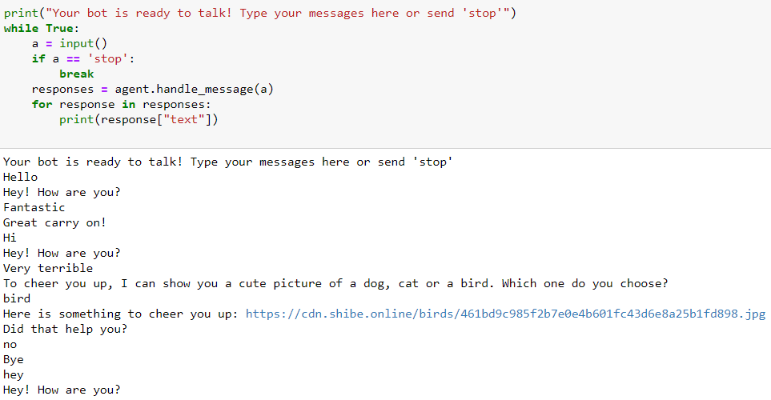
Screenshot

Slide 9
Thank You

